Slide 1
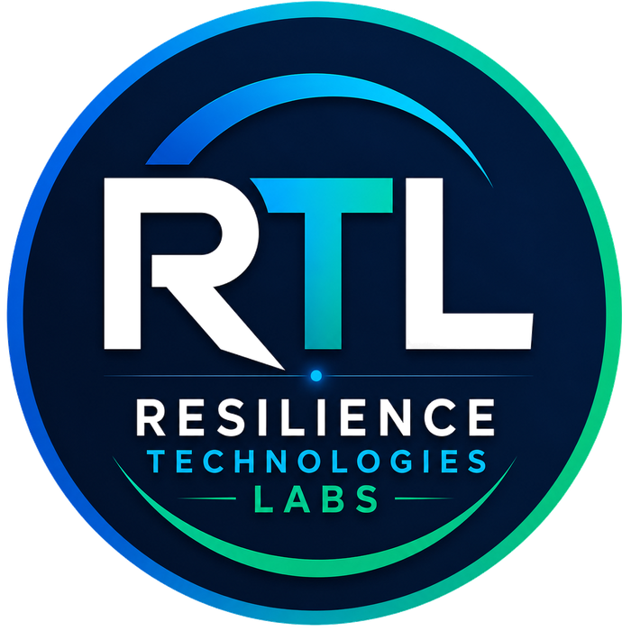
RESILIENCE TECHNOLOGIES LABS
Data. Insight. Impact.
Pakistan's AI Infrastructure & Engineering Intelligence Company
Corporate Company Profile
SMC-Private Limited · CUIN 0343147 · Islamabad, Pakistan
www.sustainablesolution360.com
+92 340 331 8127

Slide 2
RESILIENCE TECHNOLOGIES LABS
Corporate Company Profile
About RTL
Mission · Vision · Purpose · Engineering philosophy
Resilience Technologies Labs (RTL) is an engineering-led technology company based in Islamabad, Pakistan. We design and build digital platforms that help governments, engineers, and institutions understand infrastructure risk, plan for disaster resilience, and make better decisions using data, GIS, and artificial intelligence.
Mission
Vision
To give Pakistan — and partners beyond — practical infrastructure intelligence: tools that combine civil engineering judgement with AI, geospatial analysis, and decision-support systems, so that resilience planning happens before the next flood, earthquake, or failed investment.
A future in which critical infrastructure, communities, and public institutions are supported by trusted digital systems — systems that turn complex engineering and climate data into clear, actionable insight.
Core Purpose
Engineering Philosophy
RTL exists to close the gap between engineering knowledge and digital decision systems. Too much infrastructure and disaster planning still relies on fragmented data and reactive response. We build platforms that make resilience measurable, searchable, and usable in day-to-day work.
Engineering first. Software second. Every product starts from real infrastructure, hazard, and institutional needs — not from technology for its own sake. We ship working systems, document them clearly, and design for public-sector and field conditions in Pakistan.
Data. Insight. Impact.
www.sustainablesolution360.com

Slide 3
RESILIENCE TECHNOLOGIES LABS
Corporate Company Profile
Who We Are
History · Why RTL · Evolution
Background
RTL grew out of Sustainable Solution 360 — a product and digital-solutions practice founded in 2023 by Shahnawaz to build real platforms for infrastructure resilience, education, and public service. On 30 June 2026, Resilience Technologies Labs (SMC-Private) Limited was incorporated under the Companies Act, 2017 (CUIN 0343147), with its registered office in the Islamabad Capital Territory.
Why RTL Was Established
The company was established to formalise an engineering-and-AI practice already delivering platforms such as Infra Resilience360°, She360, and NET360 Preparation — and to create a corporate vehicle suited to government, development partners, and institutional collaboration.
Company Evolution
Work began with structural engineering practice and research at NUST, moved into national infrastructure resilience work at NDMA, and expanded into full-stack platforms that serve engineers, agencies, students, and communities. RTL is the institutional home of that journey.
Incorporated 30 June 2026 · CUIN 0343147 · Islamabad Capital Territory
Data. Insight. Impact.
www.sustainablesolution360.com

Slide 4

RESILIENCE TECHNOLOGIES LABS
Corporate Company Profile
Founder
Executive profile
Shahnawaz
Founder & Chief Executive Officer
Resilience Technologies Labs (SMC-Private) Limited
Civil Engineer, National University of Sciences & Technology (NUST), Islamabad — Rector's Gold Medal for final-year research on sustainable high-performance Engineered Cementitious Composites (ECC).
Assistant Manager, Infrastructure Advisory & Project Development Wing, National Disaster Management Authority (NDMA) — supporting national infrastructure resilience, audits, and GIS-informed risk work.
Prior structural engineering practice with Bendcrete Construction Services — reinforced concrete design, BOQs, site quality assurance, and construction coordination.
Builds the platforms RTL ships: product strategy, full-stack architecture, AI integration, and cloud deployment — alongside published research applying machine learning to fibre-reinforced concrete behaviour (MDPI).
Data. Insight. Impact.
www.sustainablesolution360.com

Slide 5


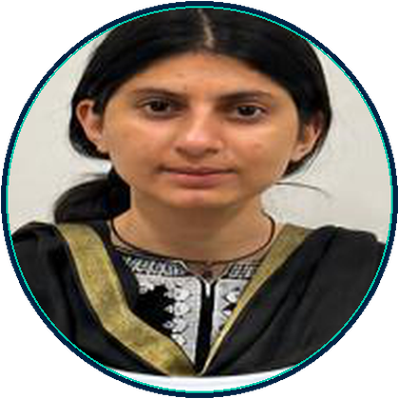

RESILIENCE TECHNOLOGIES LABS
Corporate Company Profile
Our Team
Engineering · software · partnerships · climate & operations
Shahnawaz
Amina Tariq
Asma Tariq
Touqeer Ahmed
FOUNDER & CEO
SOFTWARE ENGINEER
GROWTH & PARTNERSHIPS
CLIMATE & OPERATIONS MANAGER
Civil & structural engineering · NDMA infrastructure advisory · AI platforms · product architecture
Full-stack development · responsive interfaces · API integration · performance optimisation
Stakeholder coordination · branding · outreach · proposal and partnership development
Operational workflows · implementation · deployment coordination · cross-functional delivery
Data. Insight. Impact.
www.sustainablesolution360.com

Slide 6
RESILIENCE TECHNOLOGIES LABS
Corporate Company Profile
Our Expertise
Where engineering judgement meets digital systems
Infrastructure Intelligence
Disaster Resilience
Digital Twins & Spatial Systems
GIS & Remote Sensing
Artificial Intelligence
Asset risk, resilience assessment, and engineering decision support for critical infrastructure.
Preparedness tools, hazard guidance, and platforms aligned with disaster-management workflows.
Geospatial analytics, mapping, and interactive models for places and assets.
Spatial intelligence for hazard context, planning, and infrastructure analysis.
Practical AI for damage interpretation, code search, recommendations, and analytics.
Climate Intelligence
Structural Engineering
Engineering Consultancy
Decision Support Systems
Sustainability
Climate-risk awareness, adaptation support, and sustainability-oriented digital tools.
Civil and structural depth informing every product and advisory engagement.
Technical advisory spanning audits, resilience planning, and digital transformation.
Dashboards, readiness scores, and reporting for institutional decision-makers.
Green building guidance, compliance support, and SDG-aligned platform design.
Data. Insight. Impact.
www.sustainablesolution360.com

Slide 7
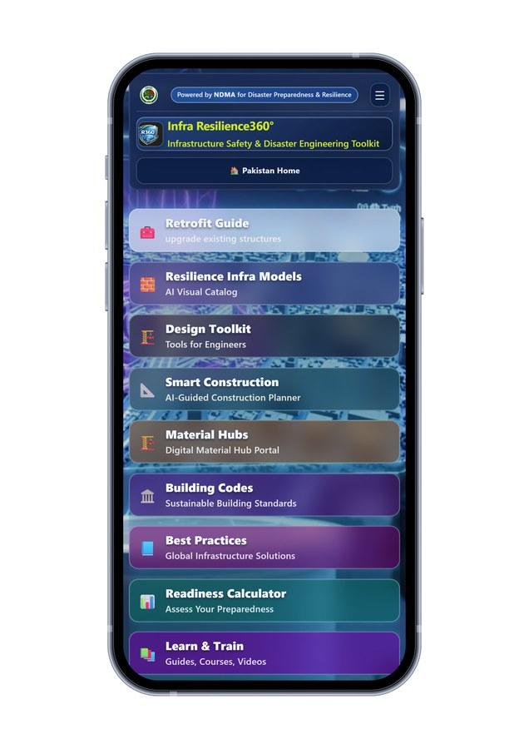
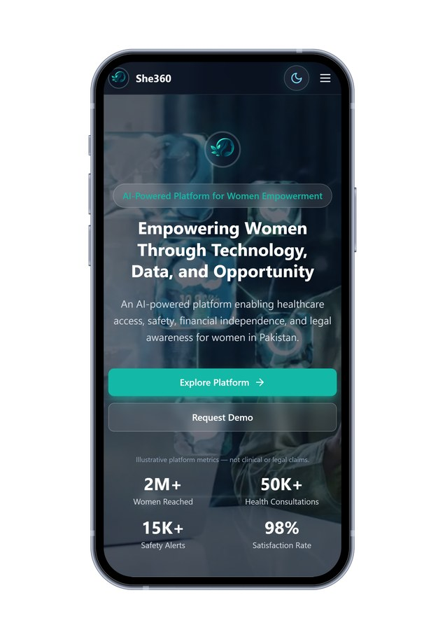
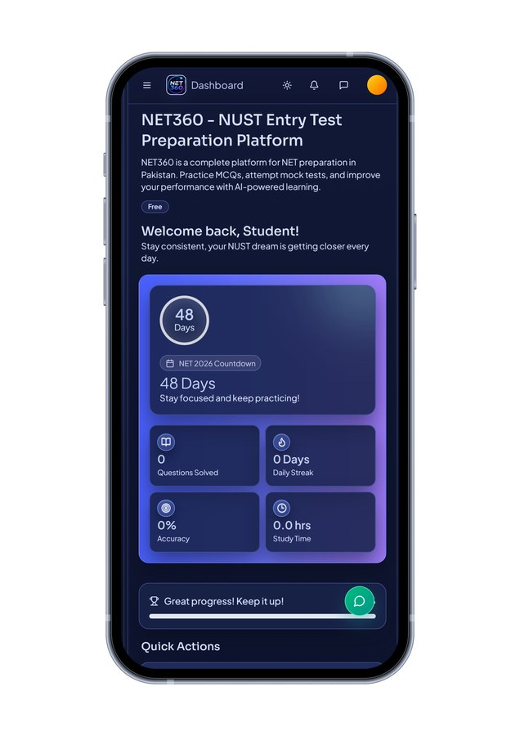
RESILIENCE TECHNOLOGIES LABS
Corporate Company Profile
Products
Real platforms — shipped or in active testing
Infra Resilience360°
She360
NET360 Preparation
Available on Google Play and the App Store
In testing / closed release on Google Play
Published on Google Play (com.net360prep.app)
Pakistan's infrastructure safety and disaster engineering toolkit — helping engineers, planners, and agencies assess buildings, plan resilient construction, and…
An AI-enabled women empowerment platform connecting healthcare guidance, safety support, financial literacy pathways, and legal awareness in one accessible digi…
A complete preparation platform for the NUST Entry Test (NET): structured MCQ practice, full-length mock exams, performance analytics, and AI-assisted study rec…
Data. Insight. Impact.
www.sustainablesolution360.com

Slide 8
RESILIENCE TECHNOLOGIES LABS
Corporate Company Profile
Infra Resilience360°
Available on Google Play and the App Store
Purpose
Pakistan's infrastructure safety and disaster engineering toolkit — helping engineers, planners, and agencies assess buildings, plan resilient construction, and access hazard-ready guidance in one platform.
Users
Civil and structural engineers, planners, disaster-management practitioners, and institutions supporting resilient construction.
Technology
React / mobile clients, Node.js services, geospatial context, AI-assisted analysis (damage and code Q&A), cloud deployment.
Benefits
• Retrofit guidance with image-based damage context and costed recommendations
• Smart construction planning with region-aware rates and hazard settings
• Resilience infrastructure model library for disaster-prone settings
• Design toolkit for seismic, flood, wind, and foundation guidance
• Searchable Pakistan building codes with AI-assisted Q&A
• Disaster dashboard, readiness scoring, material hubs, and learning modules
Data. Insight. Impact.
www.sustainablesolution360.com

Slide 9
RESILIENCE TECHNOLOGIES LABS
Corporate Company Profile
She360
In testing / closed release on Google Play
Purpose
An AI-enabled women empowerment platform connecting healthcare guidance, safety support, financial literacy pathways, and legal awareness in one accessible digital experience designed for Pakistan.
Users
Women users seeking practical guidance and support; NGOs and institutions exploring digital empowerment tools.
Technology
React / React Native, Node.js, cloud hosting, AI integration (OpenAI / Gemini) for guided assistance.
Benefits
• Healthcare information and guidance pathways
• Safety-oriented support flows and emergency-minded features
• Financial literacy and independence-oriented tools
• Legal awareness and rights information access
Data. Insight. Impact.
www.sustainablesolution360.com

Slide 10
RESILIENCE TECHNOLOGIES LABS
Corporate Company Profile
NET360 Preparation
Published on Google Play (com.net360prep.app)
Purpose
A complete preparation platform for the NUST Entry Test (NET): structured MCQ practice, full-length mock exams, performance analytics, and AI-assisted study recommendations.
Users
Students preparing for NUST entry tests across relevant programmes and subjects.
Technology
React / Next.js frontend, Node.js / Express API, MongoDB / PostgreSQL, AI study mentor, Capacitor Android app.
Benefits
• Adaptive MCQ banks with subject-wise practice
• Timed, NET-style mock examinations
• Analytics on accuracy, progress, and weak areas
• AI-assisted study recommendations
Data. Insight. Impact.
www.sustainablesolution360.com

Slide 11
RESILIENCE TECHNOLOGIES LABS
Corporate Company Profile
Future Technology Roadmap
Under Research & Development — Future Innovation Areas
These are development directions — not existing commercial products.
Smart Cities & Urban Intelligence
Climate Intelligence Platforms
Energy Analytics
FUTURE INNOVATION AREA
FUTURE INNOVATION AREA
FUTURE INNOVATION AREA
Integrated urban risk, planning, and operations views for municipalities.
Deeper climate datasets, hazard forecasting interfaces, and adaptation analytics.
Tools for energy performance insight and sustainable infrastructure planning.
Environmental Monitoring
Advanced Digital Twins
National GIS Platforms
FUTURE INNOVATION AREA
FUTURE INNOVATION AREA
FUTURE INNOVATION AREA
Monitoring interfaces for environmental and climate-linked indicators.
Richer asset and city-scale digital twin environments for scenario planning.
Institutional geospatial platforms for shared infrastructure and hazard layers.
Infrastructure AI
Asset Management Systems
AI Decision Intelligence
FUTURE INNOVATION AREA
FUTURE INNOVATION AREA
FUTURE INNOVATION AREA
Expanded computer-vision and ML models for inspection and damage classification.
Lifecycle registers, inspection workflows, and resilience scoring for asset owners.
Decision-support layers that turn multi-source data into institutional recommendations.
Data. Insight. Impact.
www.sustainablesolution360.com

Slide 12
RESILIENCE TECHNOLOGIES LABS
Corporate Company Profile
Services
How institutions engage with RTL
Engineering Consultancy
AI Solutions
GIS Solutions
Infrastructure resilience advisory, audits, and technical reviews grounded in civil engineering practice.
Applied AI for analysis, recommendations, search, and operational intelligence — designed for real workflows.
Spatial data systems, mapping interfaces, and geospatial analytics for planning and risk.
Infrastructure Analytics
Digital Transformation
Software Development
Risk, readiness, and performance analytics for assets and networks.
Enterprise platforms for data centralisation, dashboards, LMS, and institutional operations.
Full-stack web and mobile products — from architecture through cloud deployment.
Research & Technical Advisory
Capacity Building
Decision Support Systems
Engineering research translation and advisory for climate, materials, and resilience topics.
Training, documentation, and onboarding for institutional users of digital systems.
Dashboards, reporting engines, and command-style interfaces for decision-makers.
Data. Insight. Impact.
www.sustainablesolution360.com

Slide 13
RESILIENCE TECHNOLOGIES LABS
Corporate Company Profile
Industries & Technology
Sectors served · Core technology stack
Industries Served
Technology Stack
• Government & Public Sector
• Disaster Management
• Infrastructure & Utilities
• Engineering & Construction
• Education
• Climate & Environment
• Development Sector & NGOs
• Transport & Urban Planning
• Technology Partners
Frontend
React, Next.js, TypeScript / JavaScript, React Native
Backend
Node.js, Express, NestJS
Data
PostgreSQL, PostGIS, MongoDB
GIS & Spatial
GIS mapping, geospatial analytics, remote sensing data integration
AI / ML
OpenAI & Gemini APIs, applied machine learning for engineering and learning use cases
Cloud & DevOps
AWS, Vercel, Railway, Docker, Cloudflare, CI/CD
Security
JWT / OAuth, role-based access control, TLS, encrypted storage patterns
Data. Insight. Impact.
www.sustainablesolution360.com

Slide 14
RESILIENCE TECHNOLOGIES LABS
Corporate Company Profile
Why RTL
What distinguishes an engineering-led intelligence company
Engineering-first approach
Government domain knowledge
AI with a purpose
Civil and structural engineering sits at the centre of product design — not as decoration around software.
Direct experience of national disaster-management and infrastructure-advisory workflows.
AI is applied to damage interpretation, codes, learning, and guidance — where it reduces real work.
Infrastructure specialisation
Real products
National relevance
Focus on resilience, audits, hazard context, and built-environment intelligence.
Shipped and in-testing platforms — Infra Resilience360°, She360, NET360 Preparation — not concept slides alone.
Designed for Pakistan's codes, hazards, institutions, and field conditions, with room to scale.
Data. Insight. Impact.
www.sustainablesolution360.com

Slide 15
RESILIENCE TECHNOLOGIES LABS
Corporate Company Profile
Sustainable Development Goals
SDGs supported by RTL products and purpose
Quality Education
SDG 4
NET360 Preparation supports structured, data-driven learning for university entry.
Gender Equality
SDG 5
She360 advances digital access to health, safety, finance, and legal awareness for women.
Industry, Innovation & Infrastructure
SDG 9
Infra Resilience360° and RTL's engineering platforms strengthen resilient infrastructure intelligence.
Sustainable Cities & Communities
SDG 11
Tools for safer construction, urban hazard awareness, and community preparedness.
Climate Action
SDG 13
Climate-risk awareness, adaptation-oriented guidance, and resilience planning systems.
Data. Insight. Impact.
www.sustainablesolution360.com

Slide 16
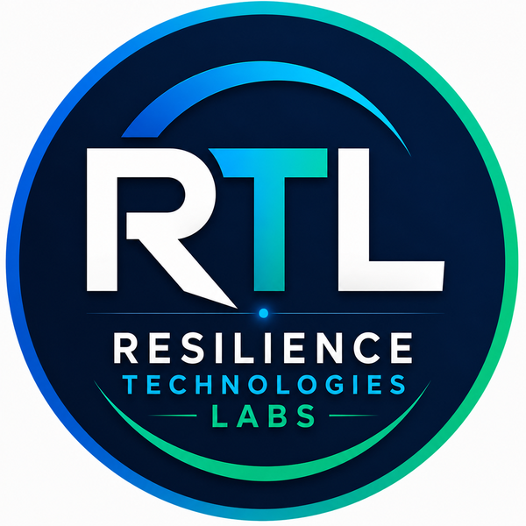
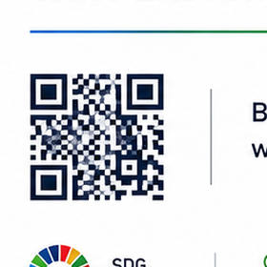
RESILIENCE TECHNOLOGIES LABS
Corporate Company Profile
Contact
Resilience Technologies Labs (SMC-Private) Limited
Resilience Technologies Labs (SMC-Private) Limited
Pakistan's AI Infrastructure & Engineering Intelligence Company
Phone
+92 340 331 8127
Email
info@sustainablesolution360.com
Scan QR
Website
https://www.sustainablesolution360.com/
Address
House no: 287, Street No: 6, Block D-Extension, Rawal Enclave Phase-1, Kuri, Islamabad, Pakistan
Building a better tomorrow with technology and sustainability.
Data. Insight. Impact.
Data. Insight. Impact.
www.sustainablesolution360.com

