Slide 1
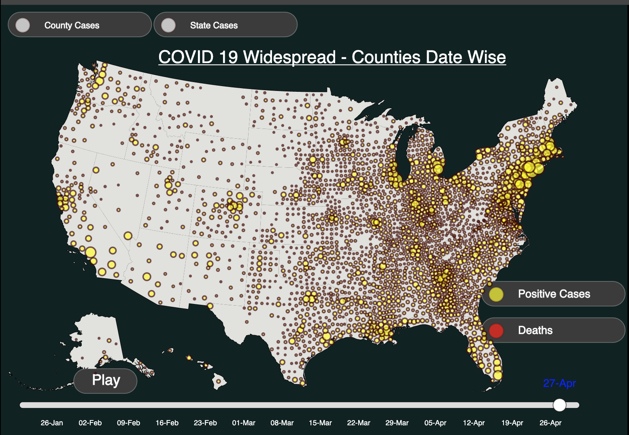
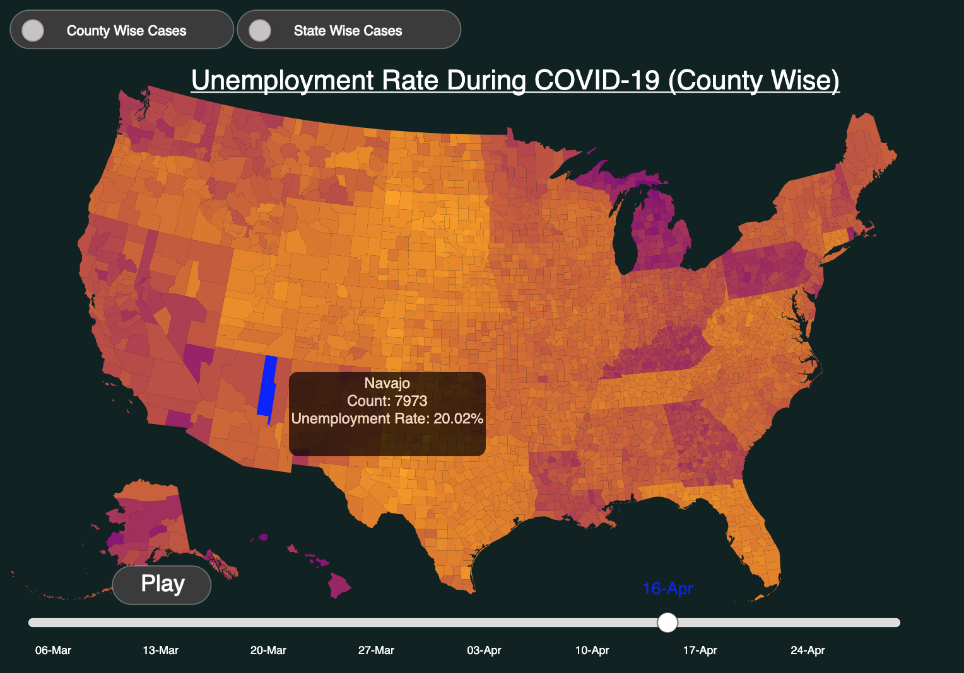
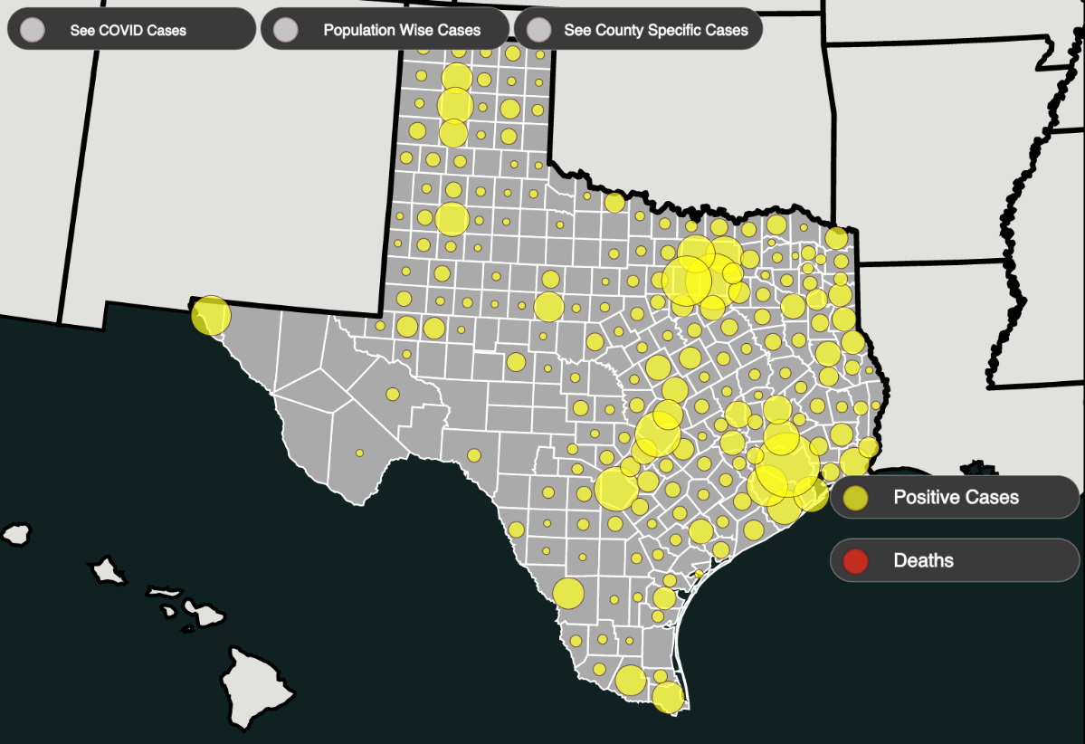
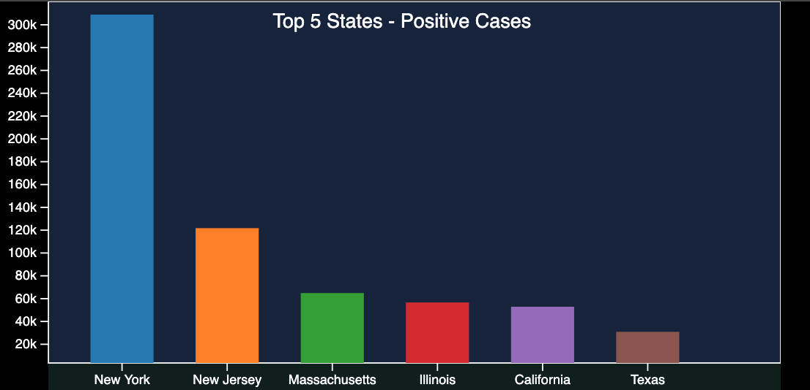
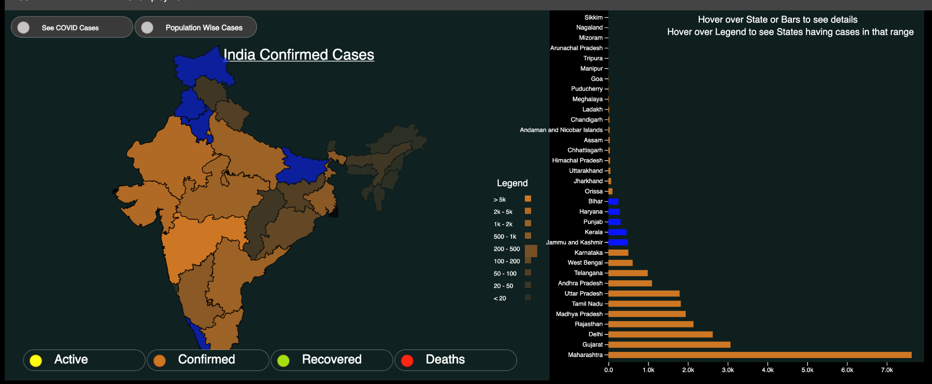
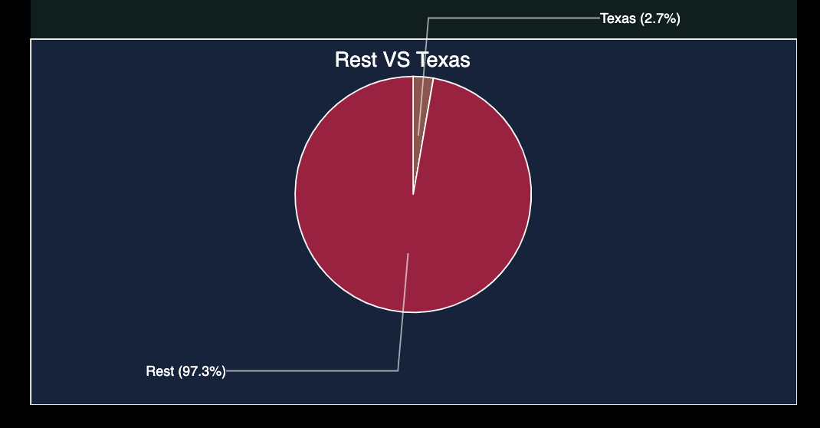
Visualizing the spread of COVID-19 and
its effects in USA and India
Shanuj Shekhar (SBU ID: 112670784), Priyanka Nath (SBU ID: 112715634)
Introduction
Features
COVID-19 has changed life as we know it. This deadly virus is an active crisis that is affecting people all over the globe leaving a large number of people unemployed. We are focusing on USA and India and aim to create a useful visualization about the spread and affects of COVID-19 in these countries.
We also used bubble plot to visualize the rate of change number of infections in the states and counties. We can understand how highly infected a place is based on the size of the bubble and on hovering over it we can get the exact data of the place. This lets us analyze “centers” of infections and how the virus spread. If we could get flight data to match the time line it could be even more insightful.
We created an animated visualization which lets us see how the spread changes with time. We also have the functionality of pausing when we like and then resuming again from that point. This lets the user explore the data at that point in time.
Project Overview and Implementation
The main goal of the project was to create a dashboard for visualizing COVID-19 cases in USA, how the disease spread and how it effected on the country’s unemployment rates.
We created two modes for our dashboard - one for the unemployment data and one for the COVID-19 case data to show the spread in different states and counties.
Our backend used flask while our frontend work is done using d3. We used chloropleths and bubble plots on topojson maps to show the spread of the virus and its deadly trail.
Since the data we obtained was timestamped we were able to animate the data to show a live visualization of how the spread occurred over the country and how unemployment rate increased as a result. The figures show how our dashboard looks.
Fig.2 More Visualizations form our dashboard
Fig.3 Visualization of spread of COVID-19 in US counties
Challenges
We collected various different datasets and combined them so that our dashboard could give a a more compact and complete visualization of how fast COVID-19 infected the different states and counties of USA and the states of India.
Collecting data that could be combined was a tedious task and it proved to be difficult for India since not much data was available. We were able to collect a good amount of data for the US , however if would have been really useful if we could get our hands on interstates flight paths during the pandemic period for a better analysis of the spread. Moreover since the COVID-19 pandemic is still an active crisis the data is changing everyday which was challenging when it came to keeping our database up to date and synchronized.
The dashboards use a lot of data which are processed on the backend. Even then, we have to send a somewhat large amount of data to the front end for visualization which leads to noticeable latency in graph creation. This was especially true for the bubble plot because for every time unit we had to refresh our map with new bubbles of different radius. Hence the animation may seem to lag during play mode.
Insights
Figure 1. State level visualization
While visualizing the COVID-19 cases in USA and India using chloropleths, it was interesting to see how the count per million value conveyed more information than the absolute counts. This is a better measure of how a state was affected by COVID-19 because it takes into account the population of the state.
For example a state having 150 cases can seem to be better off than one recording 1000 cases. However if the population of the latter state is 500,000 and the population of the former is 300, visualizing the actual counts can lead to a bias.
The bubble plot allows use to visualize centres of infections effectively.
Features
Conclusion
We can zoom into a county-level view from a state level view and see how the state as a whole stands. We have supporting visualizations in the form of a pie chart and a bar chart on the right side. The bar chart shows how where the state stands with the top 5 most affected states while the pie chart shows how much the selected state accounts for the the country’s infected count/ deaths. (Fig.1)
We created a dashboard which visualizes the spread of COVID-19 cases in USA and India and how it affected the unemployment rates in USA.
The dashboard also gives us an idea of where any state in the US stands in terms of infections and deaths due to COVID-19.
References
https://www.genigraphics.com/templates
https://data.bls.gov/timeseries/LNS14000000
https://coronavirus.1point3acres.com/en
https://www.theguardian.com/environment/interactive/2013/may/14/alaska-villages-frontline-global-warming
https://htmlcolorcodes.com/color-chart/
https://data.world/covid-19-data-resource-hub/covid-19-case-counts
https://www.cdc.gov/nchs/nvss/vsrr/COVID19/index.htm
https://www.who.int/emergencies/diseases/novel-coronavirus-2019/situation-reports
https://www.covid19india.org/
https://en.wikipedia.org/wiki/List_of_states_and_union_territories_of_India_by_population
https://simple.wikipedia.org/wiki/List_of_U.S._states_by_population
http://embed.plnkr.co/i2eLwxweLJhuUgTuOS4x/
http://bl.ocks.org/michellechandra/0b2ce4923dc9b5809922
https://github.com/topojson/us-atlas
https://data.bls.gov/timeseries/LNS14000000
https://www.appliedgeographic.com/

