Slide 1
SHOP
E-COMMERCE DATA ANALYSIS
STORE
“Enhancing E-commerce Performance through Data-Driven Insights

Slide 2
INTRODUCTION:-
Title: Enhancing E-commerce Performance through Data-Driven Insights.
In the increasingly competitive landscape of e-commerce, businesses strive to maximize sales, improve profitability, and enhance customer satisfaction. To achieve these objectives, it is crucial for e-commerce companies to leverage data-driven insights for informed decision-making and strategic planning. The provided e-commerce dataset offers a valuable resource for analyzing sales trends, customer behavior, and geographic patterns to identify opportunities for optimization and growth.
Sales Performance Analysis: Analyze factors influencing sales performance, such as seasonality, product popularity, and pricing strategies.
Customer Behaviour Analysis:Analyze customer lifetime value (CLV) and retention rates to identify valuable customer segments.
Geographic Analysis: Analyze sales performance across different regions, states, and cities.
Inventory Management Optimization:Analyze product categories and sub-categories to identify top-selling items and slow-moving inventory.
Competitor Analysis: Identify competitive strengths and weaknesses to inform strategic positioning and differentiation strategies.

Slide 3

DATASET OVERVIEW:
LIST OF ORDER
ORDER DETAILS
SALES TARGET
This dataset contains purchase information. The information includes ID, Date of Purchase and customer details .
This dataset contains order ID, with the order price, quantity, profit, category and sub-category of product .
This dataset contains sales target amount and date for each product category.
SERVICES
PAY
ONLINE

Slide 4
POWER BI VISUALIZATION:
PAY
UNDERSTANDING THE DATA
01
Before start creating visuals, it’s essential to thoroughly understand the data at your disposal.
02
RIGHT TYPE OF VISUALIZATION
The type of visualization selected should complement the data’s nature.
POWER BI FEATURES FOR DATA MODELING
03
Use DAX to create calculated columns and measures for more dynamic and complex analyses
DESIGN TO MAKE INTERACTIVE REPORT
04
Leverage filters, slicers in power bi to allow users to explore the data in a self service manner. Design with accessibility in mind.

Slide 5
E-COMMERCE DASHBOARD OVERVIEW:
1
2
3
4
5
CATEGORY WISE SALES PERFORMANCE
CUSTOMER BEHAVIOUR ANALYSIS
PRODUCT PROFITABILITY ANALYSIS
SALES PERFORMANCE ANALYSIS
HOME

Slide 6
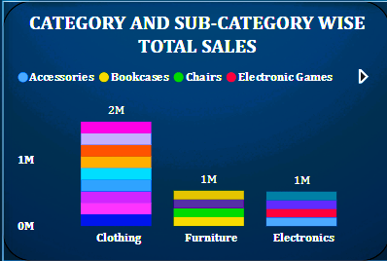
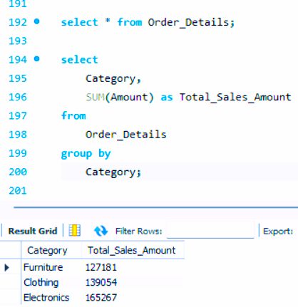
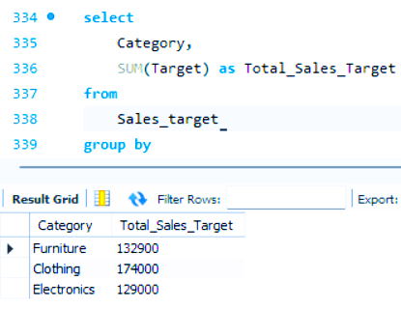
CATEGORY WISE SALES PERFORMANCE:
CATEGORY WISE TOTAL SALES
It is valuable for understanding the revenue contribution of different product categories to the overall business.
CATEGORY AND SUB-CATEGORY WISE TOTAL SALES
It enables them to identify which subcategories are the most lucrative and where adjustments may be needed to improve profitability.
CATEGORY WISE TOTAL SALES AMOUNT
Identifying the most profitable product categories, which can guide inventory management and marketing strategies.

Slide 7
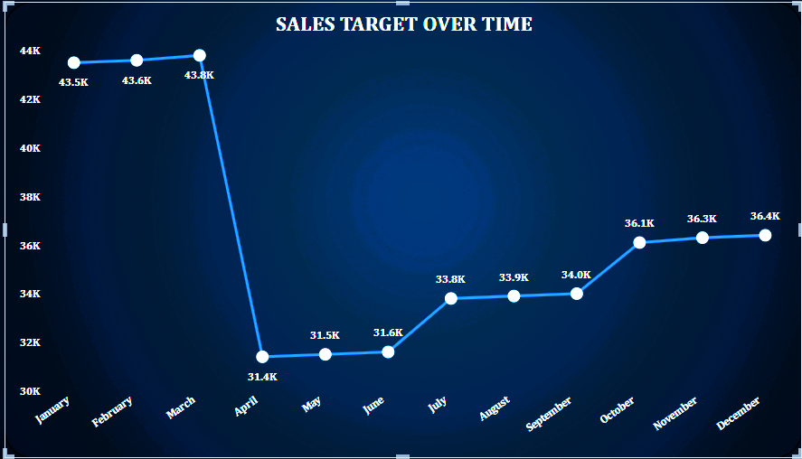
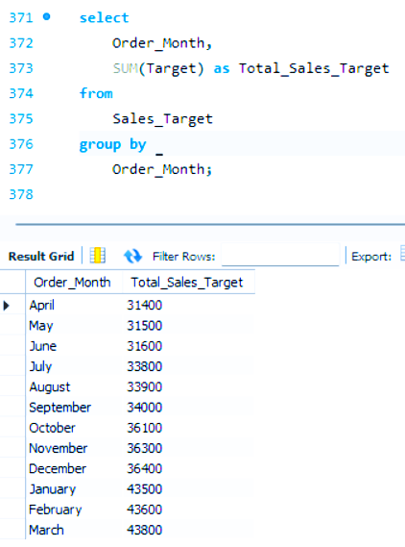
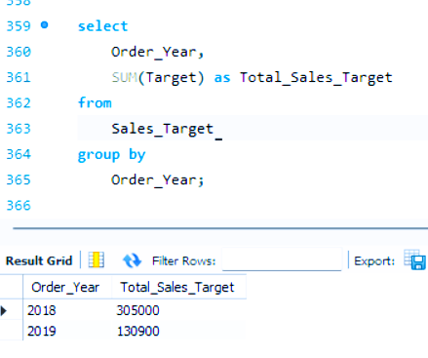
SALES PERFORMANCE ANALYSIS:
TOTAL SALES TARGET PER YEAR
This insights enables businesses to set realistic targets, allocate resources effectively and measure performance against predetermined objectives.
TIME WISE TOTAL SALES
This insights allows to identify the change in sales over the month.
TOTAL SALES TARGET PER MONTH ACROSS ALL YEARS
This insight allows businesses to analyse seasonal variations identify peak months and assess overall sales patterns.

Slide 8
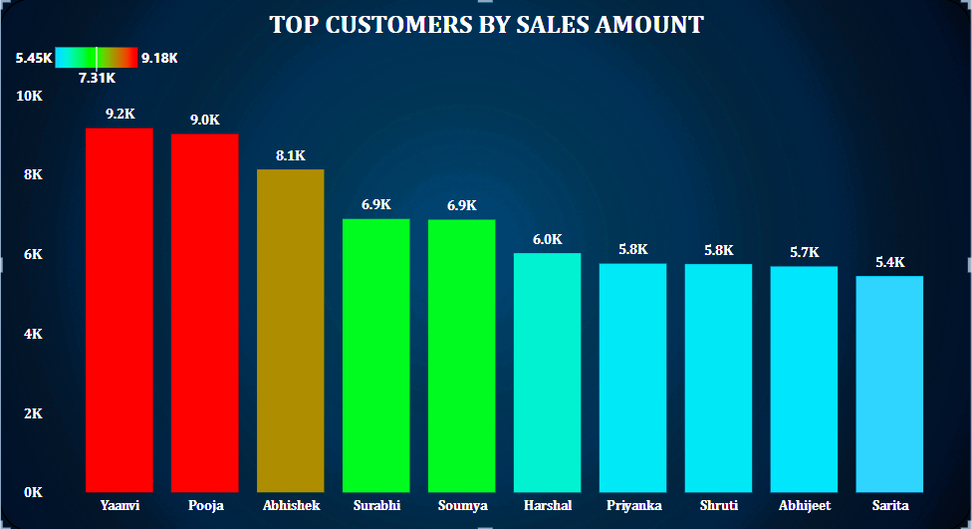
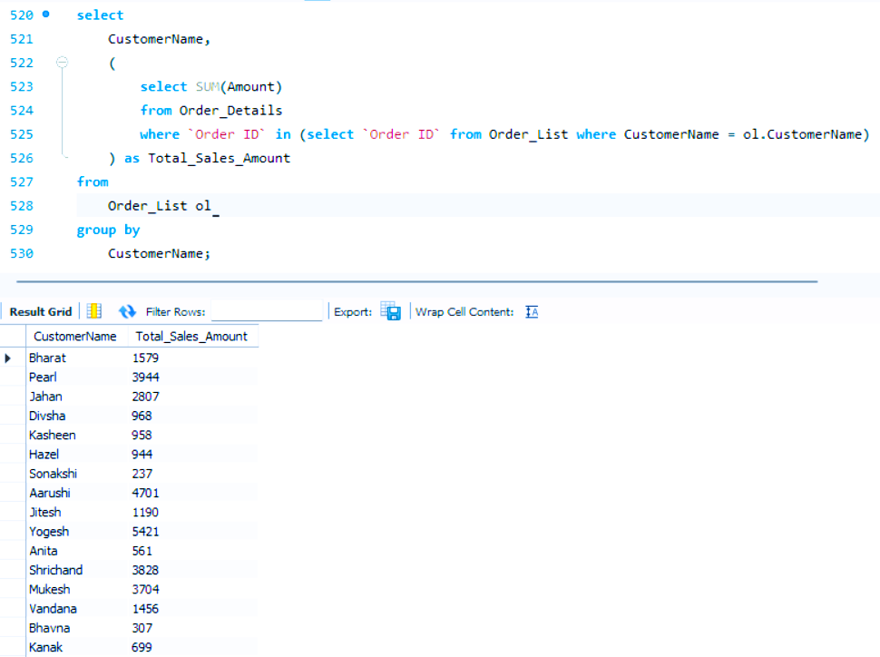
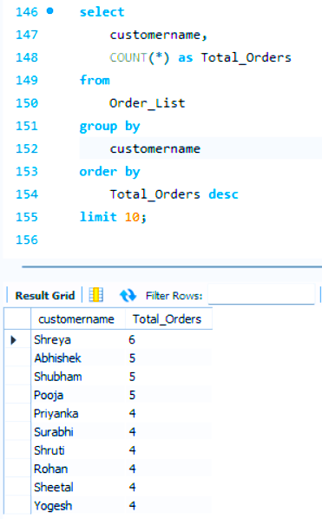
CUSTOMER BEHAVIOUR ANALYSIS:
SALES AMOUNT BY TOP CUSTOMERS
TOTAL SALES AMOUNT PER CUSTOMER FOR EACH MONTH
It identifies seasonal patterns or fluctuations in demand, and asses the impact of marketing iniiatives or external factors.
TOP 10 CUSTOMERS WITH THE HIGHEST NUMBER OF OREDRS.
The company is focusing on identifying its top customers base don the frequency of orders they place.

Slide 9
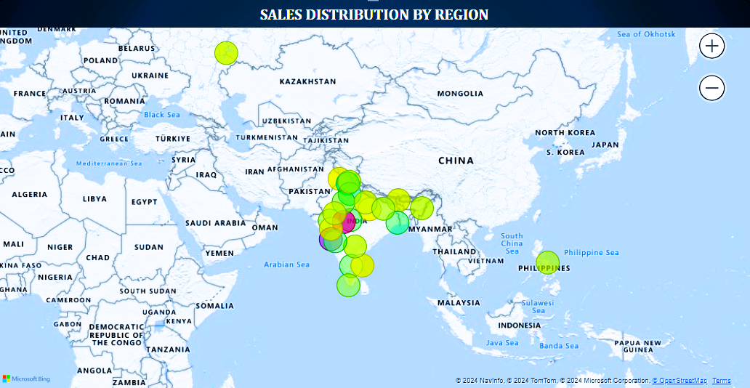
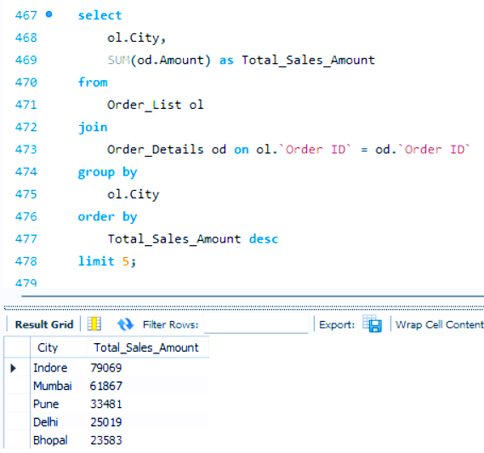
GEOGRAPHICAL ANALYSIS:
STATE WISE SALES DISTRIBUTION
TOP 5 CITIES WITH THE HIGHEST TOTAL SALES AMOUNT
It allows businesses to identify key market areas where sales are strongest, understand regional preferences or demand patterns, allocate resources effectively.

Slide 10
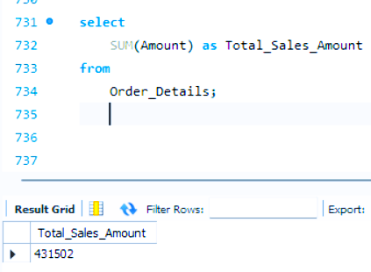
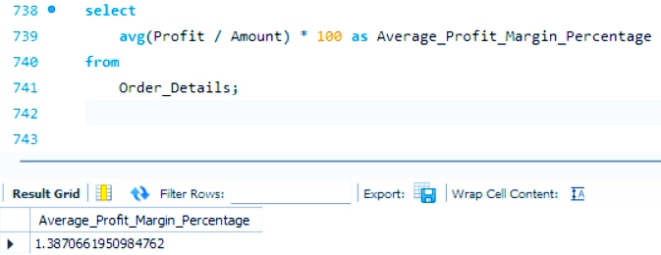
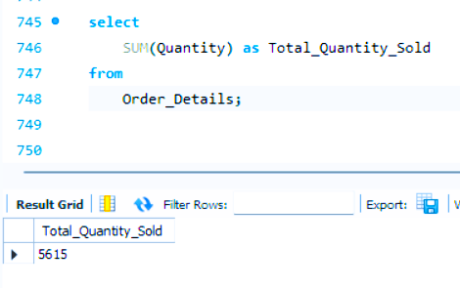
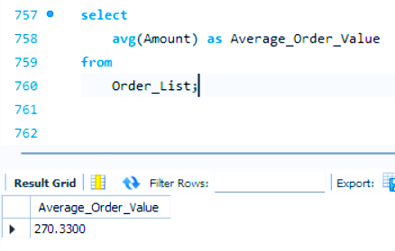
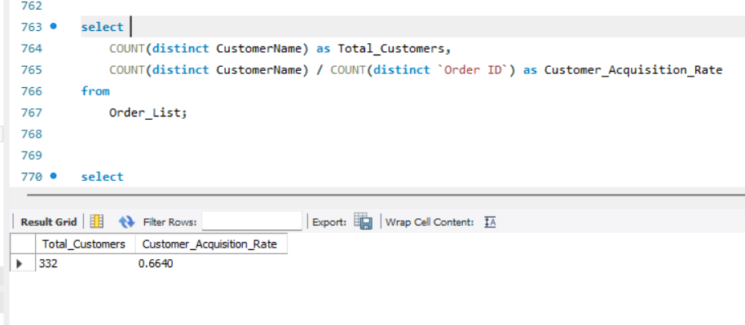
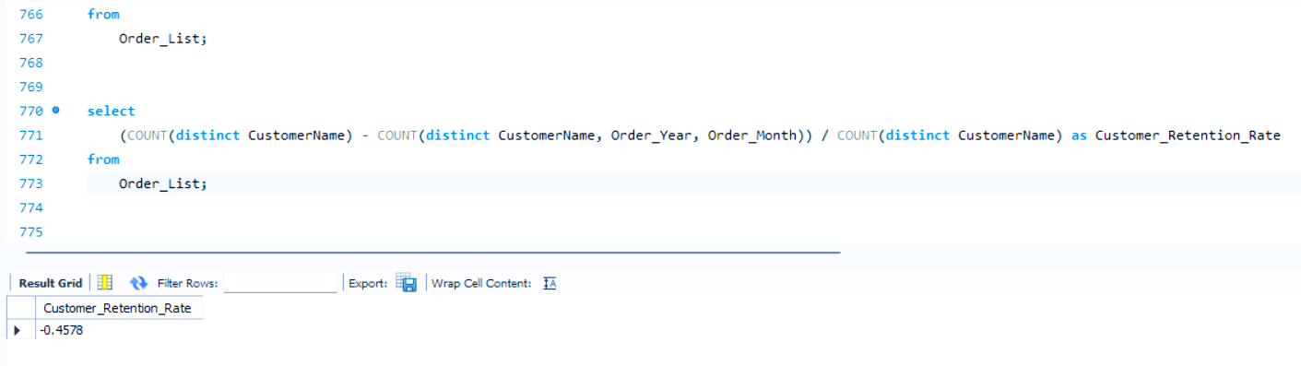
SQL KPI’S:-
TOTAL SALES AMOUNT AVERAGE PROFIT MARGIN % TOTAL QUANTITY SOLD AVERAGE ORDER VALUE
CUSTOMER ACQUISITION RATE CUSTOMER RETENTION RATE

Slide 11
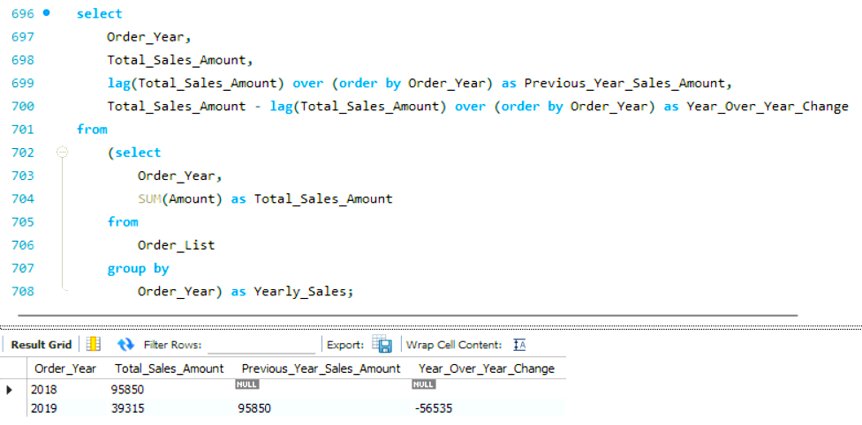
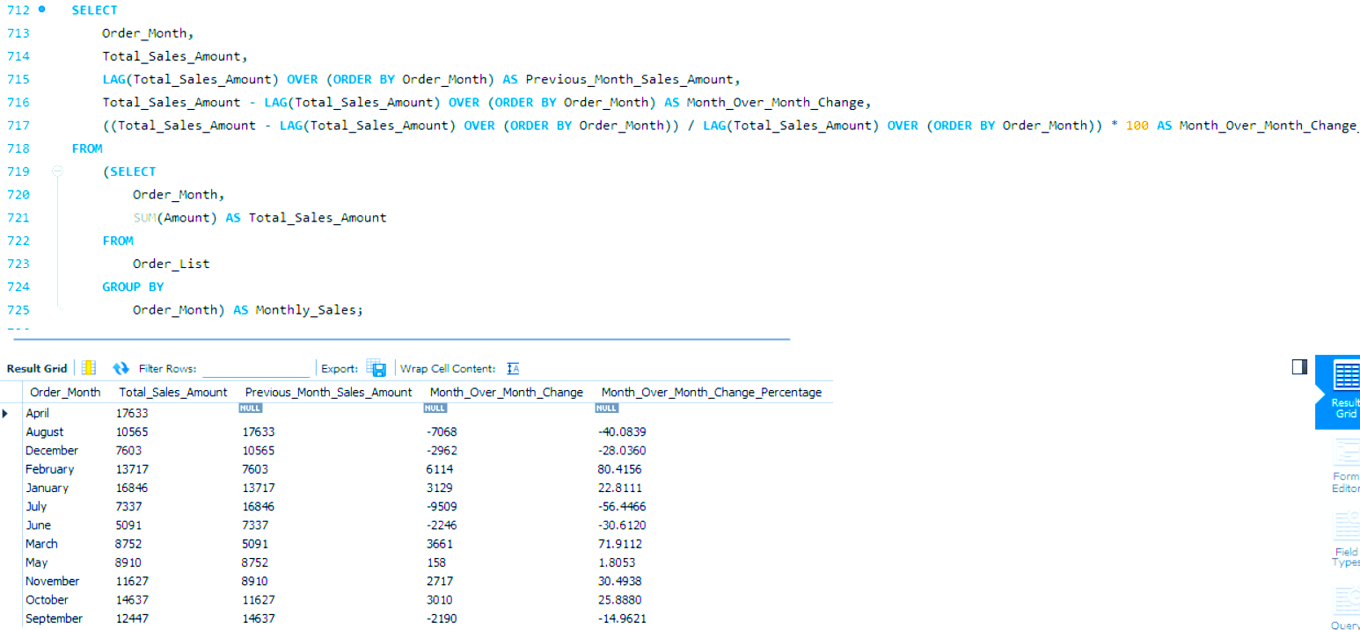
SQL CHANGE IN SALES IN %:-
YEAR ON YEAR CHANGE BY LAG
MONTH ON MONTH CHAGE BY LAG AND LEAD

Slide 12
E-COMMERCE ANALYSIS
E-COMMERCE CONCLUSION
CONCLUSION
The comprehensive analysis of the e-commerce dataset has provided actionable insights that can drive strategic decision-making and enhance business performance. By leveraging these insights, e-commerce companies can optimize sales strategies, improve customer engagement, and gain a competitive edge in the dynamic online marketplace.
Moving forward, continued monitoring and analysis of key metrics will be essential to adapt to evolving market trends, capitalize on emerging opportunities, and sustain long-term growth in the highly competitive e-commerce landscape.
.

