Slide 1


Slide 2
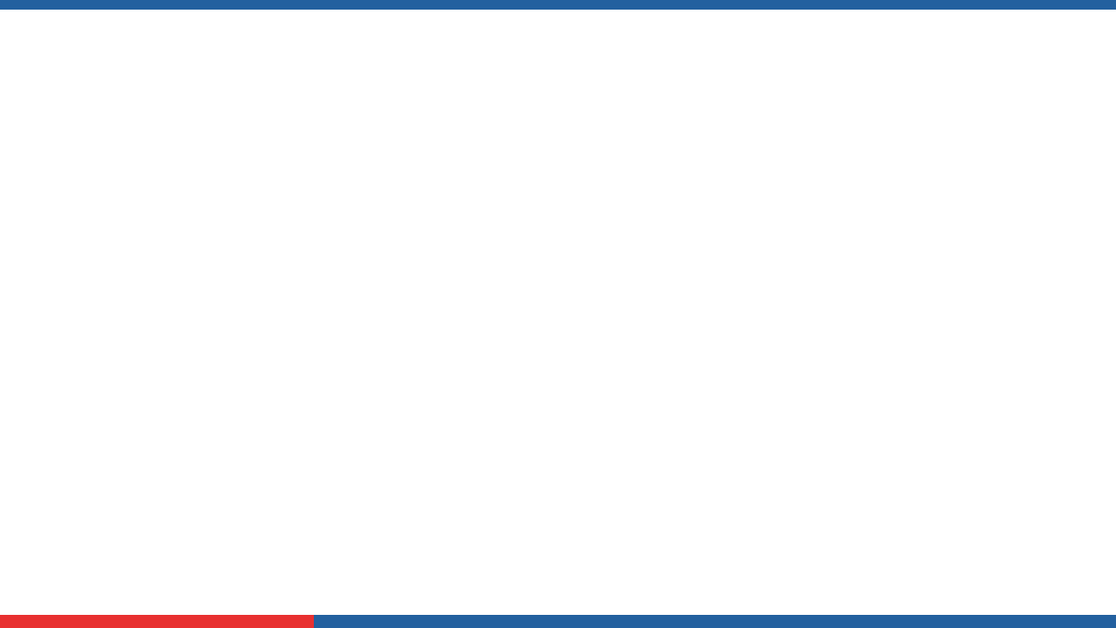

Teaching-Learning Monitoring & Effectiveness Tracking System for SOET
Final Year Project Synopsis
Submitted by
ROLL | NAME
2201010078 | Ananya Joshi
2201010081 | Shanvi Mathuria
Industry Mentor:
Faculty Mentor:

Slide 3

Project Overview
Our project aims to develop a Teaching-Learning Monitoring and Feedback System that helps institutions track both teaching effectiveness and student learning. Faculty can log syllabus coverage, upload lecture notes, and record classroom details such as topics taught, teaching methods, and attendance. An Assessment & Outcome Tracker connects exam and assignment questions with Course Outcomes (COs) and Program Outcomes (POs) to measure learning progress. Students can also share feedback, and all data is compiled into dashboards and reports, supporting better academic planning and quality improvement.

Slide 4
Specific Objectives
Objective 1: Monitor Teaching & Syllabus Progress
To systematically track daily class logs, topics covered, teaching methods, and syllabus completion.
To map assessments with Course Outcomes (COs) and Program Outcomes (POs) while also collecting student feedback for improvement.
Objective 2: Evaluate Student Learning & Feedback
Objective 3: Record and Analyze Academic Activities
To maintain records of beyond-classroom learning (MOOCs, workshops, hackathons, internships) and generate dashboards/reports for data-driven decisions..

Slide 5
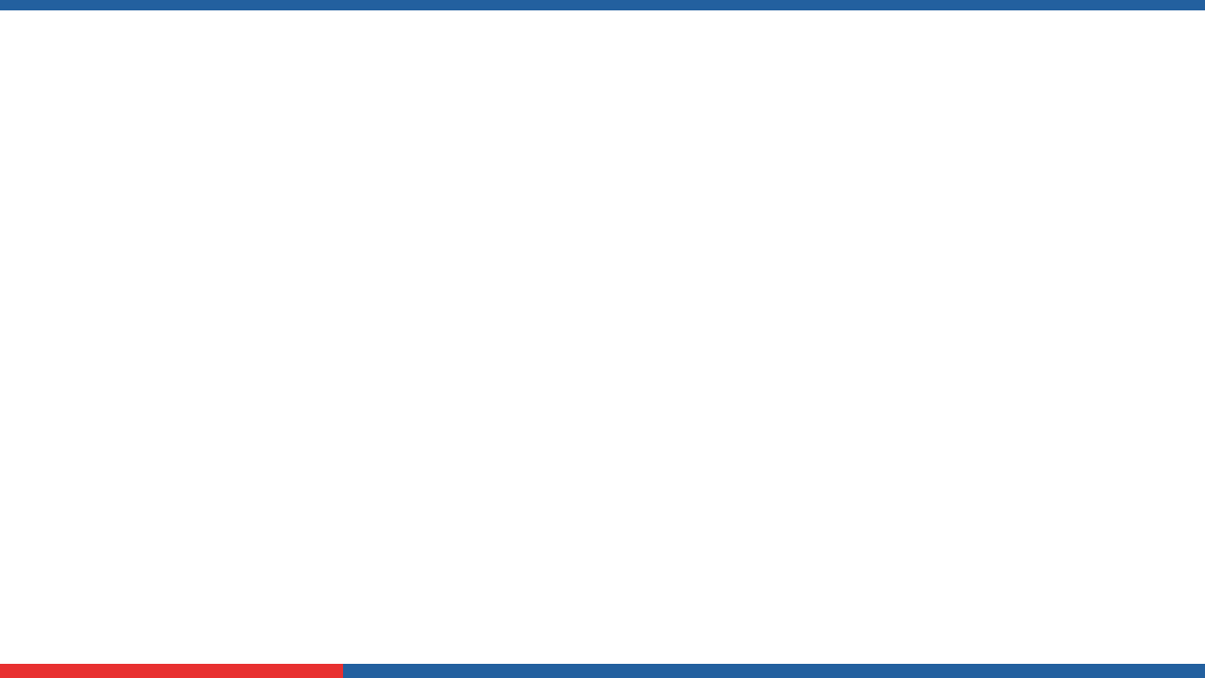
Key Features
Syllabus Tracking – Day-wise coverage with lecture notes upload.
Class Log – Records topics taught, methods used, and attendance.
Assessment & Outcome Mapping – Links exams/assignments to COs and POs.
Student Feedback – Collects insights on teaching and learning experience.
Beyond-Classroom Records – Captures MOOCs, workshops, hackathons, internships.
Dashboards & Reports – Provides clear insights for faculty and admin.

Slide 6
Project Usecases & Scope
Use Cases
Faculty:
Log classes, syllabus, and upload notes.
Track assessments and teaching methods.
Students:
Provide feedback on teaching and courses.
Access uploaded notes and progress reports.
Scope
Supports classroom + beyond-classroom learning activities.
Scalable MERN-based system with structured data handling.

Slide 7

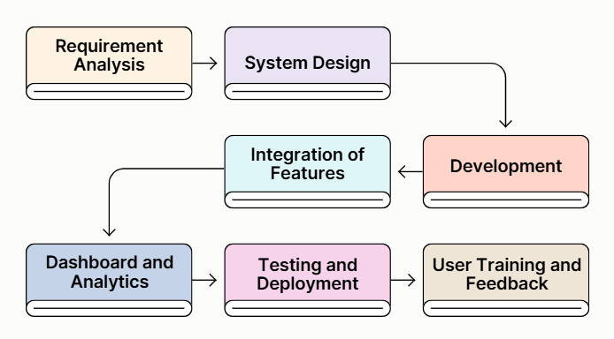

Project Flow diagram/Architecture
Notes:
New Courses replaced with New Programmes

Slide 8
Data & Resources
Data
Faculty Data: Syllabus coverage, lecture notes, attendance records, exam/assignment details.
Student Data: Feedback, participation, and records of extra activities (MOOCs, workshops, internships).
Institutional Data: COs, POs, curriculum structure, and evaluation guidelines.
Resources Used
MERN stack (MongoDB, Express.js, React.js, Node.js), Clerk authentication, Tailwind CSS, Figma for design.

Slide 9
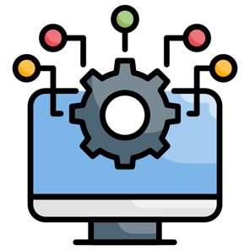

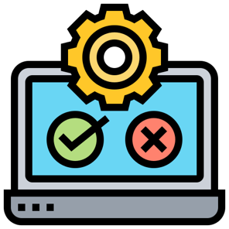
Methodology
Requirement Analysis – Identify needs like syllabus tracking, assessment mapping, and feedback collection.
System Design & Development – Build modules using MERN stack, integrating frontend, backend, and database.
Testing & Deployment – Validate system features, refine user experience, and prepare for institutional use.

Slide 10
Expected Results & Impact
Expected Results
A functional system to track teaching, syllabus coverage, assessments, and feedback.
Clear dashboards and reports for faculty and administration.
Better visibility of student learning progress and academic activities.
Impact
Improves teaching quality through structured monitoring.
Helps institutions make data-driven academic decisions and strengthen outcome-based education.
Encourages student engagement by including feedback and beyond-classroom activities.

Slide 11
THANK YOU

