Slide 1
NCS Capstone Project – ABC University

Slide 2

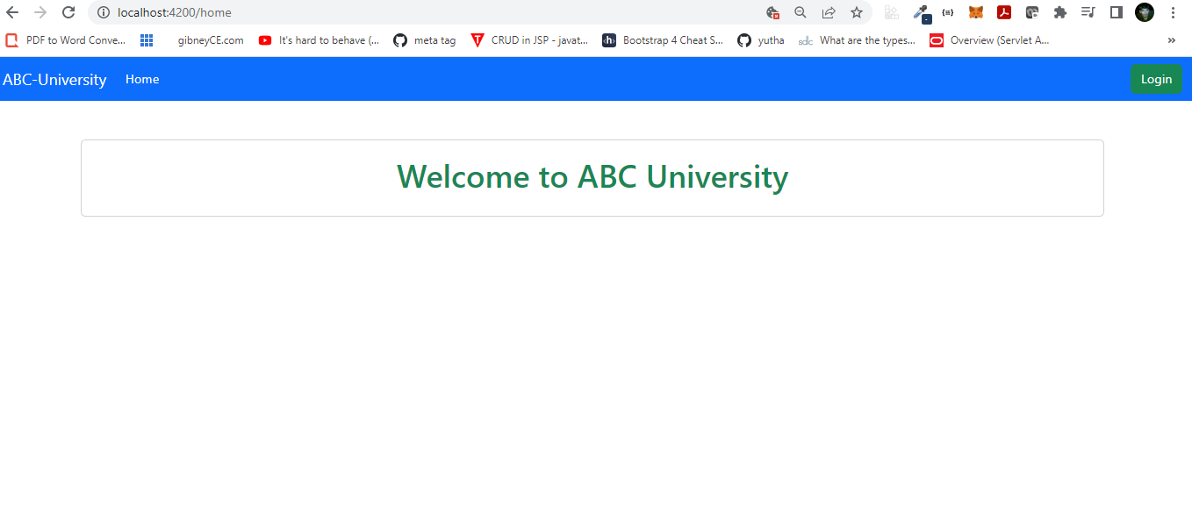

ABC University
Name: ABC University
Descriptions: Web application which provide quiz for students in various category so that student can practice and learn.
Technology : Java 8, Spring boot, Spring rest, MySQL, Spring Data JPA, Spring Security, JWT Authentication, Micro services, Angular

Slide 3
ABC University Main functions
Login
Logout
Register/Edit/Delete Users – Admin Only
Add/Edit/Delete Questions - Admin Only
Filter Students By Category - Admin Only
Quiz – Student Only
View Result – Student Only
View Quiz History – Student Only

Slide 4
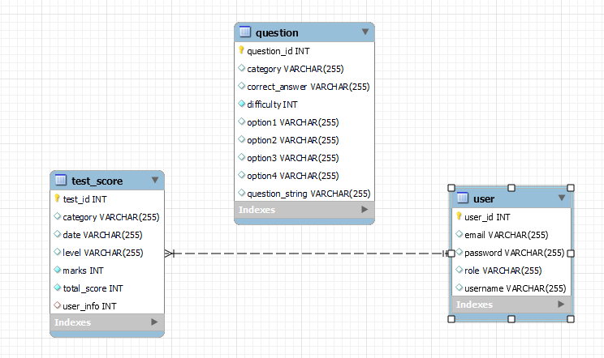
ABC University Database

Slide 5
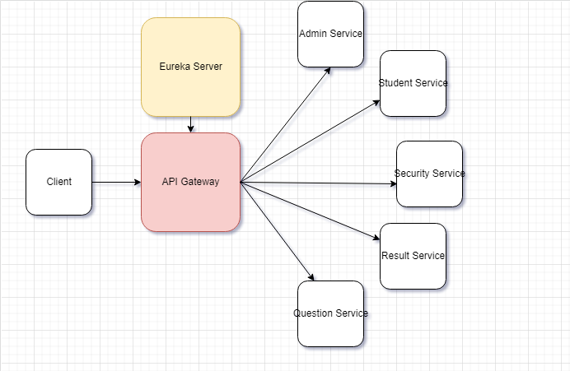
ABC University Micro Service Architecture

Slide 6
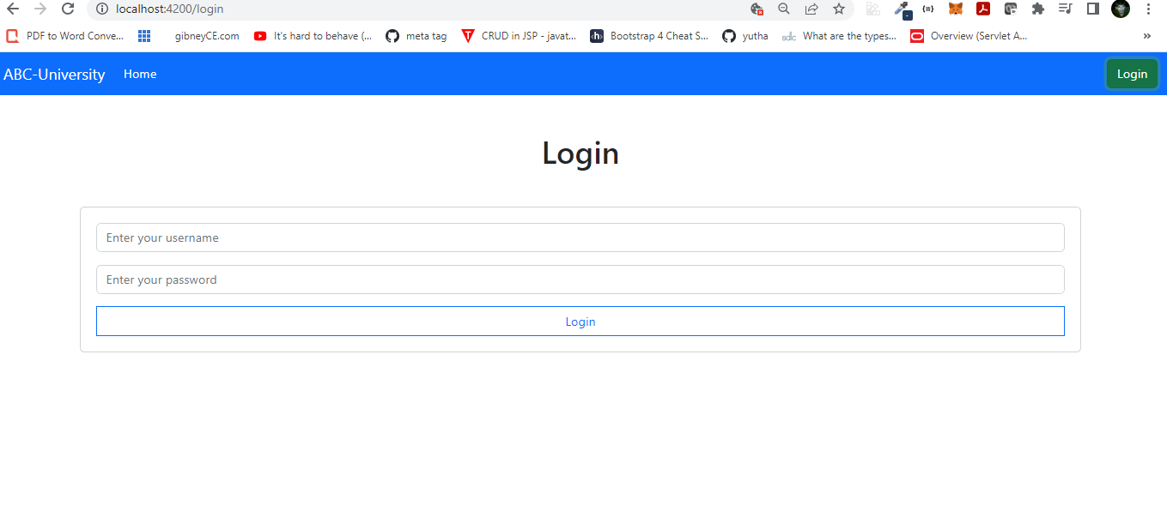
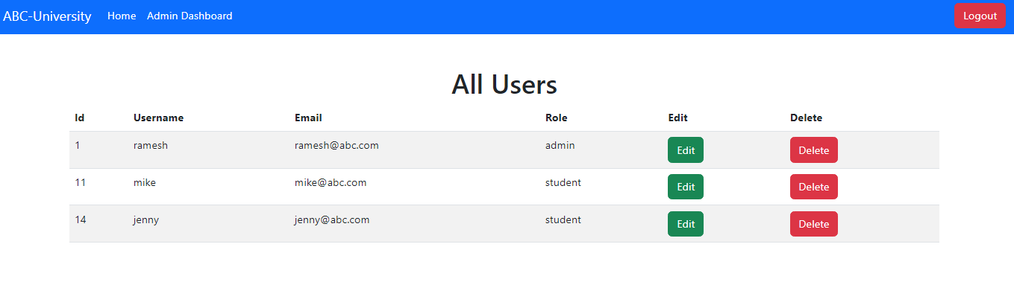
ABC University Micro Service Web Pages

Slide 7
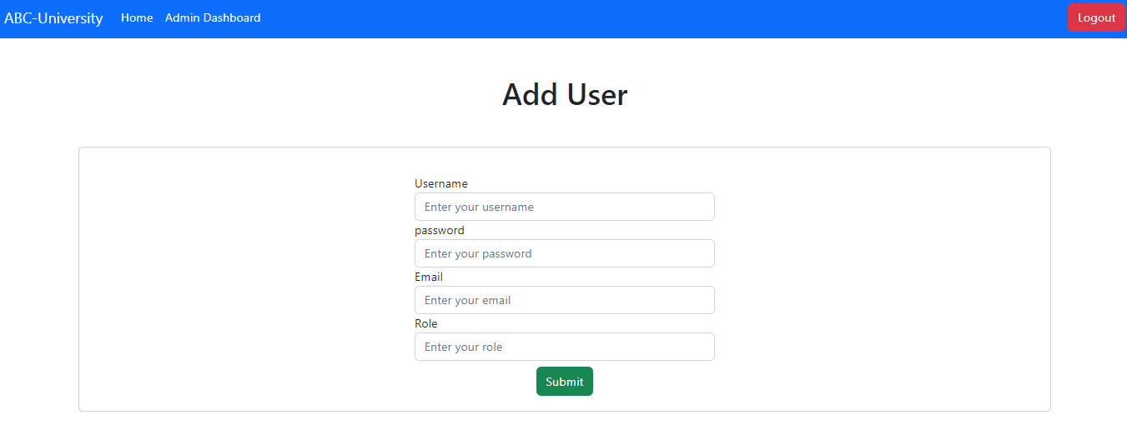
ABC University Micro Service Web Pages

Slide 8
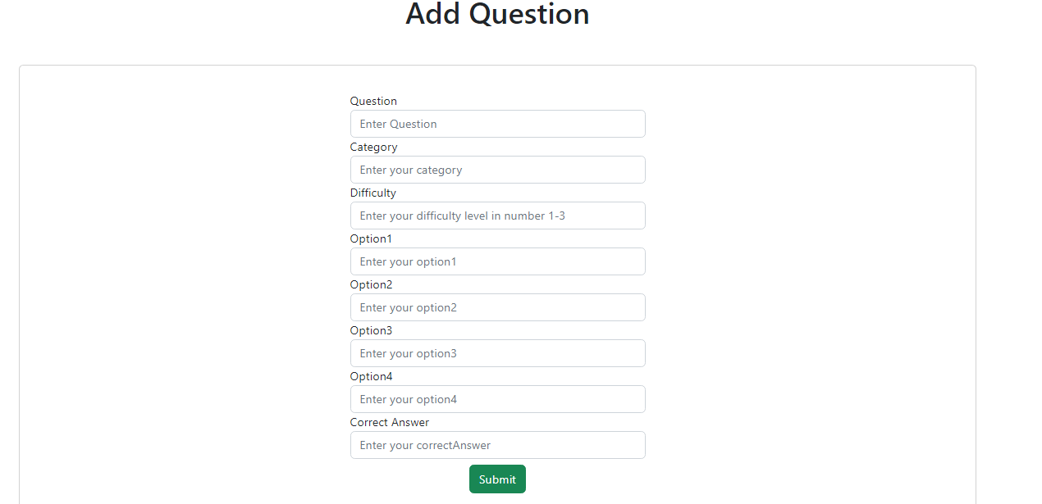
ABC University Micro Service Web Pages

Slide 9
ABC University Improvements
Create Documentation for API
Improve Angular Front End Design
Add More Category of Quiz

Slide 10


