Slide 1



Low-latency Deep Clustering for Speech Separation
*Shanshan Wang, Gaurav Naithani, Tuomas Virtanen
Audio Research Group

Slide 2
2-speaker mixture separation
Good morning!
Hello, ICASSP 2019!
Hello, ICASSP 2019!
Good morning!

Slide 3
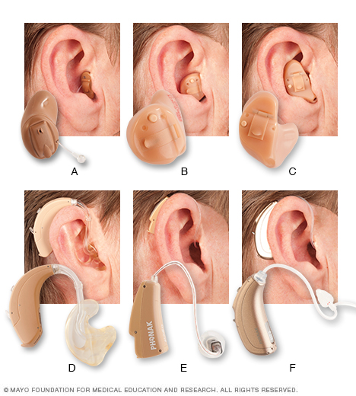
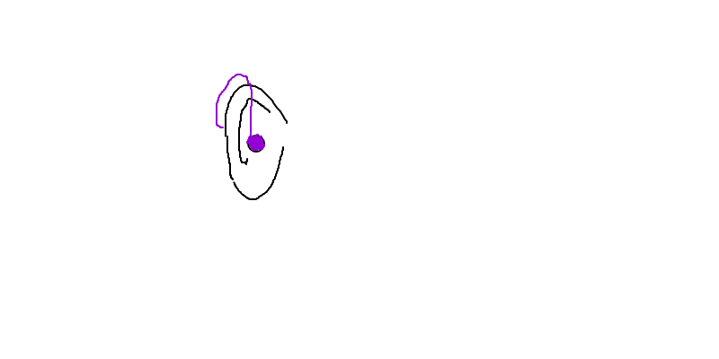
Why low latency?
Low latency is important in many scenarios like telephone calls, live concert performance.
Especially, for hearing aids.
Hearing aid

Slide 4
Why low latency?
Currently, most state of the art of speech separation systems are offline.
A low-latency version is strongly needed!

Slide 5
Main Contribution
A low algorithmic latency adaptation of the deep clustering approach for speaker-independent speech separation.
Precisely, by investigating
1. network topology that allows online processing
2. time-frequency representation that allows low latency
3. how to obtain speaker models (cluster of embeddings) in short time

Slide 6
Outline
Offline Deep Clustering
Low-latency Deep Clustering
Evaluation

Slide 7
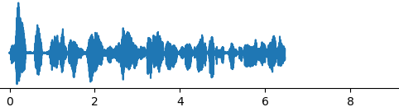
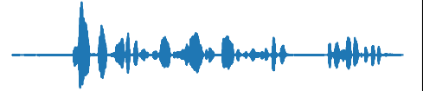

Offline Deep Clustering
Mixture
STFT
Supervised learning
S1
DNN
iSTFT
Embeddings
S2
Unsupervised learning
K-Means
Masks
J. R. Hershey, Z. Chen, J. Le Roux, and S. Watanabe, “Deep clustering: Discriminative embeddings for segmentation and separation,” in Proc. IEEE International Conference on Acoustics, Speech and Signal Processing (ICASSP), 2016, pp. 31–35.

Slide 8
Offline Deep Clustering
Embeddings V
Binary Mask
Mixture Spectrogram
Binary Mask
0
1
DNN
K-Means
Reshape
0 | 1 | 0
1 | 0 | 1
0
1
T × F
T × F
0
1
Speaker 1
Speaker 2
T F × D
T F × 1

Slide 9
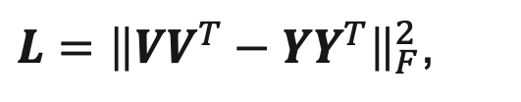


Offline Deep Clustering
The neural network is trained to minimize the difference between the estimated affinity matrix $VV^{T}$ and the target binary mask affinity matrix $YY^{T}$ .
$L={\left\|{VV}^{T}−{YY}^{T}\right\|}_{F}^{2}$,
where F denotes the Frobenius norm of the matrix
$$V∈ℝ^{TF×D}$$
$$Y∈ℝ^{TF×C},c=2$$
...
0
1
...
0
1
Pros: Speaker independent
...
1
0
…
…
Cons: offline
...
...
0
1
...
1
0
...
0
1

Slide 10
Outline
Deep Clustering
Low-latency Deep Clustering
Evaluation

Slide 11










Low-latency Deep Clustering
Network topology that allows online processing – LSTM network
$$y_{0}$$
$$y_{1}$$
$$y_{t}$$
LSTM
LSTM
…
LSTM
$$x_{i},$$
$$i ε 0,1,…t$$
Input
$$x_{0}$$
$$x_{1}$$
$$x_{t}$$
$$y_{i},$$
$$i ε 0,1,…t$$
Output

Slide 12
Low-latency Deep Clustering
Time-frequency representation that allows low latency – using 8 ms window length
…
8 ms

Slide 13
Low-latency Deep Clustering
Obtain speaker models (cluster of embeddings) in short time
- buffer
Using only a certain length in the beginning of the mixture, to get the cluster centers,
and those centers can be used to predict the masks for the rest of the mixture.

Slide 14
Speech Mixture
Low-latency Deep Clustering
0.3 s
The rest
T
F
LSTM
Embeddings
LSTM
K-means
Cluster centers
Embeddings
Predict
Masks

Slide 15
Outline
Deep Clustering
Low-latency Deep Clustering
Evaluation

Slide 16
Data Set: 2-speaker mixtures from Wall Street Journal corpus (wsj0)
Low-latency DC Evaluation
 | Training data | CV data | Test data
Duration | 33 hours | 8 hours | 5 hours
# of speakers | 110 | - | 18

Slide 17
Low-latency DC Evaluation
Leading and trailing silence are trimmed from test audio signals.
S1
Ensuring that both speakers are
active in the buffer.
S2
Mixture

Slide 18
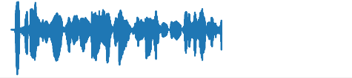
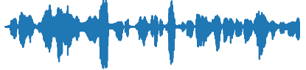
Low-latency DC Evaluation
In order to keep the test material the same for different buffer length, test and cluster utterance are taken from different mixtures of the same speaker pair.
0.3 s
Cluster utterance
Test utterance

Slide 19
Networks and Parameters
 | Offline DC | Low-latency DC
Window length | 32 ms | 8 ms
Hop length | 8 ms | 4 ms
Sequence length | 100 | 200
Network | BLSTM | LSTM
Number of layers | 4
Number of LSTM units | 600
Embedding dimension | 40

Slide 20
Offline DC & Online DC result
Window length
SDR (dB)
*BLSTM
32 ms
7.9
Offline DC
LSTM
32 ms
6.9
LSTM
8 ms
5.8
LSTM
(0.3s buffer)
8 ms
Online DC
5.1

Slide 21
The Effect of Buffer Length

Slide 22

Audio Samples
Mixture ( female + male )
Estimated speaker 1
Estimated speaker 2

Slide 23
Audio Samples
Mixture ( male + male )
Estimated speaker 1
Estimated speaker 2

Slide 24
Conclusion
A low algorithmic latency adaptation of the deep clustering approach for speaker-independent speech separation.
BLSTM (32 ms)
LSTM (32 ms)
LSTM (8 ms)
1.0 dB drop
1.1 dB drop
2.8 dB drop
Online DC system
More importantly, we found that even with 0.3 s buffer duration, it is sufficient to estimate reasonable clusters for separation.

