Slide 1


Serverless and support
Shashank Shekhar Tewari
Technical Support Supervisor & Account Manager

Slide 2

Traditional support

Slide 3

Faster support

Slide 4


Slide 5

Troubleshooting
Remember the route, chase the clues
Isolate the problem - process of elimination
Ignore if irrelevant
Logs, logs and logs
Search online

Slide 6
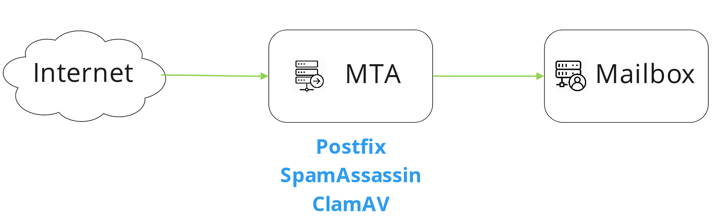
Basic email flow

Slide 7
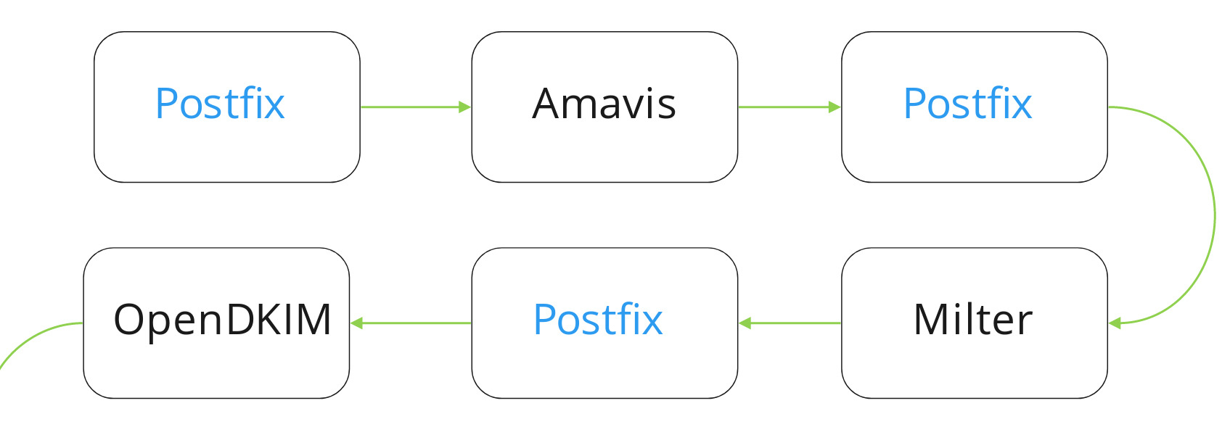
Postfix processing

Slide 8
Typical log file
Feb 16 20:45:57 mail-shephard postfix/postscreen[1813]: CONNECT from [10.32.1.5]:51403 to [10.32.1.3]:25
Feb 16 20:45:57 mail-shephard postfix/postscreen[1813]: WHITELISTED [10.32.1.5]:51403
Feb 16 20:45:57 mail-shephard postfix/smtpd[3240]: connect from dc5.global.mymailserver.xpl[10.32.1.5]
Feb 16 20:45:57 mail-shephard postfix/smtpd[3240]: disconnect from dc5.global.mymailserver.xpl[10.32.1.5] ehlo=1 quit=1 commands=2
Feb 16 20:46:30 mail-shephard postfix/smtp[16243]: connect to newexternalserver.xpl[10.137.26.4]:25: Connection refused
Feb 16 20:46:30 mail-shephard postfix/smtp[16243]: 9B21E447F6: to=<rohan.kumar@newexternalserver.xpl>, relay=none, delay=0.03, delays=0.01/0.02/0/0, dsn=4.4.1, status=deferred (connect to newexternalserver.xpl[10.137.26.4]:25: Connection refused)
Feb 16 20:46:52 mail-shephard postfix/smtp[3642]: BD1EF4B32F85: to=<julius.c@montfurniture.xpl>, relay=mail.montfurniture.xpl[25.229.128.102]:25, delay=320, delays=0.05/0.0
1/320/0, dsn=4.4.2, status=deferred (conversation with mail.montfurniture.xpl[5.189.128.102] timed out while performing the EHLO handshake)
Feb 16 20:46:53 mail-shephard postfix/smtp[3653]: 2DEAF4B1B57A: to=<office@dukeautorepair.xpl>, relay=dukeautorepair.xpl[24.31.7.19]:25, delay=320, delays=0.01/0.02/320/0, dsn=4.4.
2, status=deferred (conversation with dukeautorepair.xpl[94.127.7.149] timed out while performing the EHLO handshake)
Feb 16 20:47:31 mail-shephard amavis[31377]: (31377-20-5) DSN: NOTIFICATION: Action:failed, LOCAL 550 MtaRejected, spam level 0.000, <raj.d@acme.ac.xpl> -> <rahul.dev@acme.xpl>
Feb 16 20:47:31 mail-shephard amavis[31377]: (31377-20-5) DSN: NOTIFICATION: Action:failed, LOCAL 550 MtaRejected, spam level 0.000, <raj.d@acme.ac.xpl> -> <manny.covda@acme.xpl>
Feb 16 20:47:31 mail-shephard amavis[31377]: (31377-20-5) wDf1f36MZ4mw(653Mi2upLd9r) SEND from <> -> <raj.d@acme.ac.xpl>, ENVID=AM.wDf1f36MZ4mw.20180911T093531Z@mail-smtp02.urc.xpl BODY=7BIT 250 2.0.0 from MTA(smtp:[127.0.0.1]:10025): 250 2.0.0 Ok: queued as 69D9F400EE6

Slide 9
Easy to automate
Fixed errors
Causes are varied
Common errors have common solutions
Just the right amount of challenge

Slide 10
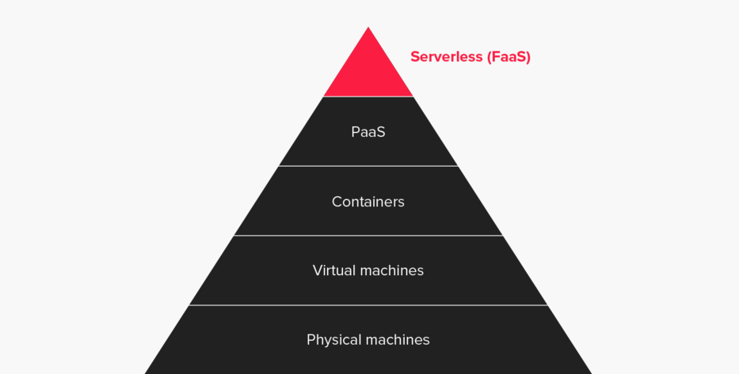
Credit: https://dzone.com/articles/why-serverless-1

Slide 11
Why Serverless?
No server management
No log retention
Scalable
Quick deployments, quick updates
SO CHEAP! Cost-effective

Slide 12
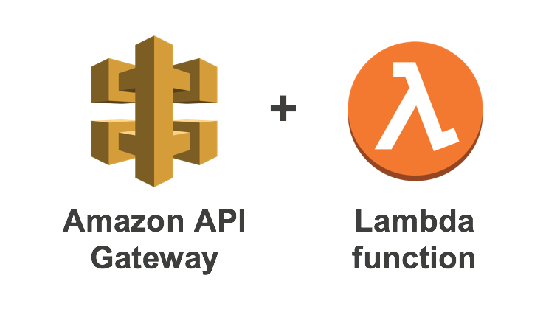


Components

Slide 14
Security
Many traditional problems solved automatically
Good programming practices resolve most
New tech = New problems
Create time outs!

Slide 15
Shout outs!
Mehul Patel
Deepa Selvam and Heera Singh Koranga
Ayush, and organizers of ServerlessDays

Slide 16

Any questions?

