Slide 1
Working from home – tips and suggestions
Presented by
Shashank Shekhar Tewari

Slide 2

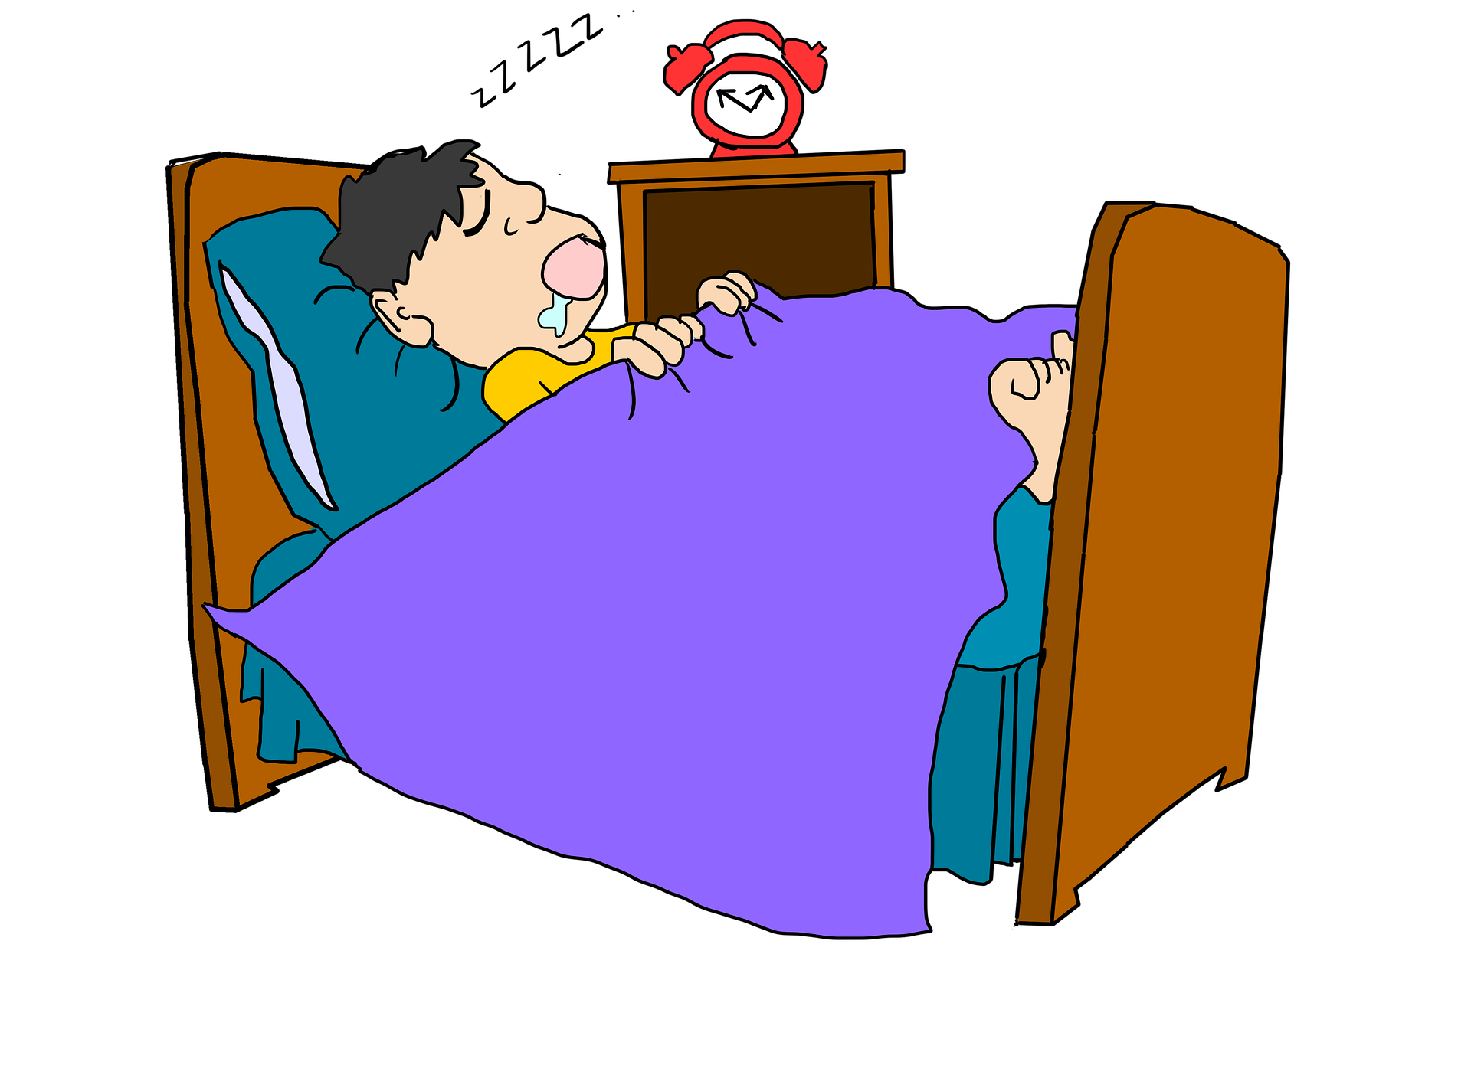

“Working” from home!

Slide 3

Preparing for work
Set up a dedicated workspace
Get ready like you would go to office
All of this is just to get you mentally prepared

Slide 4
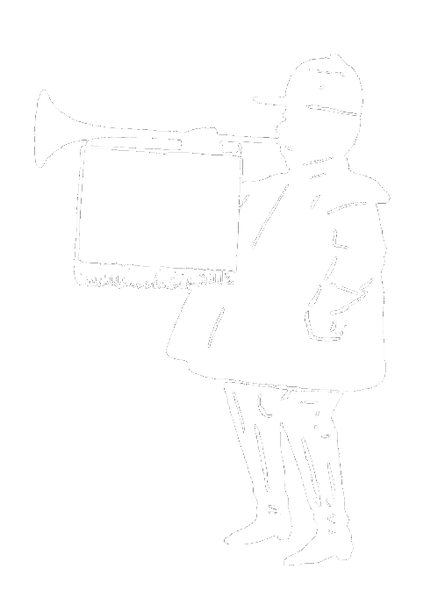
Starting work
Remember that you are remote
Make your presence felt!

Slide 5
What about distractions?
Classify your distractions, and develop strategies to tackle them
Two common types:
  Family
  Self-induced distractions

Slide 6

Would you do this in office?

Slide 7
What about the rest of the time?
Take care of physical and mental health
  Exercise!
  Meditate
  Pick up a hobby
Make use of the extra time – learn something new

Slide 8
Questions or Suggestions?

