Slide 1
Transition API in KitKat
Bin Shao
2014-07-21

Slide 2
Introduction
New animation feature in KitKat
Based on Property Animation which is introduced in Honeycomb
Provides a simple way for developers to provide animated segues to different scenes of their application
Tell the system that you'd like to run a transition animation, then make the necessary changes to your UI. The system figures out the differences and animates the changes.

Slide 3
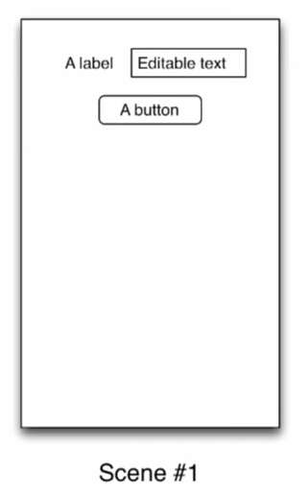
Scene & Transition

Slide 4
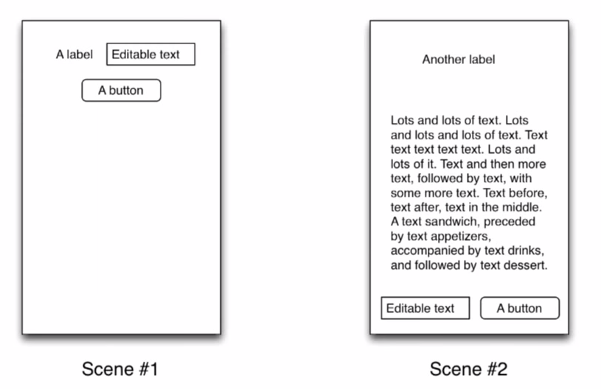
Scene & Transition

Slide 5
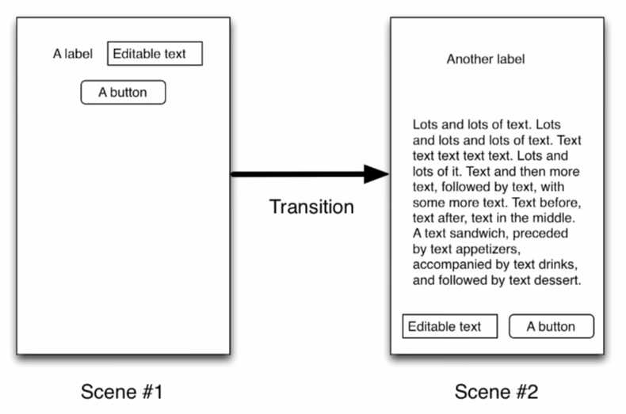
Scene & Transition

Slide 6
Classes in android.trasition
Scene
Transition, ChangeBounds, TransitionSet, AutoTransition, Visibility, Fade
TransitionListener
TransitionManager
TransitionInflater
TransitionValues

Slide 7
Scenes
an encapsulation of the state of a view hierarchy, including the views in that hierarchy and the various values (layout-related and otherwise) that those views have.
can be defined by a layout hierarchy directly or by code which sets up the scene dynamically as it is entered.
Notes:
activityCloseEnterAnimation When closing the current activity, this is the animation that is run on the next activity (which is entering the screen).
activityCloseExitAnimation When closing the current activity, this is the animation that is run on the current activity (which is exiting the screen).
activityOpenEnterAnimation When opening a new activity, this is the animation that is run on the next activity (which is entering the screen).
activityOpenExitAnimation When opening a new activity, this is the animation that is run on the previous activity (which is exiting the screen).

Slide 8
Construct Scenes
From scratch
Scene(ViewGroup);
Scene.setEnterAction(Runnable);
From a ViewGroup
Scene(ViewGroup, ViewGroup);
From a layout resource
Scene.getSceneForLayout(sceneRoot,R.layout.someId, context);
Notes:
activityCloseEnterAnimation When closing the current activity, this is the animation that is run on the next activity (which is entering the screen).
activityCloseExitAnimation When closing the current activity, this is the animation that is run on the current activity (which is exiting the screen).
activityOpenEnterAnimation When opening a new activity, this is the animation that is run on the next activity (which is entering the screen).
activityOpenExitAnimation When opening a new activity, this is the animation that is run on the previous activity (which is exiting the screen).

Slide 9
Transitions
The engine responsible for declaring what it is you want to do when things change from scene to scene.
Listen for changes before and after, and compare those values, and then based on changes that occurred to any view in the scene hierarchy, they’ll create an animator that then gets run to animate those changes.
Notes:
A Transition is a mechanism to automatically animate changes that occur when a new scene is entered. Some transition capabilities are automatic. That is, entering a scene may cause animations to run which fade out views that go away, changeBounds and resize existing views that change, and fade in views that become visible. There are additional transitions that can animate other attributes, such as color changes, and which can optionally be specified to take place during particular scene changes. Finally, developers can define their own Transition subclasses which monitor particular property changes and which run custom animations when those properties change values.

Slide 10
Construct Transitions
Individually
ChangedBounds();
Fade();
Sets
TransitionSet set = new TransitionSet();
set.addTransition(new ChangeBounds())
.addTransition(new Fade());
From resource files
<transitionSet>
<changeBounds/><fade/>
</transitionSet>

Slide 11
Custom Transitions
Subclass Transition
Override
captureStartValues(TransitionValues)
captureEndValues(TransitionValues)
createAnimator(ViewGroup, TransitionValues, TransitionValues)

Slide 12
Changing Scenes
Without transitions
Scene.enter();
With default transition
TransitionManager.go(Scene);
With custom transition
TransitionManager.go(Scene, Transition)
// or, on TransitionManager instance
TransitionManager.transitionTo(Scene);

Slide 13
TransitionManager
Used as a one-off thing to go to some scene and use the custom transition here
Keep a whole graph of information about all the transition combinations

Slide 14
Transitions, Simplified
TransitionManager.beginDelayedTransition(ViewGroup)
Notes:
on this last exciting slide is that with all this information, all these different classes to think about it, and you’ve got scenes and you got transitions, but really, the idea was to make animations simpler for most development cases. So in general, the only method that you probably are going to care about is this one called TransitionManager.beginDelayedTransition. And give it the scene root that you want to run the transition on. What that does is kicks in all of the process that is going to capture the current values. And then it’s going to spawn a layout and rendering run. And then in the middle of that frame, it's going to capture the end values, figure out where things are, and then run an automatic transition for you. In most cases, this is all that you actually care about. It's basically a dynamic change. You can think of this as creating and animating a dynamic scene. So instead of having these pre-baked scenes from layout resource IDs, you can basically say, OK, I want you to run a transition, so get ready. And then in the meantime, I'm going to make a bunch of changes. And then by the time those changes have actually kicked in, measure and layout has run, and the system is ready to draw the new frame. Then, the transitions kick in, figure out the deltas, figure out the changes, and create the animations, and start the animations running. Fairly straightforward. One line of code. Nice.

Slide 15
Demos
KitKat API Demos/animation/Transition
Another demo
Notes:
on this last exciting slide is that with all this information, all these different classes to think about it, and you’ve got scenes and you got transitions, but really, the idea was to make animations simpler for most development cases. So in general, the only method that you probably are going to care about is this one called TransitionManager.beginDelayedTransition. And give it the scene root that you want to run the transition on. What that does is kicks in all of the process that is going to capture the current values. And then it’s going to spawn a layout and rendering run. And then in the middle of that frame, it's going to capture the end values, figure out where things are, and then run an automatic transition for you. In most cases, this is all that you actually care about. It's basically a dynamic change. You can think of this as creating and animating a dynamic scene. So instead of having these pre-baked scenes from layout resource IDs, you can basically say, OK, I want you to run a transition, so get ready. And then in the meantime, I'm going to make a bunch of changes. And then by the time those changes have actually kicked in, measure and layout has run, and the system is ready to draw the new frame. Then, the transitions kick in, figure out the deltas, figure out the changes, and create the animations, and start the animations running. Fairly straightforward. One line of code. Nice.

Slide 16
Ref
http://www.bignerdranch.com/blog/building-animations-android-transition-framework-part-1/
http://www.bignerdranch.com/blog/building-animations-android-transition-framework-part-2/
http://developer.android.com/reference/android/transition/index.html
KitKat API Demos/animation/Transition

