Slide 1
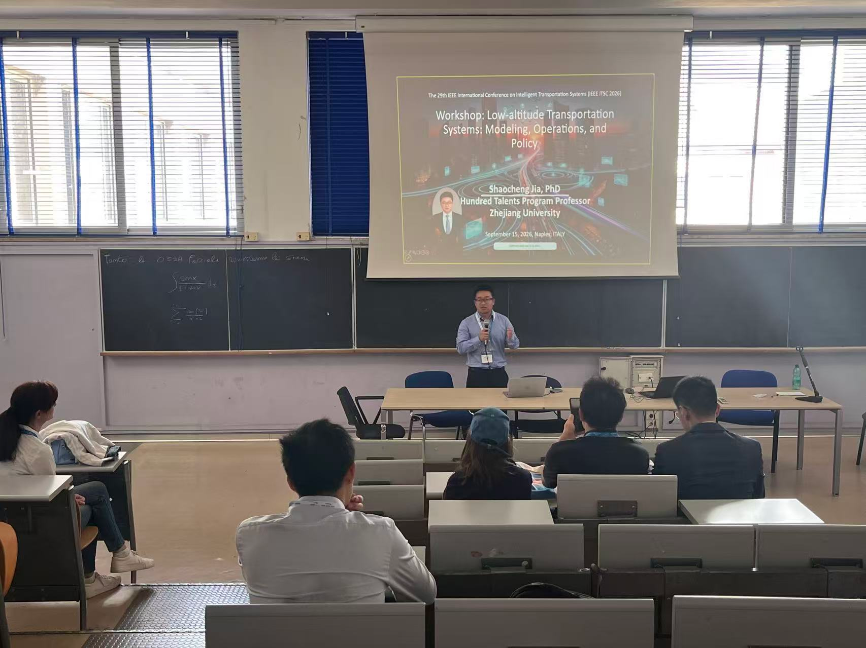




Slide 2
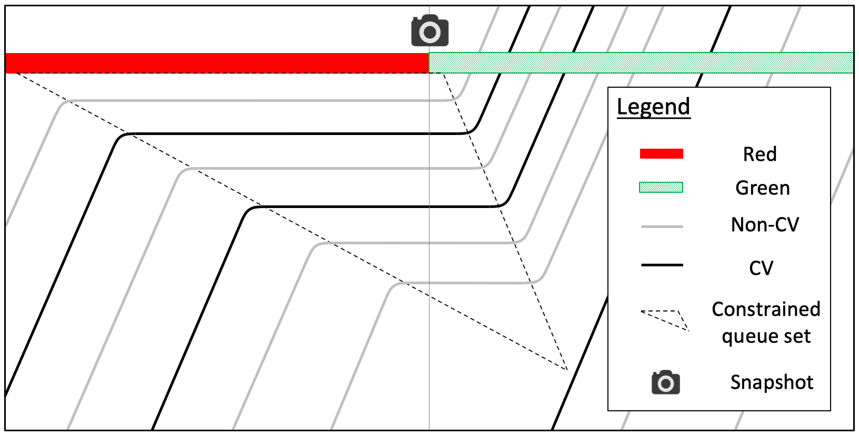
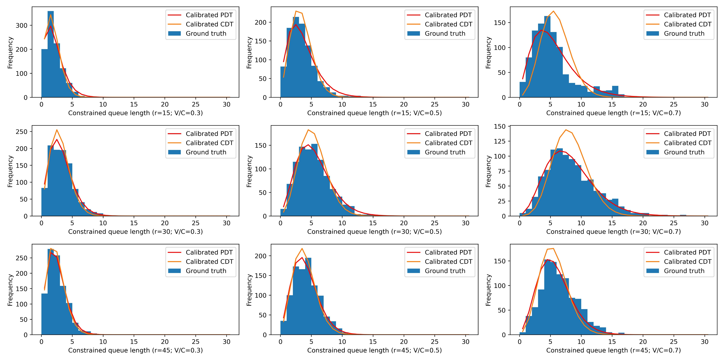

Slide 3
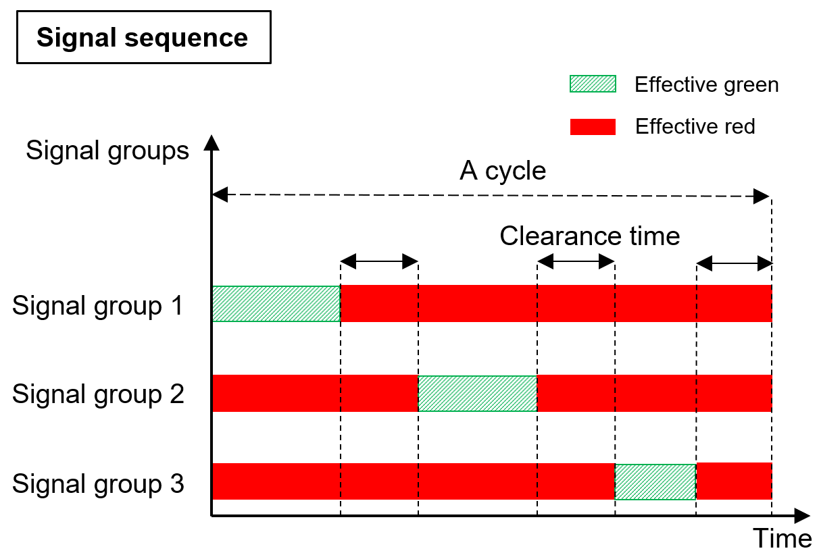
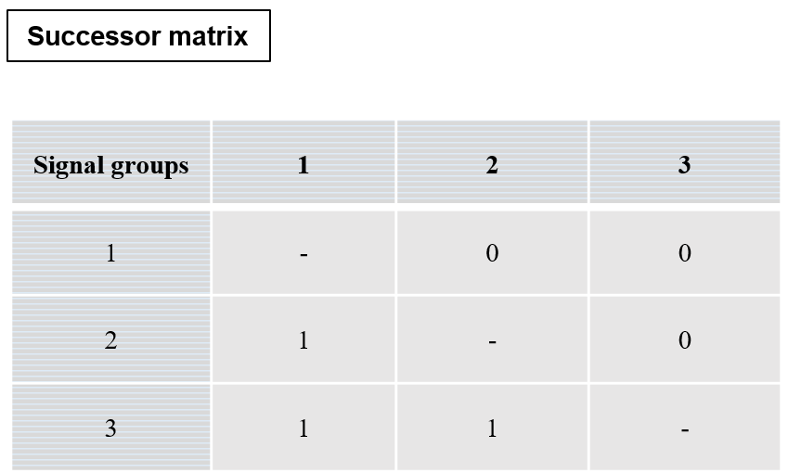

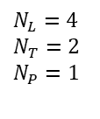
Lane 2
Signal group 2
Conflict
point
Lane 3
Clearance
time
Signal group 1
Pedestrian
crossing 1
Lane 1
Signal group 3
Signal group 1
Signal group 3
Pedestrian
crossing 2
$N_{L}=4$
$N_{T}=2$
$N_{P}=1$
Signal group 2
Lane 4

