Slide 1
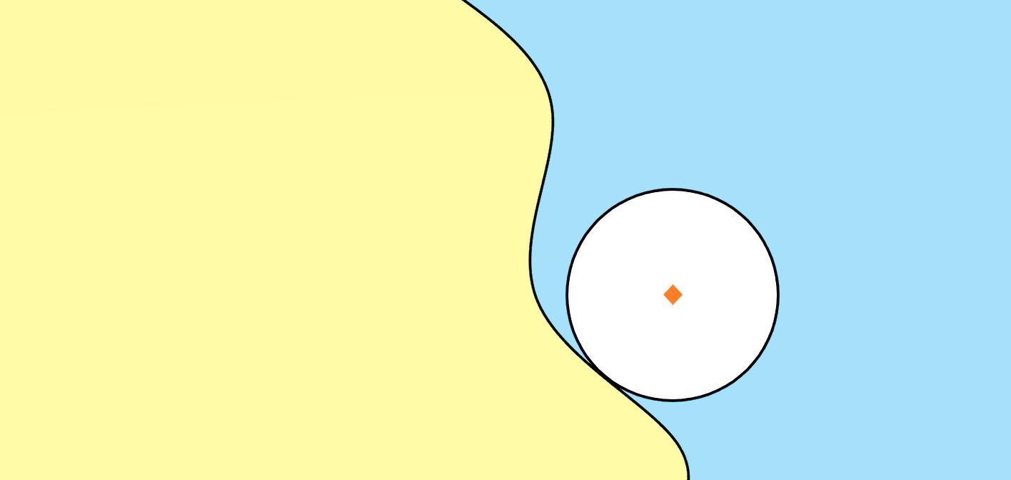
Norm Ball
Decision Boundary by Human Perception
Decision Boundary Learned by the Network
α
Maximum Safe Radius
α，
Adversarial Example

Slide 2
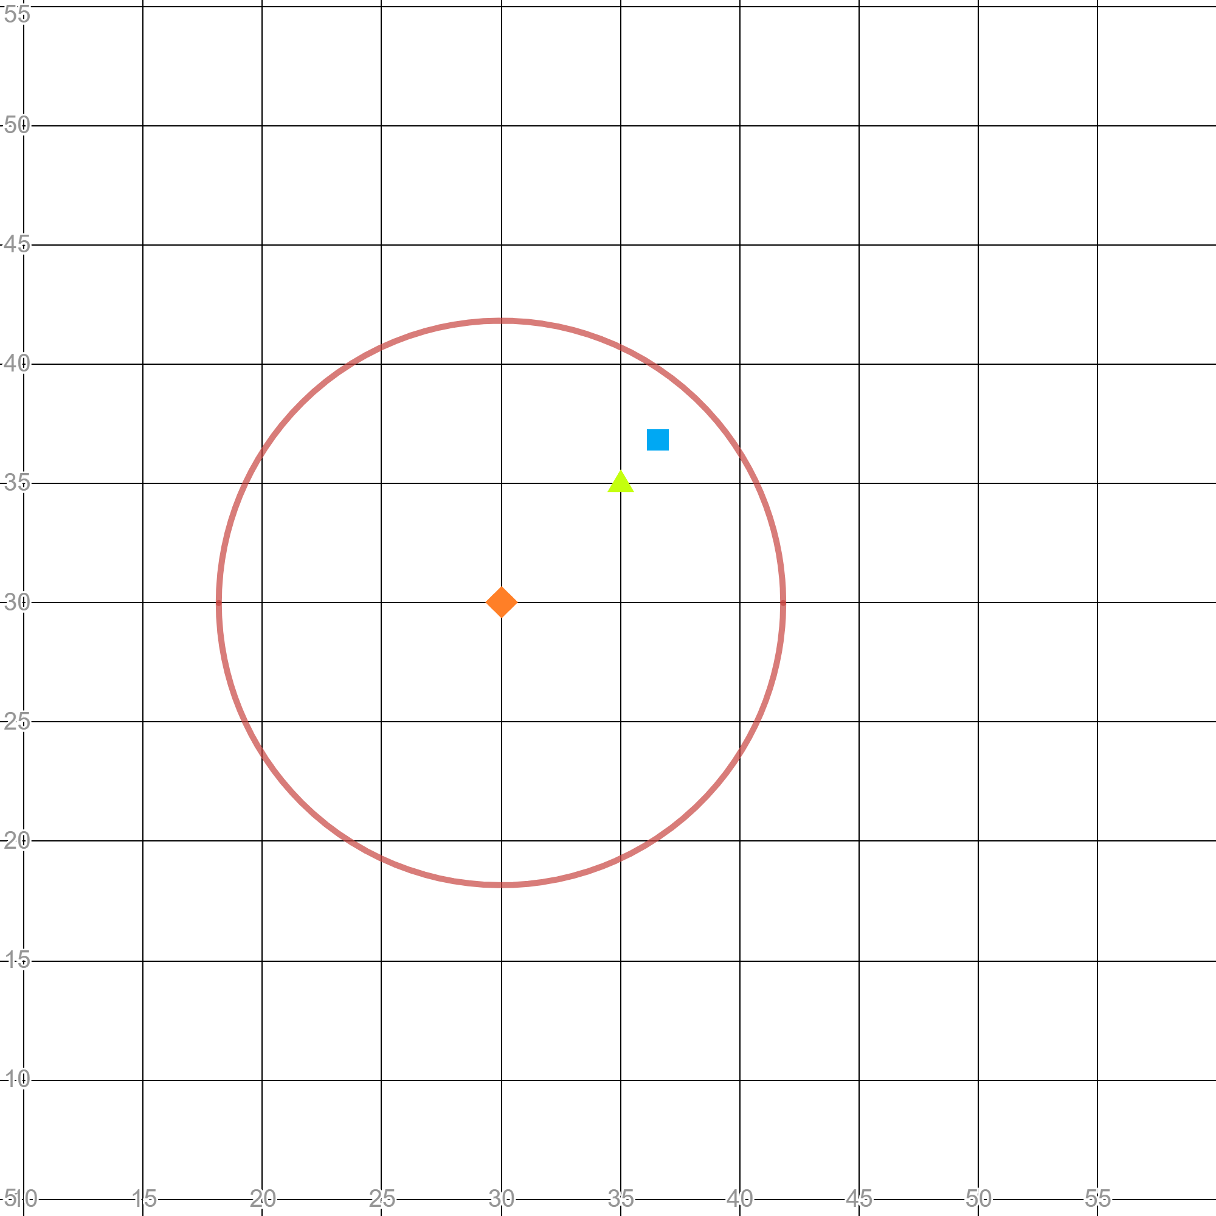
Grid Points
MSR
β(τ)
FMSR
τ
Norm Ball

Slide 3
add perturbations
Free
Fee

