Slide 1

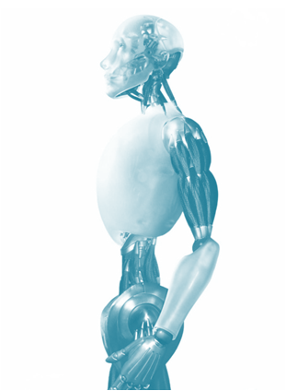

ICME 2014 – Chengdu, China(14-18 July, 2014)
High-Level Semantic Feature for 3D Shape Based on Deep Belief Network
Shuhui Bu¹, Shaoguang Cheng¹, Zhenbao Liu¹, Ke Li²
1 Northwest Polytechnical University, Xi’an, China.
2 Information Engineering University, Zhengzhou, China.

Slide 2


Outline
Backgrounds
Conclusion
Idea
Why
Experiments
how
Method
What

Slide 3
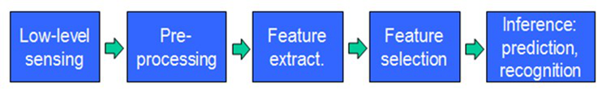
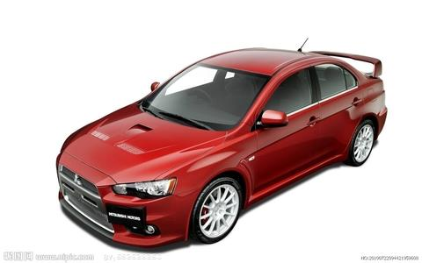
Backgrounds
Feature
Representation
Learning
Algorithm
The Key step

Slide 4
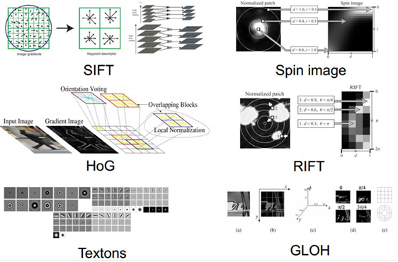
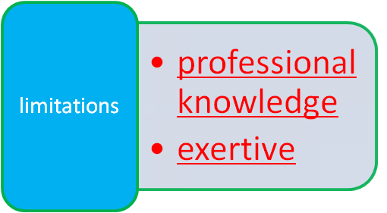
Backgrounds
Q: how do we extract features in practice?
A: specified manually . Such as SIFT, HoG ...

Slide 5
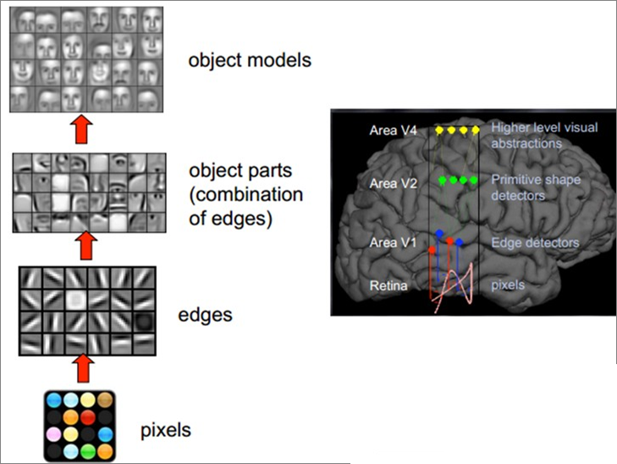
Backgrounds

Slide 6

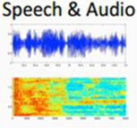

Backgrounds
NLP
Speech Recgnition
Computer Vision

Slide 7
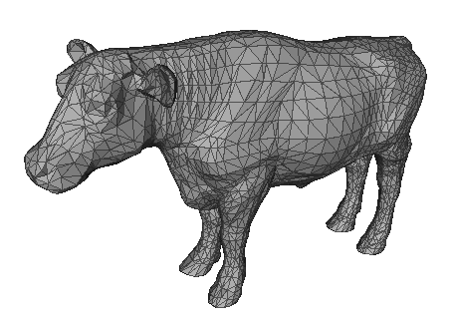
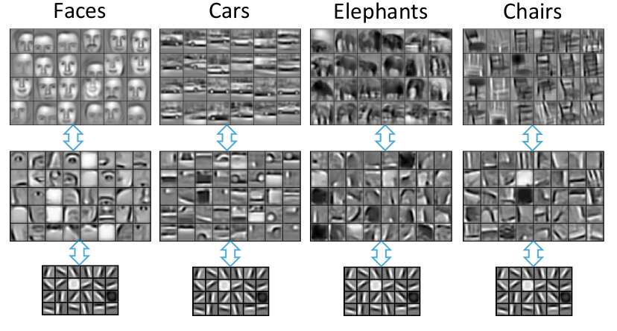
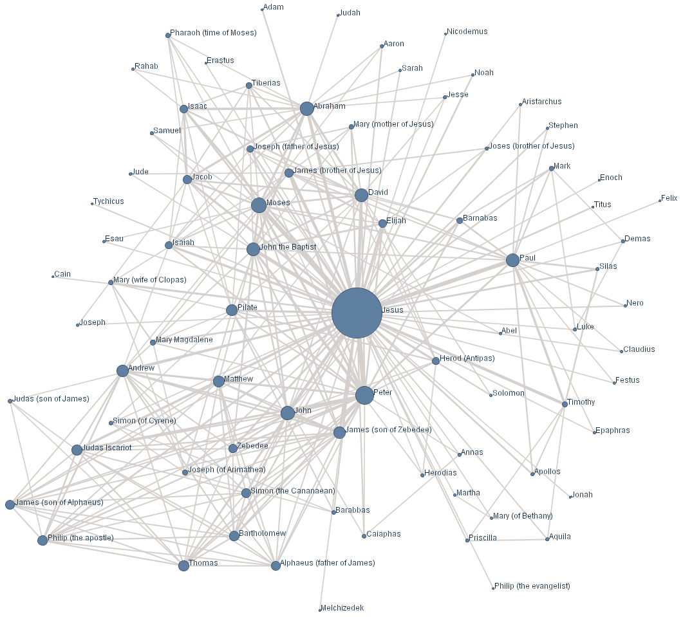
Backgrounds
Why deep learning is difficult for 3D shape (graph data)?

Slide 8

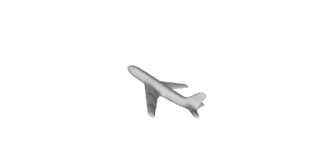




Idea – 3D feature learning framework
Deep
Learning
High-level feature
3D shape
...

Slide 9
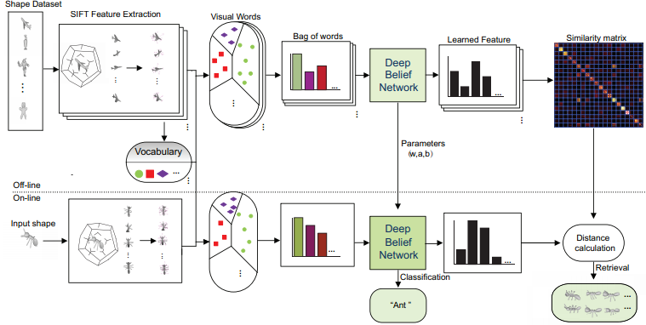
Idea – 3D feature learning framework
low-level feature
high-level feature
middle-level feature
Off-line
On-line

Slide 10
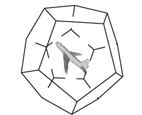
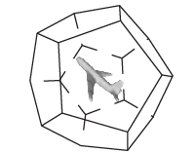
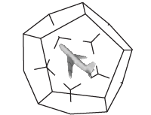
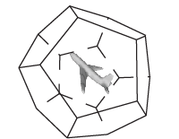
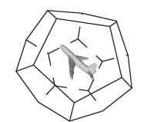
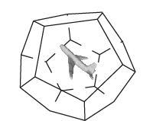
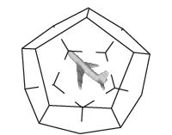
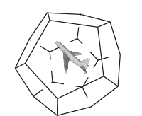
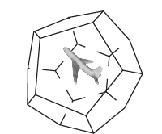
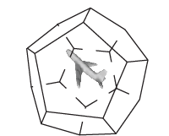
Method – Low Level Feature
view images generation
Attention:
Rotation angle must be set carefully to ensure that all cameras are distributed uniformly on a sphere.
A 3D object is represented by 10× 20 images from different views.

Slide 11

Method – Low Level Feature
SIFT feature extraction
Robust to noise and illumination and stable
to various changes of 3D viewpoints.
20 to 40 SIFT features per image. About 5000 to 7000 SIFT features for a 3D shape.
... ...
... ...

Slide 12
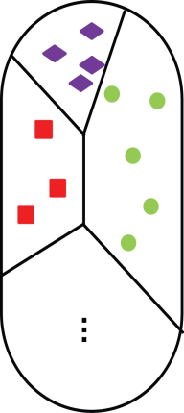

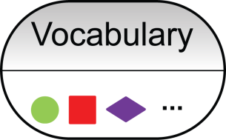
Method – Middle Level Feature
Bag-of-Visual-Feature
Visual Words
SIFT feature from all shapes
BoVF
K-means
Encode
SIFT feature from single shape
NN

Slide 13
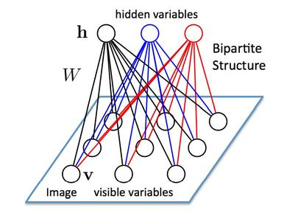


Method –Deep Belief Network
restricted Bolztman Manchine
Math model ：
joint distribution
Energy function

Slide 14
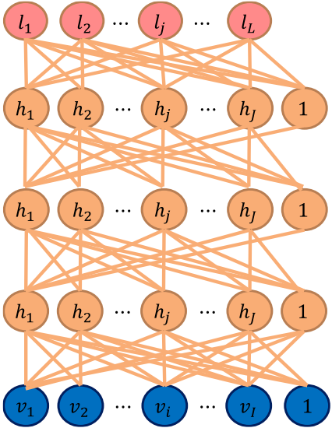
Method –Deep Belief Network
Classification
High-level feature
Stacking a number of the RBMs and learning layer by layer from bottom to top gives rise to a DBN.
The bottom layer RBM is trained with the input data of BoVF.
BoVF

Slide 15
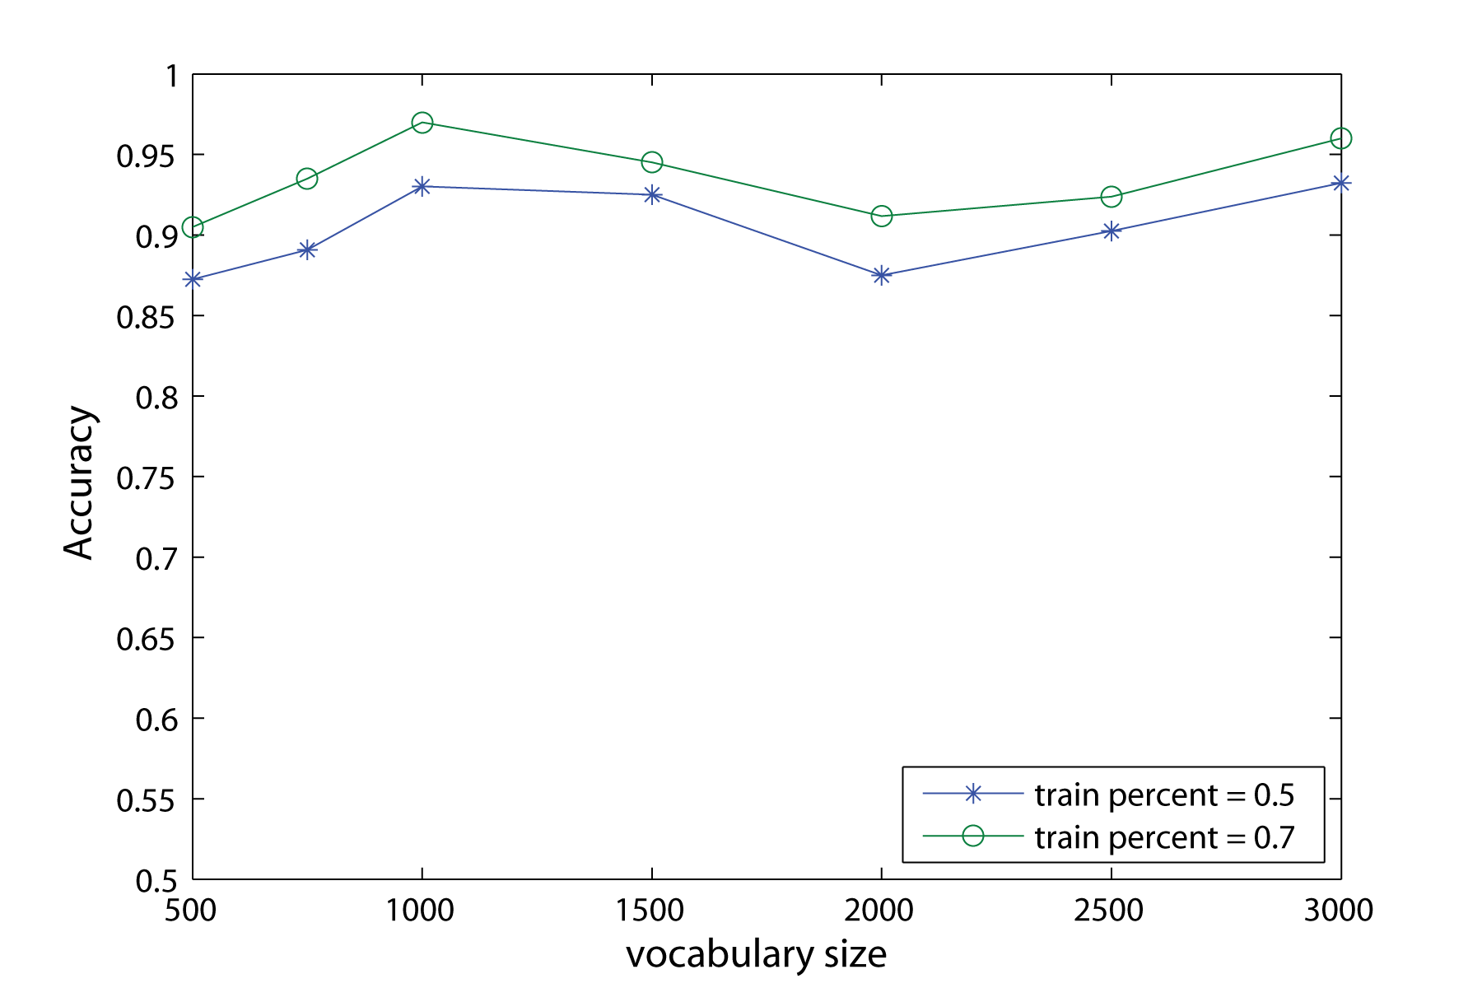
Experiments - parameters setting

Slide 16
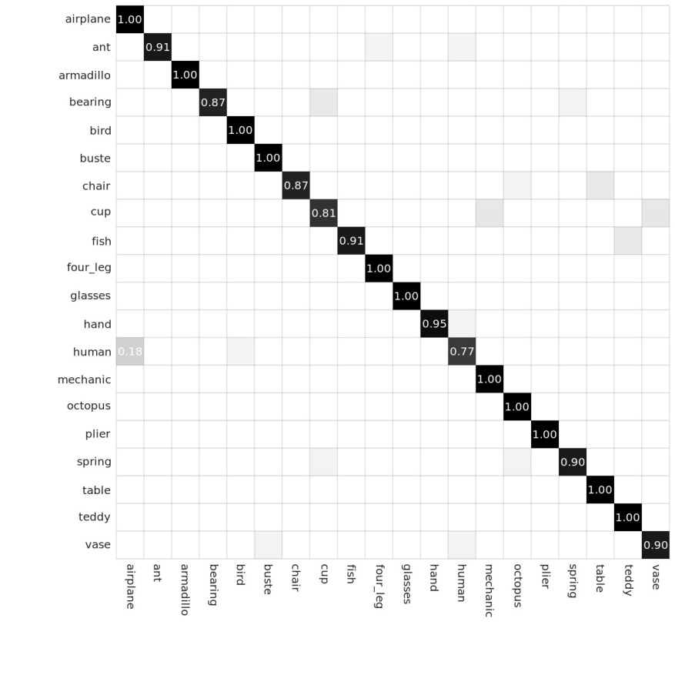
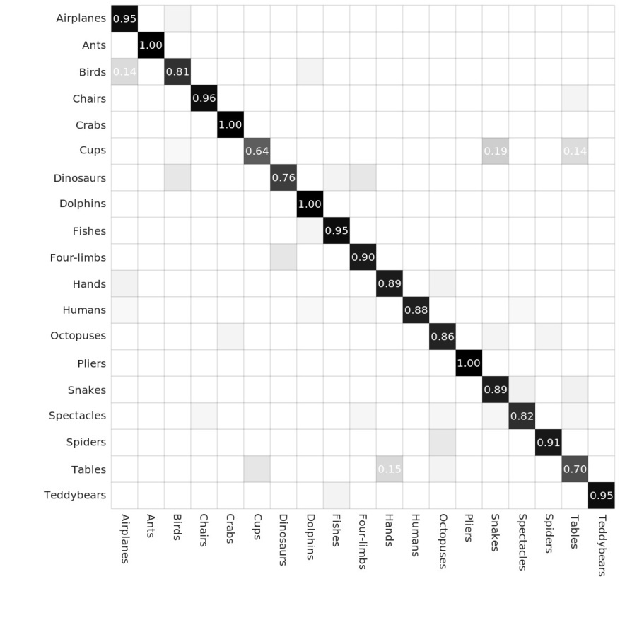
Experiments - classification
 | SHREC 2007 | McGill
BOVF | 83% | 78%
Proposed method | 93% | 89%
Classification results on SHREC 2007 (left) and McGill (right)

Slide 17
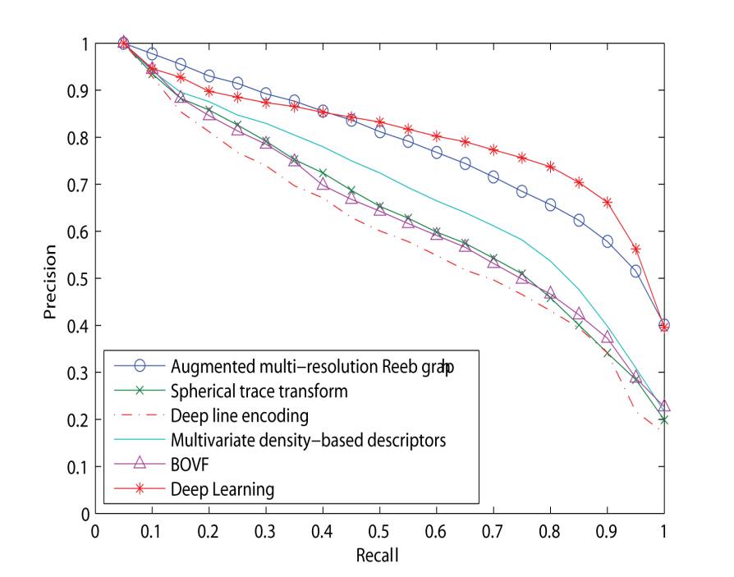

Experiments - retrieval
experiment on SHREC 2007

Slide 18
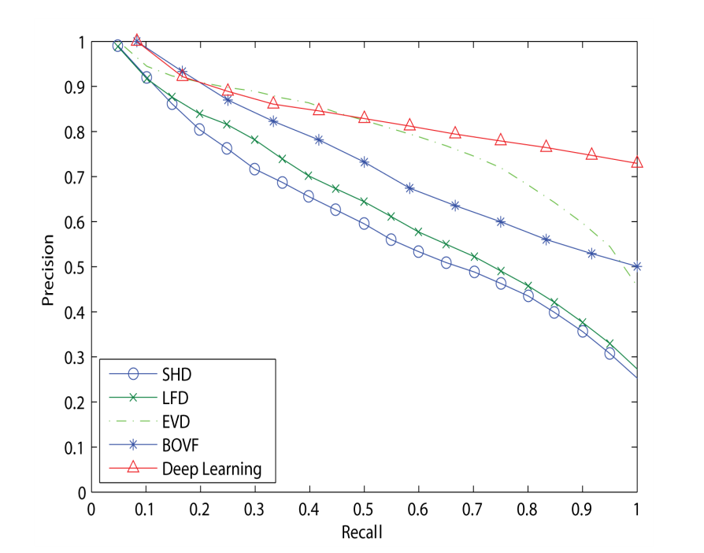

Experiments - retrieval
experiment on McGill

Slide 19
Conclusion
The experiment results demonstrate that the learned high-level features are more discriminative and can achieve better performance both on classification and retrieval tasks.
The number of view images is large.
Currently only investigate SIFT as the low-level descriptors.

Slide 20
Thank you for your attention!

