Slide 1

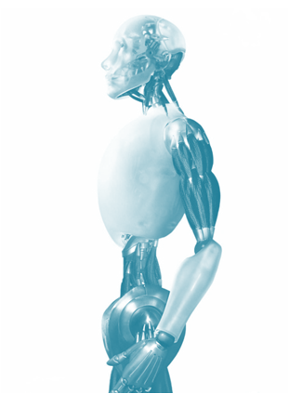

ICME 2014 – Chengdu, China(14-18 July, 2014)
Shape Analysis Using Deep Learning
Shuhui Bu¹, Shaoguang Cheng¹, Zhenbao Liu¹, Ke Li²
1 Northwest Polytechnical University, Xi’an, China.
2 Information Engineering University, Zhengzhou, China.
Notes:
Hello, everyone. My name is Shaoguang Cheng, a first year master student from northwest polytechnical university of China, today it’s my honor to be here to present my accepted paper: high-level semantic feature for 3D shape based on deep belief network.

Slide 2


Outline
Backgrounds
Conclusion
Idea
Why
Experiments
how
Method
What
Notes:
This is the outline of my presentation. I will show you the backgrounds, why we can come up with the idea, what our method is, how to validate our idea with experiments and finally make conclusions

Slide 3
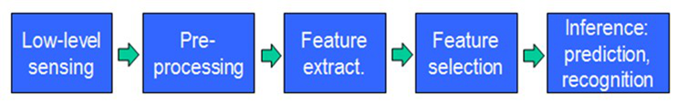

Backgrounds
Feature
Representation
Learning
Algorithm
The Key step
Notes:
At first, I will introduce you some backgrounds about our paper.
(As all we known, machine learning has made great progress in recent years, but there are still lots of challenges.)
Generally, when we use machine learning methods to solve a practical problem, these steps are always needed.
The above procedure can be concluded as : for an input object, we need to obtain its feature representation, and then a learning algorithm is employed to learn the information we care about.
Among these procedures, feature representation is a key step which decide the final result to a large extent.

Slide 4
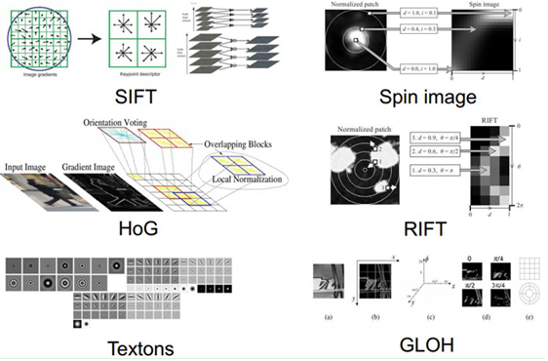
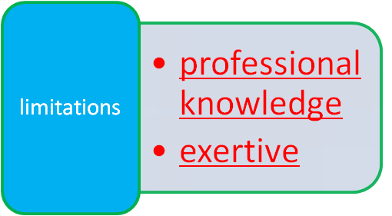
Backgrounds
Q: how do we extract features in practice?
A: specified manually . Such as SIFT, HoG ...
Notes:
So we may ask the question naturally. For example, how do we extract feature in practice? The answer is that it’s always specified manually. Such as SIFT, Spin image, HoG and so on. But this way to extract features needs lots of professional knowledge and is very exertive.
So we may ask “does there exsits a method that can extract features automatically?”, the answer is YES and That’s just what Deep learning can do.

Slide 5
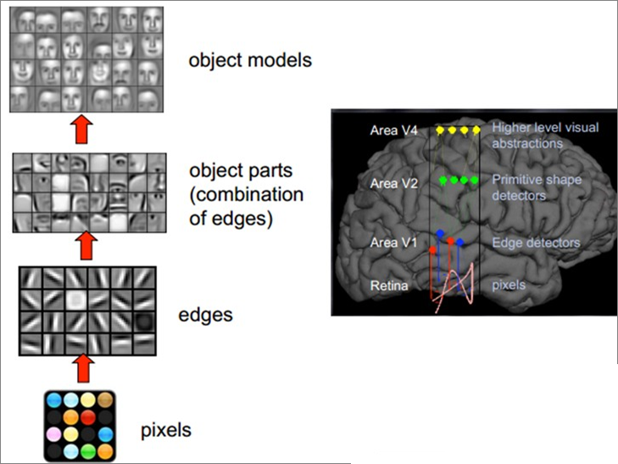
Backgrounds
Notes:
Deep learning is also called Unsupervised Feature Learning. It simulates the process that our brain cognizes things.
But how do our brains do with feature ? From researches of brain, we can get that the mammal brain is organized in a deep architecture which process the input information at multiple levels of abstraction. just like the right part of the picture.
Similar to the brain, deep learning processes information hierarchically. For example, the input pixels of a face image are recognized as edge, object patrs sequentially. Finally after several abstraction, deep learning can tell you whose face it is.
So the deep learning can extract deep structure correlations of input data.

Slide 6

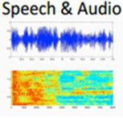

Backgrounds
NLP
Speech Recgnition
Computer Vision
Notes:
Currently,deep learning has been studied in natural language processing, speech recognition, image processing, and computer vision, demonstrating much better performace.
Inspired by the success of deep learning in these domains, in this research, we try to seek for the possibility to apply deep learning into 3D shape field.

Slide 7
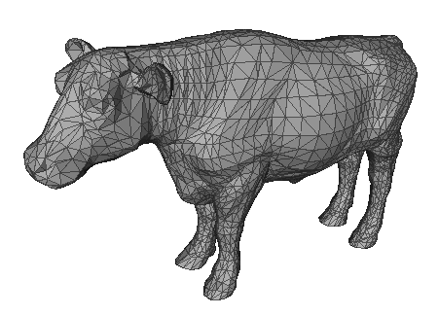
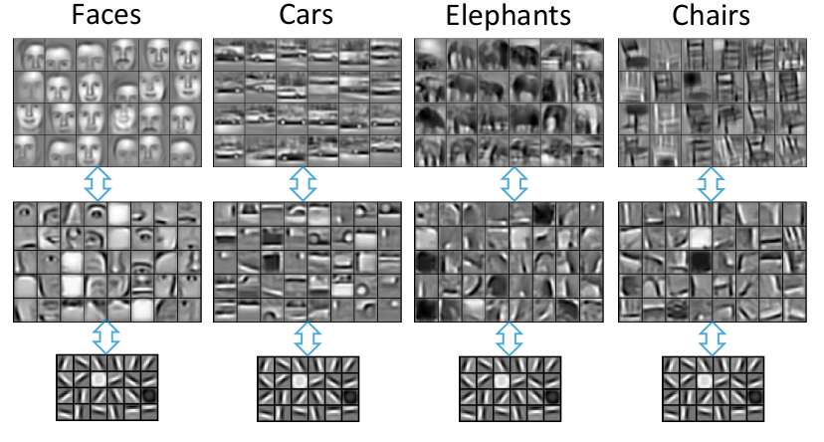
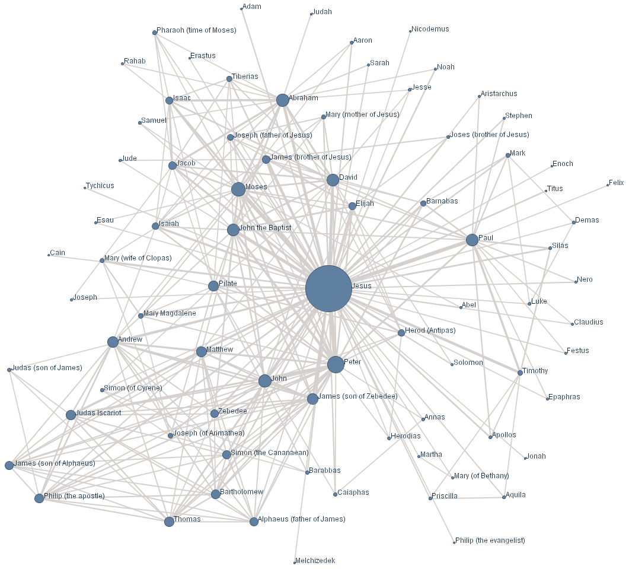
Backgrounds
Why deep learning is difficult for 3D shape (graph data)?
Notes:
However, due to the intrinsic differences between the structure of 3D shape data and speech data or images, we can not apply the techniques that have been mature in these realms to 3D shape directly.
Look at the picture, we can see for images, the hierarchy information is obvious. So it’s suitable for deep learning to learn the deep structure inforation. While for 3D shape, the topology structure plays the leading role. The hierarchy information is not obvious. Therefore, deep learning is difficult for 3D shape.

Slide 8

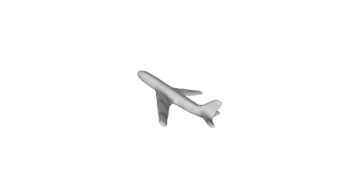




Idea – 3D feature learning framework
Deep
Learning
High-level feature
3D shape
...
Notes:
So how can we solve this problem and connect the 3D shape and the deep learning?
In this work, we propose a novel framework which builds a bridge between 3D shape and deep learning. The core idea is to extract
bag-of-visual-features (BoVF) from multi-views of the shapes, and then generate high-level features for 3D shape retrieval via deep learning.

Slide 9
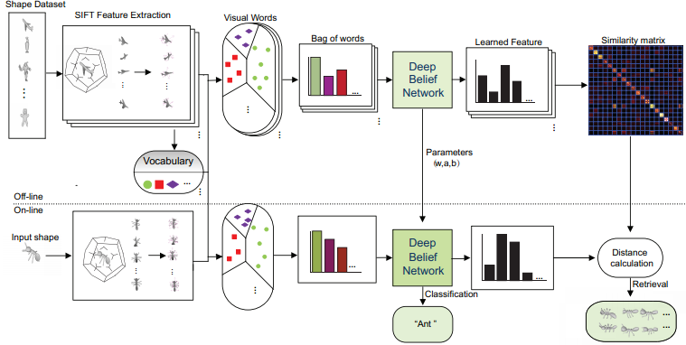
Idea – 3D feature learning framework
Notes:
This is the flowchart of our proposed method.
The upper part shows the off-line training process which learns a model. The lower part demonstrates when a new 3D shape is given, how the model classifies it and retrieves shapes like it.
The left shows the low-level feature extraction, we choose SIFT as the low-level descriptor in our algorithm. The middle part displays the middle-level features generation process and the left exhibits how we obtain high-level features through deep learning.
This part demonstrates the classification and retrieval process in our framework.
The whole process is just like this and I will introduce each part detailly in the following.

Slide 10
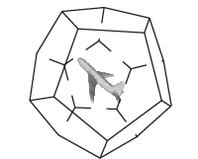
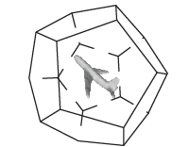
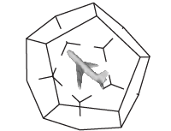
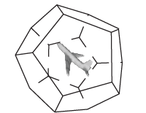
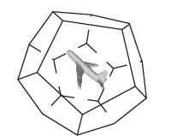
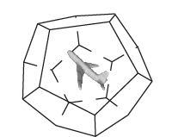
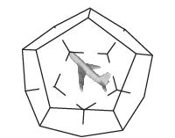
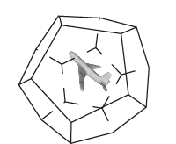
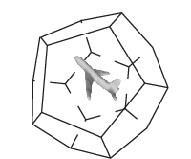
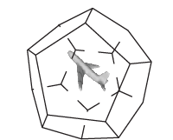
Method – Low Level Feature
view images generation
Attention:
Rotation angle must be set carefully to ensure that all cameras are distributed uniformly on a sphere.
A 3D object is represented by 10× 20 images from different views.
Notes:
let us see how we extract the low level feature for 3D shape. We need to generate view images at first.
In this research, view images are rendered from 20 vertices of a regular dodecahedron. Imagine that we place a camera at each vertice of dodecahedron, then we can capture 20 images from different views.
Moreover, to make the feature robust for rotation, we rotate the dodecahedron 10 times and extract views at vertices of dodecahedron. The rotation angle must be set carefully to ensure that all the cameras are distributed uniformly and able to cover different viewing angles for a 3D model. Hence a 3D object is represented by 200 view images.

Slide 11

Method – Low Level Feature
SIFT feature extraction
Robust to noise and illumination and stable
to various changes of 3D viewpoints.
20 to 40 SIFT features per image. About 5000 to 7000 SIFT features for a 3D shape.
... ...
... ...
Notes:
After view-images are rendered, we extract SIFT features on each view-image. We use the default parameters for visual feature extraction, thus the output feature vector has a dimension of 128.
The SIFT descriptor is designed to be robust to noise and illumination changes of images, moreover, it is stable to various
changes of 3D viewpoints which can do some compensation for lack of rotation normalization.
(
According to our experiments, SIFT features’ number vary from 20 to 40 due to the different content of every view image. Finally, a 3D model is approximately represented with up to 5000-7000 SIFT features.)

Slide 12
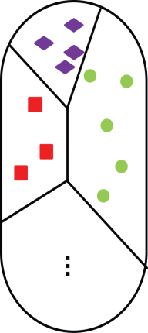

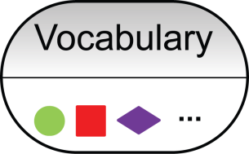
Method – Middle Level Feature
Bag-of-Visual-Feature
Visual Words
SIFT feature from all shapes
BoVF
K-means
Encode
SIFT feature from single shape
NN
Notes:
Next, we compute the middle-level feature, bag of visual feature, which can also be called BoVF.
We first learn the vocabulary with K-means via clustering the features collected from every view of every model into a specified vocabulary size. Then each SIFT feature extracted from 3D models is coded as a visual word through searching for the nearest neighbor in the vocabulary.
After feature encoding, frequencies of words generated from a shape are accumulated into a histogram which becomes a feature vector, called BoVF, for each 3D model.

Slide 13
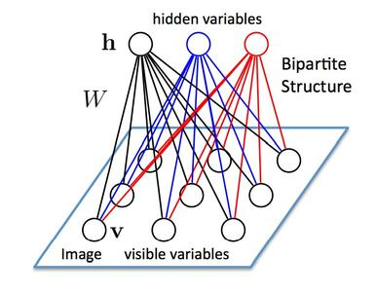


Method –Deep Belief Network
restricted Bolztman Manchine
Math model ：
joint distribution
Energy function
Notes:
After the BoVF is obtained, we employ Deep Belief Network to learn high-level features for 3d shape.
A DBN can be viewed as a composition of simple learning structure. This simple learning module is called restricted Boltzmann machines (RBMs) that we introduce next.
An RBM has one layer of hidden units and one layer of visible units and can be represented as undirected graphs, where all visible units are connected to all hidden units, and there are no visible-visible or hidden-hidden connections.
It has been proved that the math model of RBM can be solved by using maximum likelihood estimation and contrastive divergence (CD) algorithm.
(
A practical guide of the RBM training is provided in the paper “A Practical Guide to Training RBM” by Hinton in 2010.
)

Slide 14
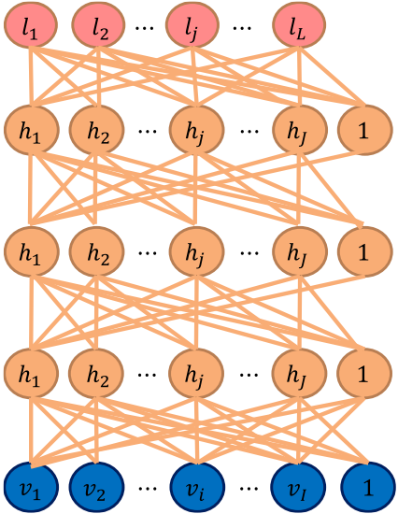
Method –Deep Belief Network
Classification
High-level feature
Stacking a number of the RBMs and learning layer by layer from bottom to top gives rise to a DBN.
The bottom layer RBM is trained with the input data of BoVF.
BoVF
Notes:
Stacking a number of the RBMs and learning layer by layer from bottom to top gives rise to a DBN. It has been shown that the layer-by-layer greedy learning strategy is effective.
In our work, the bottom layer RBM is trained with the input data of BoVF.
( and the activation probabilities of hid-den units are treated as the input data for training the upper-layer RBM. The activation probabilities of the second-layer RBM are then used as the visible data input for the third-layer RBM, and so on.)
And the last layer’s output is used as the high-level features. For retrieval task, L2 distance of the high-level features is used to measure the similarity of two shapes. In the classification, we should add an extra Softmax layer for one-vs-all task .

Slide 15
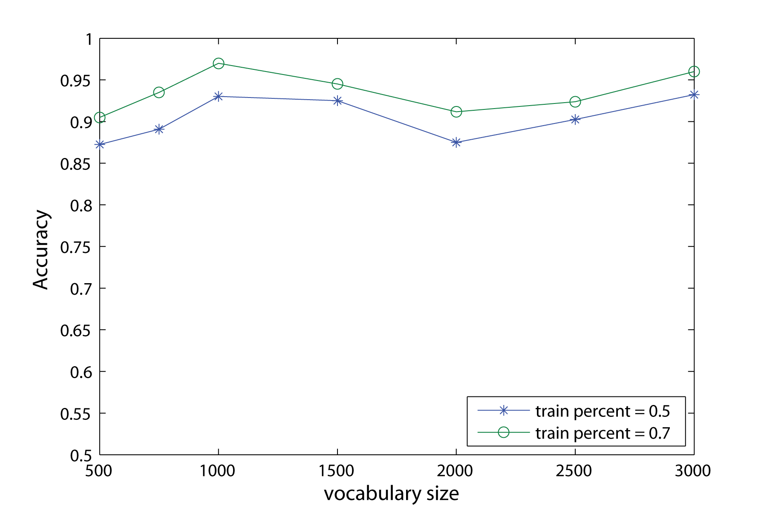
Experiments - parameters setting
Notes:
For evaluating the proposed method, we conduct two experiments: shape classification and retrieval.
According to the above method, we can find that the vocabulary size directly affects the performance of the feature.
Thus, we should do several experiments to decide the optimal value of the vocabulary size.
We construct four layers for DBN including input and output layers. The number of nodes in each hidden layer is empirically set to be 1000, 800. We set the vocabulary size from 500 to 3000 respectively, and obtain different results, which is shown in Figure.
As can be seen, generally, small vocabulary leads to lower classification accuracy. Although larger vocabulary size achieves better performance, the calculation time of the visual features increases rapidly, which causes low computation performance. Therefore, an optimal words number of 1000 is selected for the following experiments.

Slide 16
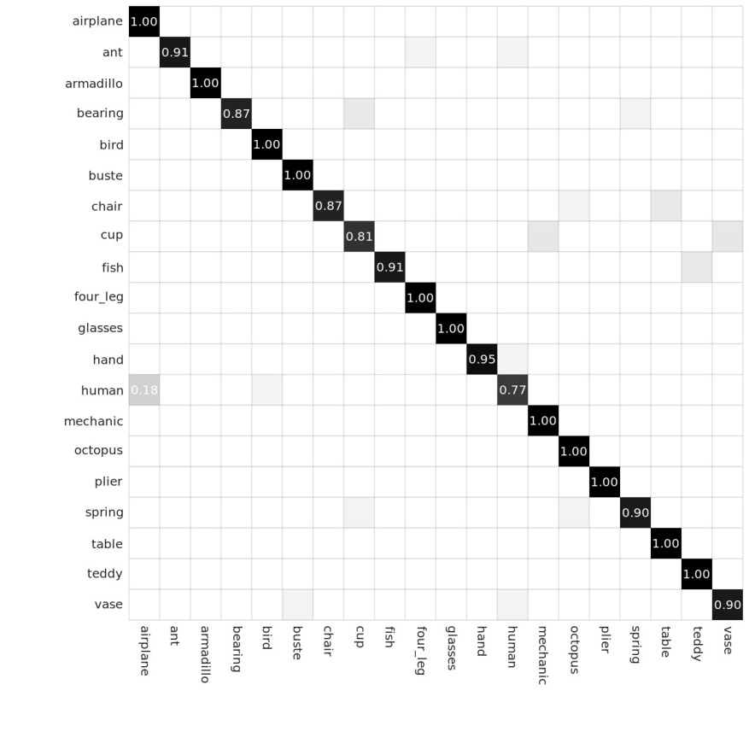
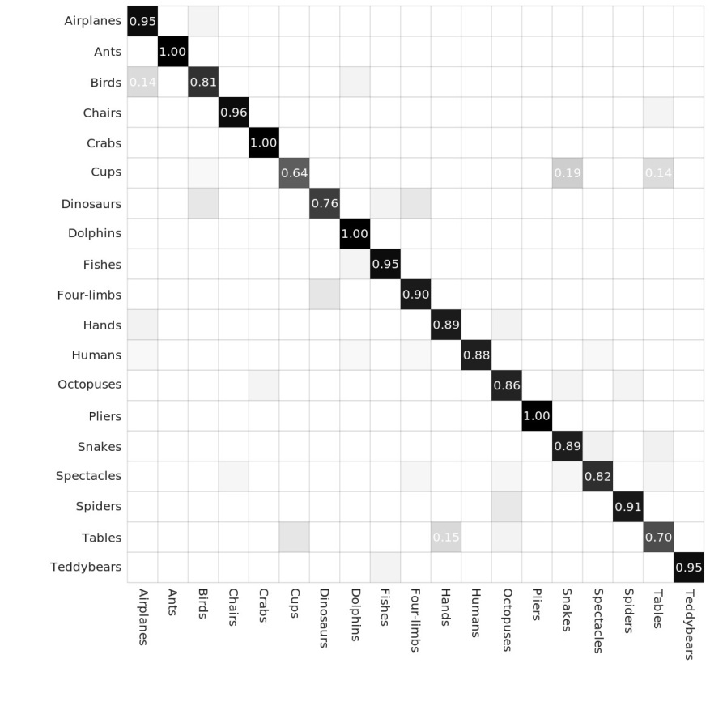
Experiments - classification
 | SHREC 2007 | McGill
BOVF | 83% | 78%
Proposed method | 93% | 89%
Classification results on SHREC 2007 (left) and McGill (right)
Notes:
In the classification experiments, we randomly select 50% models in each category as training samples, and left models as test data.
The classification result is shown in figure.The average classification accuracies of the proposed method on SHREC 2007 and McGill dataset are 93% and 89%, respectively.
From the results, we can conclude that the high-level feature which extracted by the deep network can achieve much higher recognition accuracy, and therefore the high-level feature is more discriminative.

Slide 17
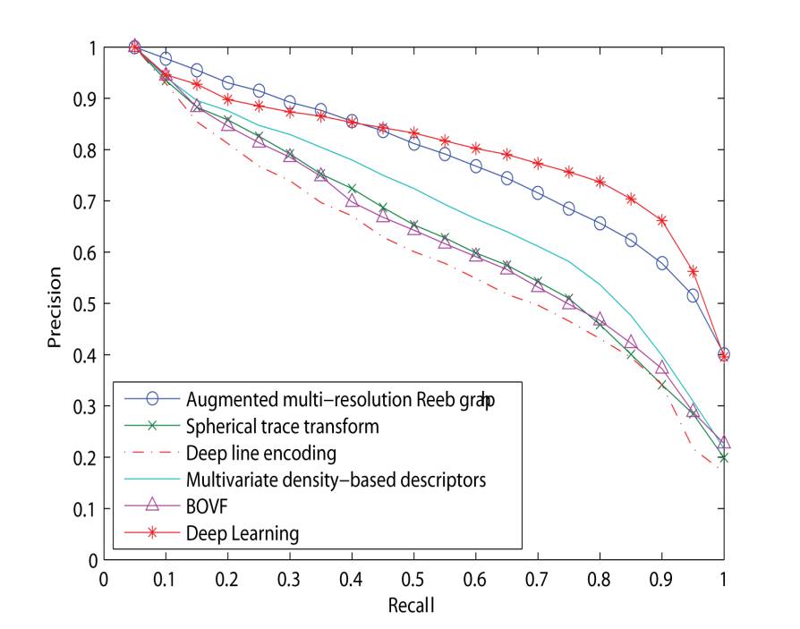

Experiments - retrieval
experiment on SHREC 2007
Notes:
We also conduct the retrieval experiments.
First, we use the SHREC 2007 dataset to evaluate the retrieval performance of the proposed method.
The recall-precision curves of some state-of-the-art methods and proposed method are plotted in figure. From the figure, we can see that the proposed method achieves better overall retrieval performance.
From the table, we can conclude all the measures have great improvements from using BoVF to high-level features. The improvement of DCG index is 6.84%, which demonstrates that the proposed method has the capability to improve retrieval performance by using high-level features

Slide 18
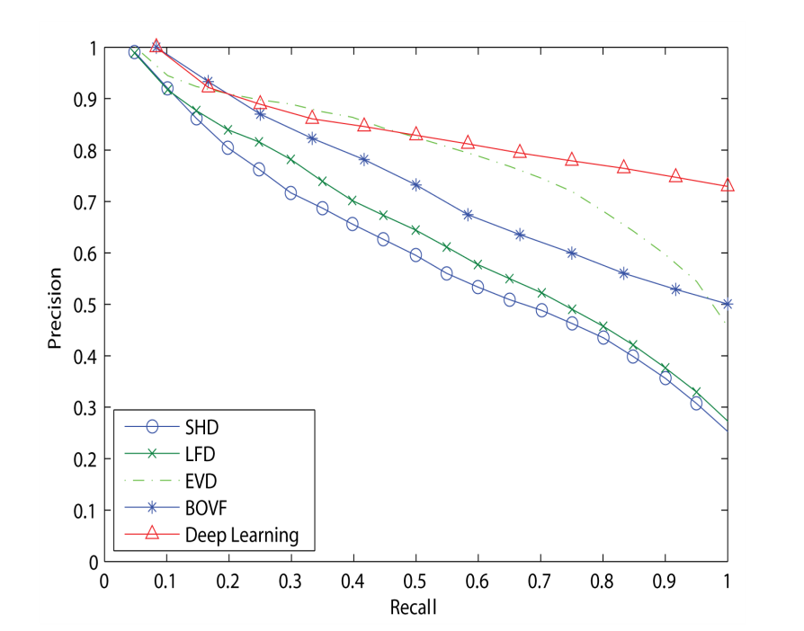

Experiments - retrieval
experiment on McGill
Notes:
In order to assess the robustness of the proposed method, we also perform retrieval experiment on McGill dataset and the result is shown in the figure.
from the figure and table, we can see that the average retrieval performance of the proposed high-level features is superior than other methods.

Slide 19
Conclusion
The experiment results demonstrate that the learned high-level features are more discriminative and can achieve better performance both on classification and retrieval tasks.
The number of view images is large.
Currently only investigate SIFT as the low-level descriptors.
Notes:
Ok, let’s conclude the whole process. The above experiment results demonstrate that the learned high-level features are more discriminative and have better performance both on classification and retrieval tasks
But there are also some limitation :
1. In low-level feature generation step, we capture 200 view images for each 3D shape. To extract SIFT features from these view images are time-consuming. Therefore we need to seek a better strategy to reduce the the number of view images.
2. At present we only investigate SIFT as the low-level descriptors, although promising results are obtained, better retrieval and recognition performance may be achieved by using other visual descriptors or sampling scheme.

Slide 20
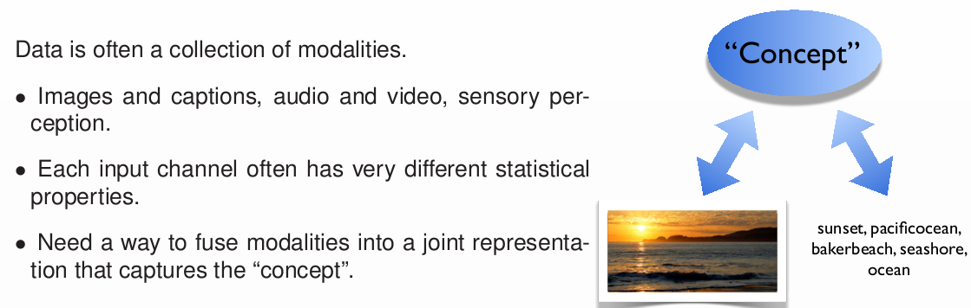
Multimodal Property

Slide 21
Multimodal Property for 3D Shape
3D shape
appearance
structure
...
SIHKS, AGD, ...
View-based modality
Geometric-based modality

Slide 22
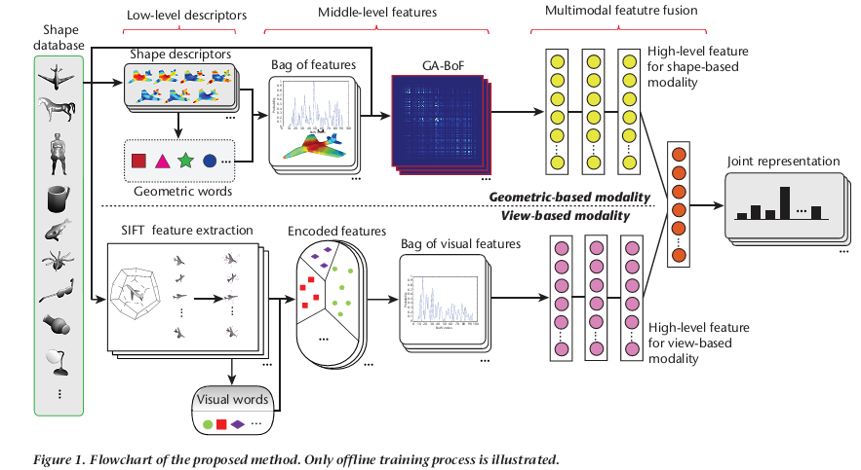
Multimodal Feature Fusion for 3D shape

Slide 23
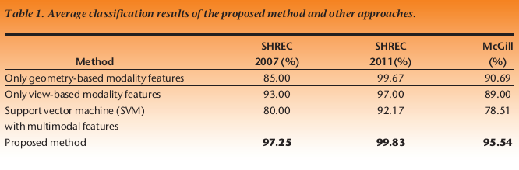
Experiments - classification

Slide 24
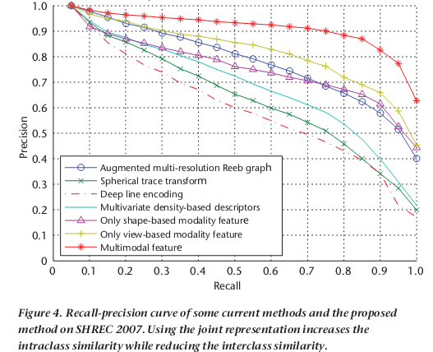
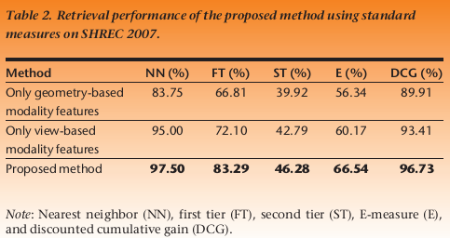
Experiments - retrieval

Slide 25
Thank you for your attention!

