Slide 1






















$$f_{6}(x)$$
$$f_{7}(x)$$
$$6$$
$$7$$
$$f_{1}(x)$$
$$1$$
$$f_{3}(x)$$
$$11$$
$$3$$
$$8$$
$$f_{11}(x)$$
$$f_{8}(x)$$
$$2$$
$$f_{2}(x)$$
$$f_{10}(x)$$
$$10$$
$$4$$
$$f_{4}(x)$$
$$5$$
$$9$$
$$f_{5}(x)$$
$$f_{9}(x)$$

Slide 2



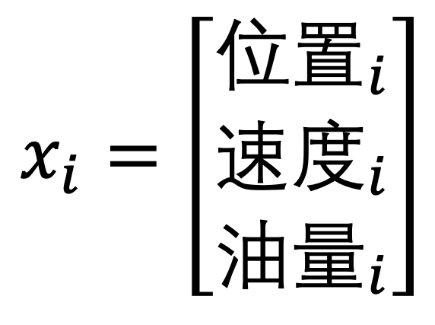
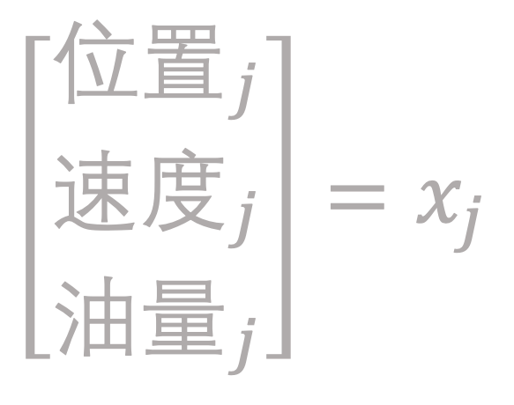

$$x_{i}=\left[\begin{matrix}位置_{i} \\ 速度_{i} \\ 油量_{i}\end{matrix}\right]$$
$$\left[\begin{matrix}位置_{j} \\ 速度_{j} \\ 油量_{j}\end{matrix}\right]=x_{j}$$
$$i$$
$$j$$

