Slide 1
Minimizing Congestion in Multi-Commodity Routing
Speaker: Chih-Hang Wang

Slide 2
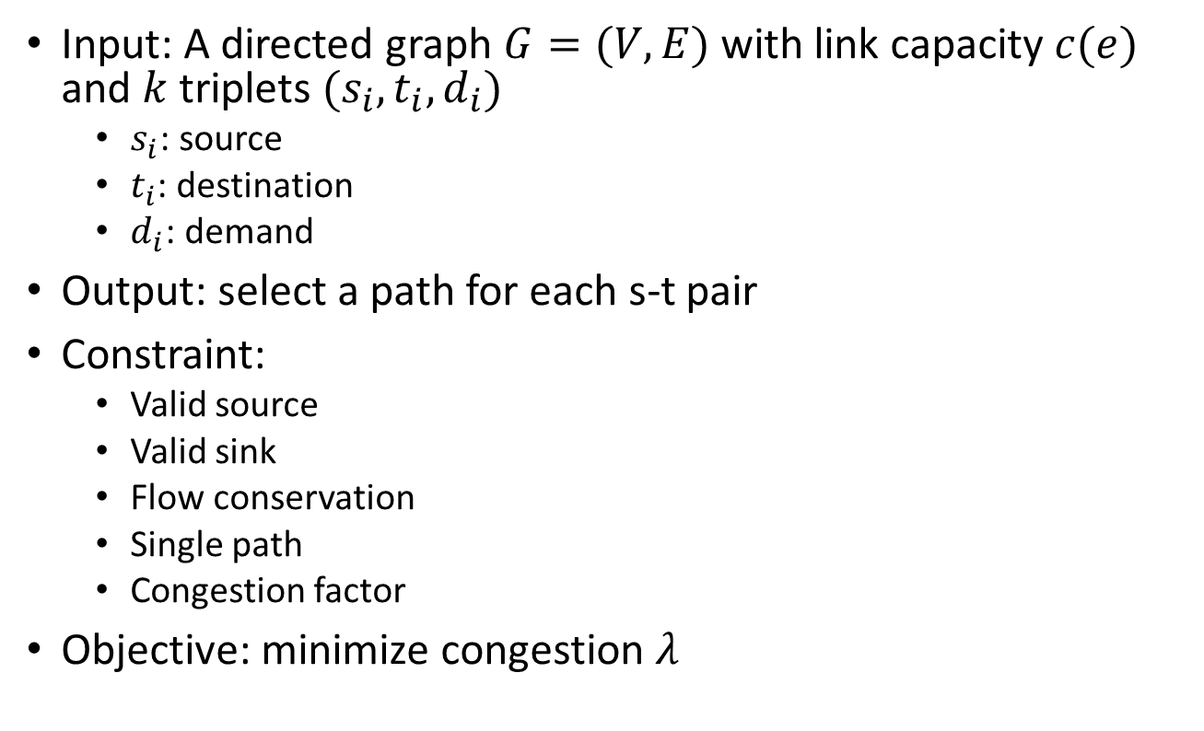
Problem Formulation
Input: A directed graph $G=(V,E)$ with link capacity $c(e)$ and $k$ triplets $(s_{i}, t_{i}, d_{i})$
$s_{i}$: source
$t_{i}$: destination
$d_{i}$: demand
Output: select a path for each s-t pair
Constraint:
Valid source
Valid sink
Flow conservation
Single path
Congestion factor
Objective: minimize congestion $λ$

Slide 3
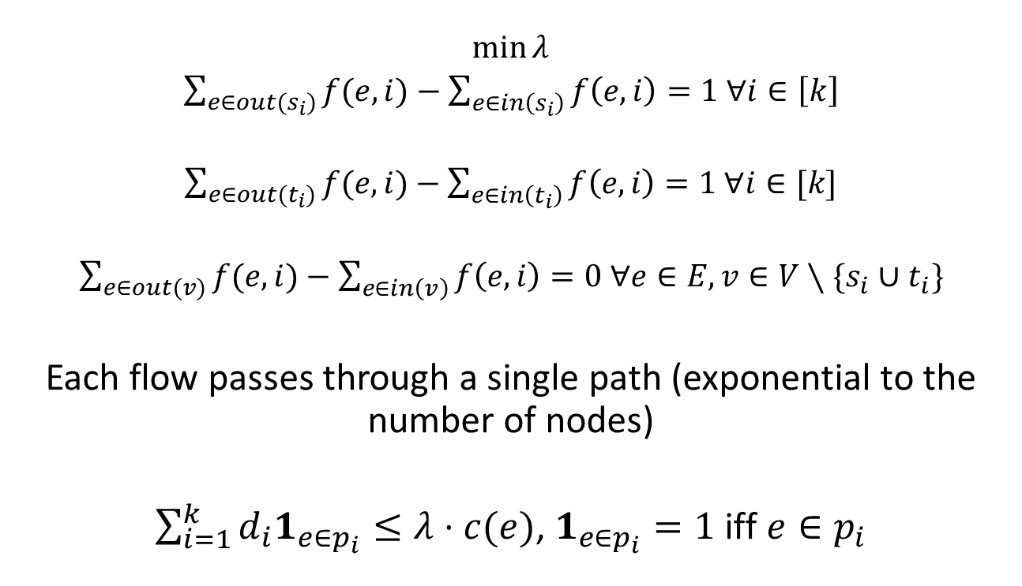
Problem Formulation
$\min{λ}$
$\sum_{e∈out(s_{i})}{f(e,i)}−\sum_{e∈in\left(s_{i}\right)}{f\left(e,i\right)}=1 ∀i∈\left[k\right]$
$\sum_{e∈out(t_{i})}{f(e,i)}−\sum_{e∈in\left(t_{i}\right)}{f\left(e,i\right)}=1 ∀i∈[k]$
$\sum_{e∈out(v)}{f(e,i)}−\sum_{e∈in\left(v\right)}{f\left(e,i\right)}=0 ∀e∈E, v∈V∖\{s_{i}∪t_{i}\}$
Each flow passes through a single path (exponential to the number of nodes)
$\sum_{i=1}^{k}{d_{i}1_{e∈p_{i}}}≤λ⋅c(e)$, $1_{e∈p_{i}}=1$ iff $e∈p_{i}$

Slide 4

$k=3, d_{1}=d_{2}=d_{3}=10$

Slide 5
$k=3, d_{1}=d_{2}=d_{3}=10$

Slide 6
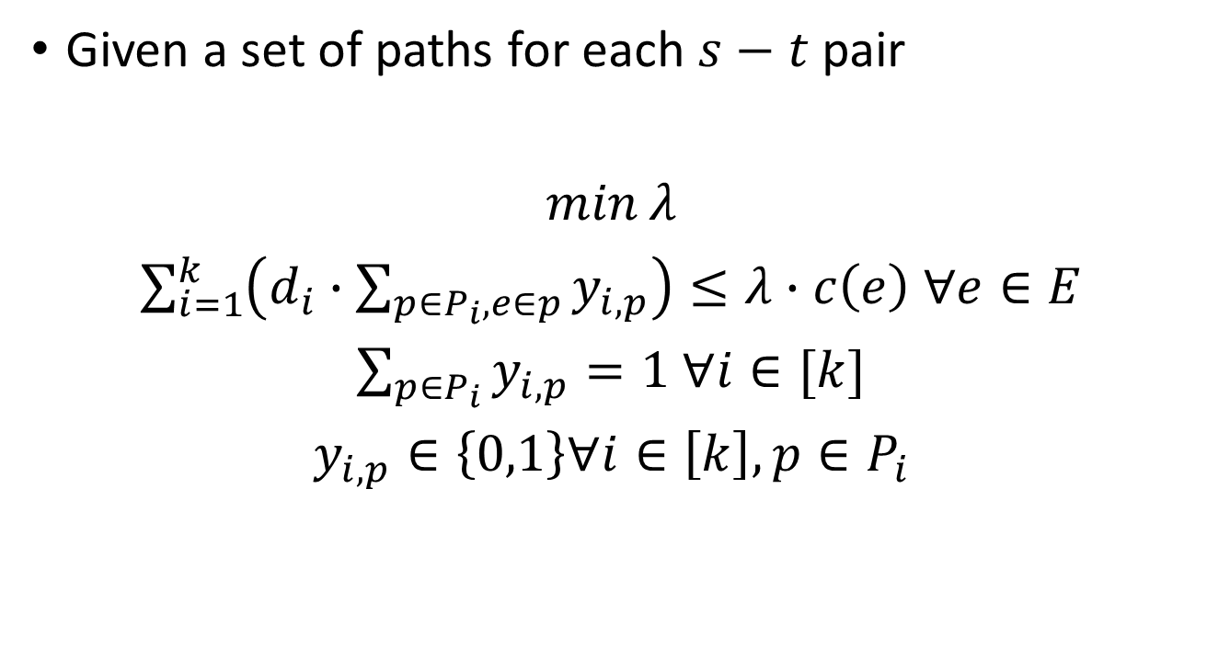
Special Case
Given a set of paths for each $s−t$ pair
$\min{λ}$
$\sum_{i=1}^{k}{\left(d_{i}∙\sum_{p∈P_{i}, e∈p}{y_{i,p}}\right)}≤λ∙c\left(e\right) ∀e∈E$
$\sum_{p∈P_{i}}{y_{i,p}}=1 ∀i∈[k]$
$y_{i,p}∈\left\{0,1\right\}∀i∈\left[k\right],p∈P_{i}$

Slide 7
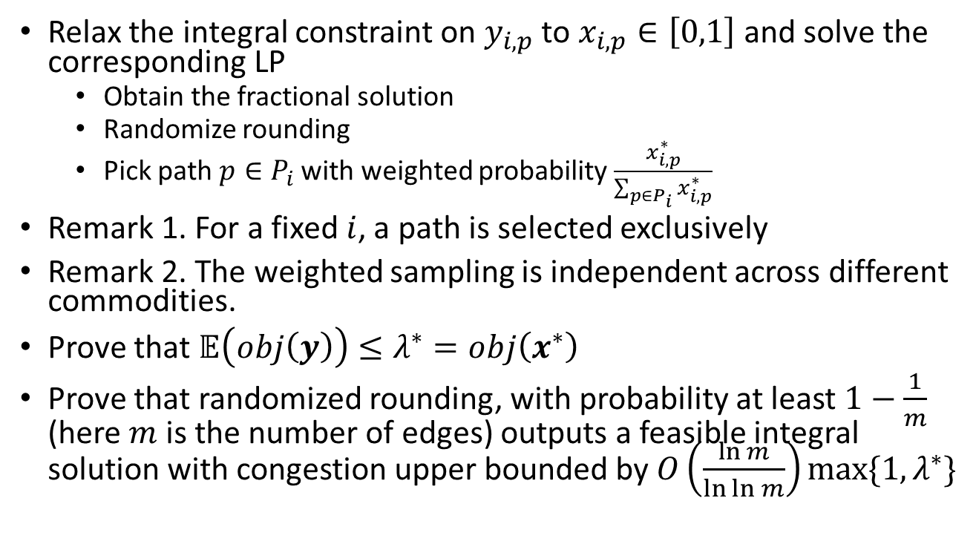
Special Case -Idea
Relax the integral constraint on $y_{i,p}$ to $x_{i,p}∈\left[0,1\right]$ and solve the corresponding LP
Obtain the fractional solution
Randomize rounding
Pick path $p∈P_{i}$ with weighted probability $\frac{x_{i,p}^{∗}}{\sum_{p∈P_{i}}{x_{i,p}^{∗}}}$
Remark 1. For a fixed $i$, a path is selected exclusively
Remark 2. The weighted sampling is independent across different commodities.
Prove that $𝔼\left(obj\left(y\right)\right)≤λ^{∗}=obj\left(x^{∗}\right)$
Prove that randomized rounding, with probability at least $1−\frac{1}{m}$ (here $m$ is the number of edges) outputs a feasible integral solution with congestion upper bounded by $O\left(\frac{\ln{m}}{\ln{\ln{m}}}\right)\max{\{1,λ^{∗}\}}$

Slide 8

General Case -Idea
Solve flow-based ILP
Randomize rounding
By similar arguments, we get a $O\left(\frac{\ln{m}}{\ln{\ln{m}}}\right)$-approximation algorithm.

