Slide 1
Probabilistic tree embedding

Slide 2
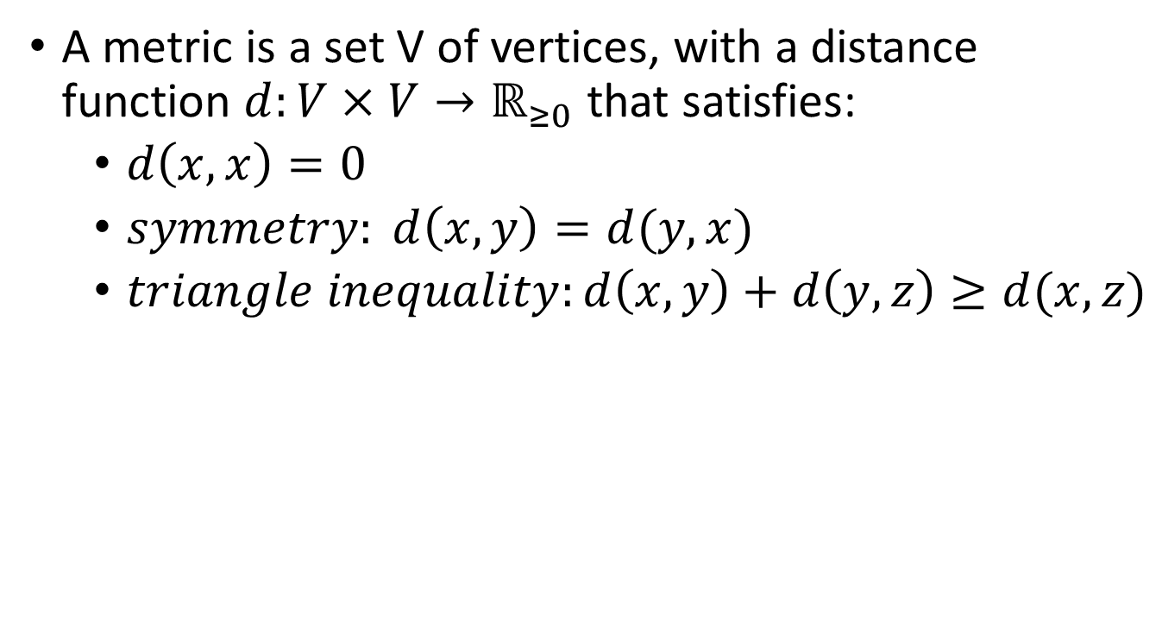
Metric spaces
A metric is a set V of vertices, with a distance function $d:V×V→ℝ_{≥0}$ that satisfies:
$d\left(x,x\right)=0$
$symmetry: d\left(x,y\right)=d(y,x)$
$triangle inequality:d\left(x,y\right)+d\left(y,z\right)≥d(x,z)$

Slide 3
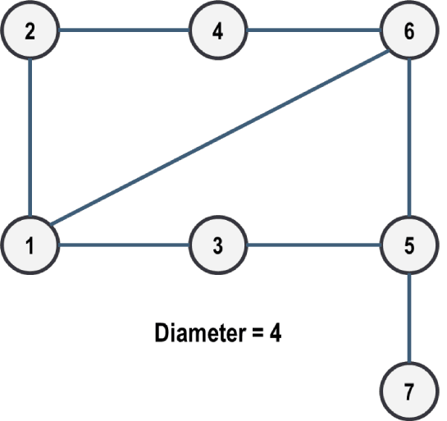
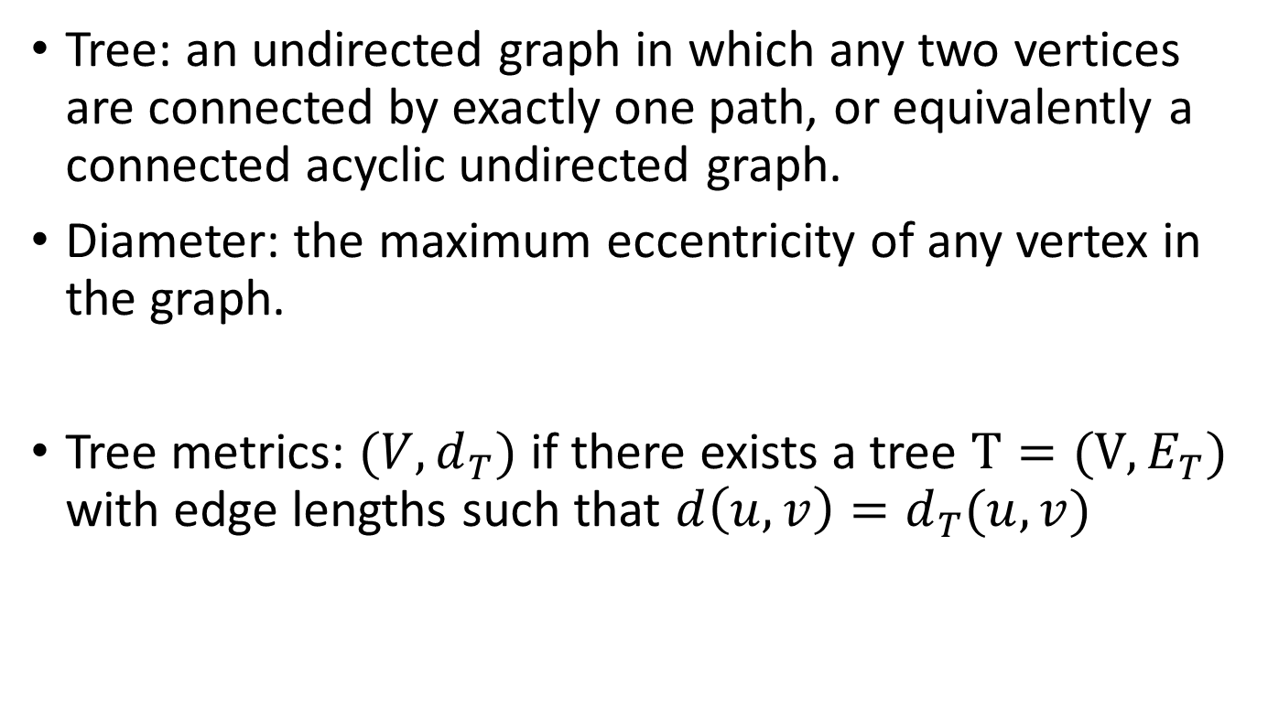
Tree metrics
Tree: an undirected graph in which any two vertices are connected by exactly one path, or equivalently a connected acyclic undirected graph.
Diameter: the maximum eccentricity of any vertex in the graph.
Tree metrics: $(V,d_{T})$ if there exists a tree $T=(V,E_{T})$ with edge lengths such that $d\left(u,v\right)=d_{T}(u,v)$
Notes:
A special kind of metric spaces
Graphical models on trees have many nice properties
exponential families with explicit formulas for the MLE
dynamic programming for efficient computation of various
probabilistic quantities
Making some of the variables hidden gives greater flexibility

Slide 4
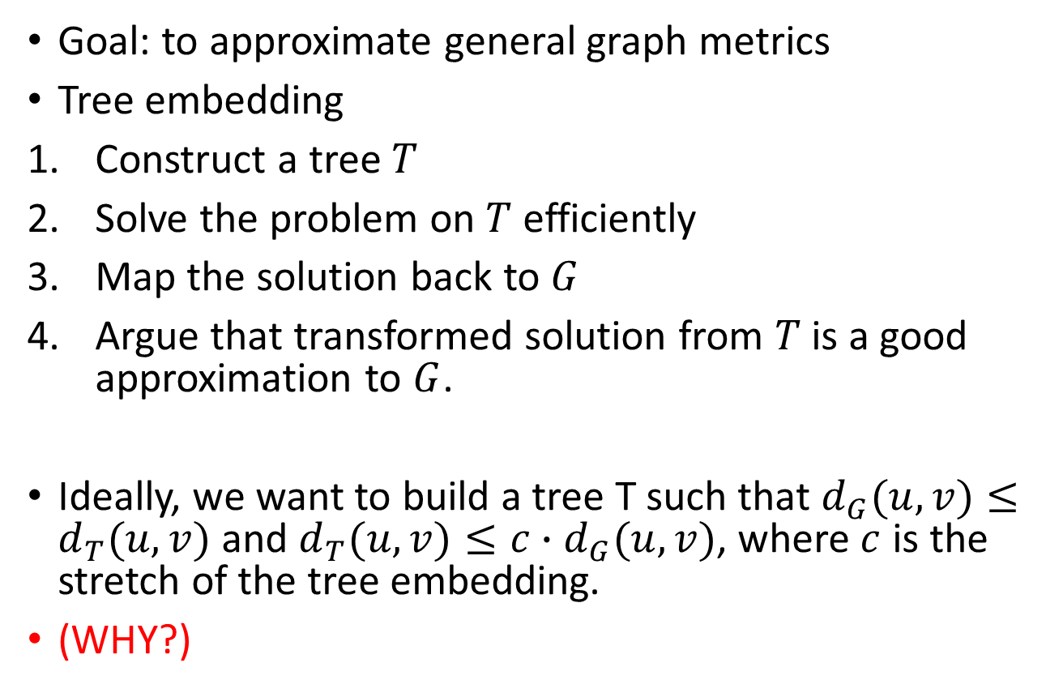
Approximation the graph
Goal: to approximate general graph metrics
Tree embedding
Construct a tree $T$
Solve the problem on $T$ efficiently
Map the solution back to $G$
Argue that transformed solution from $T$ is a good approximation to $G$.
Ideally, we want to build a tree T such that $d_{G}(u,v)≤d_{T}(u,v)$ and $d_{T}(u,v)≤c∙d_{G}(u,v)$, where $c$ is the stretch of the tree embedding.
(WHY?)
Notes:
We can build tree metric to approximate general graph metrics
Stretch = distortion ?

Slide 5
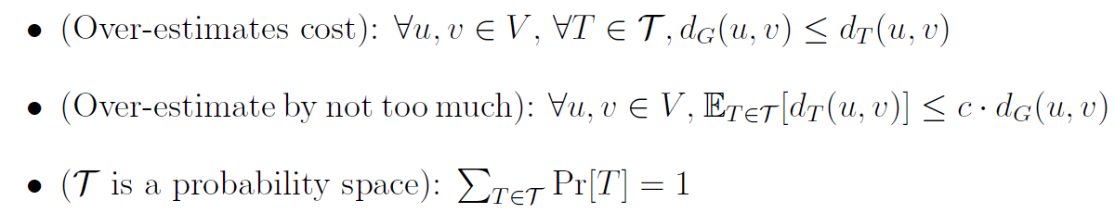

Probabilistic approximation
We relax the hard constraint $d_{T}(u,v)≤c∙d_{G}(u,v)$, and consider a distribution over a collection of trees $T$.
Notes:
Given a graph metric $G=\left(V,d\right),$ find a collection of tree $𝒯 = \left\{T_{1},⋯T_{m}\right\}$ such that

Slide 6
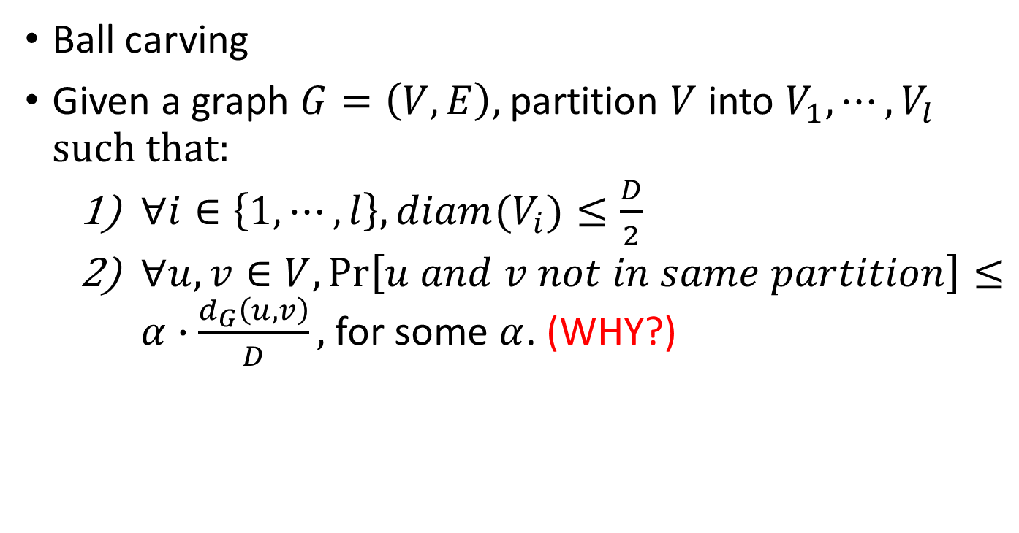
Low diameter decomposition
Ball carving
Given a graph $G=\left(V,E\right),$ partition $V$ into $V_{1},⋯,V_{l}$ such that:
$∀i∈\left\{1,⋯,l\right\},diam(V_{i})≤\frac{D}{2}$
$∀u,v∈V, \operatorname{Pr}\left[u and v not in same partition\right]≤α∙\frac{d_{G}\left(u,v\right)}{D},$ for some $α$. (WHY?)

Slide 7
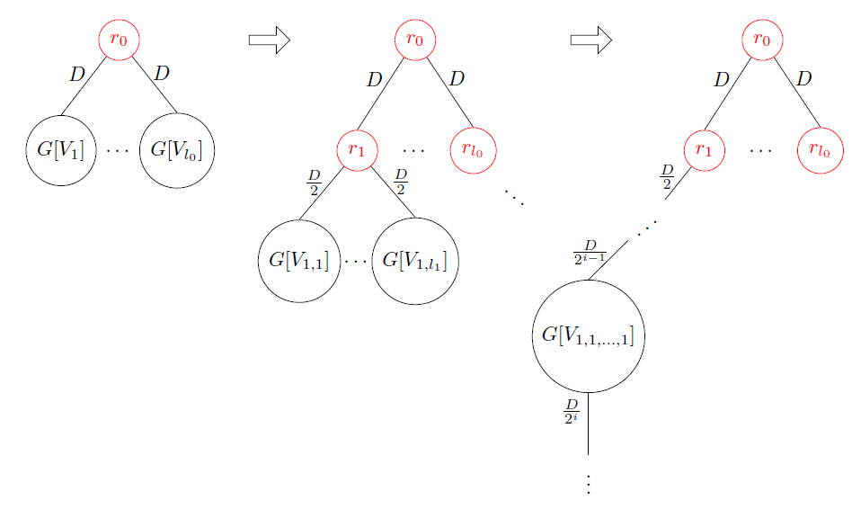
An iterative construction
Tree embedding construction

Slide 8
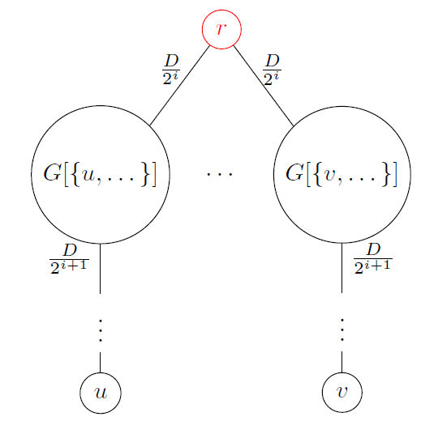
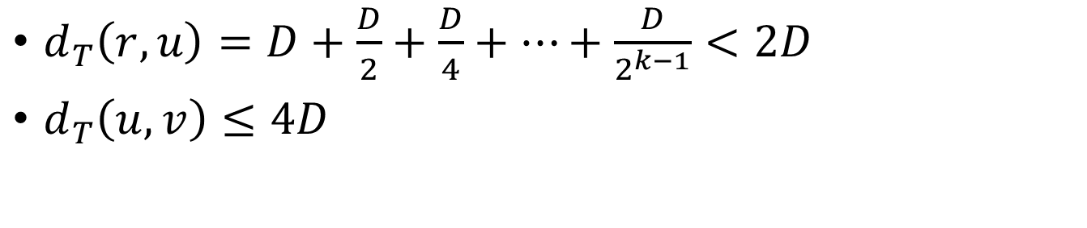
An iterative construction
$d_{T}\left(r,u\right)=D+\frac{D}{2}+\frac{D}{4}+⋯+\frac{D}{2^{k−1}}<2D$
$d_{T}\left(u,v\right)≤4D$

Slide 9
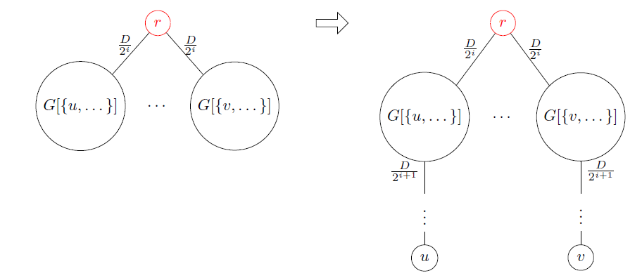

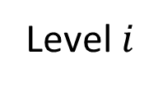
An iterative construction
If $T$ separates vertices $u,v∈V$ at level $i$
$\frac{2D}{2^{i}}≤d_{T}\left(u,v\right)=2∙(D+\frac{D}{2^{i}}+\frac{D}{2^{i+1}}+⋯)≤\frac{4D}{2^{i}}$
Level $i$

Slide 10
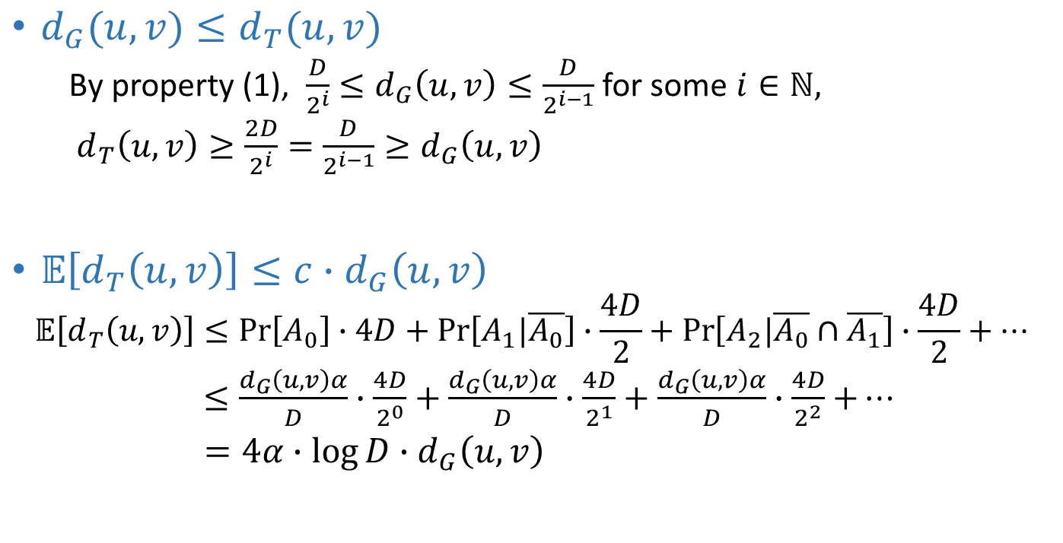
An iterative construction
$d_{G}(u,v)≤d_{T}(u,v)$
By property (1), $\frac{D}{2^{i}}≤d_{G}\left(u,v\right)≤\frac{D}{2^{i−1}}$ for some $i∈ℕ,$
$d_{T}\left(u,v\right)≥\frac{2D}{2^{i}}=\frac{D}{2^{i−1}}≥d_{G}\left(u,v\right)$
$𝔼\left[d_{T}\left(u,v\right)\right]≤c∙d_{G}\left(u,v\right)$
$$𝔼\left[d_{T}\left(u,v\right)\right]≤\operatorname{Pr}\left[A_{0}\right]∙4D+\operatorname{Pr}\left[A_{1}|\overline{A_{0}}\right]∙\frac{4D}{2}+\operatorname{Pr}\left[A_{2}|\overline{A_{0}}∩\overline{A_{1}}\right]∙\frac{4D}{2}+⋯$$
$≤\frac{d_{G}\left(u,v\right)α}{D}∙\frac{4D}{2^{0}}+\frac{d_{G}\left(u,v\right)α}{D}∙\frac{4D}{2^{1}}+\frac{d_{G}\left(u,v\right)α}{D}∙\frac{4D}{2^{2}}$ $+⋯$
$=4α∙\log{D}∙d_{G}\left(u,v\right)$

Slide 11
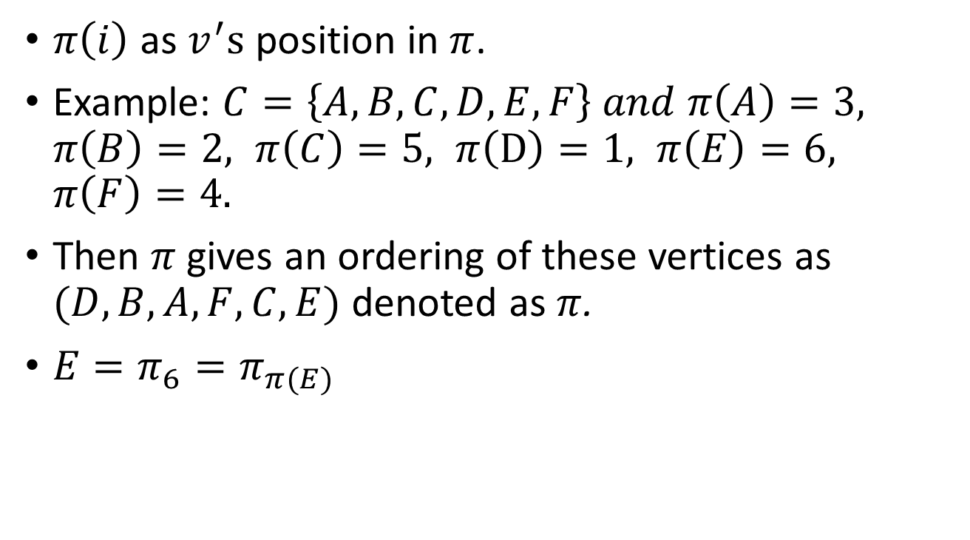
Position of vertices
$π\left(i\right)$ as $v^{′}s$ position in $π$.
Example: $C=\left\{A,B,C,D,E,F\right\} and π\left(A\right)=3, π\left(B\right)=2, π\left(C\right)=5, π\left(D\right)=1, π\left(E\right)=6, π\left(F\right)=4.$
Then $π$ gives an ordering of these vertices as $(D,B,A,F,C,E)$ denoted as $π$.
$E=π_{6}=π_{π(E)}$

Slide 12
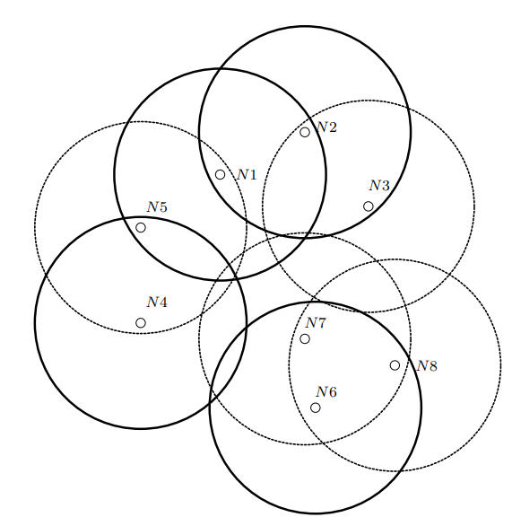








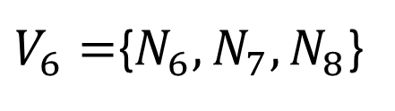
Ball carving
Ball carving on a set of vertices $C=\{N_{1}, N_{2}, · · · , N_{8}\}.$
$$V_{1}=\{N_{1}, N_{2},N_{5}\}$$
$$V_{2}=\{N_{3}\}$$
$$V_{3}=∅$$
$$V_{4}=\{N_{4}\}$$
$$V_{5}=∅$$
$V_{6}=${$N_{6}, N_{7},N_{8}$}
$$V_{7}=∅$$
$$V_{8}=∅$$

Slide 13
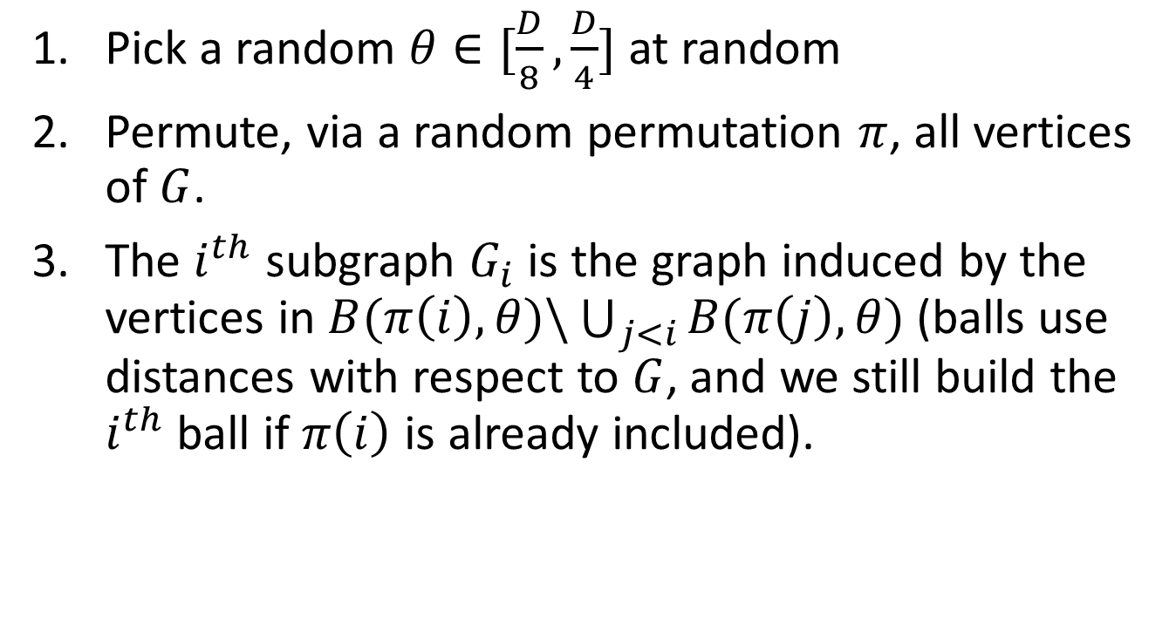



Randomized graph decomposition
Pick a random $θ∈[\frac{D}{8},\frac{D}{4}]$ at random
Permute, via a random permutation $π$, all vertices of $G$.
The $i^{th}$ subgraph $G_{i}$ is the graph induced by the vertices in $B(π\left(i\right),θ)\backslash \bigcup_{j<i}{B(π\left(j\right),θ)}$ (balls use distances with respect to $G$, and we still build the $i^{th}$ ball if $π\left(i\right)$ is already included).
$$B\left(v_{i},θ\right)$$
$$θ$$
$$v_{i}$$
Notes:
專注在分析 decomposition上

Slide 14

Ball cut
If BALLCARVING puts the vertices in $B(u,r$) in different partition of $V_{1},…V_{l}$.
$i=\min_{i∈[l]}{[V_{i}∩B(u,r)≠∅ and B(u,r)⊆V_{i}]}$

Slide 15
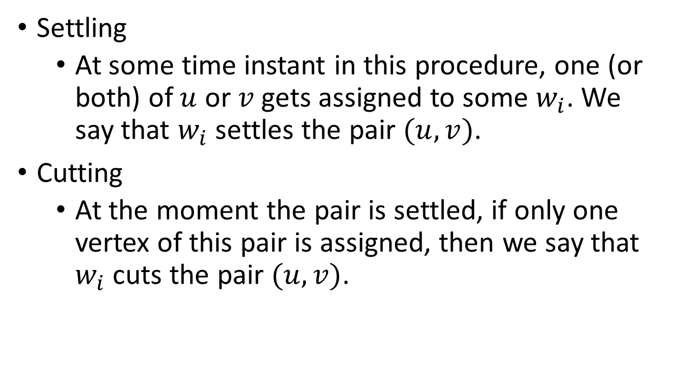
Settling and Cutting
Settling
At some time instant in this procedure, one (or both) of $u$ or $v$ gets assigned to some $w_{i}$. We say that $w_{i}$ settles the pair $(u,v)$.
Cutting
At the moment the pair is settled, if only one vertex of this pair is assigned, then we say that $w_{i}$ cuts the pair $(u,v)$.

Slide 16
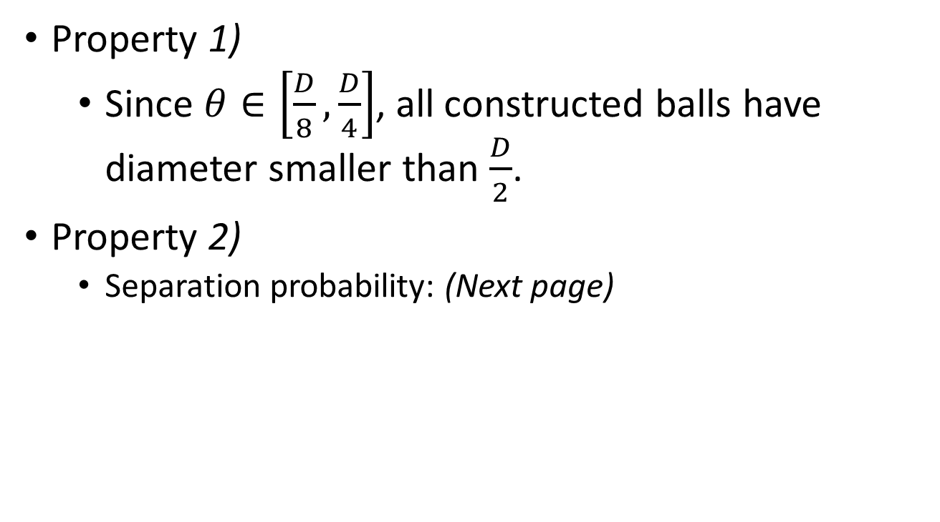
Check the properties
Property 1)
Since $θ∈\left[\frac{D}{8},\frac{D}{4}\right]$, all constructed balls have diameter smaller than $\frac{D}{2}$.
Property 2)
Separation probability: (Next page)

Slide 17

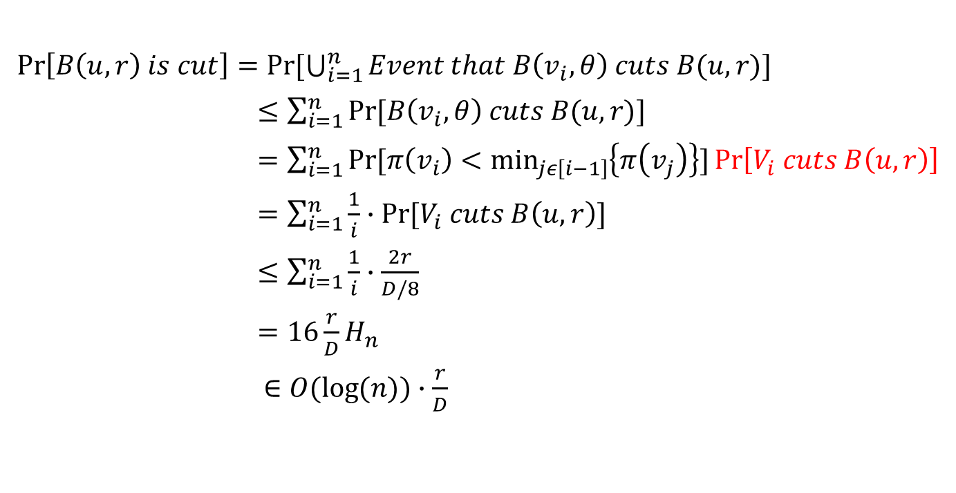

Separation probability
$\operatorname{Pr}\left[B\left(u,r\right) is cut\right]=Pr⁡[\bigcup_{i=1}^{n}{Event that B\left(v_{i},θ\right) cuts B(u,r)}]$
$≤\sum_{i=1}^{n}{Pr⁡[B\left(v_{i},θ\right) cuts B(u,r)]}$
$=\sum_{i=1}^{n}{Pr⁡[π\left(v_{i}\right)<\min_{jε\left[i−1\right]}\left\{π\left(v_{j}\right)\right\}]}\operatorname{Pr}\left[V_{i} cuts B\left(u,r\right)\right]$
$=\sum_{i=1}^{n}{\frac{1}{i}}∙Pr⁡[V_{i} cuts B\left(u,r\right)]$
$≤\sum_{i=1}^{n}{\frac{1}{i}}∙\frac{2r}{D/8}$
$=16\frac{r}{D}H_{n}$
$∈O(\log{(n)})∙\frac{r}{D}$
$$B\left(u,r\right)$$
$$B\left(v_{i},θ\right)$$

Slide 18









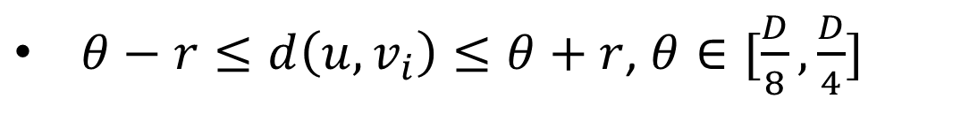




Improving the analysis
?
$θ+r<d(v_{i},u)$
$θ−r>d(v_{i},u)$
$$B\left(v_{i},θ\right)$$
$$B\left(u,r\right)$$
$$θ$$
$$r$$
$$v_{i}$$
$$u$$
?
$$θ$$
$$B\left(v_{i},θ\right)$$
$$r$$
$$B\left(u,r\right)$$
$$v_{i}$$
$$u$$
$θ−r≤d\left(u,v_{i}\right)≤θ+r$, $θ∈[\frac{D}{8},\frac{D}{4}]$

Slide 19
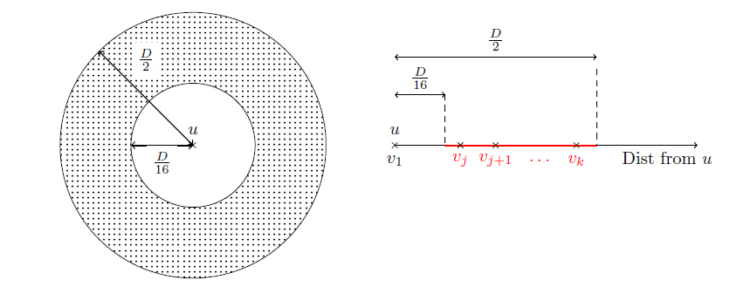

Improving the analysis
$\frac{D}{8}−r≤d\left(u,v_{i}\right)≤\frac{D}{4}+r, d\left(u,v_{i}\right)∈[\frac{D}{16},\frac{D}{2}]$
Only vertices in the shaded region could possibly cut $B(u,r$) (WHY?)

Slide 20

Improving the analysis
Let $j−1=|B(u,\frac{D}{16}\text{)}|$ as the number of nodes that have distance $≤\frac{D}{16}$ from $u$
Let $k=|B(u,\frac{D}{2}\text{)}|$ as the number of nodes that have distance $≤\frac{D}{2}$ from $u$

Slide 21
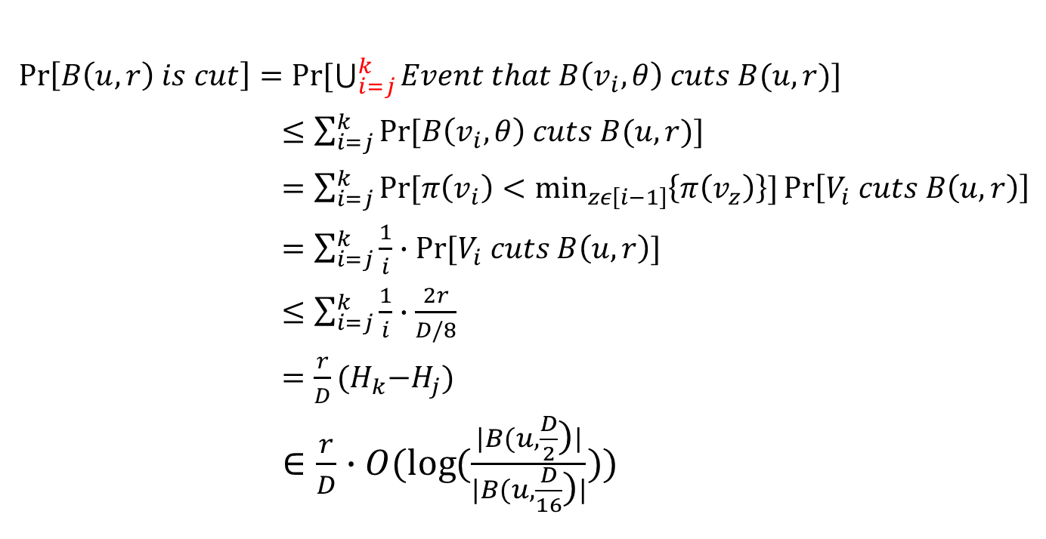
Improving the analysis
$\operatorname{Pr}\left[B\left(u,r\right) is cut\right]=Pr⁡[\bigcup_{i=j}^{k}{Event that B\left(v_{i},θ\right) cuts B(u,r)}]$
$≤\sum_{i=j}^{k}{Pr⁡[B\left(v_{i},θ\right) cuts B(u,r)]}$
$=\sum_{i=j}^{k}{Pr⁡[π\left(v_{i}\right)<\min_{zε\left[i−1\right]}\left\{π\left(v_{z}\right)\right\}]}\operatorname{Pr}\left[V_{i} cuts B\left(u,r\right)\right]$
$=\sum_{i=j}^{k}{\frac{1}{i}}∙Pr⁡[V_{i} cuts B\left(u,r\right)]$
$≤\sum_{i=j}^{k}{\frac{1}{i}}∙\frac{2r}{D/8}$
$=\frac{r}{D}{(H}_{k}−H_{j})$
$∈\frac{r}{D}∙O(\log{(\frac{|B(u,\frac{D}{2}\text{)}|}{|B(u,\frac{D}{16}\text{)}|})})$

Slide 22
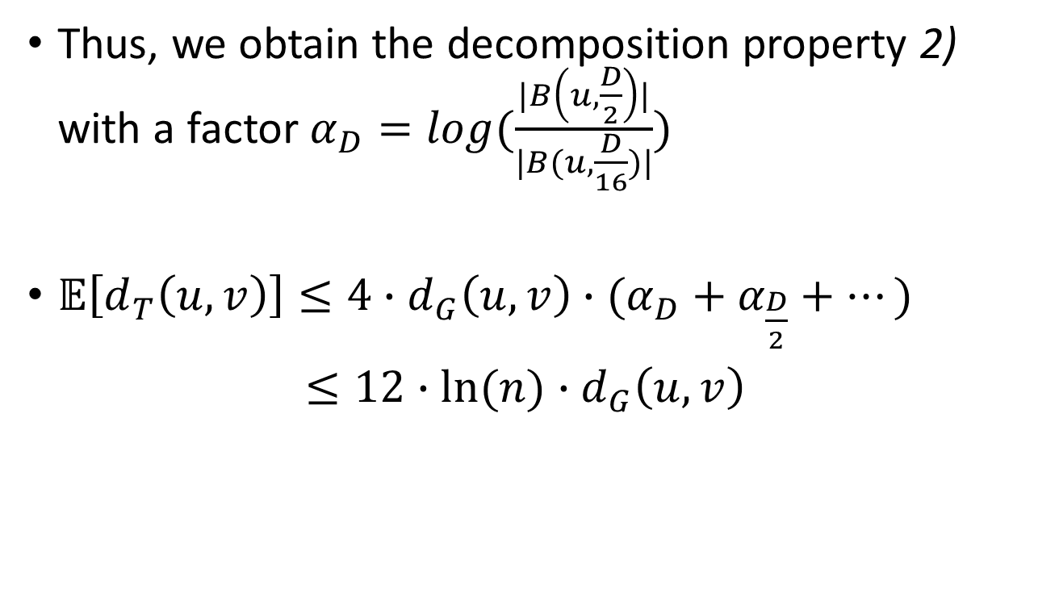

Stretch factor with $O(\log{n})$
Thus, we obtain the decomposition property 2) with a factor $α_{D}=\log{(\frac{|B\left(u,\frac{D}{2}\right)|}{|B(u,\frac{D}{16})|})}$
$𝔼\left[d_{T}\left(u,v\right)\right]≤4∙d_{G}\left(u,v\right)∙(α_{D}+α_{\frac{D}{2}}+…)$
$≤12∙ln⁡(n)∙d_{G}\left(u,v\right)$

Slide 23
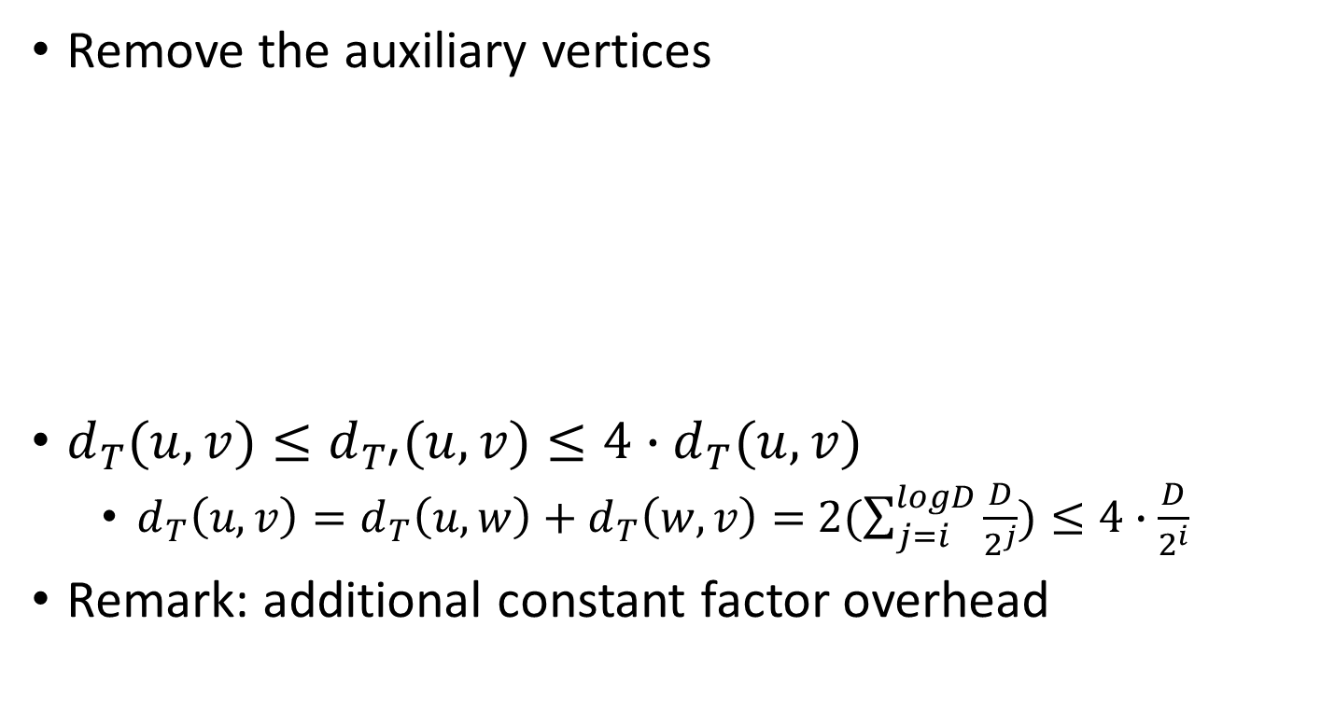

Contraction of $T$
u, v
Remove the auxiliary vertices
$d_{T}(u,v)≤d_{T′}(u,v)≤4∙d_{T}(u,v)$
$d_{T}\left(u,v\right)=d_{T}\left(u,w\right)+d_{T}\left(w,v\right)=$ $2(\sum_{j=i}^{logD}{\frac{D}{2^{j}}})≤4∙\frac{D}{2^{i}}$
Remark: additional constant factor overhead
w
u
v

Slide 24
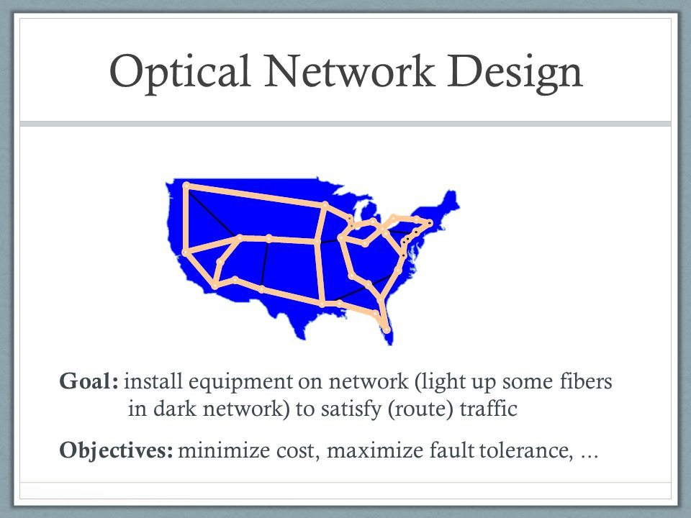
Application
Notes:
Installing capacity in communication networks

Slide 25
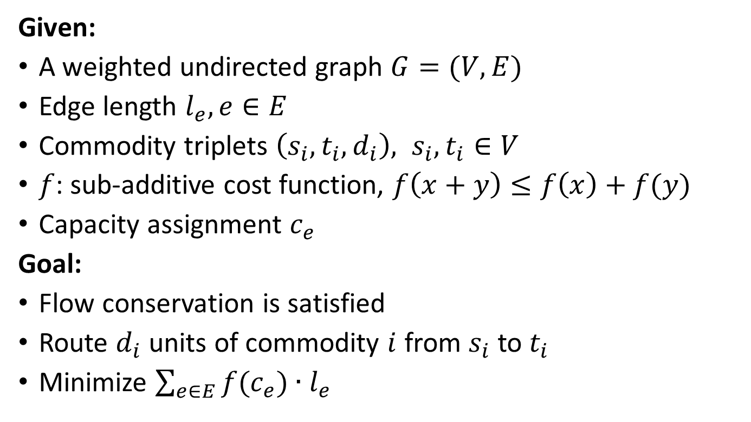
Buy-at-bulk network design
Given:
A weighted undirected graph $G=(V,E)$
Edge length $l_{e}, e∈E$
Commodity triplets $\left(s_{i},t_{i},d_{i}\right), s_{i},t_{i}∈V$
$f$: sub-additive cost function, $f\left(x+y\right)≤f\left(x\right)+f(y)$
Capacity assignment $c_{e}$
Goal:
Flow conservation is satisfied
Route $d_{i}$ units of commodity $i$ from $s_{i}$ to $t_{i}$
Minimize $\sum_{e∈E}{f(c_{e})}∙l_{e}$

Slide 26

Observation
The cost of purchasing edge capacity is linearly related to the length of that edge.
$s_{i}→t_{i}$ path is unique in a tree.

Slide 27
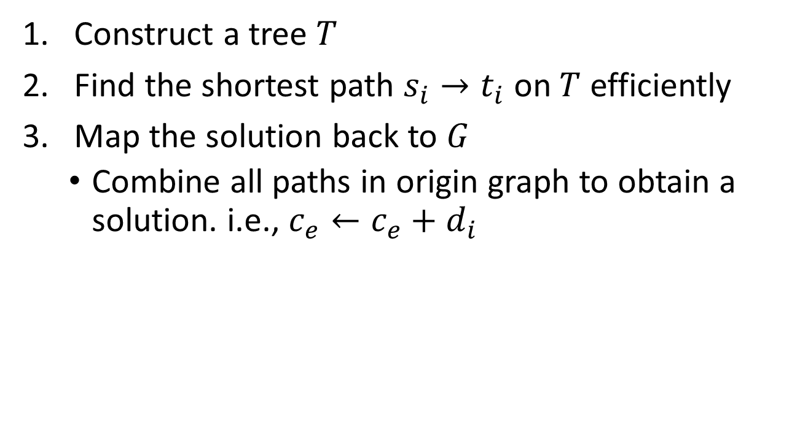
Algorithm
Construct a tree $T$
Find the shortest path $s_{i}→t_{i}$ on $T$ efficiently
Map the solution back to $G$
Combine all paths in origin graph to obtain a solution. i.e., $c_{e}←c_{e}+d_{i}$

Slide 28
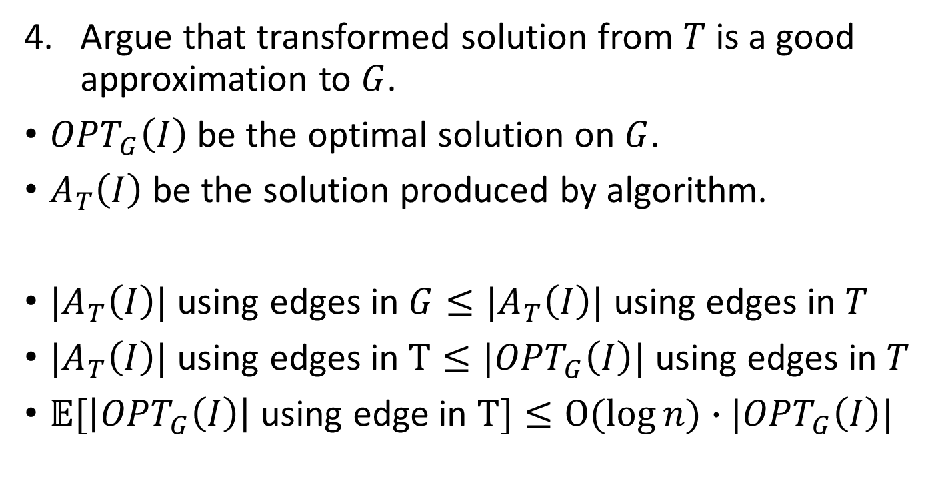
Analysis
Argue that transformed solution from $T$ is a good approximation to $G$.
${OPT}_{G}\left(I\right)$ be the optimal solution on $G$.
$A_{T}\left(I\right)$ be the solution produced by algorithm.
$|A_{T}\left(I\right)|$ using edges in $G≤|A_{T}\left(I\right)|$ using edges in $T$
$|A_{T}\left(I\right)|$ using edges in $T≤|{OPT}_{G}\left(I\right)|$ using edges in $T$
$𝔼[\left|{OPT}_{G}\left(I\right)\right|$ using edge in $T]≤O(\log{n})∙|{OPT}_{G}\left(I\right)|$

