Slide 1
A Tutorial on Network Embeddings
Pp. 3-13

Slide 2
Outline
Dimensionality reduction
Principal Component Analysis (PCA)
Multidimensional Scaling (MDS)
Isomap
Local Linear Embeddings (LLE)
Laplacian Eigenmaps (LE)
Unsupervised Network Embeddings
GraRep
Walklets
Graph Attention
HOPE
Graph Likelihood
SiNE
HARP

Slide 3
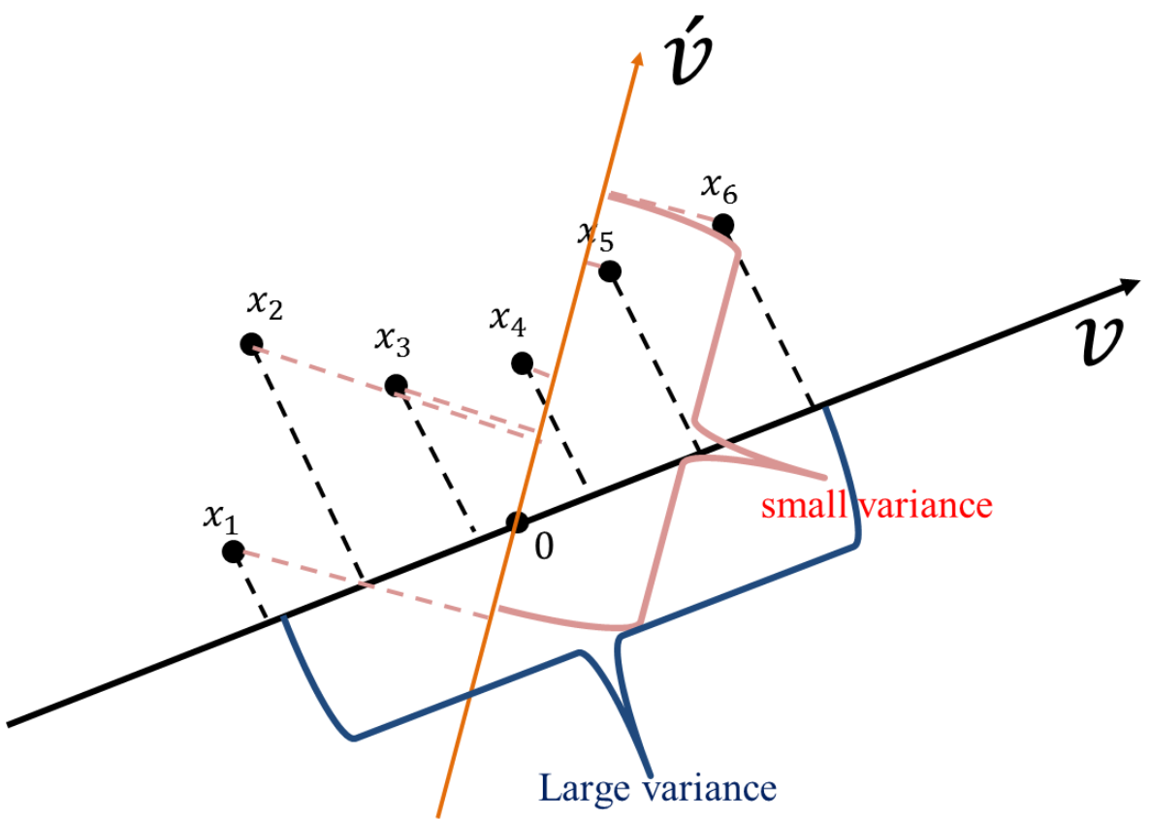
PCA
Find a set of orthogonal principal components: maximizing variance
The number of these components could be equal or less than n
Each original data point could be projected to the lower-dimensional space determined by them

Slide 4
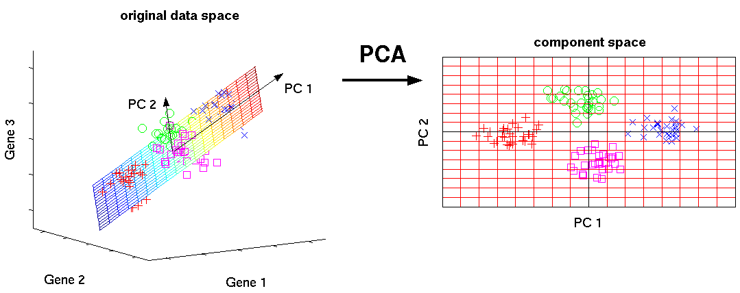
PCA

Slide 5
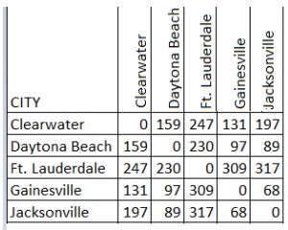
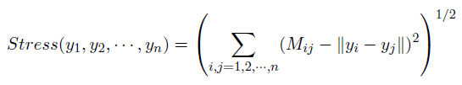
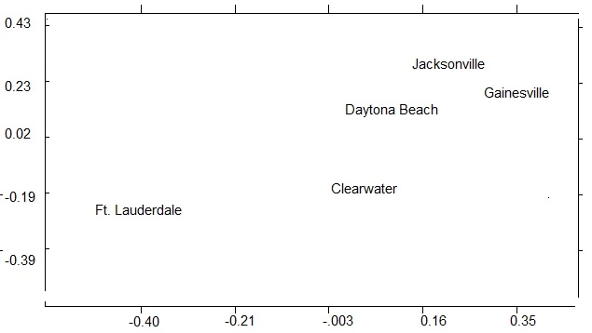
MDS
No high-dimensional features
Preserve the distance between different objects in the original feature matrix M in the k-dimensional space
Minimize

Slide 6
Isomap
An extension of MDS
Preserve geodesic distances in the neighborhood graph of input data
Steps
Construct neighborhood graph
nodes closer than a certain distance
nodes which are k-nearest neighbors
Compute shortest paths
min_k {d(i, j), d(i,k)+d(k, j)}
Construct d-dimensional embedding (the same as MDS)

Slide 7

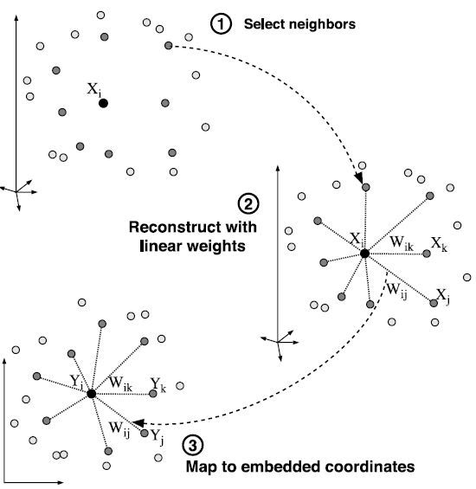

LLE
Only exploits the local neighborhood of data points
Assume: a data point can be reconstructed from a linear combination of its neighbors
W: reflect the invariant geometric properties of the input data

Slide 8
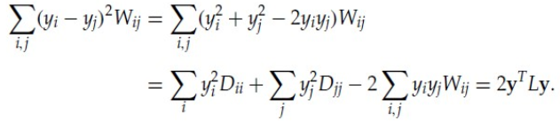
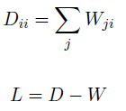


LE
W: reflect the invariant geometric properties of the input data (similar to LLE)
Minimize
The solutions to the eigenvector problem
can be used as the low-dimension embeddings
Each node is represented by the eigenvectors associated with its k-smallest nontrivial eigenvalues

Slide 9
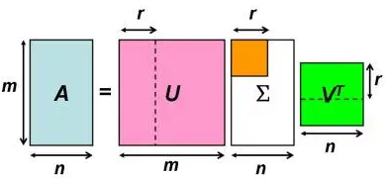


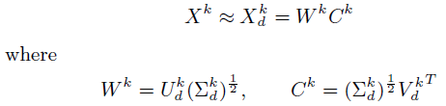
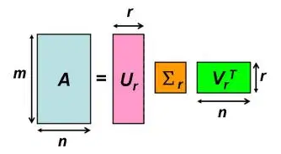

GraRep
Source of Context Nodes:
Embedding Learning Method: SVD
k-step representation: $W^{k}$

Slide 10
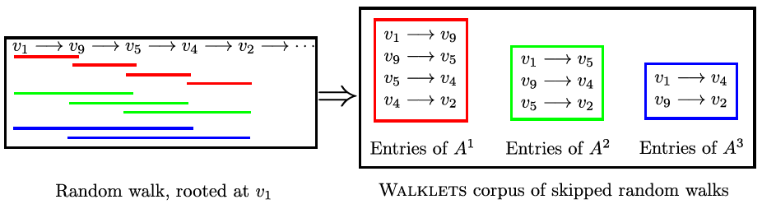
Walklets
DeepWalk: it is biased towards representations that preserve the lowest power of A
In some cases, a coarse-grained representation may offer performance benefits over a finer representation that preserves individual edges
DeepWalk learns one global representation that conflates all possible scales of network relationships
Source of Context Nodes:
Embedding Learning Method: Skip-gram
More scalable than GraRep

Slide 11
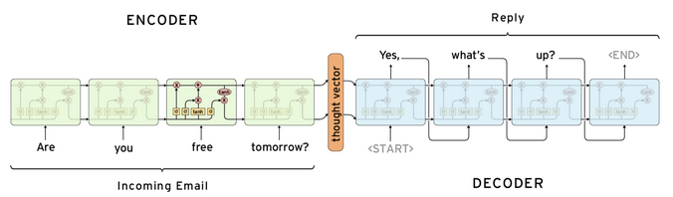
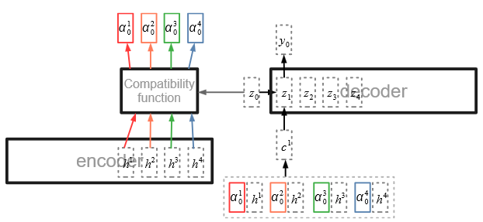
Graph Attention
Seq2Seq
Attention mechanism

Slide 12


Graph Attention
Weakness of previous works: selecting these hyper-parameters is non-trivial
Use a probability distribution
${\tilde{P}}^{\left(0\right)}$: the initial random walk starting positions matrix
Jointly learn Q and node embedding

Slide 13
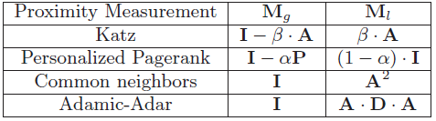



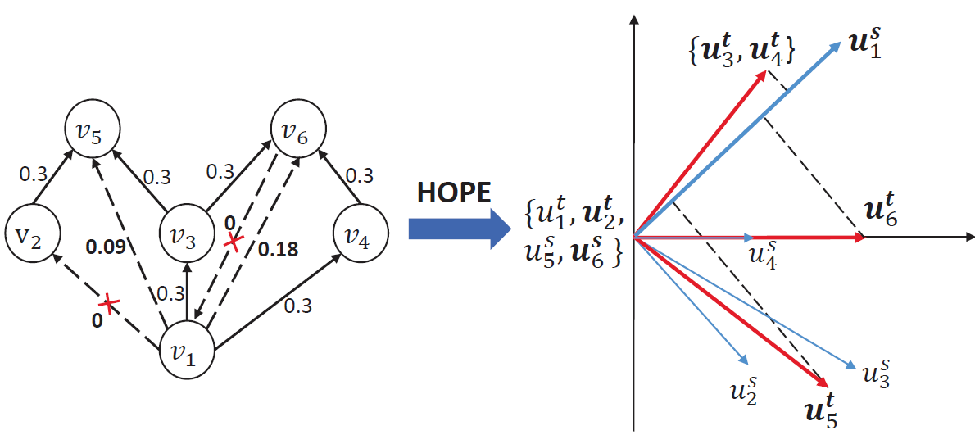

HOPE
Directed graph embedding
Minimize
S: high-order proximity matrix
Solve
Embeddings

Slide 14
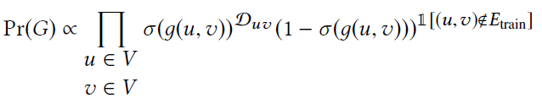
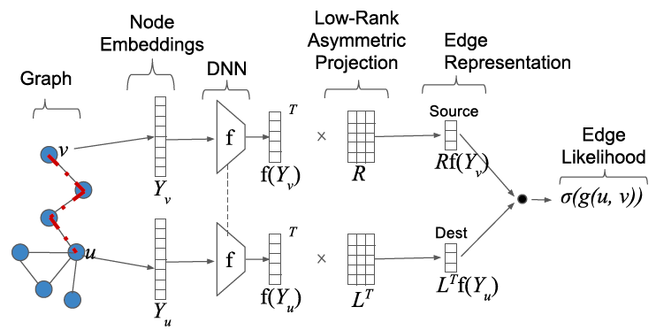


Graph Likelihood
Edge embedding
Graph likelihood
$𝒟_{uv}$
Perform random walk in $E_{train}$
Extract all node pairs within the context window in each random walk
Consider the frequency of occurrence as $𝒟_{uv}$

Slide 15

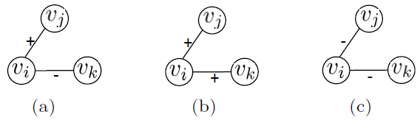
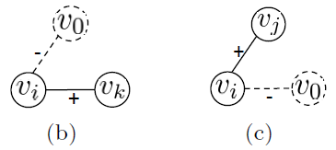
SiNE
Nodes should be closer to their friends (linked with positive edges) than their foes (linked with negative edges)
For (a),
In a signed social network, positive links are denser than negative links
For (b) and (c),

Slide 16
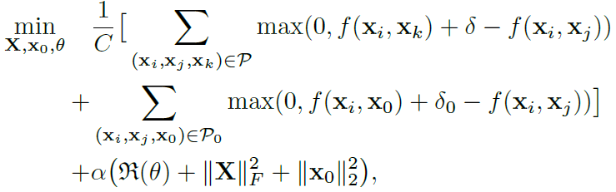
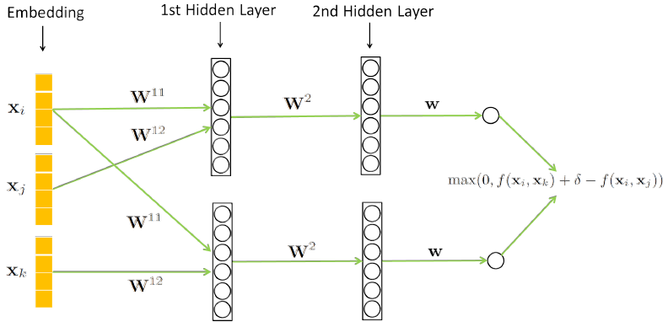
SiNE
Objective
Architecture
Can be extended to N layers

Slide 17
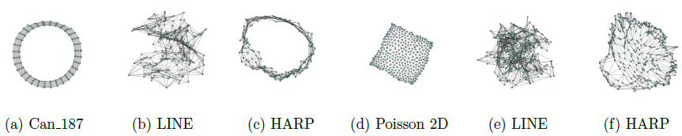
HARP
Weaknesses of previous works
Limited to the structure immediately around a node: ignore long-distance global relationships
May stuck in a local minima: rely on a non-convex optimization goal solved using stochastic gradient descent
A meta strategy to preserve higher-order structural features

Slide 18
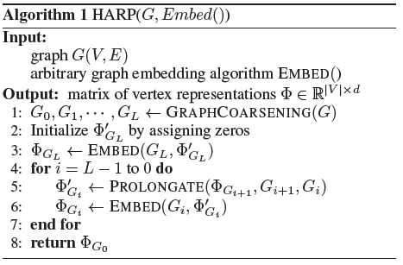
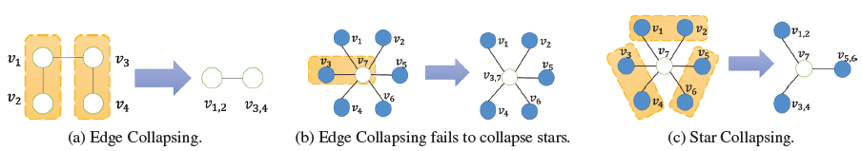
HARP
Graph Coarsening
Edge collapsing: first-order proximity
Star collapsing: second-order proximity
Graph Embedding on the Coarsest Graph
Graph Representation Prolongation and Refinement
Graph Embedding of the Original Graph

