Slide 1
Streaming Algorithms
Recap and Applications
Presenter: Vincent Jui-Yi Tsai

Slide 2
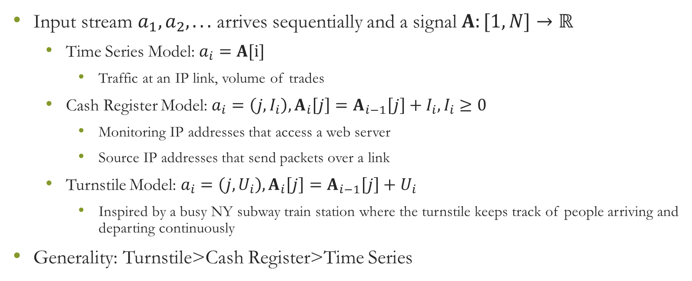
Data Stream Models
Input stream $a_{1},a_{2}, . . .$ arrives sequentially and a signal $A:[1,N]→ℝ$
Time Series Model: $a_{i}=A[i]$
Traffic at an IP link, volume of trades
Cash Register Model: $a_{i}=\left(j,I_{i}\right), A_{i}\left[j\right]=A_{i−1}\left[j\right]+I_{i},I_{i}≥0$
Monitoring IP addresses that access a web server
Source IP addresses that send packets over a link
Turnstile Model: $a_{i}=\left(j,U_{i}\right), A_{i}\left[j\right]=A_{i−1}\left[j\right]+U_{i}$
Inspired by a busy NY subway train station where the turnstile keeps track of people arriving and departing continuously
Generality: Turnstile>Cash Register>Time Series

Slide 3
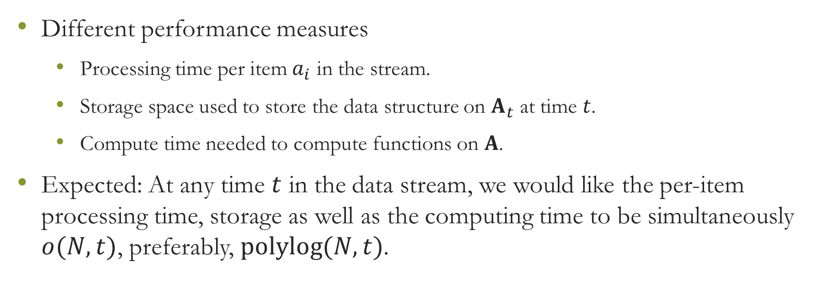
Data Stream Models
Different performance measures
Processing time per item $a_{i}$ in the stream.
Storage space used to store the data structure on $A_{t}$ at time $t$.
Compute time needed to compute functions on $A$.
Expected: At any time $t$ in the data stream, we would like the per-item processing time, storage as well as the computing time to be simultaneously $o(N, t)$, preferably, $polylog(N, t)$.

Slide 4
Motivating Scenario－Internet
1. Packet log: each IP packet has a header that contains source and destination IP addresses, ports, etc.
2. Flow log: each flow is a collection of packets with same values for certain key attributes such as the source and destination IP addresses and the log contains cumulative information about number of bytes and packets sent, start time, end time, protocol type, etc. per flow.
3. SNMP log: the aggregate data of the number of bytes sent over each link every few minutes.

Slide 5
Motivating Scenario－Internet
1. How much HTTP traffic went on a link today from a given range of IP addresses?
2. How many distinct IP addresses used a given link to send their traffic from the beginning of the day, or how many distinct IP addresses are currently using a given link on ongoing flow?
3. What are the top k heaviest flows during the day, or currently in progress?
4. How many flows comprised one packet only (i.e., rare flows)? Closely related to this is the question: Find TCP/IP SYN packets without matching SYNACK packets.
5. How much of the traffic yesterday in two routers was common or similar?
6. What are the top k correlated link pairs in a day, for a given correlation measure. In general a number of correlation measures may be suitable. Those that rely on signal analysis—wavelet, fourier etc.—of the traffic pattern prove effective. We will later describe algorithms for computing wavelet or fourier representation for data streams.
7. For each source IP address and each five minute interval, count the number of bytes and number of packets related to HTTP transfers. This is an interesting query: how do we represent the output which is also a stream and what is a suitable approximation in this case?

Slide 6
Other Applications for Data Stream Models
One pass, Sequential I/O
Programs prefer to process the data in one (or few) scans.
This naturally maps to the Time Series/Cash Register data stream model of seeing data incrementally as a sequence of updates.
Monitoring database contents
Selectivity estimation problem
The inserts or deletes in the database are the updates in the (Turnstile model of a data) stream, and the signal is the database.
Approximate query answering
Data quality monitoring

Slide 7
New Directions
Related Area
PAC (probably approximately correct) learning
Online Algorithms
Property Testing
Markov methods

Slide 8
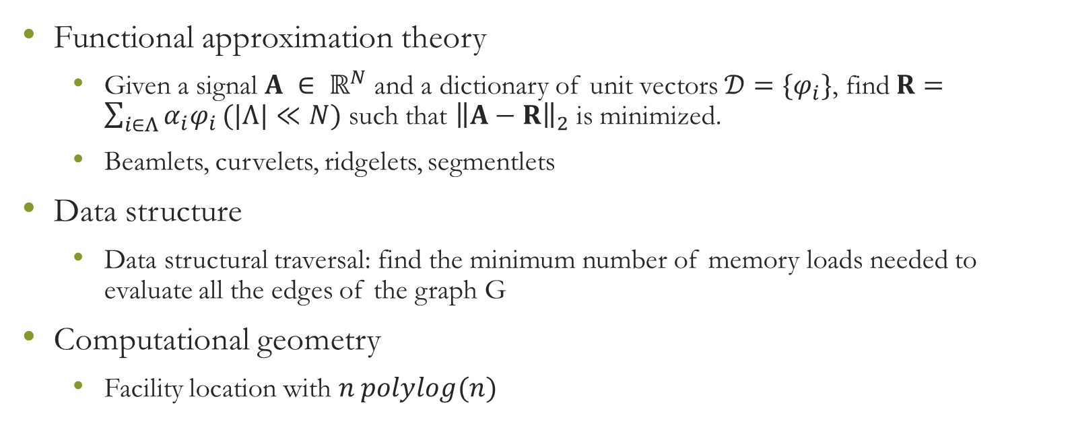
New Directions
Functional approximation theory
Given a signal $A ∈ ℝ^{N}$ and a dictionary of unit vectors $𝒟=\{φ_{i}\}$, find $R=\sum_{i∈Λ}{α_{i}φ_{i}}(|Λ|≪N)$ such that ${\left\|A−R\right\|}_{2}$ is minimized.
Beamlets, curvelets, ridgelets, segmentlets
Data structure
Data structural traversal: find the minimum number of memory loads needed to evaluate all the edges of the graph G
Computational geometry
Facility location with $n polylog(n)$

Slide 9
New Directions
Graph theory
Graph problems under semi-streaming model
Databases
Building (near) optimal 1-/2-dimensional histogram with B partitions
Approximation for a Stream In, Stream Out (SISO) query
Hardware
Tasks will be accomplished in multiple passes through a highly parallel stream processing machine with certain limitations

Slide 10
New Directions
Streaming models
Permutation Streaming
Windowed Streaming
Synchronized Streaming
Data Stream Quality Monitoring

Slide 11
New Directions
Others
Approximation to the best k-rank representation of a matrix in the Turnstile model
Regression fitting or maximum likelihood estimation on the data stream
Characterize the complexity class given by a deterministic logspace verifier
Find an approximate, provably privacy-preserving protocol to find the common secrets of two people
Design an approximate, provably privacy-preserving protocol to find the “heavy hitters” from the combined list of all transactions.

Slide 12
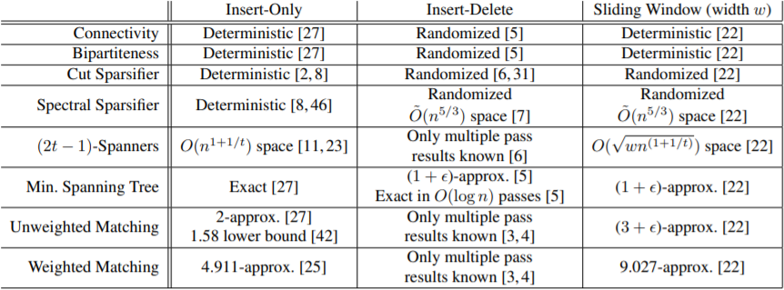
Graph Stream Algorithms

Slide 13
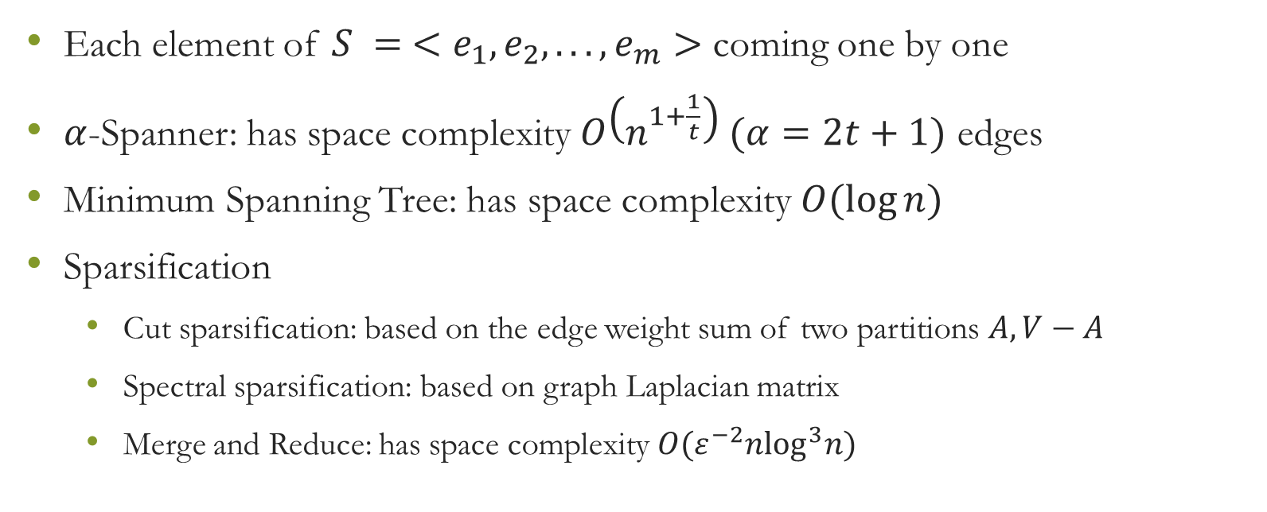
Graph Streaming Algorithms: Insertion only
Each element of $S = <e_{1}, e_{2}, . . . ,e_{m}>$ coming one by one
$α$-Spanner: has space complexity $O\left(n^{1+\frac{1}{t}}\right) (α=2t+1)$ edges
Minimum Spanning Tree: has space complexity $O(\log{n})$
Sparsification
Cut sparsification: based on the edge weight sum of two partitions $A, V−A$
Spectral sparsification: based on graph Laplacian matrix
Merge and Reduce: has space complexity $O(ε^{−2}n\log^{3}n)$

Slide 14
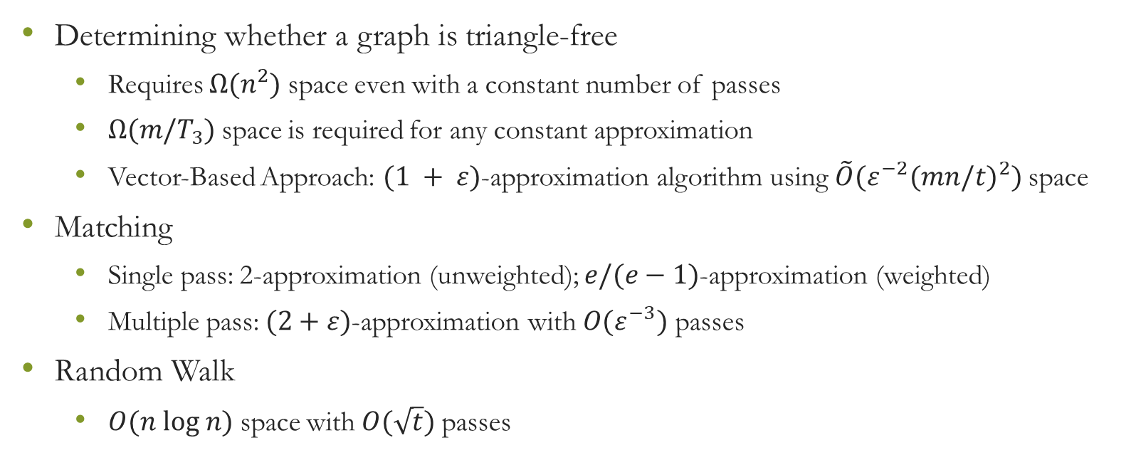
Graph Streaming Algorithms: Insertion only
Determining whether a graph is triangle-free
Requires $Ω(n^{2})$ space even with a constant number of passes
$Ω(m/T_{3})$ space is required for any constant approximation
Vector-Based Approach: $(1 + ε)$-approximation algorithm using $\tilde{O}({ε^{−2}(mn/t)}^{2})$space
Matching
Single pass: 2-approximation (unweighted); $e/(e−1)$-approximation (weighted)
Multiple pass: $(2+ε)$-approximation with $O(ε^{−3})$ passes
Random Walk
$O(n log n)$ space with $O(\sqrt{t})$ passes

Slide 15
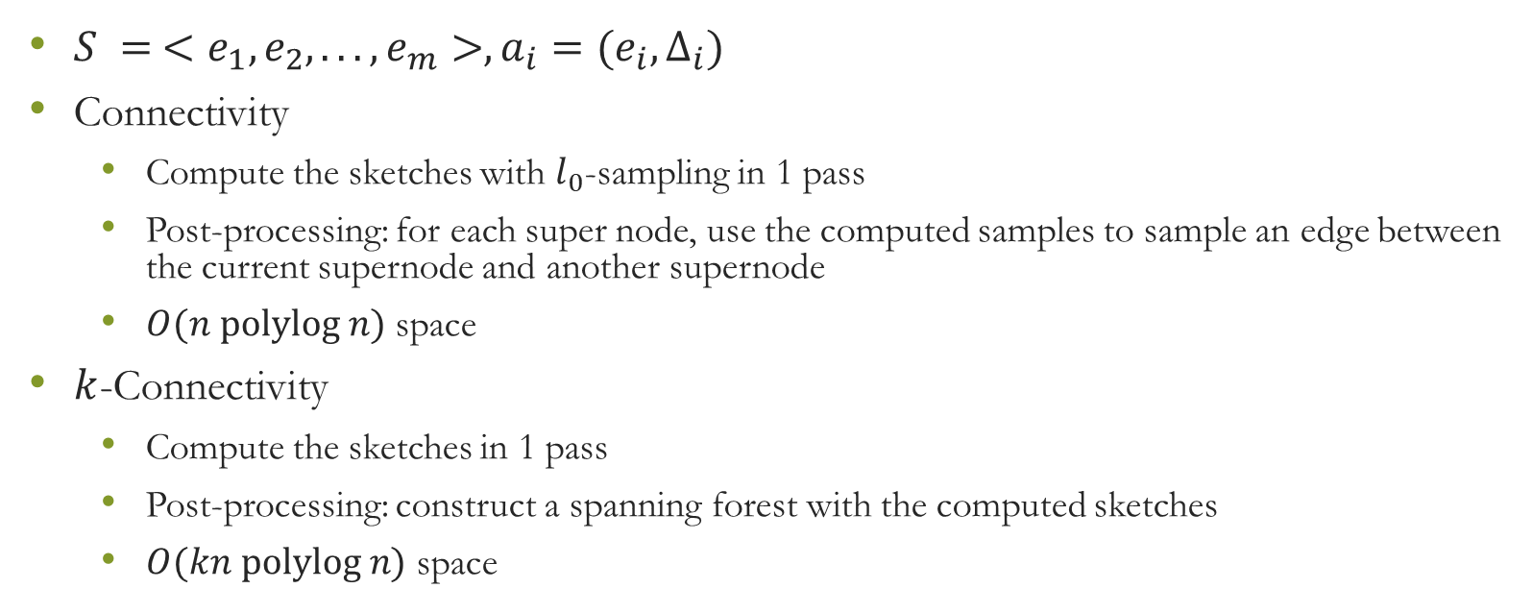
Graph Streaming Algorithms: Graph Sketch
$S = <e_{1}, e_{2}, . . . ,e_{m}>, a_{i}=(e_{i},∆_{i})$
Connectivity
Compute the sketches with $l_{0}$-sampling in 1 pass
Post-processing: for each super node, use the computed samples to sample an edge between the current supernode and another supernode
$O(n polylog n)$ space
$k$-Connectivity
Compute the sketches in 1 pass
Post-processing: construct a spanning forest with the computed sketches
$O(kn polylog n)$ space

Slide 16

Graph Streaming Algorithms: Graph Sketch
Generic sampling
Sample each edge $e$ with probability $p_{e}$
Weight each sampled edge $e$ by $1/p_{e}$
Min-cut
Construct $k$-skeletons
Sparsification
Sample edges with probability $q_{e}=min⁡\{1,t/λ_{e}\}$

Slide 17
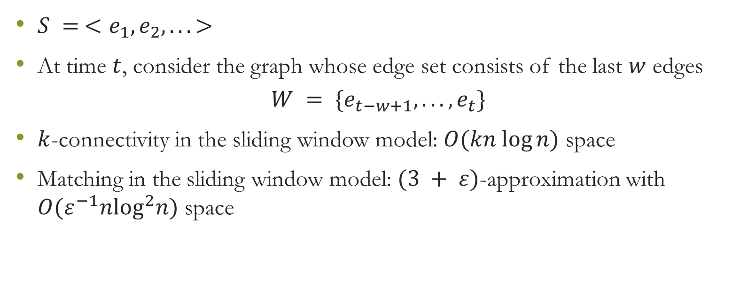
Graph Streaming Algorithms: Sliding Window
$S = <e_{1}, e_{2}, . . . >$
At time $t$, consider the graph whose edge set consists of the last $w$ edges
$$W = \{e_{t−w+1}, . . . ,e_{t}\}$$
$k$-connectivity in the sliding window model: $O(kn log⁡n)$ space
Matching in the sliding window model: $(3 + ε)$-approximation with $O(ε^{−1}n\log^{2}n)$ space

Slide 18
Graph Streaming Algorithms: Future Directions
Directed Graphs
Communication Complexity
(Random) Stream Ordering
More or Less Space

