Slide 1
Streaming Algorithms
李廷威 3/10

Slide 2
Streaming Algorithm 特性

Slide 3
Streaming Algorithm 特性
1.sequential input
2.limited memory
3.can only store a sketch of the input

Slide 4
Sketching
Examples?

Slide 5
Online Algorithm
差別在哪裡？？

Slide 6
Online Algorithm
1.產生output的時間點
2.記憶體限制
3.compare to optimal offline algorithm

Slide 7
Streaming input model
data elements from [n] = {1, . . . , n} arrive in one at a time, in a stream S = a1, . . . , am, where ai ∈ [n] arrives in the i th time step.

Slide 8
Streaming input model
data elements from [n] = {1, . . . , n} arrive in one at a time, in a stream S = a1, . . . , am, where ai ∈ [n] arrives in the i th time step. At each step, our algorithm performs some computation and discards the item ai .

Slide 9
Streaming input model
data elements from [n] = {1, . . . , n} arrive in one at a time, in a stream S = a1, . . . , am, where ai ∈ [n] arrives in the i th time step. At each step, our algorithm performs some computation and discards the item ai . At the end of the stream , the algorithm should give us a value that approximates some value of interest.

Slide 10
Frequency moment
∑ (f_{j})^{k}
(For items j ∈ [n], define f_{j} as the number of times j appears in a stream S)

Slide 11
Frequency moment
when k = 0, the frequency moment = #(distinct elements)
when k = 1, the frequency moment = #(total number of elements in the stream)=m
Today will cover the case of k=0 and 1.
Next lecture will discuss the case of k=2 and general k.

Slide 12
Two typical tricks for randomized algorithms
1.reduce variance (take mean)
2.improve success rate(take median)
->a (1 ± ε)-approximation to X that succeeds with probability > 1 − δ

Slide 13
the first moment of the stream(total #element)
simple idea: update our count for only O(lgm) times
把input 切成每2^{i} 一組(從i=0開始)
1, (2,3) , (4,5,6,7) ,(8,9,10,11,12,13,14,15)
第i組的時候，以1/2^{i}的機率更新我們的count(count+=1)

Slide 14
the first moment
only require O(lglgm) bits
return 2^(counter) - 1 as our estimation

Slide 15
the zeroth moment of the stream
1.O(n) bits
2.O(m log n) bits
why?

Slide 16
the zeroth moment of the stream
idealized algorithm: using a uniform hash function [0,1]
but need lots of bits to store the result
->using pairwise hashing functions instead

Slide 17
FM sketch
want to estimate logD = O(logN) only
must deal with repeated elements
consider hash function h:[N] ->[logN]
and we do not care about elements in bucket, but only bucket indexes

Slide 18
FM sketch
1.need to assign a random id for each element first
2.then hash these random ids to geometric distributed hashing buckets
3.store the bucket which contains at least one element with the largest bucket id (=about logD)

Slide 19
FM sketch
1.first hash each element from [1...n] to [1...n]
2.then send to buckets with prob. (½,¼,⅛, …….)
3.count elements through the smallest prob. bucket

Slide 20
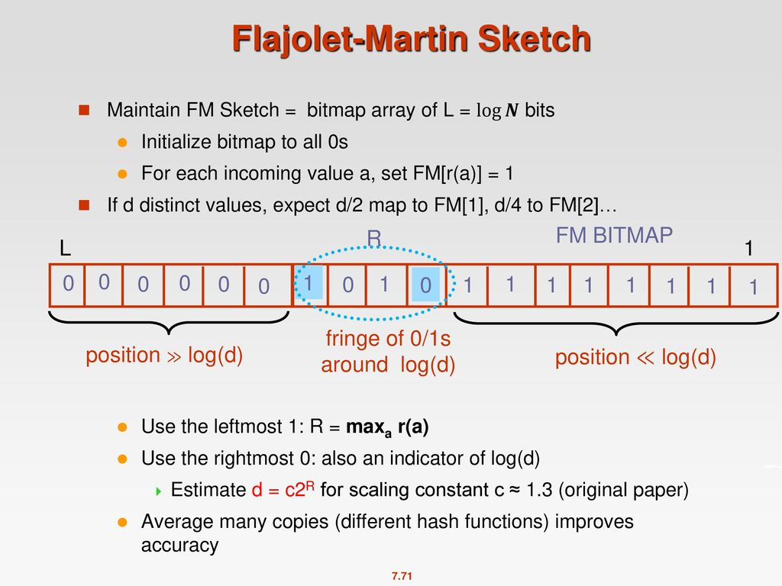
REF:COMP9313: Big Data Management Lecturer: Xin Cao Course

Slide 21
FM sketch(given c, consider Z’s position)
2^{τ2} *√2
2^{τ2 +1} *√2
2^{τ1} *√2
D/3
3D
τ2
τ2 + 1
τ1

Slide 22
Xr
assume ½ , ¼ , ⅛ , 1/16,1/16
r=0,1,2,3,4
cdf = 1,½,¼,1/8/1,16
#被8整除但不被16整除 + #被16整除 = #被8整除 ->機率為⅛
#被4整除但不被8整除 + #被8整除 = #被4整除 ->機率為1/4

Slide 23
Some other values of interest
1.heavy hitters
2.range queries
make use of f1 frequency estimation of each element

Slide 24
Heavy hitter problem
find the element with prob. higher than some threshold
can apply count-min sketch to solve

Slide 25
Range queries
asking how many elements in the stream have value between a and b?

Slide 26
Count-min sketch
to compute a given element’s frequency, namely f_{i}
1.d independent hash functions
2.and return the min of d buckets

Slide 27
Count-min sketch
maintain a relatively small space for operation
utilizes Markov-inequality

Slide 28
Count sketch
similar to count-min sketch
when assign element into a particular bucket, will multiply with either[-1,1]
hight level: can cancel out false hit effects for those high frequency elements

