Slide 1
Submodular Maximization and Influence Maximization
Sheng-Hao Chiang

Slide 2
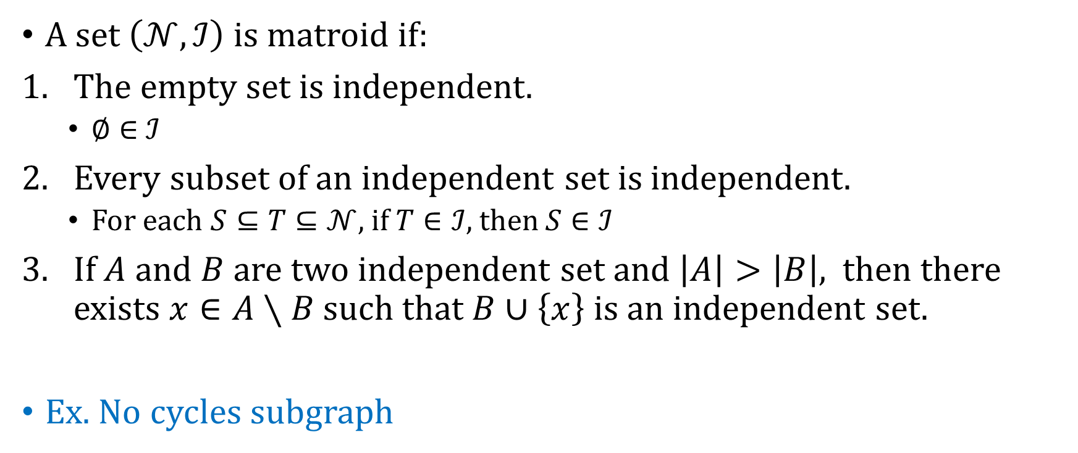
Matroid
A set $\left(𝒩,ℐ\right)$ is matroid if:
The empty set is independent.
$∅∈$ $ℐ$
Every subset of an independent set is independent.
For each $S⊆T⊆𝒩$, if $T∈ℐ$, then $S∈ℐ$
If $A$ and $B$ are two independent set and $\left|A\right|>\left|B\right|$, then there exists $x∈A∖B$ such that $B∪\left\{x\right\}$ is an independent set.
Ex. No cycles subgraph

Slide 3
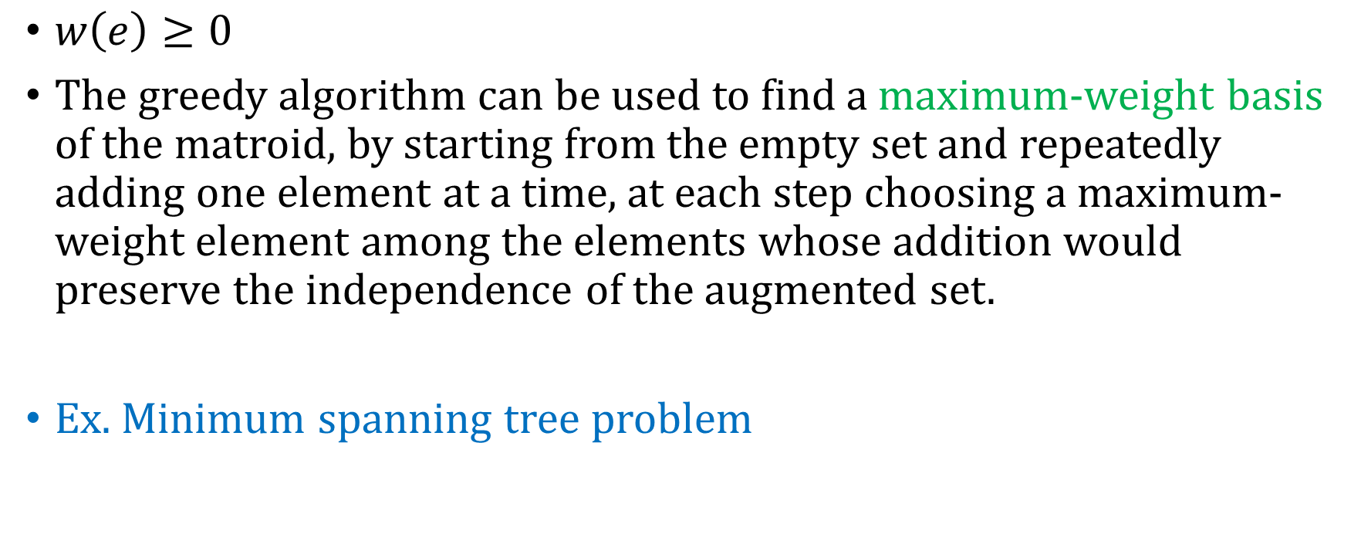
Matroid
$w\left(e\right)≥0$
The greedy algorithm can be used to find a maximum-weight basis of the matroid, by starting from the empty set and repeatedly adding one element at a time, at each step choosing a maximum-weight element among the elements whose addition would preserve the independence of the augmented set.
Ex. Minimum spanning tree problem

Slide 4
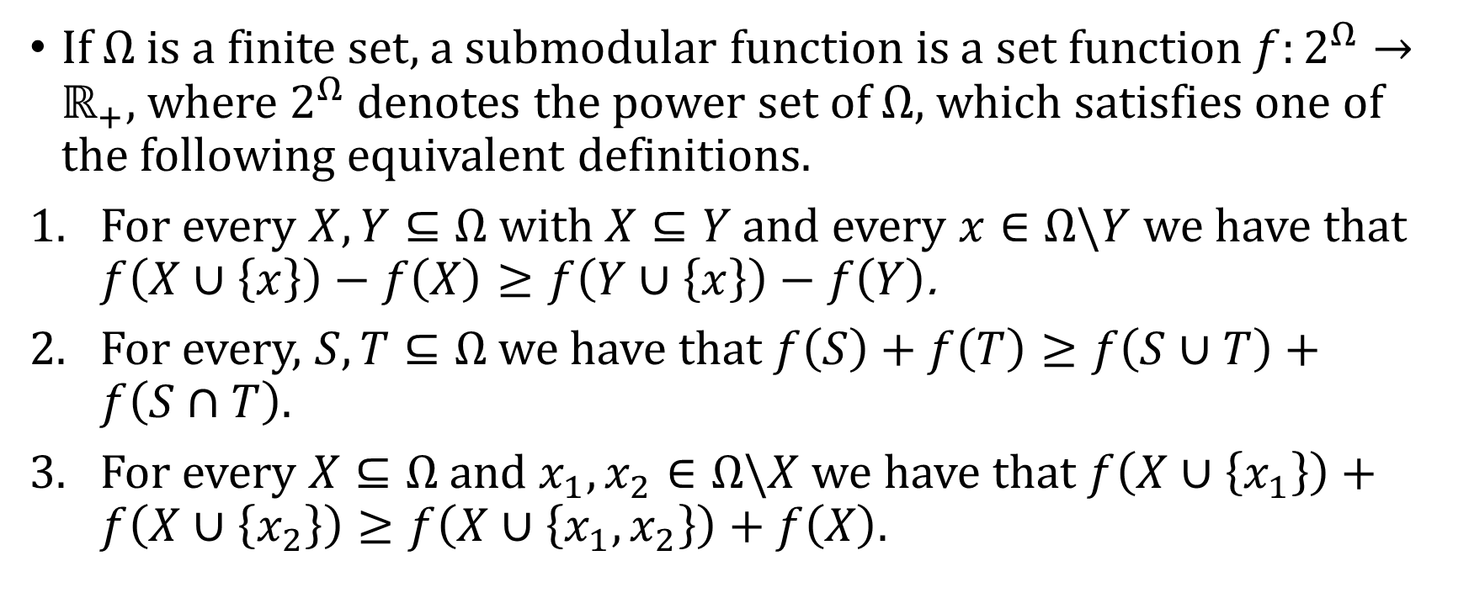
Submodular function
If $Ω$is a finite set, a submodular function is a set function $f:2^{Ω}→ℝ_{+}$, where $2^{Ω}$ denotes the power set of $Ω$, which satisfies one of the following equivalent definitions.
For every $X,Y⊆Ω$ with $X⊆Y$ and every $x∈Ω\backslash Y$ we have that $f\left(X∪\left\{x\right\}\right)−f\left(X\right)≥f\left(Y∪\left\{x\right\}\right)−f\left(Y\right)$.
For every, $S,T⊆Ω$ we have that $f\left(S\right)+f\left(T\right)≥f\left(S∪T\right)+f\left(S∩T\right)$.
For every $X⊆Ω$ and $x_{1},x_{2}∈Ω\backslash X$ we have that $f\left(X∪\left\{x_{1}\right\}\right)+f\left(X∪\left\{x_{2}\right\}\right)≥f\left(X∪\left\{x_{1},x_{2}\right\}\right)+f\left(X\right)$.

Slide 5
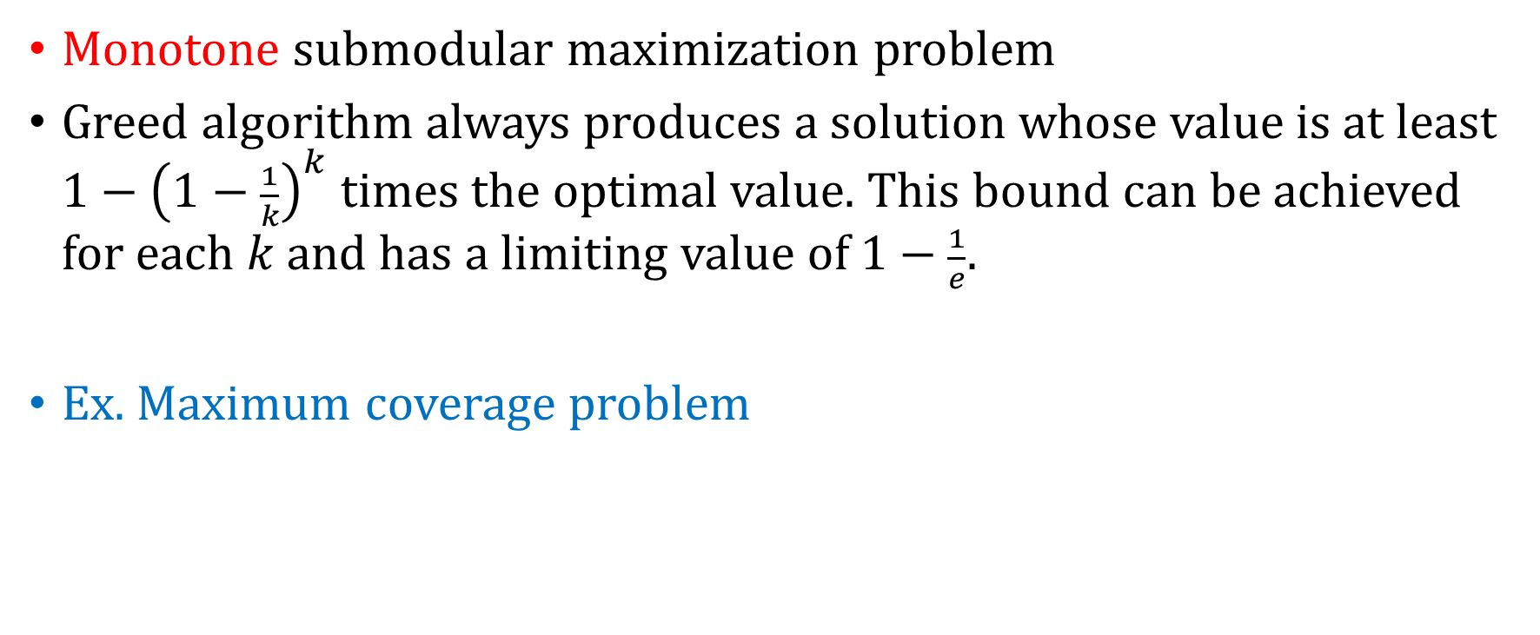
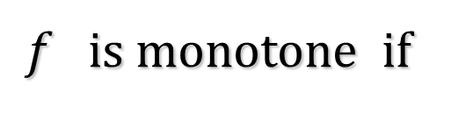
Submodular function
Monotone submodular maximization problem
Greed algorithm always produces a solution whose value is at least $1−{\left(1−\frac{1}{k}\right)}^{k}$ times the optimal value. This bound can be achieved for each $k$ and has a limiting value of $1−\frac{1}{e}$.
Ex. Maximum coverage problem
$f$ is monotone if

Slide 6
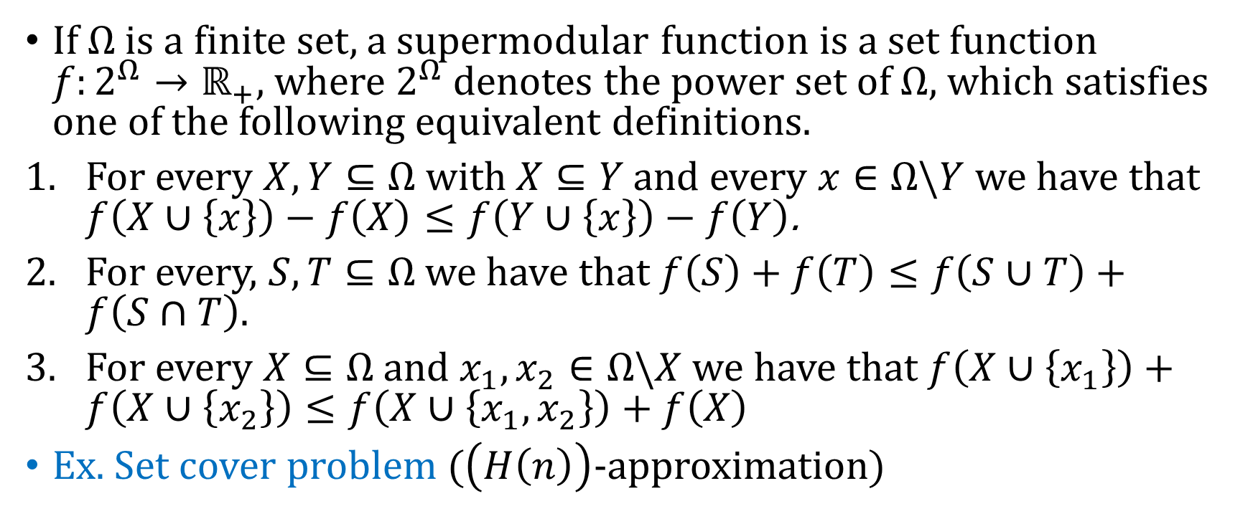
Supermodular function
If $Ω$is a finite set, a supermodular function is a set function $f:2^{Ω}→ℝ_{+}$, where $2^{Ω}$ denotes the power set of $Ω$, which satisfies one of the following equivalent definitions.
For every $X,Y⊆Ω$ with $X⊆Y$ and every $x∈Ω\backslash Y$ we have that $f\left(X∪\left\{x\right\}\right)−f\left(X\right)≤f\left(Y∪\left\{x\right\}\right)−f\left(Y\right)$.
For every, $S,T⊆Ω$ we have that $f\left(S\right)+f\left(T\right)≤f\left(S∪T\right)+f\left(S∩T\right)$.
For every $X⊆Ω$ and $x_{1},x_{2}∈Ω\backslash X$ we have that $f\left(X∪\left\{x_{1}\right\}\right)+f\left(X∪\left\{x_{2}\right\}\right)≤f\left(X∪\left\{x_{1},x_{2}\right\}\right)+f\left(X\right)$
Ex. Set cover problem ($\left(H\left(n\right)\right)$-approximation)

Slide 7
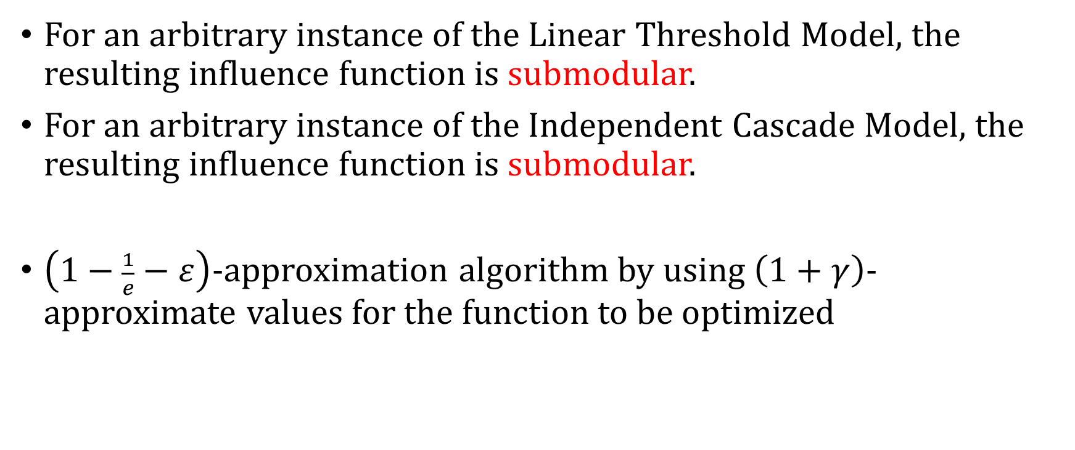
Maximizing the spread of influence in a social network
For an arbitrary instance of the Linear Threshold Model, the resulting influence function is submodular.
For an arbitrary instance of the Independent Cascade Model, the resulting influence function is submodular.
$\left(1−\frac{1}{e}−ε\right)$-approximation algorithm by using $\left(1+γ\right)$-approximate values for the function to be optimized

