Slide 1
Study Group
Mar 8

Slide 2
Agenda
Basic Streaming Model (and a few examples)
Probabilistic Methods
Union Bound
Local Lemma (Symmetric Case)
Play VR

Slide 3
Streaming Model (1/3)
Input: A stream (sequence) S of data is given one by one to algorithms.
Requirement: Algorithms are allowed to use o(|S|) space.
Output: Write the solution to a write-only stream.
O(poly log |S|) = O(log^{k} |S|)
for some constant k.
In the literature, streaming algorithms are defined to be those algorithms that use O(poly log |S|) space. However, this requirement may be relaxed for some domains.

Slide 4
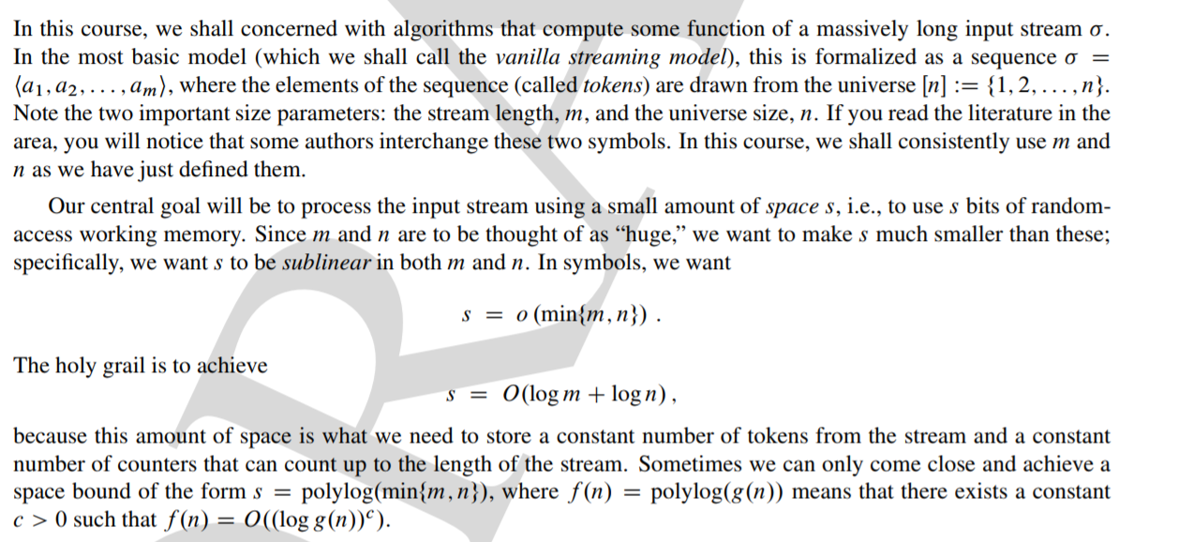

Slide 5
Streaming Model (3/3)
Algorithms may scan the input from the beginning to the end multiple times, say p times, which are called p-pass algorithms.

Slide 6
Example 1 - Min
Input: A stream (sequence) S of integers is given one by one to algorithms.
Requirement: Algorithms are allowed to use o(|S|) space.
Output: Write minx∈S x to a write-only stream.
Yes, O(1) = o(|S|) space suffice.
How to find the k-th smallest integers in S where k ≪ |S|?

Slide 7
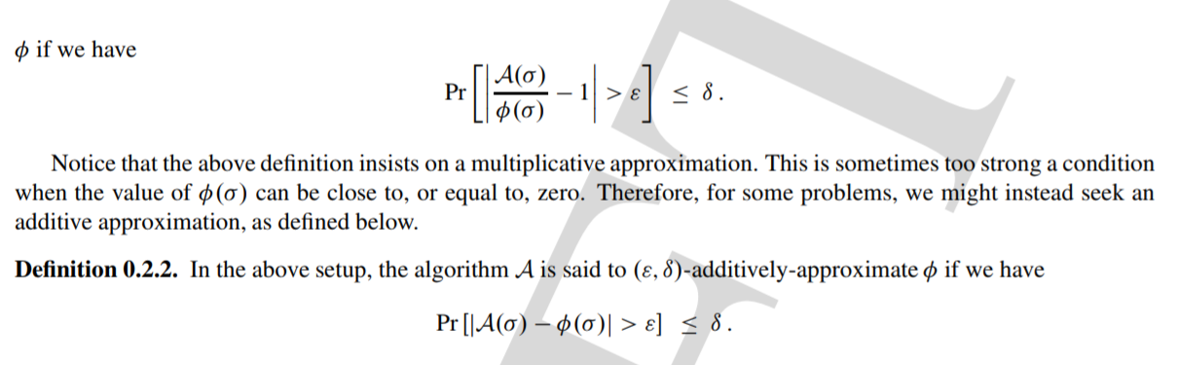

Slide 8
Frequency Related Problems
Top-k most frequent elements
1 2 3 4 5 6 7 8 9 10 11 12 13 14 15 16 17 18 19 20
Find all elements
with frequency > 0.1%
What is the frequency
of element 3?
What is the total frequency
of elements between 8 and 14?
How many elements have non-zero frequency?

Slide 9
An Old Chestnut: Majority
A sequence of N items.
You have constant memory.
In one pass, decide if some item is in majority (occurs > N/2 times)?
2
9
9
9
7
6
4
9
9
9
3
9
N = 12; item 9 is majority

Slide 10
Misra-Gries Algorithm (‘82)
A counter and an ID.
If new item is same as stored ID, increment counter.
Otherwise, decrement the counter.
If counter <0, store new item with count = 1.
If counter > 0, then its item is the only candidate for majority.
Space O(logN) ( for the counter ) + O(logM) ( for the ID )
 | 2 | 9 | 9 | 9 | 7 | 6 | 4 | 9 | 9 | 9 | 3 | 9
ID | 2 | 2 | 9 | 9 | 9 | 9 | 4 | 4 | 9 | 9 | 9 | 9
count | 1 | 0 | 1 | 2 | 1 | 0 | 1 | 0 | 1 | 2 | 1 | 2

Slide 11
A generalization: Frequent Items (Karp 03)
Find k items, each occurring at least N/(k+1) times.
Algorithm:
Maintain k items, and their counters.
If next item x is one of the k, increment its counter.
Else if a zero counter, put x there with count = 1
Else (all counters non-zero) decrement all k counters
ID
ID₁
ID₂
.
.
.
.
ID_{k}
count
.
.

Slide 12
Problem of False Positives
False positives in Misra-Gries(MG) algorithm
It identifies all true heavy hitters, but not all reported items are necessarily heavy hitters.
How can we tell if the non-zero counters correspond to true heavy hitters or not?
A second pass is needed to verify.
False positives are problematic if heavy hitters are used for billing or punishment.
What guarantees can we achieve in one pass?

Slide 13
Approximation Guarantees
Find heavy hitters with a guaranteed approximation error [MM02]
Manku-Motwani (Lossy Counting)
Suppose you want ϕ-heavy hitters --- items with freq > ϕN
An approximation parameter ε, where ε << ϕ. (E.g., ϕ = .01 and ε = .0001; ϕ = 1% and ε = .01% )
Identify all items with frequency > ϕ N
No reported item has frequency < (ϕ - ε)N
The algorithm uses O(1/ε log (εN)) memory

Slide 14
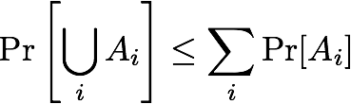
The Union Bound
The union bound, a.k.a. Boole's inequality, is stated as follows. For any countable set of probablistic events A1, A2, ..., we have
Note that Ai's may be dependent or independent.

Slide 15
Coloring Hypergraphs
We say a hypergraph is 2-colorable if there exists a coloring on nodes so that every edge is not monochromatic.
Recall that a hypergraph H = (V, E) is defined as ordinary graphs except that each edge e ∈ E is a subset of V. We say a hypergraph k-uniform if all edges in E has cardinality k.

Slide 16
Coloring Hypergraphs
We say a hypergraph is 2-colorable if there exists a coloring on nodes so that every edge is not monochromatic.
Recall that a hypergraph H = (V, E) is defined as ordinary graphs except that each edge e ∈ E is a subset of V. We say a hypergraph k-uniform if all edges in E has cardinality k.
Theorem 2. Let H be a k-uniform hypergraph.
If |E| ≤ 2^{k-1}, then H is 2-colorable.
Proof Strategy. Assign a random 2-coloring on H.

Slide 17

Coloring Hypergraphs
Let Ae for each e ∈ H be the event that e is monochromatic.
Thus, Pr[Ae] $=$ 1/2^{k-1}. (Why?)
By the Union Bound
Pr [Some e is monochromatic] $≤$ 2^{k-1} $×$1/2^{k-1} = 1
Pr [No e is monochromatic] $≥0$

Slide 18
Objectives
Introduce Lovasz Local Lemma (LLL)
one of the most elegant and useful tools in the probabilistic method
Two versions:
symmetric case
general case

Slide 19
Lovasz Local Lemma
Let E₁, E₂, …, E_{n} be a set of BAD events
Suppose each occurs with prob < 1
Fact: If they are mutually independent, it is easy to see that
Pr(no BAD events) > 0 … [why?]
However, in many natural scenario, the BAD events are not mutually independent
Problem: Can we still easily show that Pr(no BAD events) > 0 ?

Slide 20
Lovasz Local Lemma (2)
In general, probably not…
But, if there are not many dependency among the BAD events, then the set of events are ‘roughly’ mutually independent
➔ we may still be able to show Pr(no BAD events) > 0 …
Lovasz Local Lemma gives sufficient conditions when we can do so …
– It relies on a concept of dependency graph defined as follows (next slide)

Slide 21
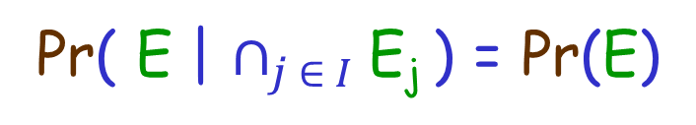
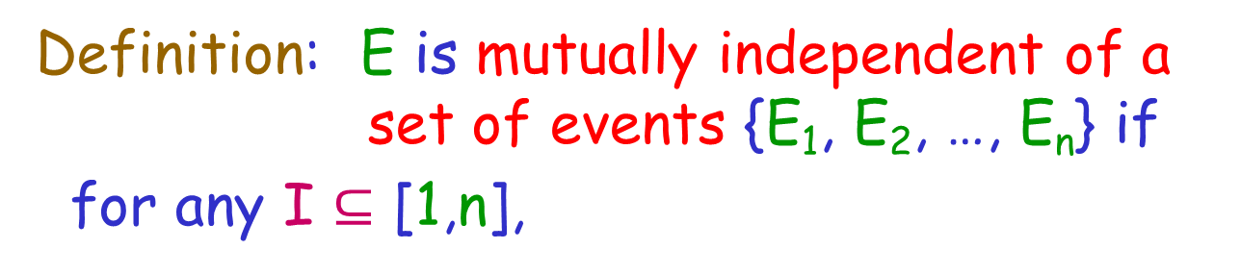
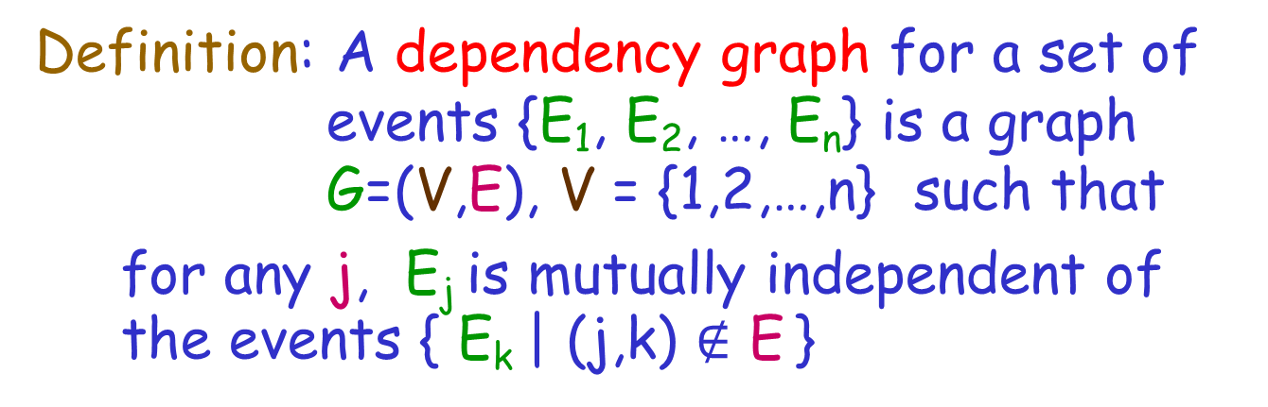
Dependency Graph
Let E be an event
Definition: E is mutually independent of a set of events {E₁, E₂, …, E_{n}} if
for any I $⊆$ [1,n],
Pr( E | $∩_{j ∈ I}$E_{j} ) = Pr(E)
Definition: A dependency graph for a set of events {E₁, E₂, …, E_{n}} is a graph G=(V,E), V = {1,2,…,n} such that
for any j, E_{j} is mutually independent of the events { E_{k} | (j,k) $∉$ E }

Slide 22
Dependency Graph (2)
Test your understanding:
Let S be a set of pair-wise independent events. Is a graph with no edges always a dependency graph of S ?
Let S be a set of events.
Is the dependency graph of S unique?
The answers are NO for both questions…

Slide 23
Dependency Graph (3)
Consider flipping a fair coin twice.
Let E₁ = the first flip is head E₂ = the second flip is tail
E₃ = the two flips are the same
➔ the events are pairwise independent
We see that if a graph has less than 2 edges, it must not be a dependency graph
On the other hand, any graph with 2 or more edges is a dependency graph !!!

Slide 24

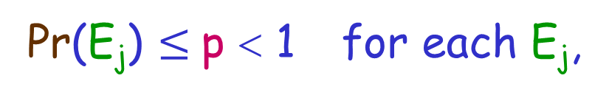
Lovasz Local Lemma
(Symmetric Case)
Theorem: Let G be a dependency graph of a set of BAD events { E₁, E₂, …, E_{n} }. If
(i)
Pr(E_{j}) $≤$p < 1 for each E_{j},
1 $≤$ maxdeg(G) $≤$ d, and
ep(d+1) $≤$ 1
then Pr(no BAD events) > 0
Remark: If maxdeg(G) = 0, then Pr(no BAD events) > 0 since all events are mutually independent

Slide 25
Coloring Hypergraphs (Revisited)
We say a hypergraph is 2-colorable if there exists a coloring on nodes so that every edge is not monochromatic.
Recall that a hypergraph H = (V, E) is defined as ordinary graphs except that each edge e ∈ E is a subset of V. We say a hypergraph k-uniform if all edges in E has cardinality k.
Theorem 2. Let H be a k-uniform hypergraph and each edge in H has an non-empty intersection with at most d other edges.
If (d+1) ≤ 2^{k-1}/e, then H is 2-colorable.

Slide 26
Comparison
Union Bound:
If |E| ≤ 2^{k-1}, then H is 2-colorable.
LLL:
If (d+1) ≤ 2^{k-1}/e, then H is 2-colorable.
Q: Which bound is tighter?

Slide 27
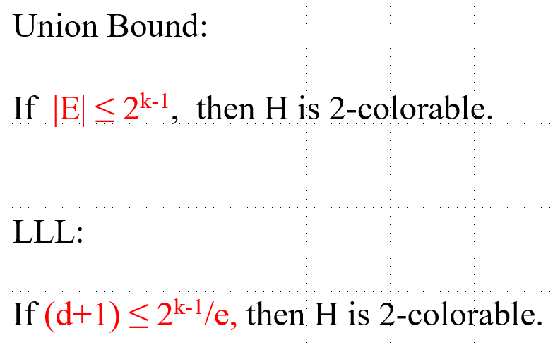
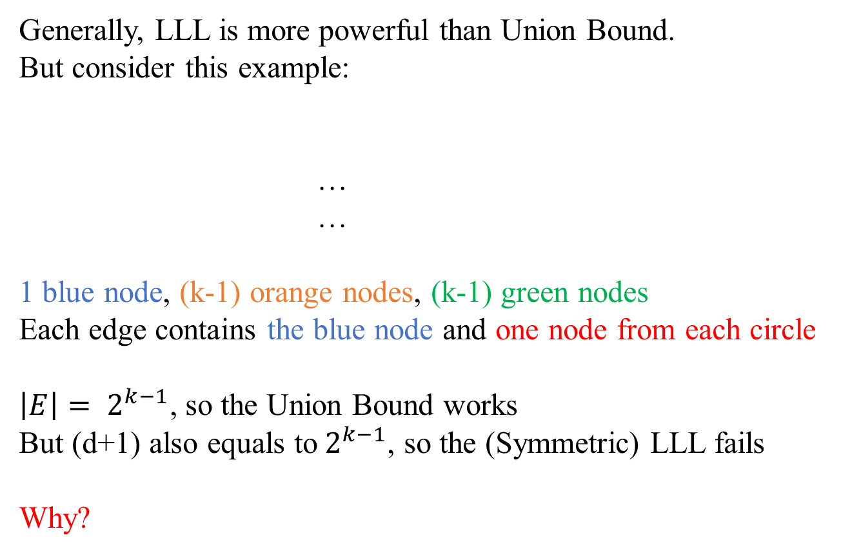
Comparison
Generally, LLL is more powerful than Union Bound.
But consider this example:
…
…
1 blue node, (k-1) orange nodes, (k-1) green nodes
Each edge contains the blue node and one node from each circle
$\left|E\right|= 2^{k−1}$, so the Union Bound works
But (d+1) also equals to$2^{k−1}$, so the (Symmetric) LLL fails
Why?

