Slide 1
Yao’s Minmax Principle

Slide 2
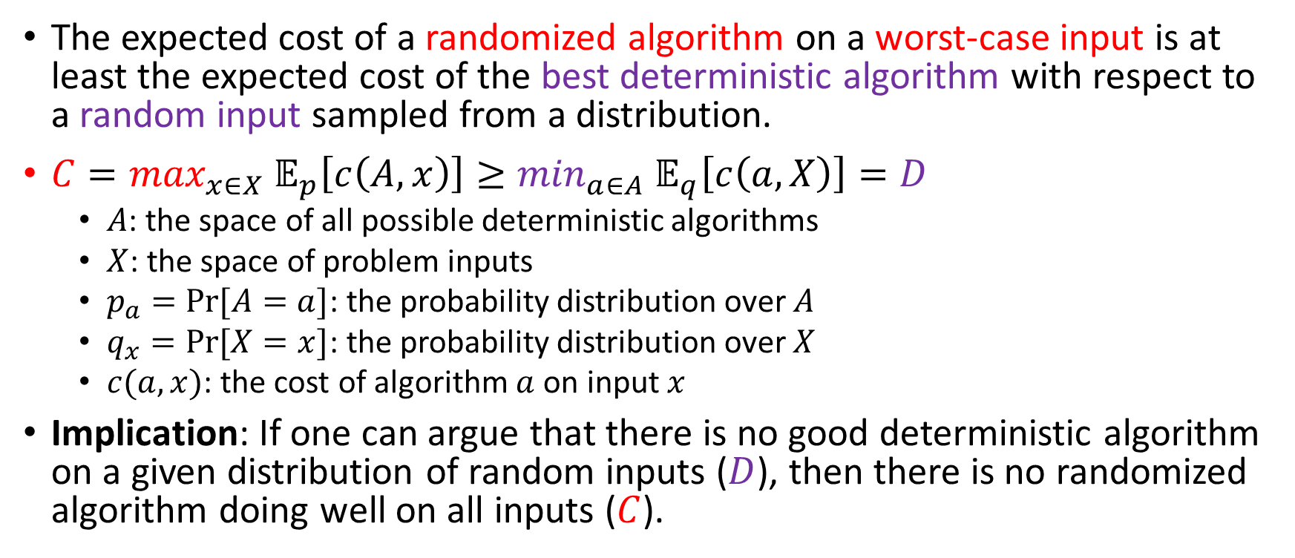
Yao’s Minmax Principle
The expected cost of a randomized algorithm on a worst-case input is at least the expected cost of the best deterministic algorithm with respect to a random input sampled from a distribution.
$C=\max_{x∈X} 𝔼_{p}\left[c\left(A,x\right)\right]≥\min_{a∈A} 𝔼_{q}\left[c\left(a,X\right)\right]=D$
$A$: the space of all possible deterministic algorithms
$X$: the space of problem inputs
$p_{a}=Pr⁡[A=a]$: the probability distribution over $A$
$q_{x}=Pr⁡[X=x]$: the probability distribution over $X$
$c(a,x)$: the cost of algorithm $a$ on input $x$
Implication: If one can argue that there is no good deterministic algorithm on a given distribution of random inputs ($D$), then there is no randomized algorithm doing well on all inputs ($C$).

Slide 3
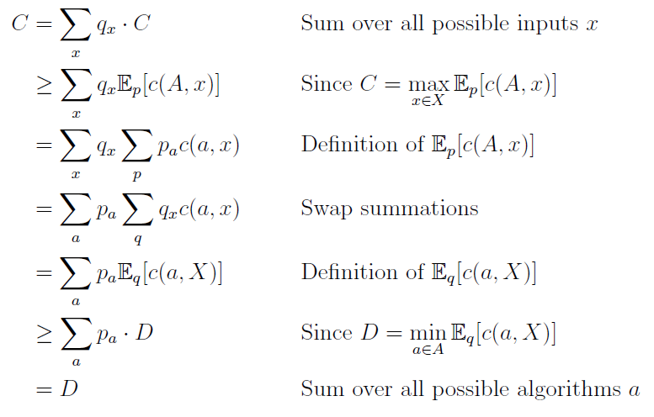
Yao’s Minmax Principle
$$C=\max_{x∈X} 𝔼_{p}\left[c\left(A,x\right)\right]≥\min_{a∈A} 𝔼_{q}\left[c\left(a,X\right)\right]=D$$

Slide 4

Application to The Paging Problem
Any (randomized) algorithm has competitive ratio $Ω(\log{k})$ against an oblivious adversary. (See the proof in Chapter 14)
Oblivious adversary: the adversary designs the input sequence $σ$ at the beginning. It does not know any randomness used by the online algorithm

