Slide 1
專題期末報告 INTERACTIVE SECURE NETWORK CODING
EE_III 柯劭珩 Shao-Heng Ko
June 28, 2014
Notes:
haha

Slide 2
Outline
Conceptual Introduction
Studied References
Modeling & Sub-problems
Results on Single-Group, Two-Way
Results on Single-Group, Multiple-Way
Future Plan, Q&A

Slide 3
CONCEPTUAL INTRODUCTION
Notes:
我現在要依序定義這三個字

Slide 4
Interactive
Secure Network Coding
Network Coding
Flow Network

Slide 5
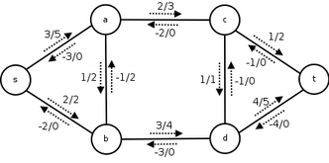
FLOW NETWORK
G = (V, E)
Vertices (Nodes)
Edges (Channels)
C(e): Edge Capacity
Directional

Slide 6
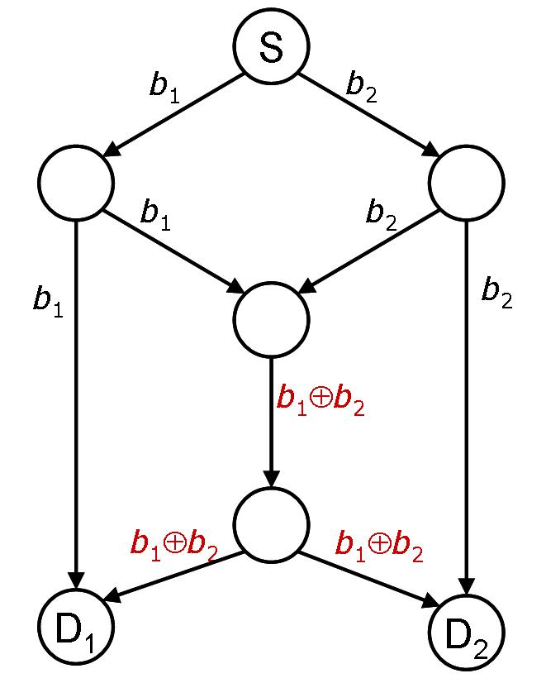
NETWORK CODING
Collecting the information received and mixing them into another information packet
Linear Coding

Slide 7
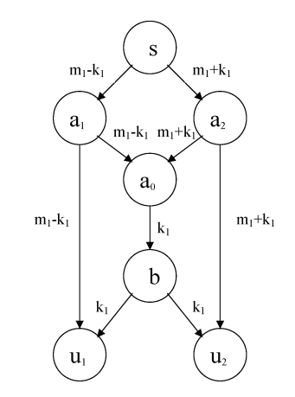
SECURE NETWORK CODING
Wiretap network (Source – User)
Compromised sets of channels
Secret Key
Criteria for security
R-secure

Slide 8
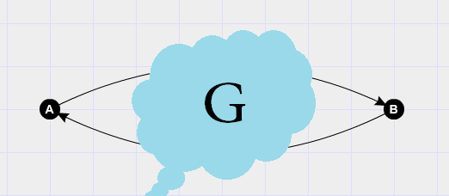
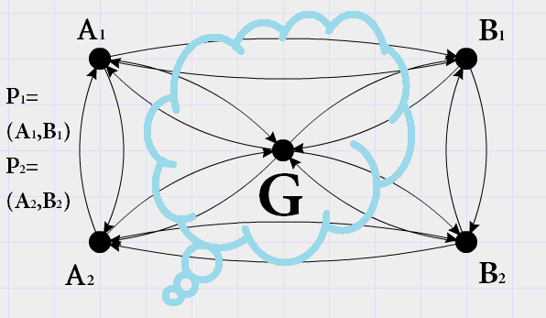
INTERACTIVE SECURE NETWORK CODING
Cyclic Wiretap Network
User nodes
Groups
Key recycling
Key distribution

Slide 9
MOTIVATION
To find an efficient way to ensure security
Resource are divided into two parts
Reduce / Increase
Key-recycling
Key-distribution
Passing Data
Passing Secret Keys

Slide 10
REFERENCES & THEORETICAL BASIS
Notes:
我現在要依序定義這三個字

Slide 11
STUDIED PAPERS
SECURE NETWORK CODING ON A WIRETAP NETWORK, by Yeung & Cai, Jan 2011
POLYNOMIAL TIME ALGORITHMS FOR MULTICAST NETWORK CODE CONSTRCUTION, by Jaggi et al, June 2005
A SECURITY CONDITION FOR MULTI-SOURCE LINEAR NETWORK CODING, by Yeung & Cai, June 2007
A GENERAL SECURITY CONDITION FOR MULTI-SOURCE LINEAR NETWORK CODING, by Zhang & Yeung

Slide 12
LINEAR NETWORK CODING
Single-source acyclic uniform-capacity flow network
Multicast from S to all D with rate = the minimum of max-flows from S to any D
Polynomial Time Algorithm
(NETWORK CODING, by Li, Yeung & Cai, Feb 2003)
(Algorithm: Jaggi et al, June 2005)

Slide 13
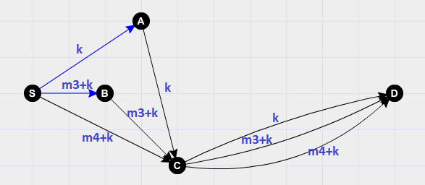
SECURE NETWORK CODING
Single-source s, Single-destination d, Acyclic, Uniform-Capacity flow network with only source generating secret keys,
It exists r-secure linear coding scheme capacity = cut(s; d) – r
(SECURE NETWORK CODING ON A WIRETAP NETWORK, Yeung & Cai, Jan 2011)

Slide 14
MODELING & SUB-PROBLEMS
Notes:
我現在要依序定義這三個字

Slide 15
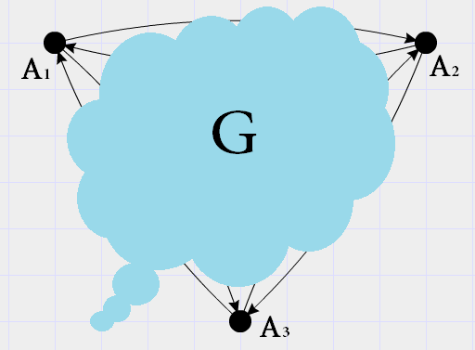
INTERACTIVE WIRETAP NETWORK
Security Constraint R
Traffic Pattern
Single-Group Two-Way
Single-Group Multi-Way
Multi-Group Two-Way
Multi-Group Multi-Way

Slide 16
RESULTS ON SINGLE-GROUP TWO-WAY
Notes:
我現在要依序定義這三個字

Slide 17
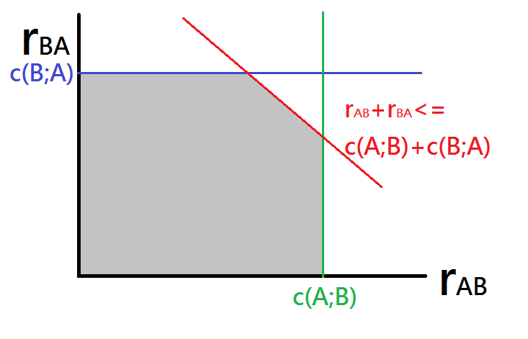
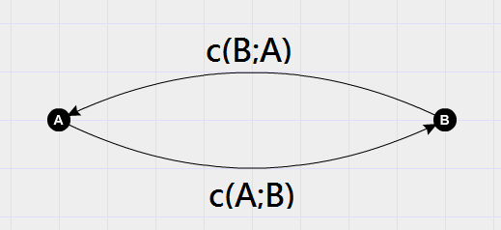
THROUGHPUT REGION
-r

Slide 18
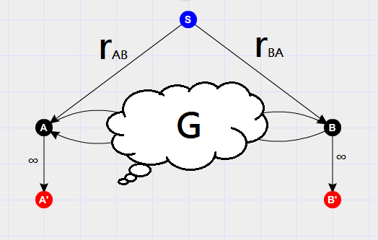
EQUIVALENT MODEL
Modify into a multicast network model
Ignore security issues first

Slide 19
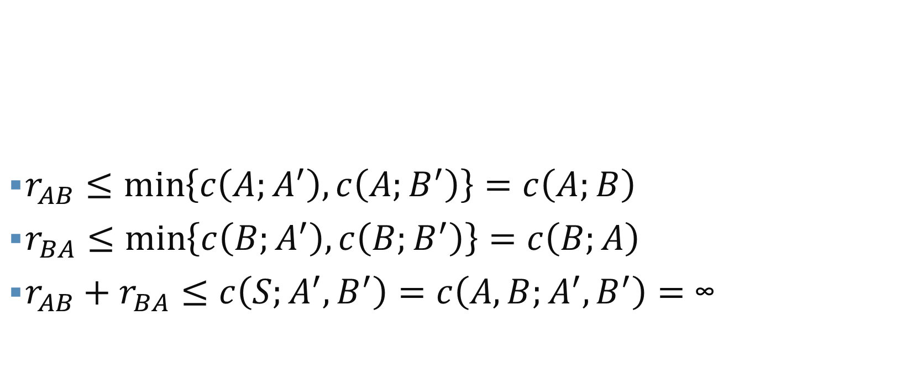
EQUIVALENT MODEL
$r_{AB}≤\min\left\{c\left(A;A^{′}\right),c\left(A;B^{′}\right)\right\}=c\left(A;B\right)$
$r_{BA}≤\min\left\{c\left(B;A^{′}\right),c\left(B;B^{′}\right)\right\}=c\left(B;A\right)$
$r_{AB}+r_{BA}≤c\left(S;A^{′},B^{′}\right)=c\left(A,B;A^{′},B^{′}\right)=\text{∞}$

Slide 20
THROUGHPUT REGION
Moves according to r
-r

Slide 21

UPPER BOUND ACHIEVEMENT
Completed in every case of the simple network
Misunderstanding of model & finding stronger implementation
Time-Varying Compromised set
“Dimensional Race”

Slide 22
RESULTS ON SINGLE-GROUP MULTI-WAY
Notes:
我現在要依序定義這三個字

Slide 23
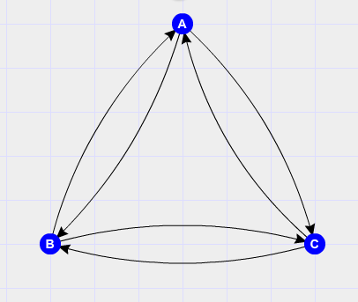
STUDIED MODEL
Uniform Capacity
Total Capacity = 6
Security Constraint = 1
Total throughput = ?
4?
5?

Slide 24
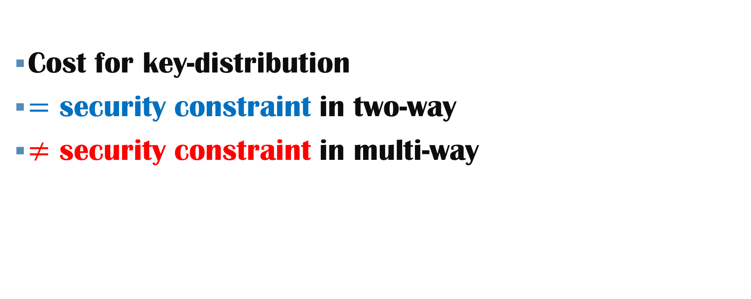
MAJOR DIFFERENCE BETWEEN TWO-WAY & MULTI-WAY
Cost for key-distribution
$=$ security constraint in two-way
$≠$ security constraint in multi-way

Slide 25
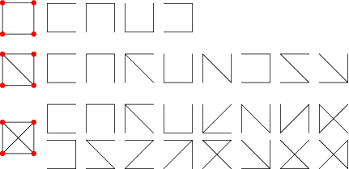
FACT & CONCEPT
Total capacity = Total throughput + Key-Distribution Cost
Key-Distribution Cost = (Security Constraint) times (Size of Spanning Tree)

Slide 26
DIAGRAM OF “DISTRIBUTED SECRET KEYS PROTOCOL”
Key Distribution
Security Encoding
Network Coding
Sequential flow of secret keys distribution
Key-acknowledgement
Once keys are known, it reduces to secure network coding

Slide 27
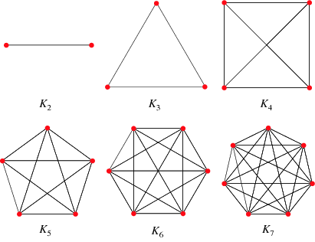

RESULTS
In n-complete network, total throughput = ${(n−1)}^{2}$
(Dual-link with capacity 1)

Slide 28
RESULTS
In most network (sufficiently connected), using only one set of secret keys is ideal
In multi-way, the individual throughput depends on the network structure (In two-way, only depends on cut value)

Slide 29
CONCLUSION
Key Distribution
Secure Coding
Network Coding

Slide 30
CONCLUSION
Single-Group Two-Way : Solved
Single-Group Multi-Way : Partially discussed
Discovered concept:
Key Distribution

Slide 31
FUTURE PLAN
Notes:
我現在要依序定義這三個字

Slide 32
SINGLE-GROUP, TWO-WAY
Explicitly prove the upper bound
Implement the algorithm

Slide 33
SINGLE-GROUP, MULTI-WAY
Find the sufficient condition for distributed-key protocol
Implement the protocol

Slide 34
MULTI-GROUP
Beyond Imagination

Slide 35
Q&A
Notes:
我現在要依序定義這三個字

Slide 36
THANK YOU!
Notes:
我現在要依序定義這三個字

