Slide 1
專題研究期末報告
電機三 柯劭珩
Jan 16, 2014
Notes:
haha

Slide 2
Outline
Introduction of my problem and its model
Studied References
Theoretical Basis
Results
Future Plan

Slide 3
Secure Network coding
Notes:
我現在要依序定義這三個字

Slide 4
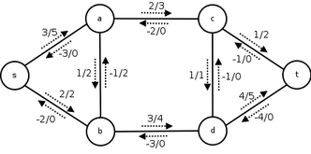
network
We represent a Flow Network with a Mathematical Graph G = (V, E), which contains
V: Set of Vertices (Nodes)
E: Set of Edges (Channels)
In particular, in the model we are interested in a graph with
C(e): Each edge has a Capacity
Each edge is directional

Slide 5
Network (TERMINOLOGY)
A 1-1 Flow Network has
One source node s
One sink (destination) node t (or d)
While a Flow from i to j means the amount of information that comes from i and arrives at j
At each node, input flow = output flow

Slide 6
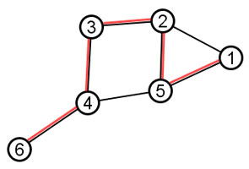
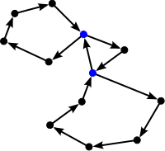
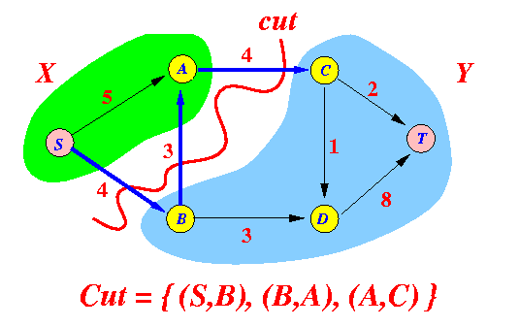
Network (TERMINOLOGY)
Path
Cycle
Cut
Max Flow – Min Cut Theorem The maximum value of a s-t flow is equal to the minimum capacity over all s-t cuts.

Slide 7
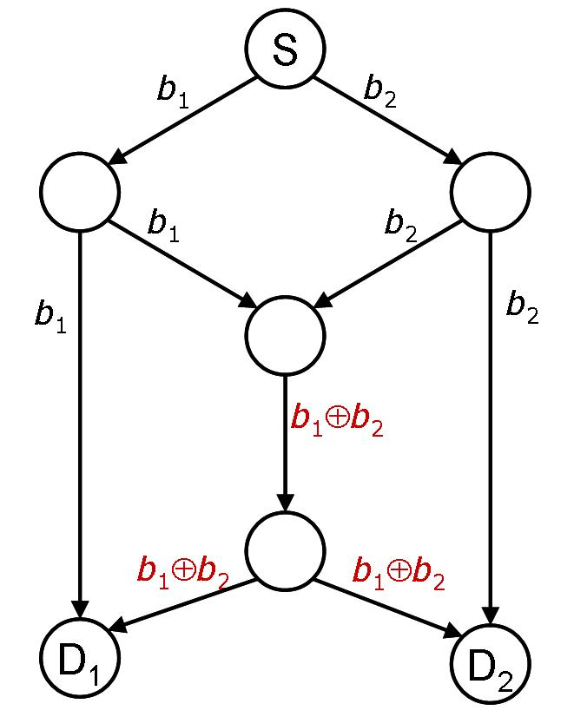
CODING
Coding in a flow network means
Instead of only relaying the information, a node collects the information it receives and mix them together into another information packet
If the mixing is linear, it is Linear Coding

Slide 8
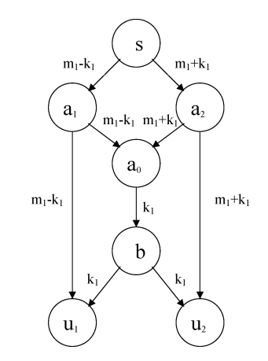
SECURE
A wiretap network is a network that may be attacked by eavesdroppers
The channels attacked are random (unknown)
With secret keys and network coding, we can prevent any eavesdropper from the secret
A wiretap network scheme is r-secure if any eavesdropper who can attack at most r edges can obtain none information about the secret messages (i.e., the secret messages are independent of the wiretapped information in probability)

Slide 9
REFERENCES
Notes:
我現在要依序定義這三個字

Slide 10
STUDIED PAPERS
NETWORK CODING, by Li, Yeung & Cai, Feb 2003
NETWORK CODING: AN INSTANT PRIMER, by Fragouli, Boudec, Widmer, Jan 2006
SECURE NETWORK CODING ON A WIRETAP NETWORK, by Yeung & Cai, Jan 2011

Slide 11
THEORETICAL basis
Notes:
我現在要依序定義這三個字

Slide 12
On linear network coding
In a Single-source, Multi-destination, Acyclic, Uniform-Capacity flow network,
Through linear network coding alone, we can multicast from source to all the destination with rate = the minimum of max-flows from source to any destination
(NETWORK CODING, by Li, Yeung & Cai, Feb 2003)

Slide 13
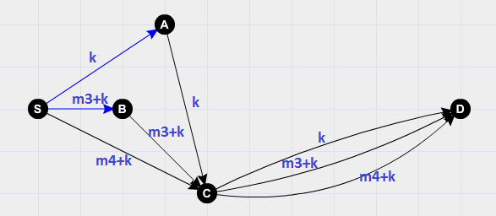
On SECURE network coding
In a Single-source s, Single-destination d, Acyclic, Uniform-Capacity flow network, with only source generating randomed secret keys,
Under secrecy constraint r, it exists a r-secure linear coding scheme with capacity = min-cut(s; d) – r
(SECURE NETWORK CODING ON A WIRETAP NETWORK, Yeung & Cai, Jan 2011)

Slide 14
My problem & research
Notes:
我現在要依序定義這三個字

Slide 15
SECURE network coding with additional property
In the previous secure network coding scheme , (1) every channel is equally like to be attacked (2) only source can generate randomness
My research focus on secure network coding with (1) Some of the channels are protected (from wiretapping) (2) Some of intermediate nodes can generate randomness

Slide 16
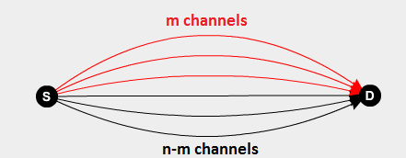
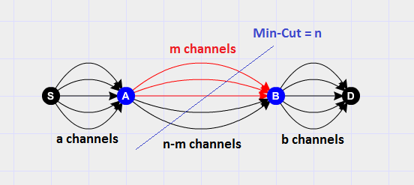
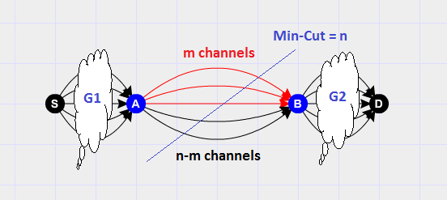
Basic cases studied
I have done in discussing & proving the capacity of r-secure scheme on these 3 basic cases in terms of n, m, a, b or the min-cut value of the subgraphs

Slide 17

Basic cases 1
R-secure capacity = $m+max\left\{n−m−r, 0\right\}$

Slide 18

Basic cases 2
R-secure capacity =
$\min\left\{a−r, m, b−r\right\}+max\left\{n−m−r, 0\right\}$ if B can generate key
$\min\left\{a−r, m, b−r\right\}+$ $n−m−r$ otherwise

Slide 19

Basic cases 3
$A=c\left(S;A\right), B=c(B;D)$, R-secure capacity =
$\min\left\{A−r, m, B−r\right\}+max\left\{n−m−r, 0\right\}$ if B can generate key
$\min\left\{A−r, m, B−r\right\}+$ $n−m−r$ otherwise

Slide 20
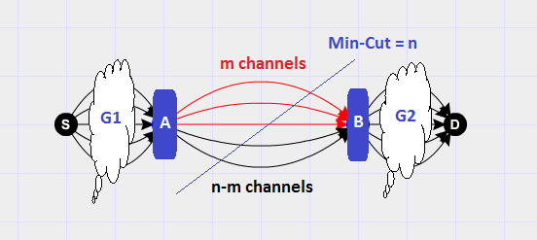
The hard problem
My research is mainly on this subproblem

Slide 21
My approach
First, we focus on maximize the use of the protected part in the min-cut (the red channels). It consists of a mathematical proposal of the upper bound, and an algorithm that tries to achieve it.
After we fully used the protected part, we try to cast more information through the residue network aside from the pre-used channels, but employ key-recycling to optimize the capacity performance

Slide 22
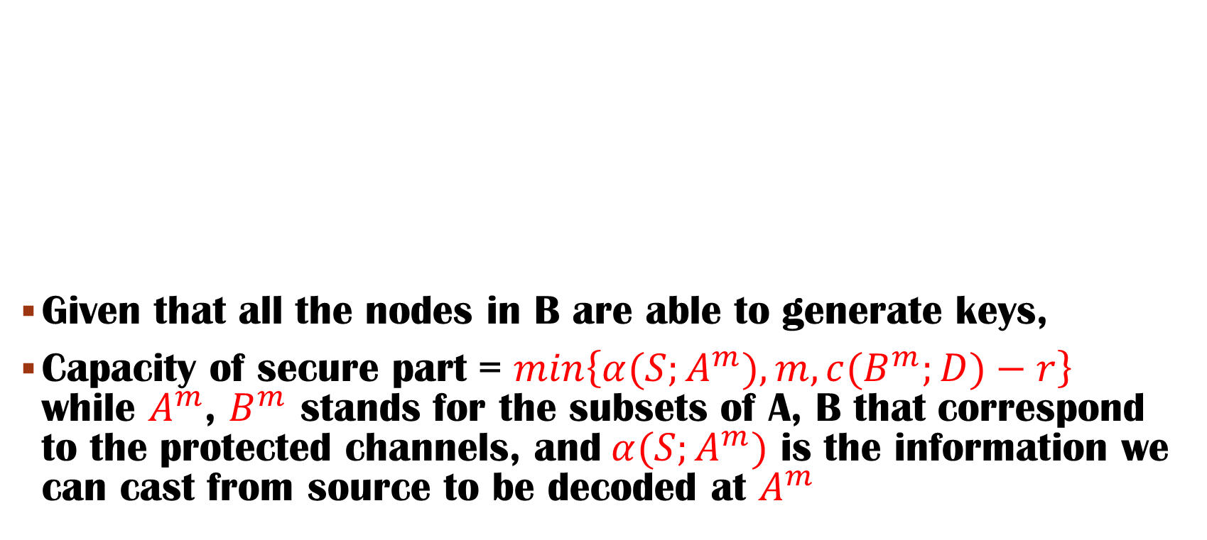
Proposal - Protected part
Given that all the nodes in B are able to generate keys,
Capacity of secure part = $\min\left\{α(S;A^{m}), m, c(B^{m};D)−r\right\}$ while $A^{m}$, $B^{m}$ stands for the subsets of A, B that correspond to the protected channels, and$α(S;A^{m})$ is the information we can cast from source to be decoded at $A^{m}$

Slide 23

Proposal - Protected part
The main difficulty is on deciding $α\left(S;A^{m}\right)$.
(1) To make sense of usage of protected channels, the messages need to be decoded before they are cast through the protected channels.
(2) Also to make sense of usage of protected channels, the B nodes need to be able to regenerate new secret keys to cast from B to destination.

Slide 24

Proposal - Protected part
Here is the unproven result:
Define a partition of $A^{m}$, $𝒫=\left\{A_{1},A_{2},…A_{n}\right\}$ such that
$A_{i}⊆A^{m}∀ 1≤i≤n,$
$A_{i}∩A_{j}=∅$ $∀ 1≤i,j≤n, i≠j,$
$\bigcup_{i=1}^{n}{A_{i}}=A^{m}$
$α\left(S;A^{m}\right)$ = $\min_{𝒫}{\{ \sum_{i=1}^{n}{\min_{i}{\{{\left(c\left(S;A_{i}\right)−r\right)}^{+}, 𝒹(A_{i})}}}\} \}$
$𝒹(A_{i})$ refers to the # of protected channels from $A_{i}$
It is proved to be an upper bound be not yet proved to be achievable.

Slide 25
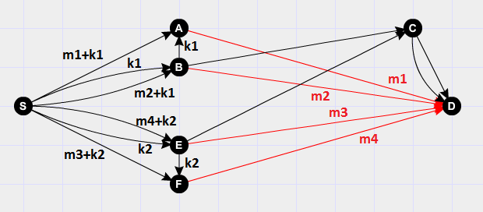
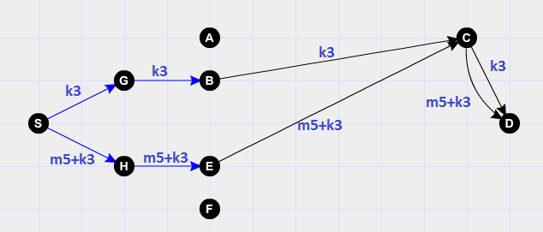
Proposal-UNProtected part
For any scheme that uses the protected part, create its residue network to be the collection of those unused channels
Since some of the nodes in this residue network already contains previous used keys, we add pseudo-nodes and pseudo-channels to the network, to model key-recycling
It is not formally proved but likely, the method I use creates a equivalent network to enhance key-recycling

Slide 26

Proposal–GREEDY ALGORITHm
I have constructed a method to iteratively maximize the flow on all the nodes in $A^{m}$, in any order of nodes, to achieve the upper bound previously mentioned.
An innovative idea of the algorithm is that when the need of a new key arises, if the amount of existing keys have reached $r$, the $r+j$-th key is substituted with $\sum_{i=1}^{r}{k_{i}+{m′}_{j}}$, while ${m′}_{j}$ is also some secret message, and in some cases it can be decoded at the destination.
So far, there are no cases found that causes this method to fail in any order of nodes to achieve the capacity upper bound that I proposed.
However, whether the upper bound is achievable in all cases, and whether this algorithm achieves it in all cases in all order of nodes, are all yet to be proved.

Slide 27
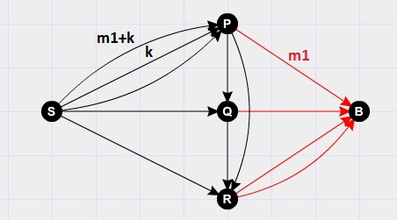
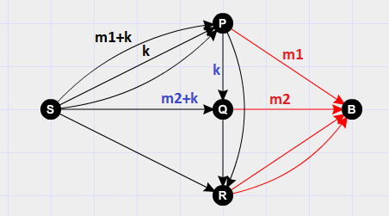
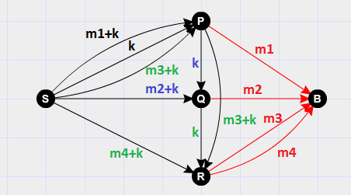

Greedy algorithm
Pick arbitrary node a; do our best to make $c\left(S;a\right)$ full or$𝒹(a)$ full
For every other node, do not alter the used channel, but recycle them as security keys

Slide 28
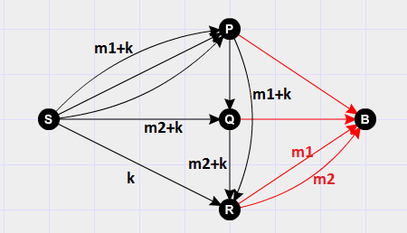
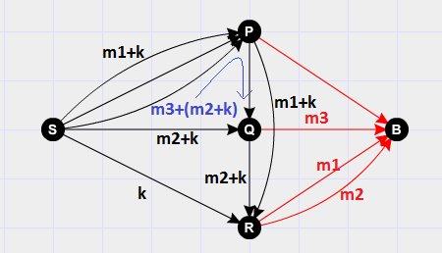
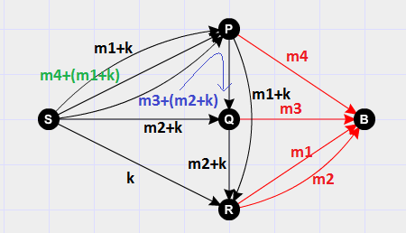
Greedy algorithm
It has now worked on all arbitrary order of nodes
Ex: Previously P→Q→R; Now try R→Q→P
Still achieving full rate

Slide 29
Feedback (CYCLIC) network
I have also studied some of the basic feedback (cyclic) networks which
All channels are equally like to be attacked
Randomness are allowed to be generated at all nodes, especially destination.
Some conclusions on basic cases are found, and a lower bound of capacity improvement on an arbitrary network containing two edge-wise disjoint anti-directed flows is found.
Also I have found some examples of capacity improvement on network that doesn’t meet that same demand.

Slide 30
FUTURE PLAN
Notes:
我現在要依序定義這三個字

Slide 31

Mathematical work
Trying to prove or find flaws in the proposed argument, with use of graph theory and information theory
Further investigation of protected-channel secure networks & feedback secure networks
Algorithm implementing
Trying to implement my method for information casting, with use of existing network coding algorithms and secure networking algorithms.

Slide 32
Q&A time
Notes:
我現在要依序定義這三個字

Slide 33
Thank you
Notes:
我現在要依序定義這三個字

