Slide 1
Lecture 10: Graph Sparsification Algorithms 1
Preserving Distances

Slide 2
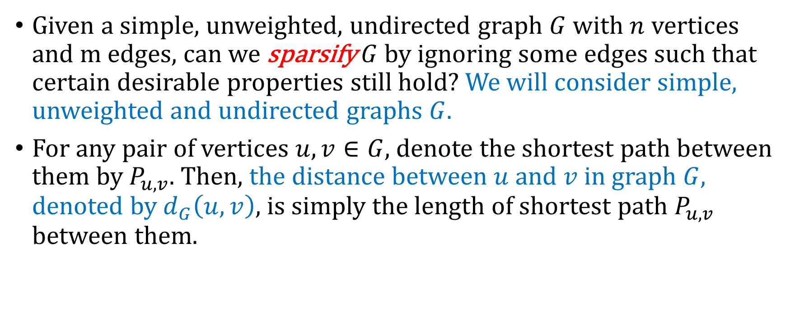
Preserving distances
Given a simple, unweighted, undirected graph $G$ with $n$ vertices and m edges, can we sparsify $G$ by ignoring some edges such that certain desirable properties still hold? We will consider simple, unweighted and undirected graphs $G$.
For any pair of vertices $u,v∈G$, denote the shortest path between them by $P_{u,v}$. Then, the distance between $u$ and $v$ in graph $G$, denoted by $d_{G}\left(u,v\right)$, is simply the length of shortest path $P_{u,v}$ between them.

Slide 3
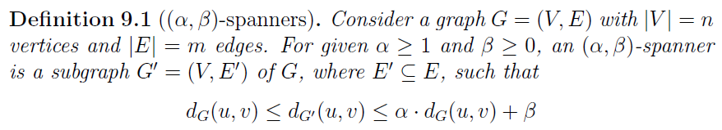





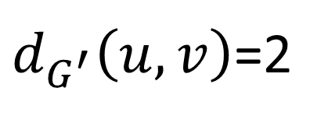

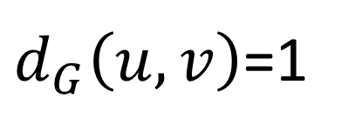
$$v$$
$$v$$
$$u$$
$$u$$
$$G$$
$$G^{′}$$
$d_{G}\left(u,v\right)$=1
$d_{G^{′}}\left(u,v\right)$=2

Slide 4
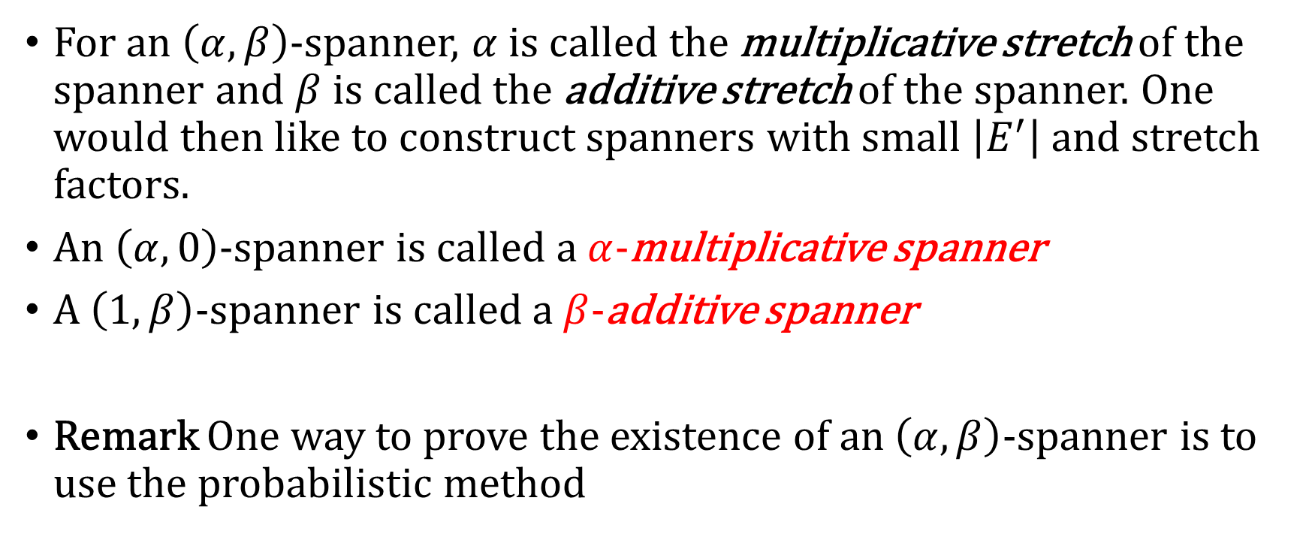
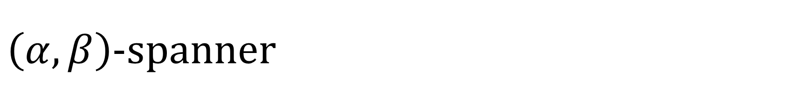
$\left(α,β\right)$-spanner
For an $\left(α,β\right)$-spanner, $α$ is called the multiplicative stretch of the spanner and $β$ is called the additive stretch of the spanner. One would then like to construct spanners with small $\left|E^{′}\right|$ and stretch factors.
An $\left(α,0\right)$-spanner is called a $α$-multiplicative spanner
A $\left(1,β\right)$-spanner is called a $β$-additive spanner
Remark One way to prove the existence of an $\left(α,β\right)$-spanner is to use the probabilistic method

Slide 5
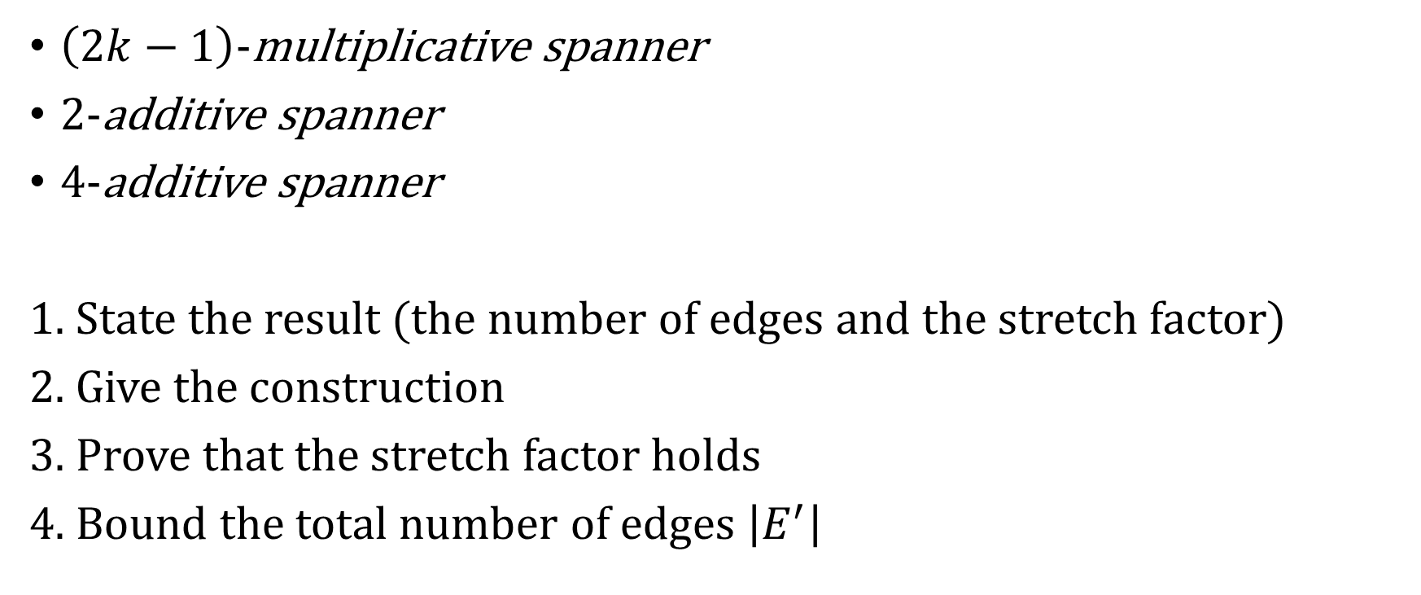
Outline
$\left(2k−1\right)$-multiplicative spanner
2-additive spanner
4-additive spanner
1. State the result (the number of edges and the stretch factor)
2. Give the construction
3. Prove that the stretch factor holds
4. Bound the total number of edges $\left|E^{′}\right|$

Slide 6
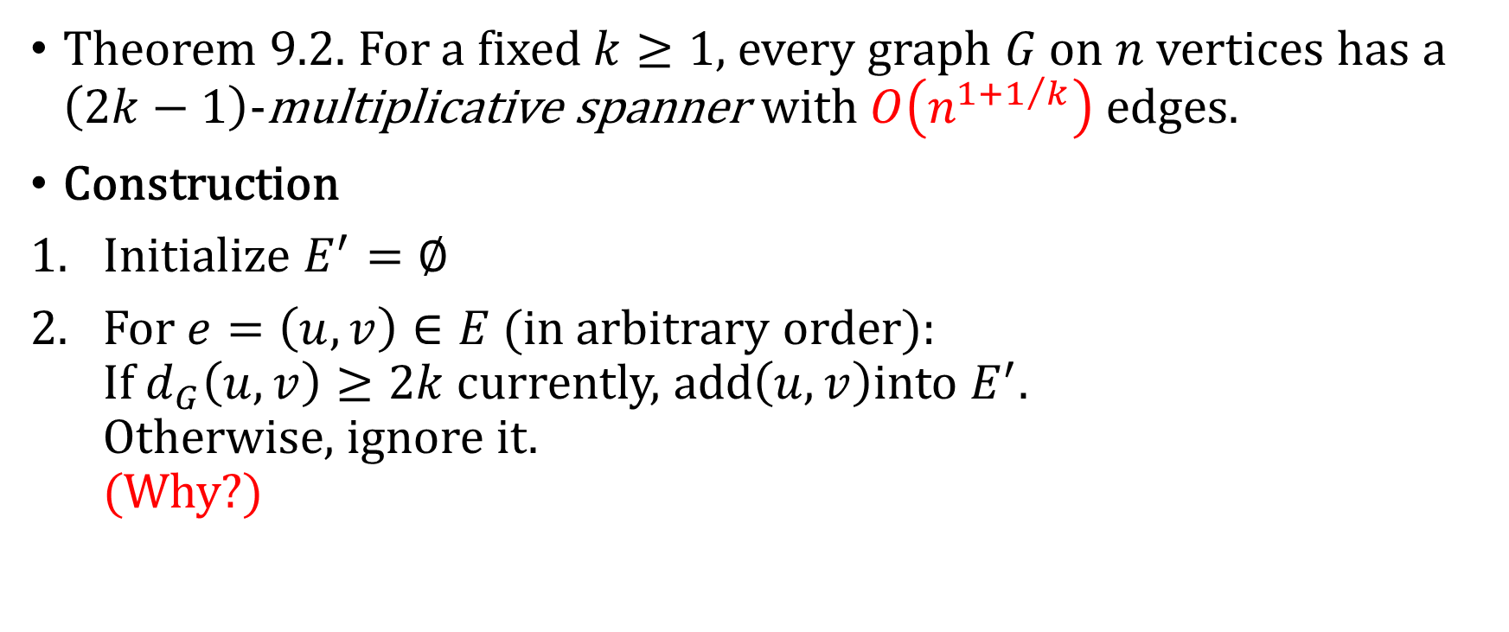
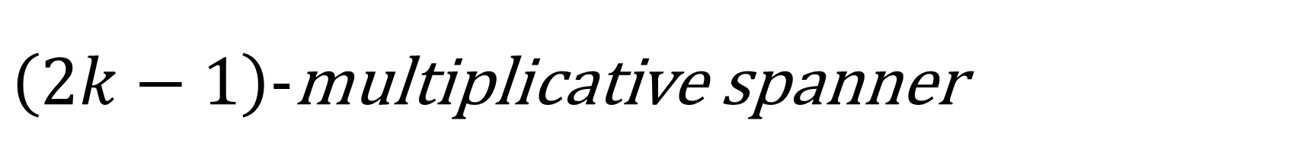
$\left(2k−1\right)$-multiplicative spanner
Theorem 9.2. For a fixed $k≥1$, every graph $G$ on $n$ vertices has a $\left(2k−1\right)$-multiplicative spanner with $O\left(n^{1+1/k}\right)$ edges.
Construction
Initialize $E^{′}=∅$
For $e=\left(u,v\right)∈E$ (in arbitrary order): If $d_{G}\left(u,v\right)≥2k$ currently, add$\left(u,v\right)$into $E^{′}$. Otherwise, ignore it. (Why?)

Slide 7
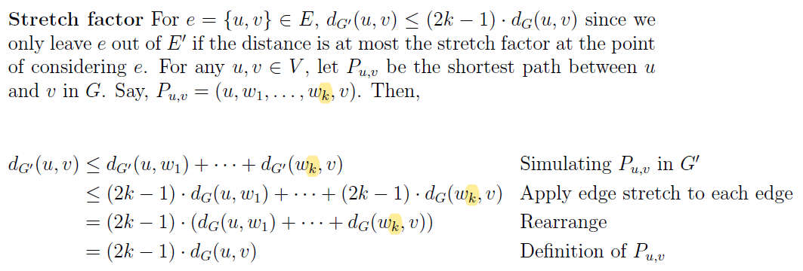
Stretch Factor

Slide 8
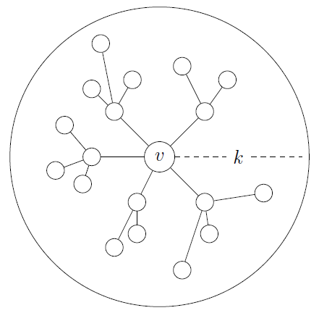

Number of Edges
The girth of a graph $G$, denoted $g\left(G\right)$, is defined as the length of the shortest cycle in $G$.
Suppose $g\left(G\right)>2k$, then for any vertex $v$, the subgraph formed by the $k$-hop neighborhood of $v$ is a tree with distinct vertices.

Slide 9
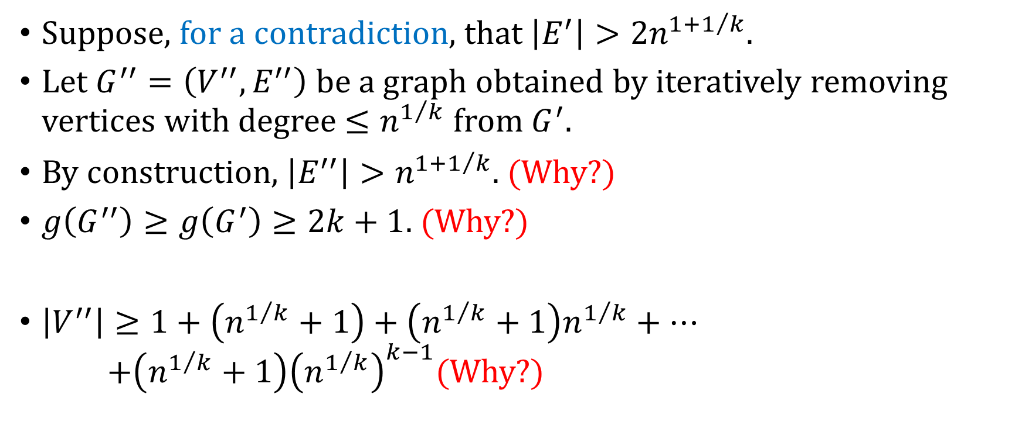
Number of Edges
Suppose, for a contradiction, that $\left|E^{′}\right|>2n^{1+1/k}$.
Let $G^{′′}=\left(V^{′′},E^{′′}\right)$ be a graph obtained by iteratively removing vertices with degree $≤n^{1/k}$ from $G^{′}$.
By construction, $\left|E^{′′}\right|>n^{1+1/k}$. (Why?)
$g\left(G^{′′}\right)≥g\left(G^{′}\right)≥2k+1$. (Why?)
$\left|V^{′′}\right|≥1+\left(n^{1/k}+1\right)+\left(n^{1/k}+1\right)n^{1/k}+⋯$ $+\left(n^{1/k}+1\right){\left(n^{1/k}\right)}^{k−1}$(Why?)

Slide 10
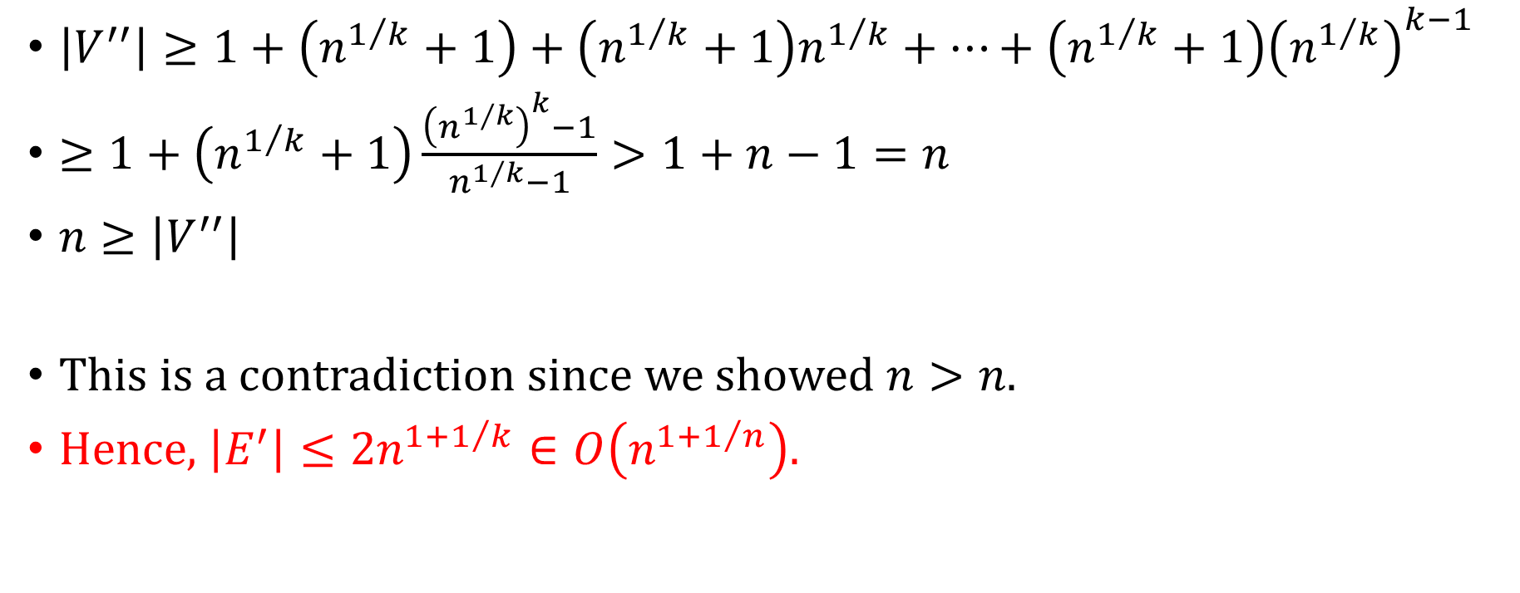
Number of Edges
$\left|V^{′′}\right|≥1+\left(n^{1/k}+1\right)+\left(n^{1/k}+1\right)n^{1/k}+⋯+\left(n^{1/k}+1\right){\left(n^{1/k}\right)}^{k−1}$
$≥1+\left(n^{1/k}+1\right)\frac{{\left(n^{1/k}\right)}^{k}−1}{n^{1/k}−1}>1+n−1=n$
$n≥\left|V^{′′}\right|$
This is a contradiction since we showed $n>n$.
Hence, $\left|E^{′}\right|≤2n^{1+1/k}∈O\left(n^{1+1/n}\right)$.

Slide 11
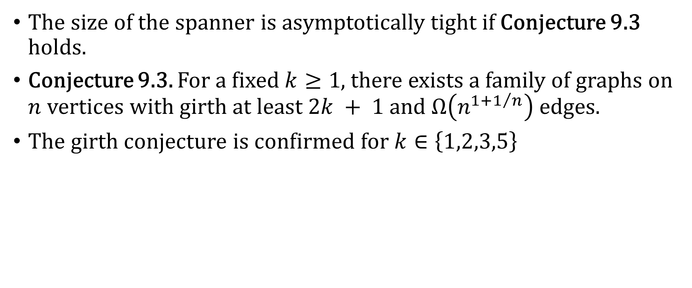
Addition
The size of the spanner is asymptotically tight if Conjecture 9.3 holds.
Conjecture 9.3. For a fixed $k≥1$, there exists a family of graphs on $n$ vertices with girth at least $2k + 1$and $Ω\left(n^{1+1/n}\right)$ edges.
The girth conjecture is confirmed for $k∈\left\{1,2,3,5\right\}$

Slide 12
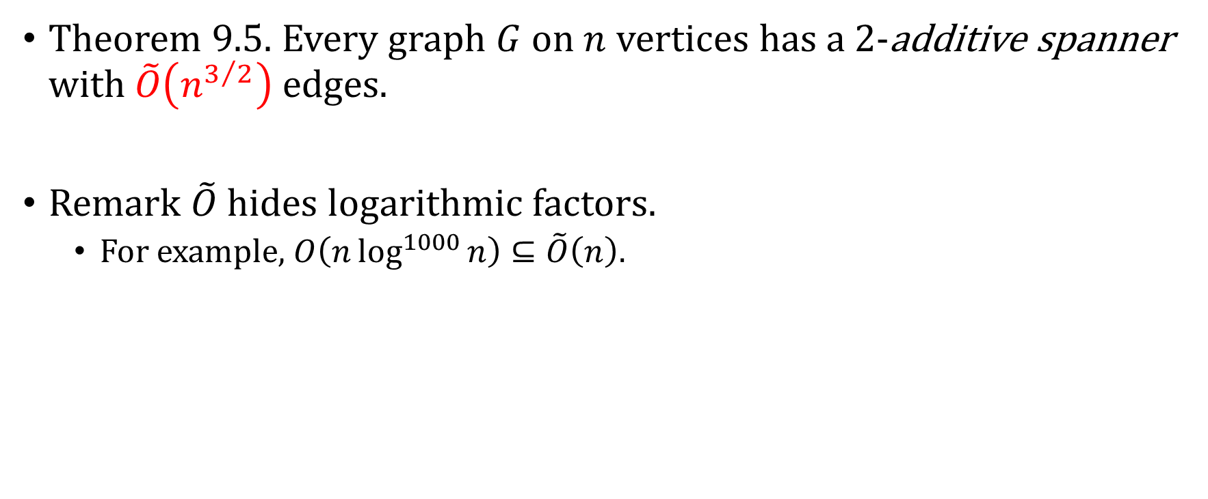
2-additive spanner
Theorem 9.5. Every graph $G$ on $n$ vertices has a 2-additive spanner with $\tilde{O}\left(n^{3/2}\right)$ edges.
Remark $\tilde{O}$ hides logarithmic factors.
For example, $O\left(n\log^{1000}{n}\right)⊆\tilde{O}\left(n\right)$.

Slide 13
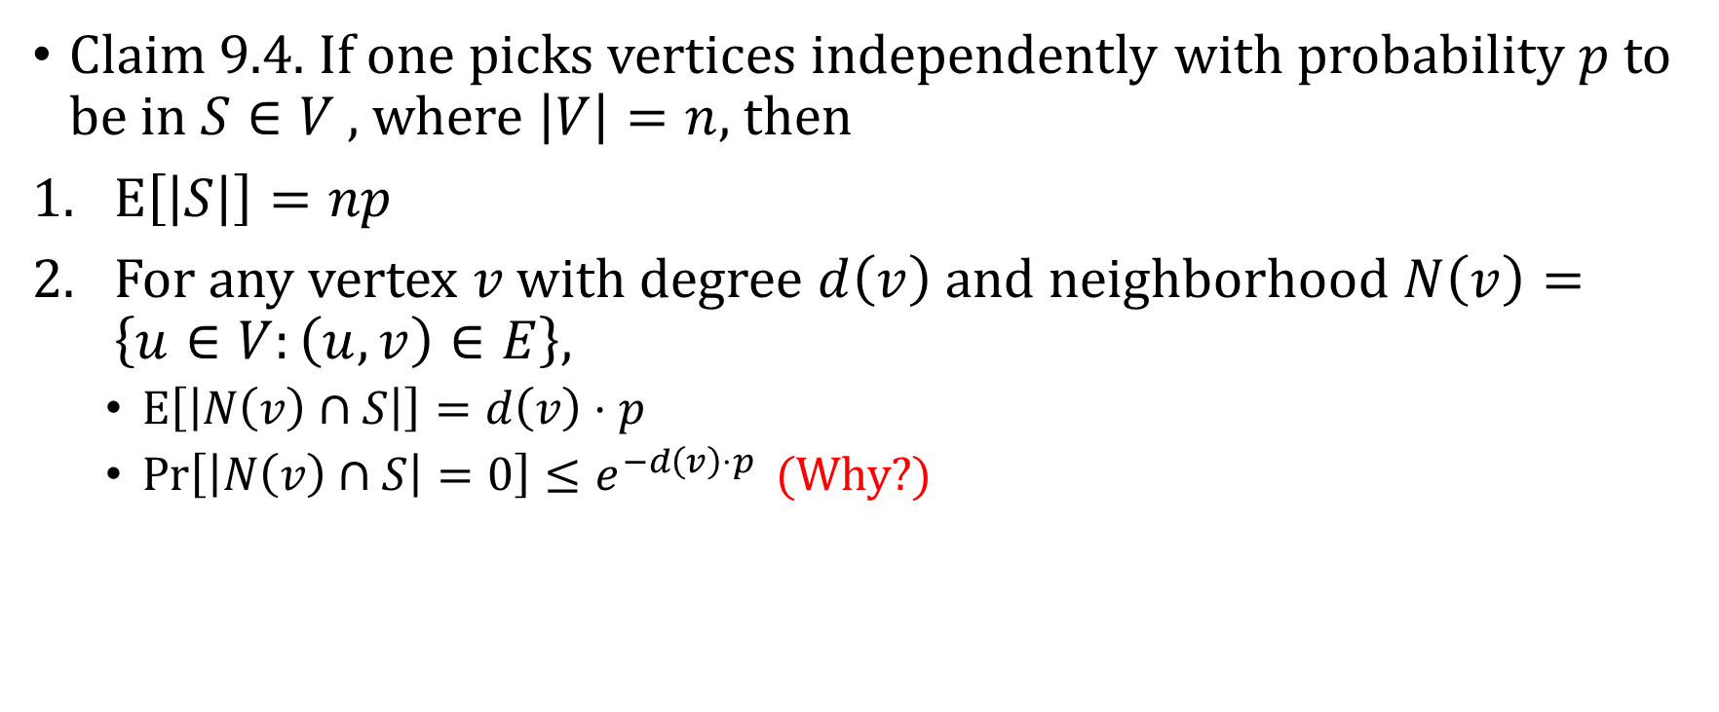
Useful Claim
Claim 9.4. If one picks vertices independently with probability $p$ to be in $S∈V$ , where $\left|V\right|=n$, then
$E\left[\left|S\right|\right]=np$
For any vertex $v$ with degree $d\left(v\right)$ and neighborhood $N\left(v\right)=\left\{u∈V:\left(u,v\right)∈E\right\},$
$E\left[\left|N\left(v\right)∩S\right|\right]=d\left(v\right)⋅p$
$Pr\left[\left|N\left(v\right)∩S\right|=0\right]≤e^{−d\left(v\right)⋅p }$ (Why?)

Slide 14
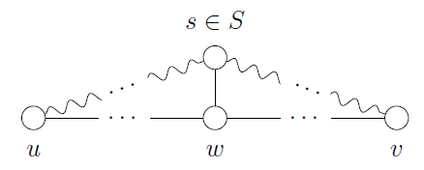
Idea

Slide 15
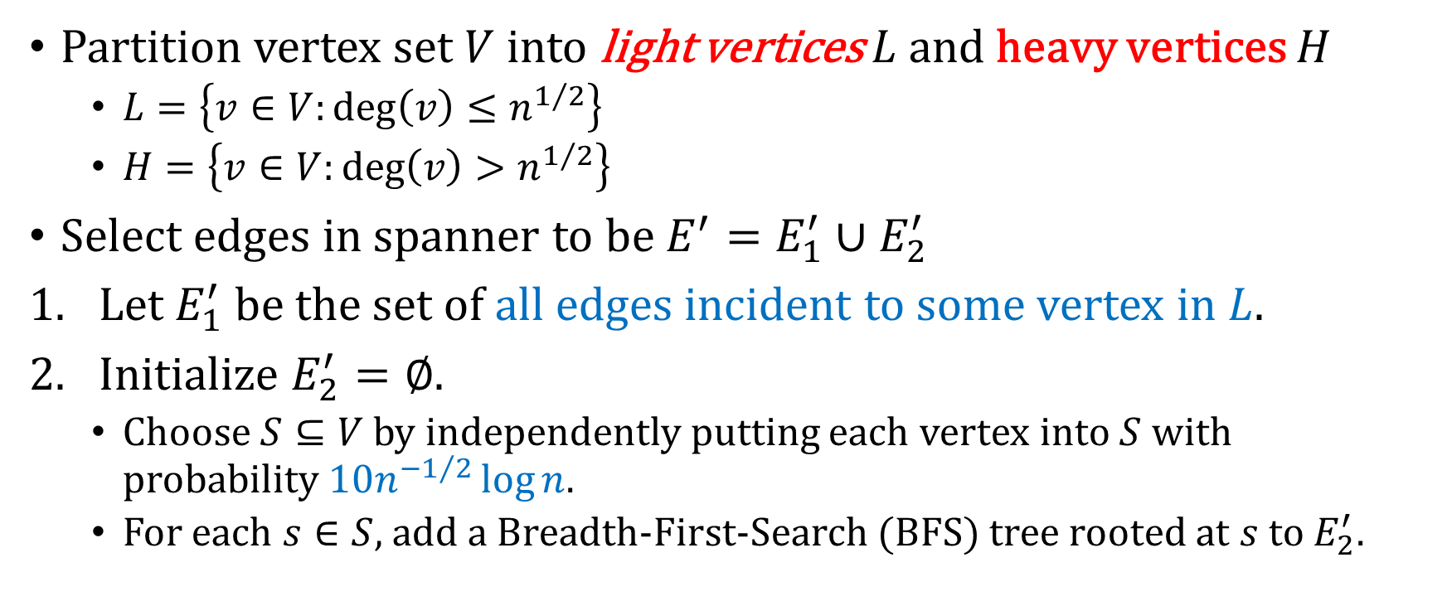
Construction
Partition vertex set $V$ into light vertices $L$ and heavy vertices $H$
$L=\left\{v∈V:deg\left(v\right)≤n^{1/2}\right\}$
$H=\left\{v∈V:deg\left(v\right)>n^{1/2}\right\}$
Select edges in spanner to be $E^{′}=E_{1}^{′}∪E_{2}^{′}$
Let $E_{1}^{′}$ be the set of all edges incident to some vertex in $L$.
Initialize $E_{2}^{′}=∅$.
Choose $S⊆V$ by independently putting each vertex into $S$ with probability $10n^{−1/2}\log{n}$.
For each $s∈S$, add a Breadth-First-Search (BFS) tree rooted at $s$ to $E_{2}^{′}$.

Slide 16
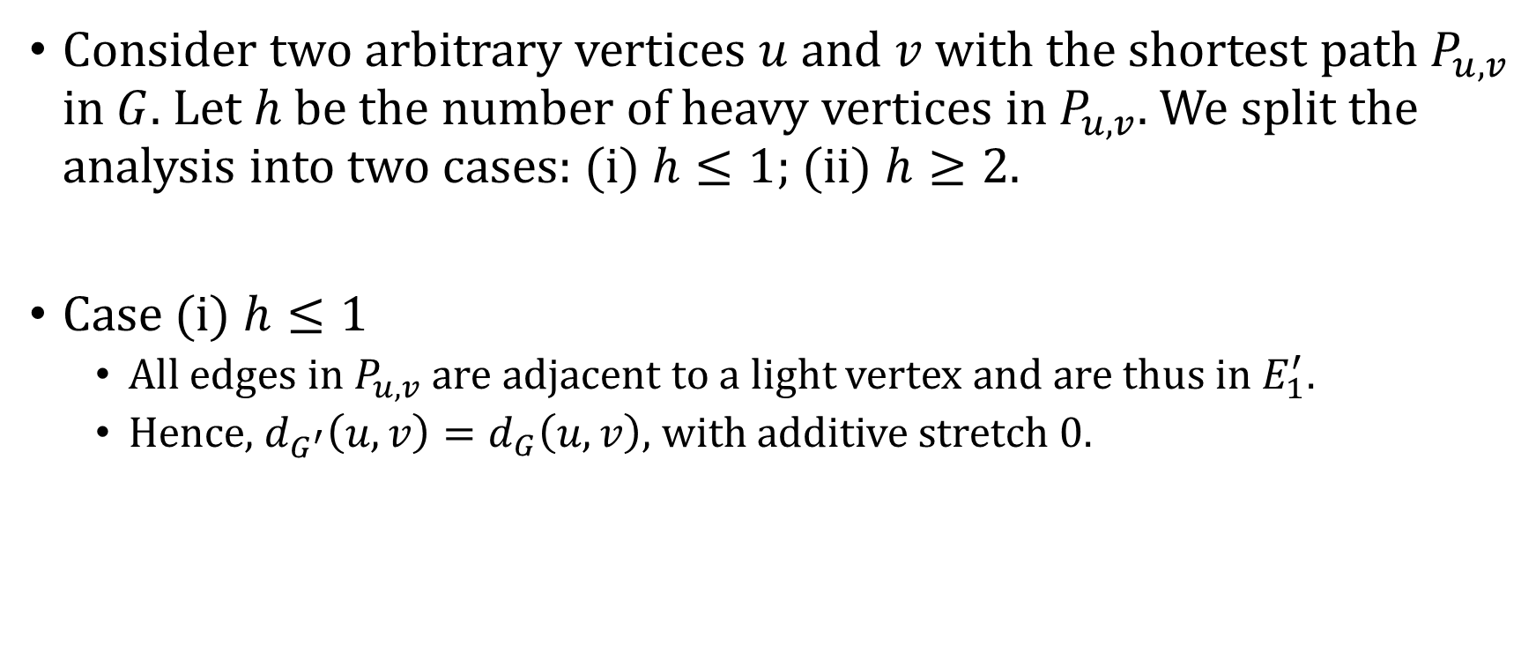
Stretch Factor
Consider two arbitrary vertices $u$ and $v$ with the shortest path $P_{u,v}$ in $G$. Let $h$ be the number of heavy vertices in $P_{u,v}$. We split the analysis into two cases: (i) $h≤1$; (ii) $h≥2$.
Case (i) $h≤1$
All edges in $P_{u,v}$ are adjacent to a light vertex and are thus in $E_{1}^{′}$.
Hence, $d_{G^{′}}\left(u,v\right)=d_{G}\left(u,v\right)$, with additive stretch 0.

Slide 17

Stretch Factor
Case (ii) $h≥2$
Claim 9.6. Suppose there exists a vertex $w∈P_{u,v}$ such that $\left(w,s\right)∈E$ for some $s∈S$, then $d_{G^{′}}\left(u,v\right)≤d_{G}\left(u,v\right)$+2.

Slide 18
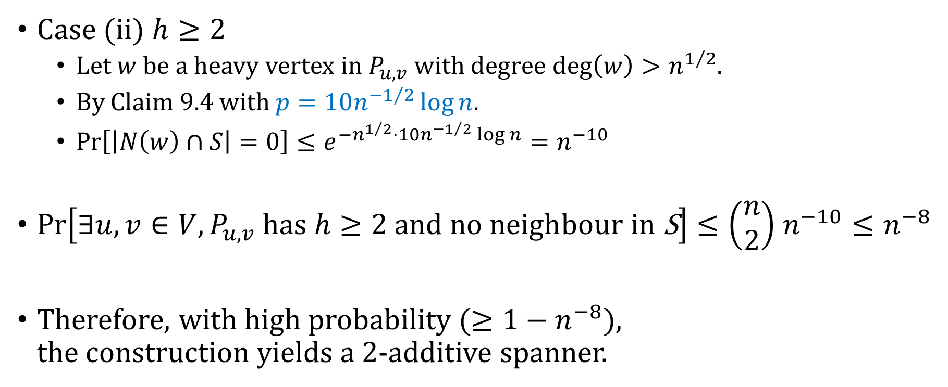



Stretch Factor
$E\left[\left|S\right|\right]=np$
$E\left[\left|N\left(v\right)∩S\right|\right]=d\left(v\right)⋅p$
$$Pr\left[\left|N\left(v\right)∩S\right|=0\right]≤e^{−d\left(v\right)⋅p }$$
Case (ii) $h≥2$
Let $w$ be a heavy vertex in $P_{u,v}$ with degree $deg\left(w\right)>n^{1/2}$.
By Claim 9.4 with $p=10n^{−1/2}\log{n}$.
$Pr\left[\left|N\left(w\right)∩S\right|=0\right]≤e^{−n^{1/2}⋅10n^{−1/2}\log{n}}=n^{−10}$
$Pr\left[∃u,v∈V,P_{u,v} has h≥2 \text{and} \text{no} \text{neighbour} \text{in} \text{S}\right]≤\left(\begin{matrix}n \\ 2\end{matrix}\right)$ $n^{−10}≤n^{−8}$
Therefore, with high probability ($≥1−n^{−8}$), the construction yields a 2-additive spanner.

Slide 19
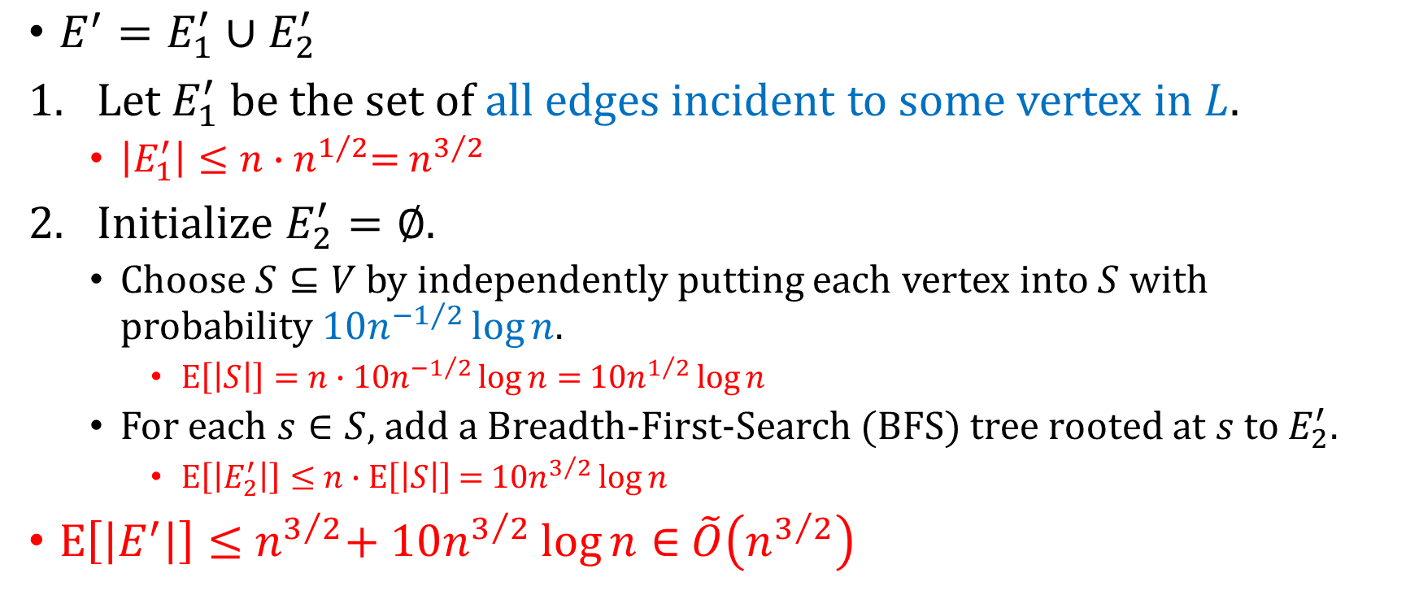
Number of edges
$E\left[\left|S\right|\right]=np$
$E\left[\left|N\left(v\right)∩S\right|\right]=d\left(v\right)⋅p$
$$Pr\left[\left|N\left(v\right)∩S\right|=0\right]≤e^{−d\left(v\right)⋅p }$$
$E^{′}=E_{1}^{′}∪E_{2}^{′}$
Let $E_{1}^{′}$ be the set of all edges incident to some vertex in $L$.
$\left|E_{1}^{′}\right|≤n∙$ $n^{1/2}$= $n^{3/2}$
Initialize $E_{2}^{′}=∅$.
Choose $S⊆V$ by independently putting each vertex into $S$ with probability $10n^{−1/2}\log{n}$.
$E\left[\left|S\right|\right]=n∙$ $10n^{−1/2}\log{n}=$ $10n^{1/2}\log{n}$
For each $s∈S$, add a Breadth-First-Search (BFS) tree rooted at $s$ to $E_{2}^{′}$.
$E\left[\left|E_{2}^{′}\right|\right]≤$ $n∙$ $E\left[\left|S\right|\right]$ $=$ $10n^{3/2}\log{n}$
$E\left[\left|E^{′}\right|\right]≤$ $n^{3/2}$+ $10n^{3/2}\log{n}∈$ $\tilde{O}\left(n^{3/2}\right)$

Slide 20
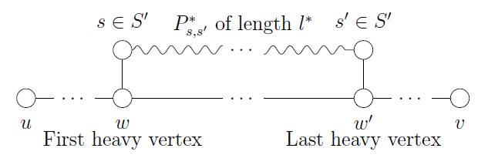

4-additive spanner
Theorem 9.7. Every graph $G$ on $n$ vertices has a 4-additive spanner with $\tilde{O}\left(n^{7/5}\right)$ edges.
Idea

Slide 21
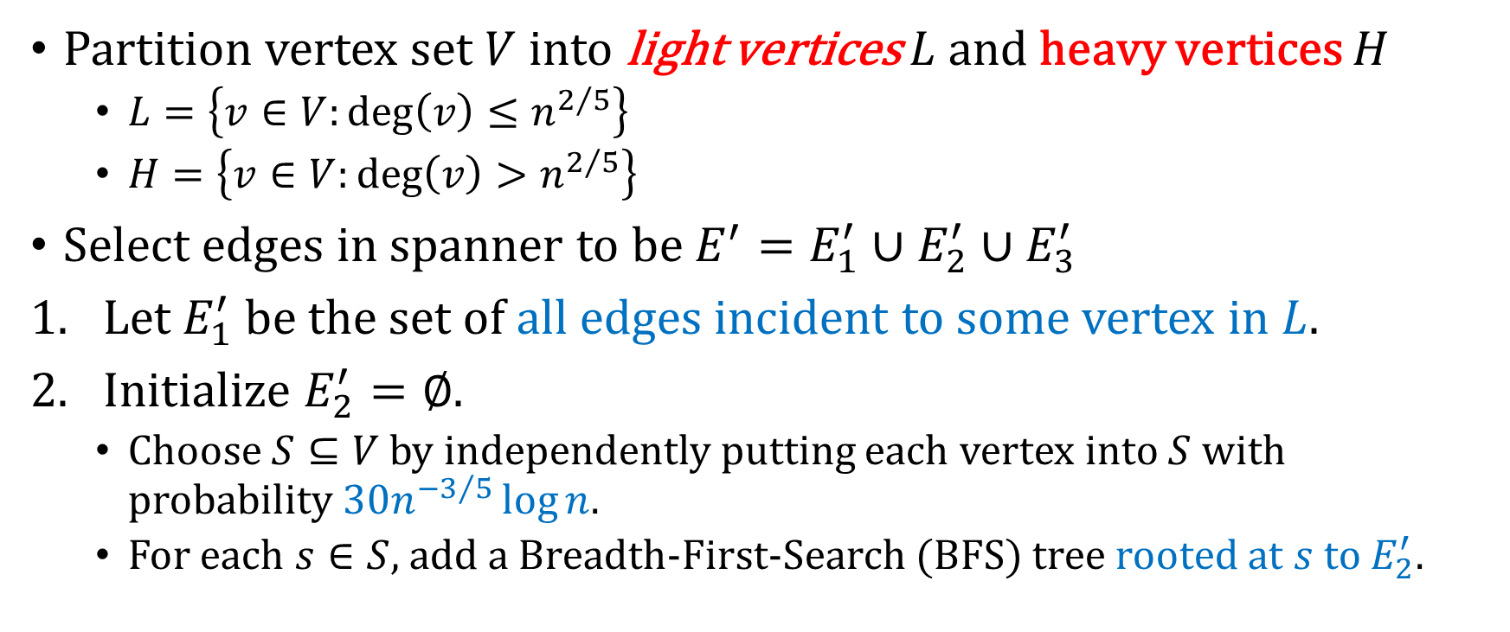
Construction
Partition vertex set $V$ into light vertices $L$ and heavy vertices $H$
$L=\left\{v∈V:deg\left(v\right)≤n^{2/5}\right\}$
$H=\left\{v∈V:deg\left(v\right)>n^{2/5}\right\}$
Select edges in spanner to be $E^{′}=E_{1}^{′}∪E_{2}^{′}$ $∪E_{3}^{′}$
Let $E_{1}^{′}$ be the set of all edges incident to some vertex in $L$.
Initialize $E_{2}^{′}=∅$.
Choose $S⊆V$ by independently putting each vertex into $S$ with probability $30n^{−3/5}\log{n}$.
For each $s∈S$, add a Breadth-First-Search (BFS) tree rooted at $s$ to $E_{2}^{′}$.

Slide 22
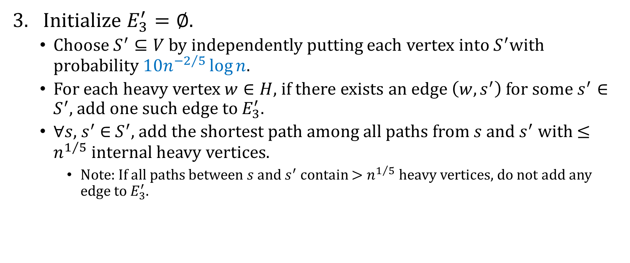
Construction
Initialize $E_{3}^{′}=∅$.
Choose $S^{′}⊆V$ by independently putting each vertex into $S^{′}$with probability $10n^{−2/5}\log{n}$.
For each heavy vertex $w∈H$, if there exists an edge $\left(w,s^{′}\right)$ for some $s^{′}∈$ $S^{′}$, add one such edge to $E_{3}^{′}$.
$∀s,$ $s^{′}$ $∈$ $S^{′}$, add the shortest path among all paths from $s$ and $s^{′}$ with $≤n^{1/5}$ internal heavy vertices.
Note: If all paths between $s$ and $s^{′}$ contain $>n^{1/5}$heavy vertices, do not add any edge to $E_{3}^{′}$.

Slide 23
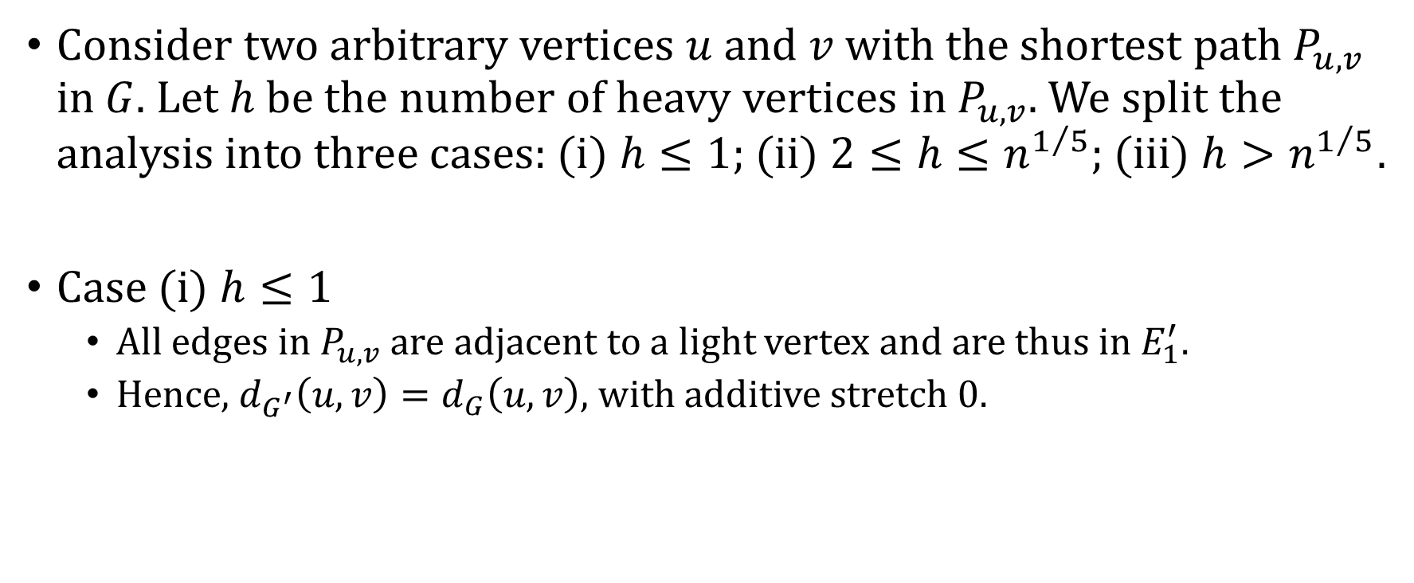
Stretch Factor
Consider two arbitrary vertices $u$ and $v$ with the shortest path $P_{u,v}$ in $G$. Let $h$ be the number of heavy vertices in $P_{u,v}$. We split the analysis into three cases: (i) $h≤1$; (ii) $2≤h≤n^{1/5}$; (iii) $h>n^{1/5}$.
Case (i) $h≤1$
All edges in $P_{u,v}$ are adjacent to a light vertex and are thus in $E_{1}^{′}$.
Hence, $d_{G^{′}}\left(u,v\right)=d_{G}\left(u,v\right)$, with additive stretch 0.

Slide 24
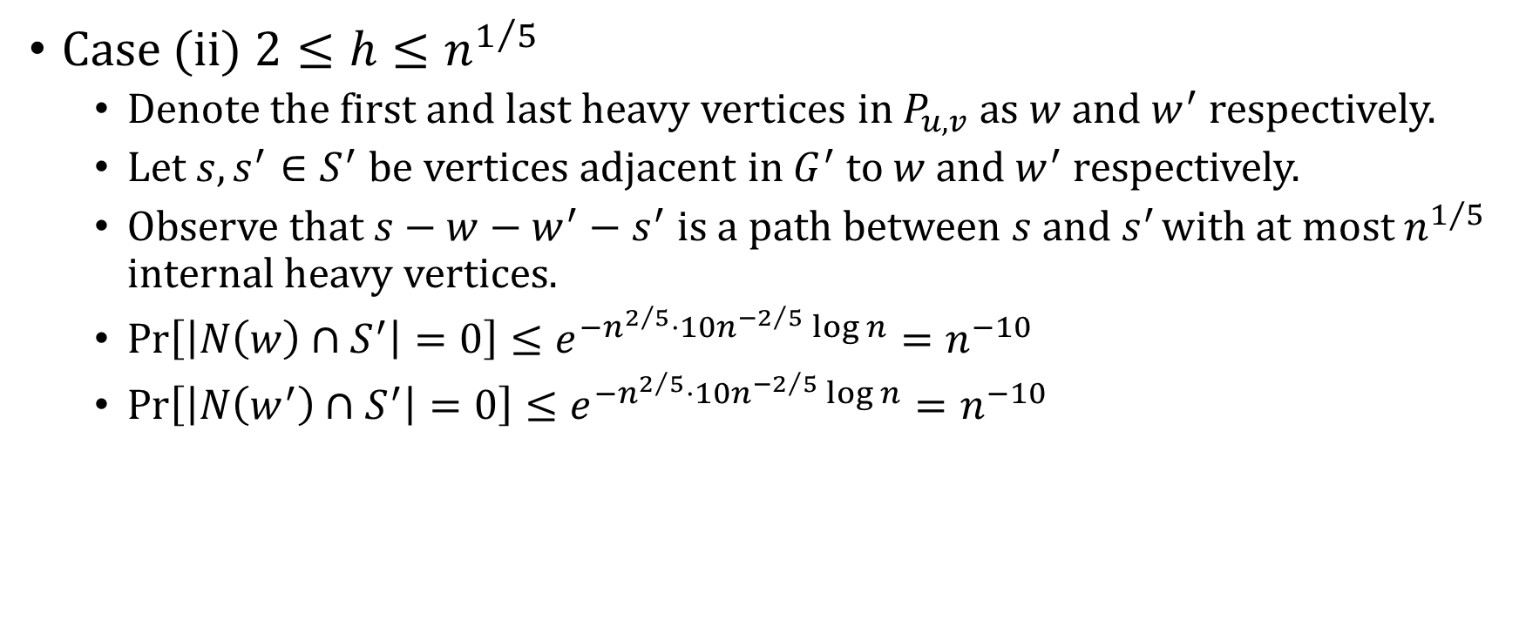
Stretch Factor
$E\left[\left|S\right|\right]=np$
$E\left[\left|N\left(v\right)∩S\right|\right]=d\left(v\right)⋅p$
$$Pr\left[\left|N\left(v\right)∩S\right|=0\right]≤e^{−d\left(v\right)⋅p }$$
Case (ii) $2≤h≤n^{1/5}$
Denote the first and last heavy vertices in $P_{u,v}$ as $w$ and $w^{′}$ respectively.
Let $s,s^{′}∈S^{′}$ be vertices adjacent in $G^{′}$ to $w$ and $w^{′}$ respectively.
Observe that $s−w−w^{′}−s^{′}$ is a path between $s$ and $s^{′}$ with at most $n^{1/5}$ internal heavy vertices.
$Pr\left[\left|N\left(w\right)∩S^{′}\right|=0\right]≤e^{−n^{2/5}⋅10n^{−2/5}\log{n}}=n^{−10}$
$Pr\left[\left|N\left(w^{′}\right)∩S^{′}\right|=0\right]≤e^{−n^{2/5}⋅10n^{−2/5}\log{n}}=n^{−10}$

Slide 25
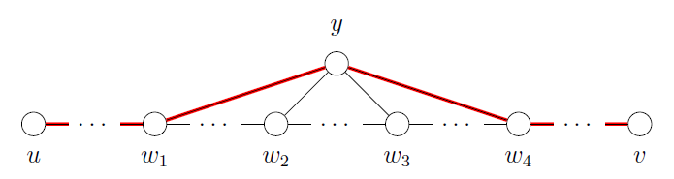

Stretch Factor
Case (iii) $h>n^{1/5}$
Claim 9.8. There cannot be a vertex $y$ that is a common neighbor to more than 3 heavy vertices in $P_{u,v}$. (Why?)

Slide 26
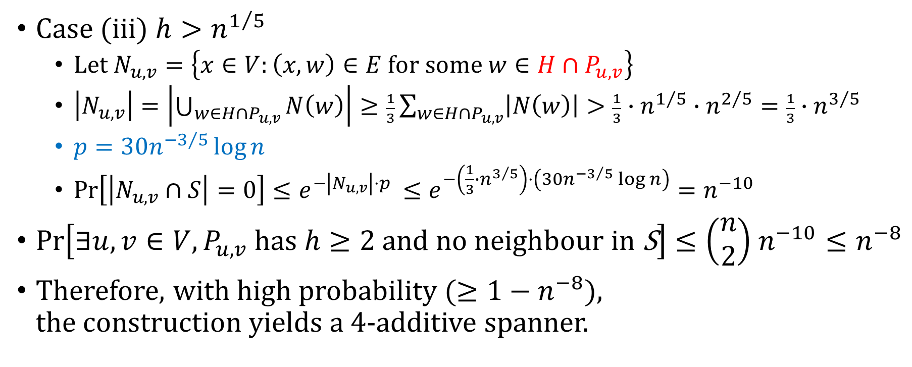
Stretch Factor
$E\left[\left|S\right|\right]=np$
$E\left[\left|N\left(v\right)∩S\right|\right]=d\left(v\right)⋅p$
$$Pr\left[\left|N\left(v\right)∩S\right|=0\right]≤e^{−d\left(v\right)⋅p }$$
Case (iii) $h>n^{1/5}$
Let $N_{u,v}=\left\{x∈V:\left(x,w\right)∈E for some w∈H∩P_{u,v}\right\}$
$\left|N_{u,v}\right|=\left|\bigcup_{w∈H∩P_{u,v}}{N\left(w\right)}\right|≥\frac{1}{3}\sum_{w∈H∩P_{u,v}}{\left|N\left(w\right)\right|}>\frac{1}{3}∙n^{1/5}∙n^{2/5}=\frac{1}{3}∙n^{3/5}$
$p=30n^{−3/5}\log{n}$
$Pr\left[\left|N_{u,v}∩S\right|=0\right]≤e^{−\left|N_{u,v}\right|⋅p }≤e^{−\left(\frac{1}{3}∙n^{3/5}\right)⋅\left(30n^{−3/5}\log{n}\right)}=n^{−10}$
$Pr\left[∃u,v∈V,P_{u,v} has h≥2 \text{and} \text{no} \text{neighbour} \text{in} \text{S}\right]≤\left(\begin{matrix}n \\ 2\end{matrix}\right)$ $n^{−10}≤n^{−8}$
Therefore, with high probability ($≥1−n^{−8}$), the construction yields a 4-additive spanner.

Slide 27
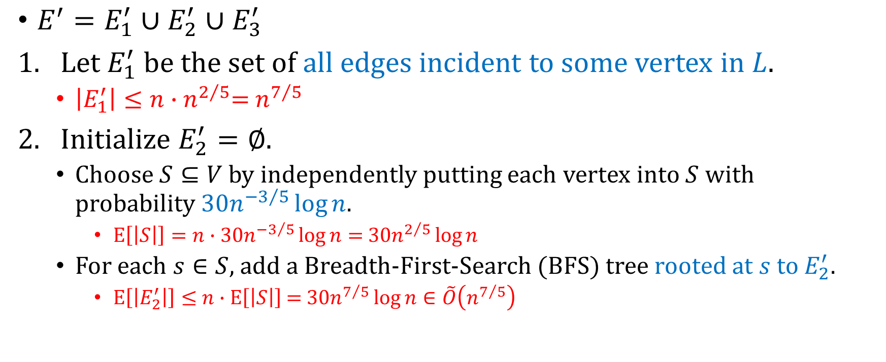
Number of edges
$E\left[\left|S\right|\right]=np$
$E\left[\left|N\left(v\right)∩S\right|\right]=d\left(v\right)⋅p$
$$Pr\left[\left|N\left(v\right)∩S\right|=0\right]≤e^{−d\left(v\right)⋅p }$$
$E^{′}=E_{1}^{′}∪E_{2}^{′}$ $∪E_{3}^{′}$
Let $E_{1}^{′}$ be the set of all edges incident to some vertex in $L$.
$\left|E_{1}^{′}\right|≤n∙$ $n^{2/5}$= $n^{7/5}$
Initialize $E_{2}^{′}=∅$.
Choose $S⊆V$ by independently putting each vertex into $S$ with probability $30n^{−3/5}\log{n}$.
$E\left[\left|S\right|\right]=n∙$ $30n^{−3/5}\log{n}=$ $30n^{2/5}\log{n}$
For each $s∈S$, add a Breadth-First-Search (BFS) tree rooted at $s$ to $E_{2}^{′}$.
$E\left[\left|E_{2}^{′}\right|\right]≤$ $n∙$ $E\left[\left|S\right|\right]$ $=$ $30n^{7/5}\log{n∈\tilde{O}\left(n^{7/5}\right)}$

Slide 28
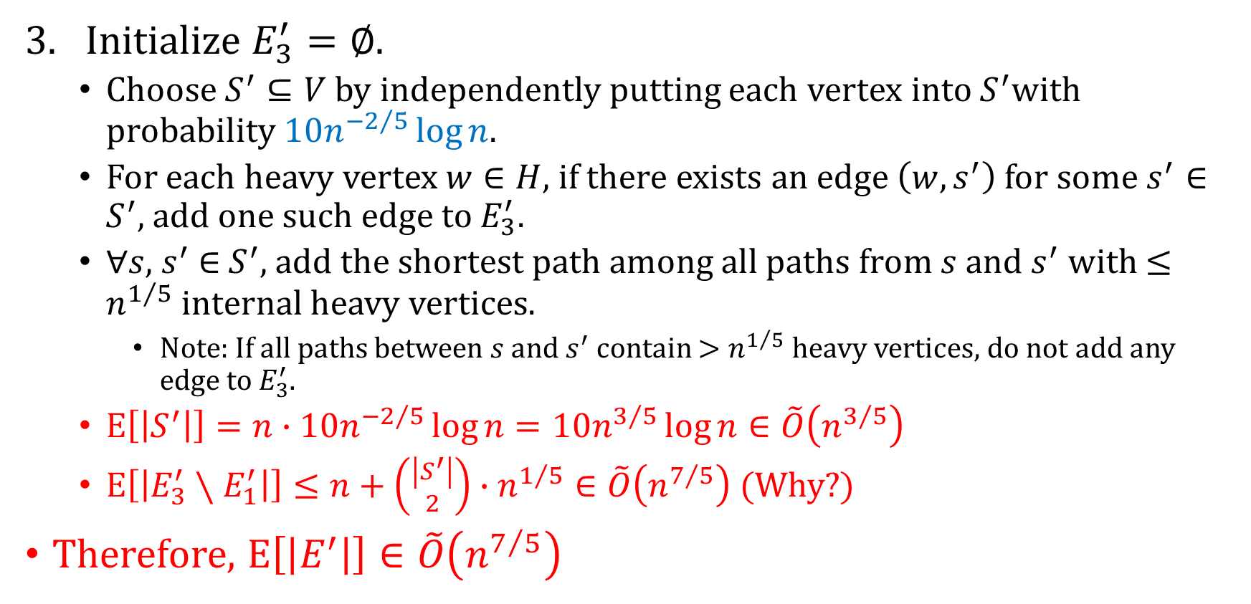
Number of edges
$E\left[\left|S\right|\right]=np$
$E\left[\left|N\left(v\right)∩S\right|\right]=d\left(v\right)⋅p$
$$Pr\left[\left|N\left(v\right)∩S\right|=0\right]≤e^{−d\left(v\right)⋅p }$$
Initialize $E_{3}^{′}=∅$.
Choose $S^{′}⊆V$ by independently putting each vertex into $S^{′}$with probability $10n^{−2/5}\log{n}$.
For each heavy vertex $w∈H$, if there exists an edge $\left(w,s^{′}\right)$ for some $s^{′}∈$ $S^{′}$, add one such edge to $E_{3}^{′}$.
$∀s,$ $s^{′}$ $∈$ $S^{′}$, add the shortest path among all paths from $s$ and $s^{′}$ with $≤n^{1/5}$ internal heavy vertices.
Note: If all paths between $s$ and $s^{′}$ contain $>n^{1/5}$heavy vertices, do not add any edge to $E_{3}^{′}$.
$E\left[\left|S^{′}\right|\right]=n∙10n^{−2/5}\log{n}=10n^{3/5}\log{n}∈\tilde{O}\left(n^{3/5}\right)$
$E\left[\left|E_{3}^{′}∖E_{1}^{′}\right|\right]≤n+\left({\left|S^{′}\right| \atop 2}\right)∙n^{1/5}∈\tilde{O}\left(n^{7/5}\right)$ (Why?)
Therefore, $E\left[\left|E^{′}\right|\right]∈\tilde{O}\left(n^{7/5}\right)$

Slide 29
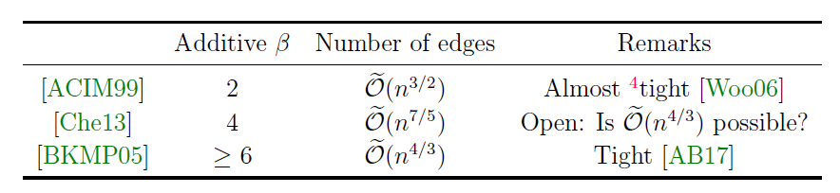
Concluding Remarks

