Slide 1
Overview and Greedy Approximation
Shao-Heng Ko
Advanced Algorithms Study Group, IIS, Academia Sinica
Oct 18, 2019

Slide 2
Today’s Agenda
Motivation and Overview
Why study advanced algorithms
What to study: approximation, randomized, streaming, online
Greedy Approximation (Set Cover, Vertex Cover)
Lecture 01 of [ETHZAA19]
Real exercise!
Get to know each other

Slide 3
The first question
What makes a good algorithm? [5P/each]

Slide 4
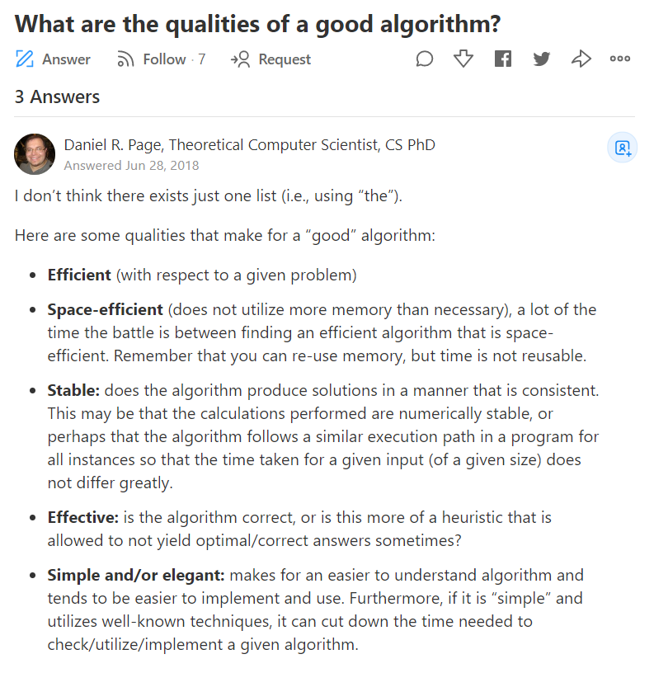
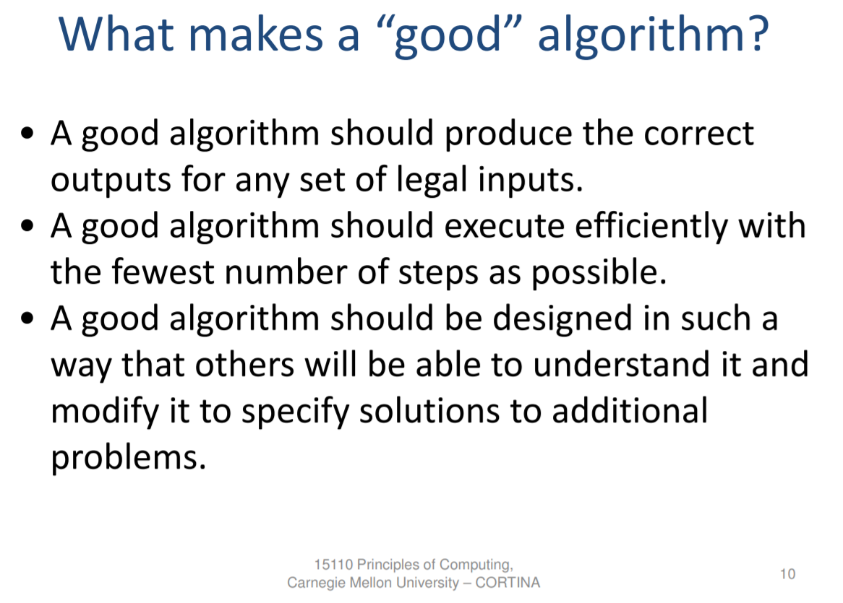
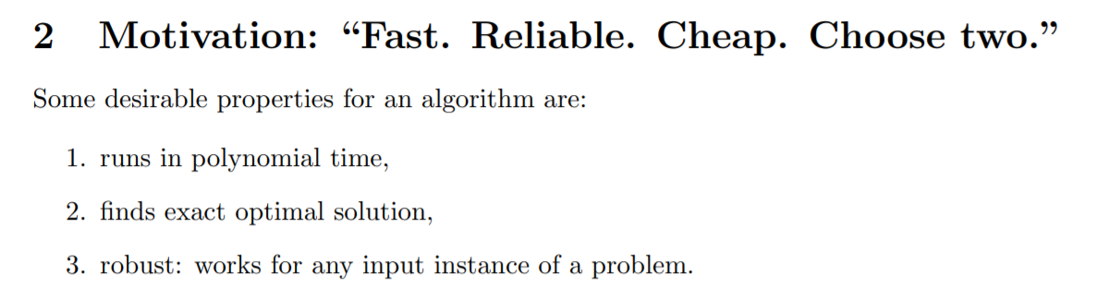

Slide 5
runs in polynomial time/space
finds exact optimal solution
robust: works for any input instance of a problem
Impossible for NP-hard problems T____T

Slide 6
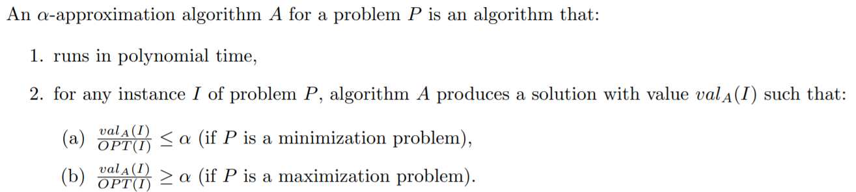
runs in polynomial time/space
finds exact approximate optimal solution
robust: works for any input instance of a problem
approximation algorithms!
Why are they better than heuristics? [5p]
Some prefer the approximation ratio to be $>1$ (use $\frac{1}{α}$ for maximization)

Slide 7
runs in polynomial time/space unfixed/unbounded finds exact optimal solution
robust: works for any input instance of a problem
Las Vegas randomized algorithms!
Some examples? [5p/each]
Quicksort with randomized pivots
Finding someone in the world

Slide 8
runs in polynomial time/space
finds exact approximate optimal solution
robust: almost always works for any input instance of a problem
Monte Carlo (approximation) algorithms!
Q: what exactly does “almost always” mean? [10p]
Q: is it equivalent to “works for almost all inputs”? [10p]

Slide 9
runs in polynomial time/space limited
finds exact approximate optimal solution
robust: almost always works for any input instance of a problem
streaming algorithms!
data model: inputs come sequentially without random access
Evaluation metrics:
# of passes, space, accuracy, time

Slide 10
Q: which alphabet (in A-E) appears the most?

Slide 11
A

Slide 12
C

Slide 13
A

Slide 14
D

Slide 15
E

Slide 16
A

Slide 17
C

Slide 18
D

Slide 19
C

Slide 20
E

Slide 21
B

Slide 22
A

Slide 23
B

Slide 24
D

Slide 25
C

Slide 26
B

Slide 27
E

Slide 28
B

Slide 29
A

Slide 30
D

Slide 31
E

Slide 32
Q: which alphabet (in A-E) appears the most?
[10p]-right answer
[-10p]-wrong answer

Slide 33
ACADEACDCEBABDCBEBADE

Slide 34
Sometimes, for real-world problems, we cannot afford waiting for all inputs to arrive in the future.
To break-up or not break-up?
To study advanced algorithms or not?
online algorithms!
Need to give solutions whenever an input arrives

Slide 35
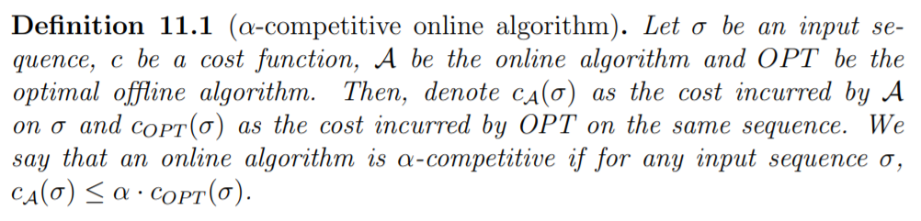
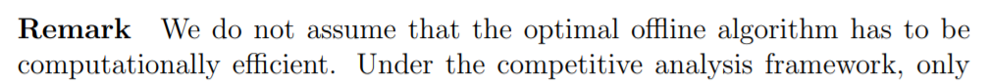
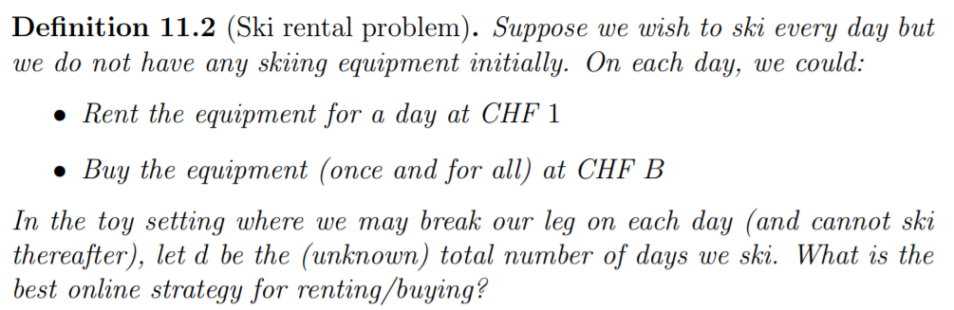
Happiness=2P
$1P
$10P

Slide 36
Day 1
Q: Buy or not buy?

Slide 37
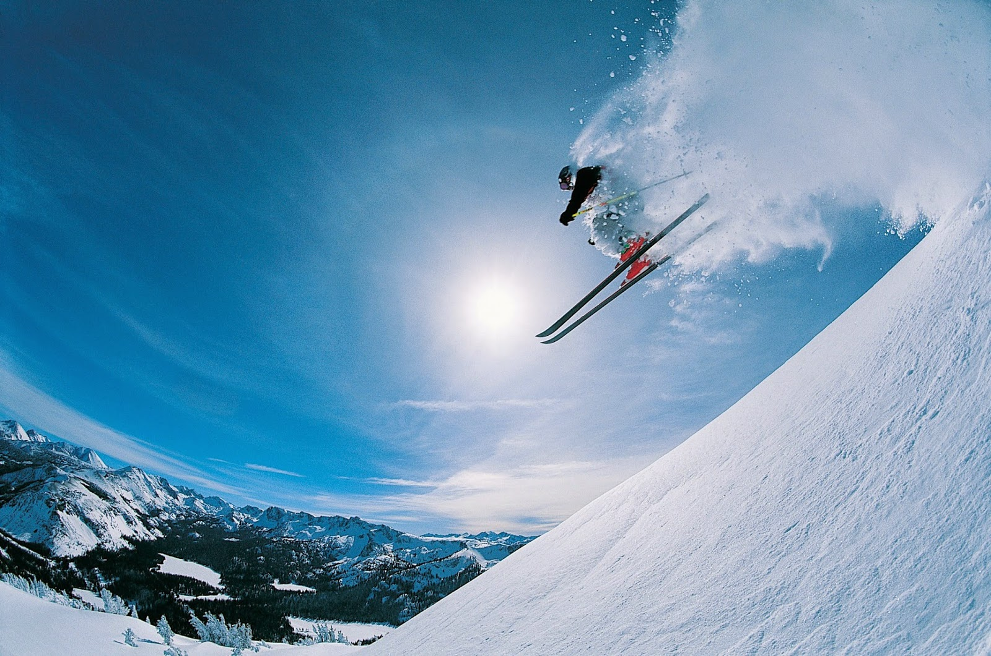

Slide 38
Day 2
Q: Buy or not buy?

Slide 40
Day 3
Q: Buy or not buy?

Slide 42
Day 4
Q: Buy or not buy?

Slide 44
Day 5
Q: Buy or not buy?

Slide 46
Day 6
Q: Buy or not buy?

Slide 48
Day 7
Q: Buy or not buy?

Slide 50
Day 8
Q: Buy or not buy?

Slide 52
Day 9
Q: Buy or not buy?

Slide 54
Day 10
Q: Buy or not buy?

Slide 56
Day 11
Q: Buy or not buy?

Slide 57
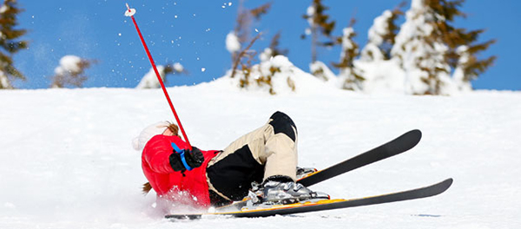

Slide 58
Question:
What’s the difference between
streaming and online algorithms? [10p]

Slide 59
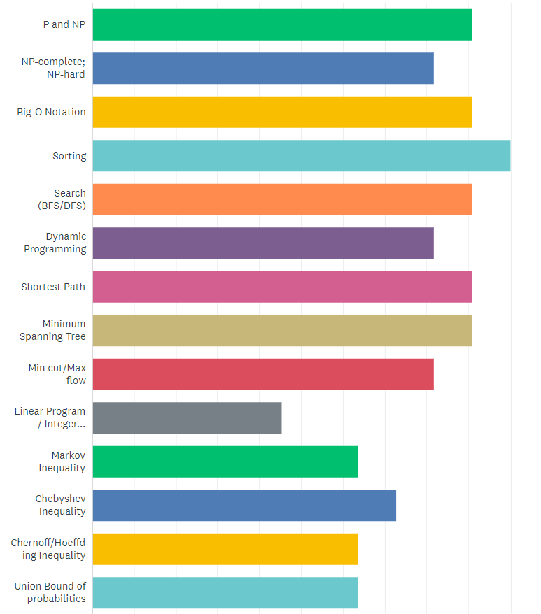
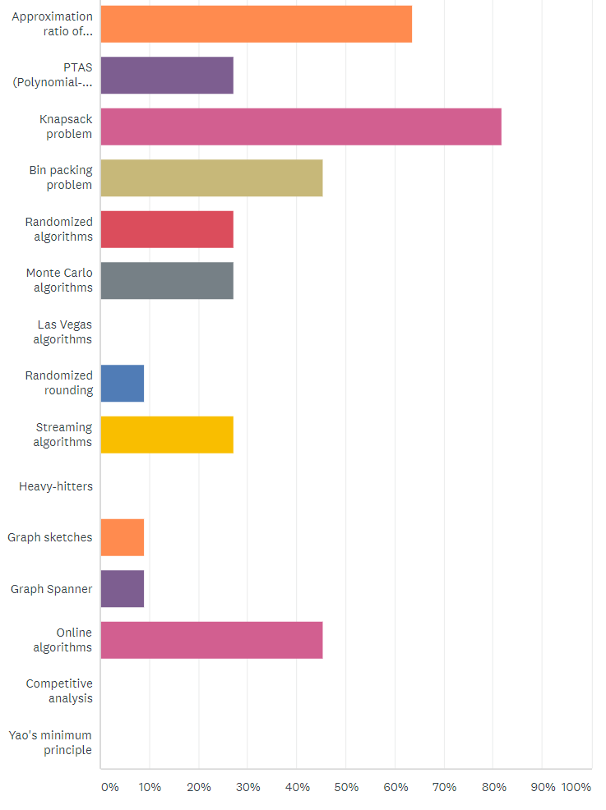
Approximation
Algorithms
Randomized
Algorithms
Streaming
Algorithms
Math
Tools
Online
Algorithms

Slide 60
Greedy Approximation
What do we usually think about greedy algorithms?
[2p/each]

Slide 61
Greedy Approximation
It is intuitive
It is straightforward
It is stupid
It is not high-quality research…?
Greedy is very effective for probably more problems than people think

Slide 62
Greedy Approximation
What are some greedy algorithms we learn in undergraduate algorithms course? [5p/each]
Dijkstra’s algorithm for shortest path
Prim’s algorithm for minimum spanning tree
Kruskal’s algorithm for minimum spanning tree
Huffman coding

Slide 63
Greedy Approximation
It is better if we can perform theoretical analysis to show that greedy is indeed effective for some problem.
Material: Lecture 1 in [AA19]

Slide 64
Ground rules
Generally, we can directly use [AA19] lecture note
Search for visualization slides online
Leader reads the material thoroughly in advance
Then go through it efficiently with high-level comprehension
Be skeptical when reading [AA19]
There are typoes/mistakes
It’s great if we can find and correct them [5p/each]

Slide 65
Exercise Activity / Real applications
It is expected that the leader of each meeting provide either an exercise activity or a real application of the theory material.
Today there is an exercise activity.
Sheng-Hao will talk about influence maximization in the next meeting, an application for submodular optimization.

Slide 66
A Covering practice
We need to cover later meetings with people (leaders). Topics are listed in the next page.
Let’s first ignore schedule problems (we’ll take care of it)
We use points to order everyone XD
(Discussion) How’s this different from Minimum Set Cover? Important practice for future research

Slide 67
PTAS/FPTAS/FPRAS/APX, Knapsack (L2)
Bin Packing (L2-L3)
DNF Counting and Graph Coloring (L4)
LP/ILP, Randomized Rounding (L5)
Multi-commodity Routing (L5)
Probabilistic Tree Embedding (L6)
Frequent Elements, Approximate Counting (L7)
Distinct Elements, Moment Estimators (L7-L8)
Graph Sketches (L9)
Graph Spanners (L10)
Graph Sparsifiers (L11)

