Slide 1
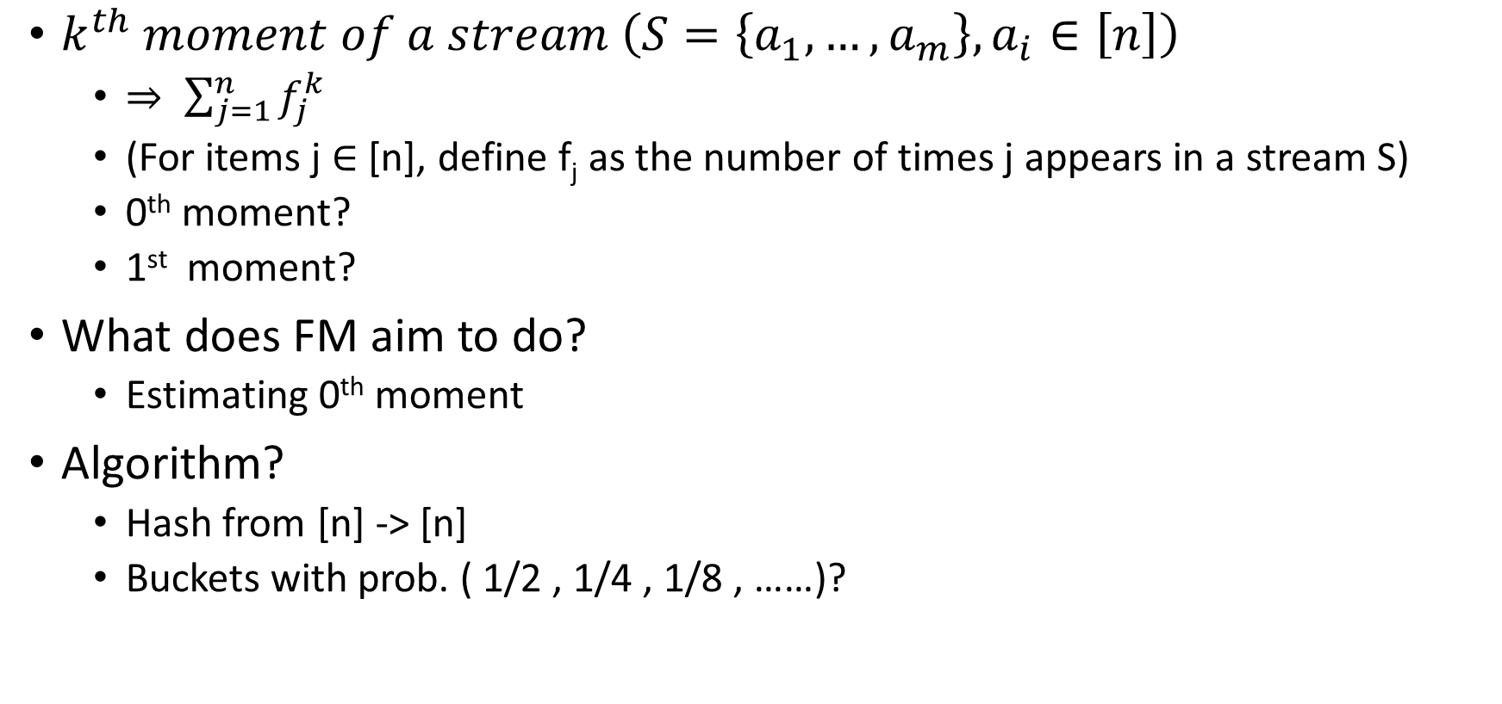
Recap: FM
$k^{th} moment of a stream \left(S=\left\{a_{1},…,a_{m}\right\}, a_{i}∈\left[n\right]\right)$
$⇒ \sum_{j=1}^{n}{f_{j}^{k}}$
(For items j ∈ [n], define f_{j} as the number of times j appears in a stream S)
0th moment?
1st moment?
What does FM aim to do?
Estimating 0th moment
Algorithm?
Hash from [n] -> [n]
Buckets with prob. ( 1/2 , 1/4 , 1/8 , ……)?

Slide 2
Recap: FM
FM needs more work to improve the approximation factor from 3 to (1 + Ɛ).
slight modification to improve it.

Slide 3
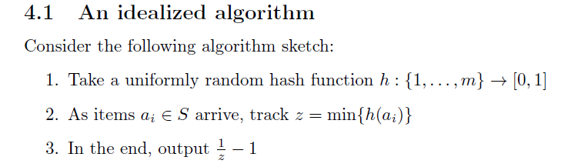

Slide 4
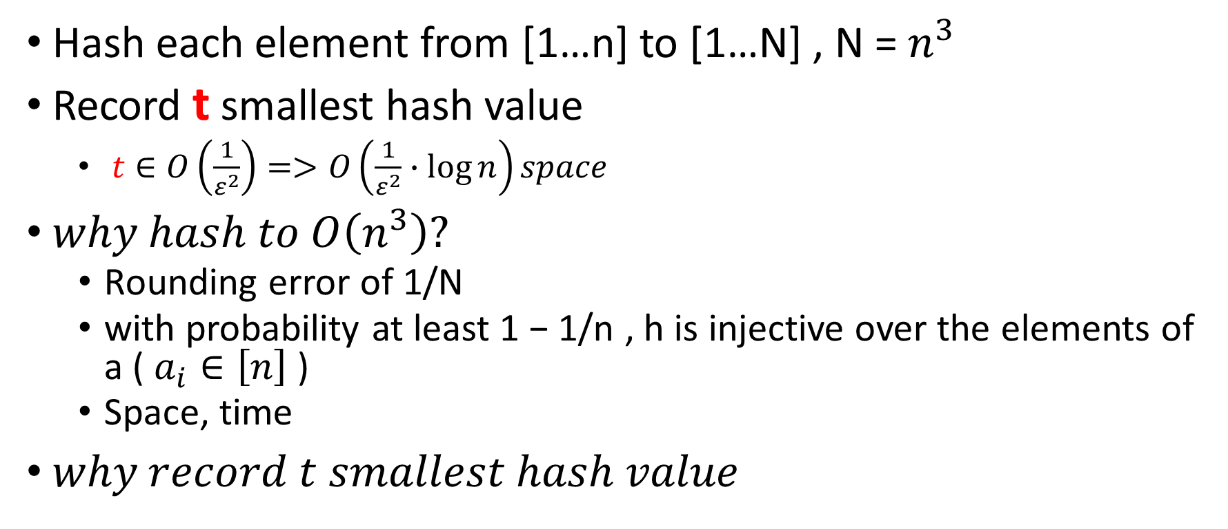
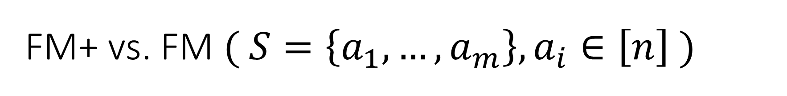
FM+ vs. FM $( S=\left\{a_{1},…,a_{m}\right\}, a_{i}∈\left[n\right] )$
Hash each element from [1…n] to [1…N] , N = $n^{3}$
Record t smallest hash value
$t∈O\left(\frac{1}{ε^{2}}\right)=>O\left(\frac{1}{ε^{2}}∙\log{n}\right)space$
$why hash to O\left(n^{3}\right)?$
Rounding error of 1/N
with probability at least 1 − 1/n , h is injective over the elements of a ( $a_{i}∈\left[n\right]$)
Space, time
$why record t smallest hash value$

Slide 5
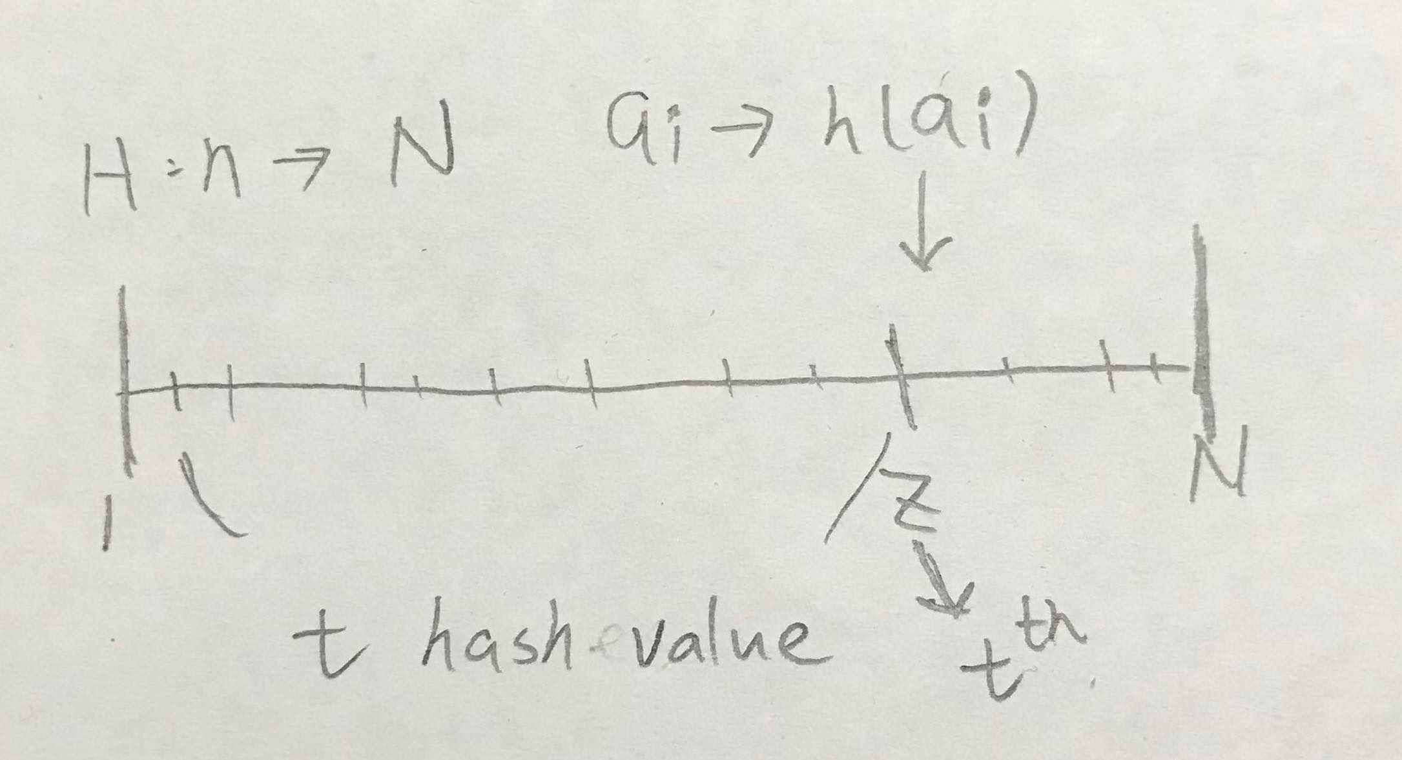

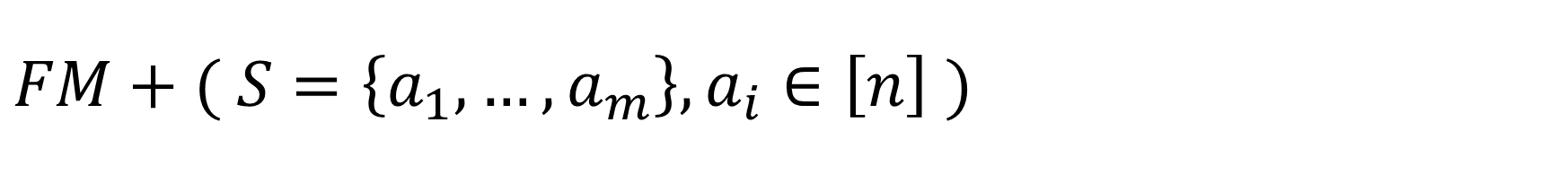
$$FM+( S=\left\{a_{1},…,a_{m}\right\}, a_{i}∈\left[n\right] )$$
$t←\frac{c}{ε^{2}}∈O\left(\frac{1}{ε^{2}}\right), c ≥28$
$h←Random hash from H_{n,N}, N=n^{3}$
$for all a_{i}, get h\left(a_{i}\right), and record t smallest value from it$
$return\frac{tN}{Z}$

Slide 6

$So, why we record t smallest hash value$
Extreme values will affect FM a lot, needs more work to improve the approximation factor

Slide 7
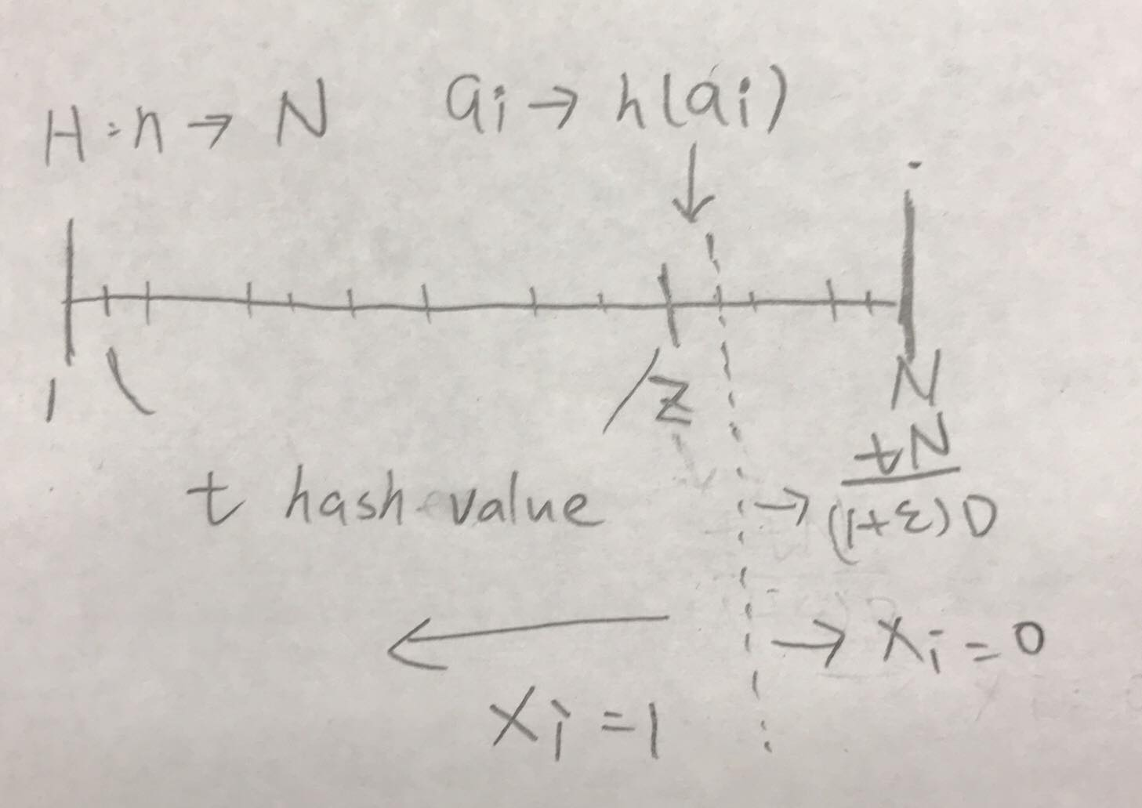

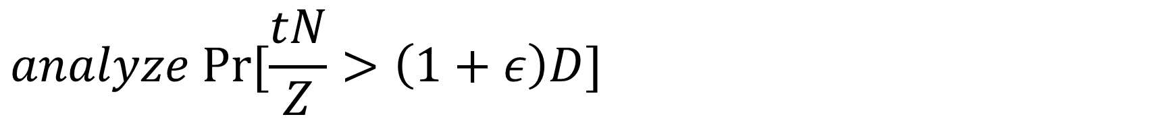
$$analyze Pr⁡[\frac{tN}{Z}>\left(1+ε\right)D]$$
$\operatorname{Pr}\left[\frac{tN}{Z}>\left(1+ε\right)D\right]=\operatorname{Pr}\left[ Z<\frac{tN}{\left(1+ε\right)D}\right]≤Pr⁡[X≥t]$
$X=\sum_{i=1}^{D}{X_{i}},$
$is the number of hashed that are smaller than\frac{tN}{\left(1+ε\right)D}$

Slide 8
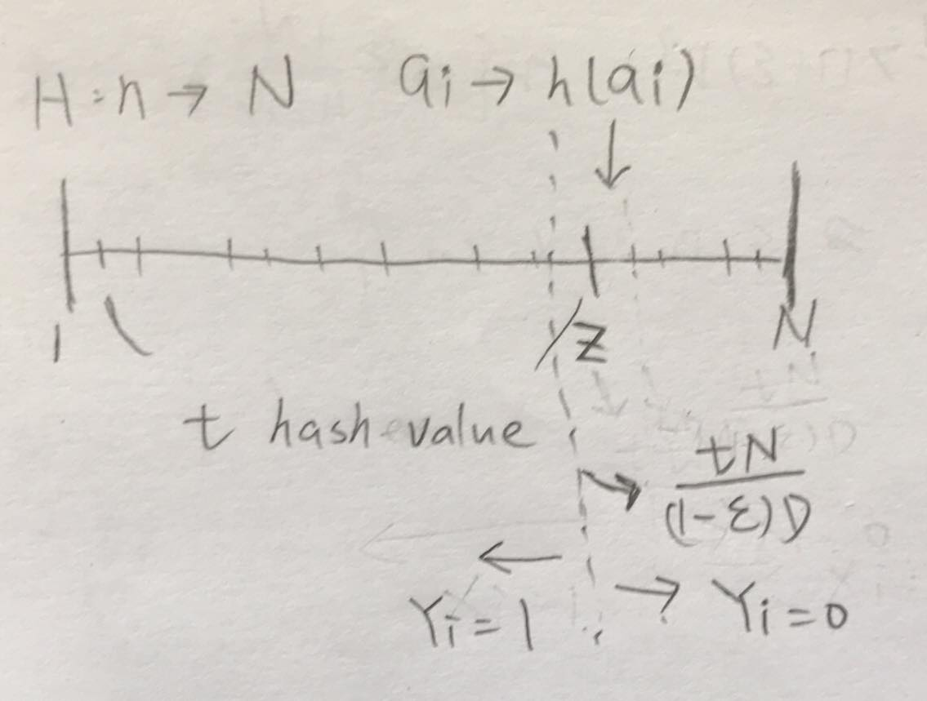

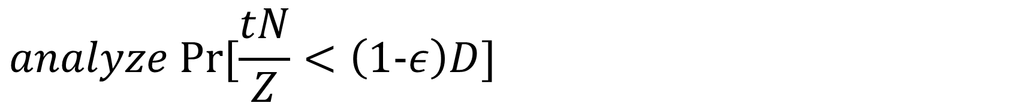
$$analyze Pr⁡[\frac{tN}{Z}<\left(1−ε\right)D]$$
$\operatorname{Pr}\left[\frac{tN}{Z}<\left(1−ε\right)D\right]=\operatorname{Pr}\left[ Z>\frac{tN}{\left(1−ε\right)D}\right]≤Pr⁡[Y≤t]$
$Y=\sum_{i=1}^{D}{Y_{i}},$
$is the number of hashed that are smaller than\frac{tN}{\left(1−ε\right)D}$

Slide 9

$\operatorname{Pr}\left[\left|\frac{tN}{Z}−D\right|>εD\right]≤\frac{1}{4}$
$$⇒for any given 0<ε<\frac{1}{2} ,\operatorname{Pr}\left[\left|\frac{tN}{Z}−D\right|≤εD\right]>\frac{3}{4} (Theorem 4)$$

Slide 10
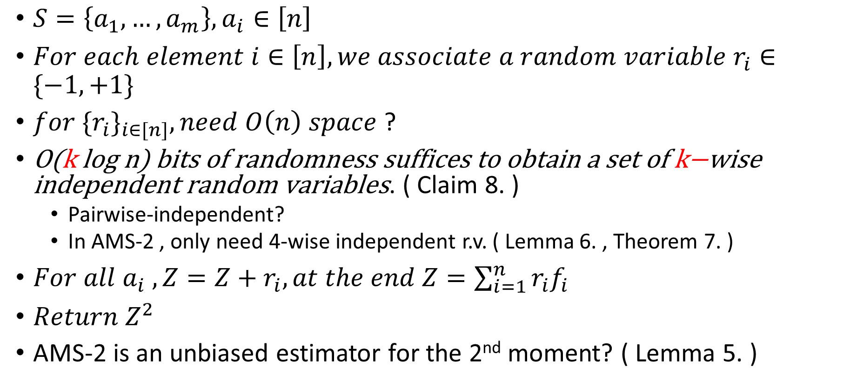
AMS(Alon-Matias-Szegedy's)
$S=\left\{a_{1},…,a_{m}\right\}, a_{i}∈\left[n\right]$
$For each element i∈\left[n\right], we associate a random variable r_{i}∈\{−1,+1\}$
$for {{\{r}_{i}\}}_{i∈[n]}, need O\left(n\right) space$ ?
$\text{O}\text{(}\text{k} \text{log} \text{n}\text{) }\text{bits} \text{of} \text{randomness} \text{suffices} \text{to} \text{obtain} \text{a} \text{set} \text{of} \text{k}\text{−}\text{wise} \text{independent} \text{random} \text{variables}\text{.}$ ( Claim 8. )
Pairwise-independent?
In AMS-2 , only need 4-wise independent r.v. ( Lemma 6. , Theorem 7. )
$For all a_{i} , Z=Z+r_{i}, at the end Z=\sum_{i=1}^{n}{r_{i}f_{i}}$
$Return Z^{2}$
AMS-2 is an unbiased estimator for the 2nd moment? ( Lemma 5. )

Slide 11
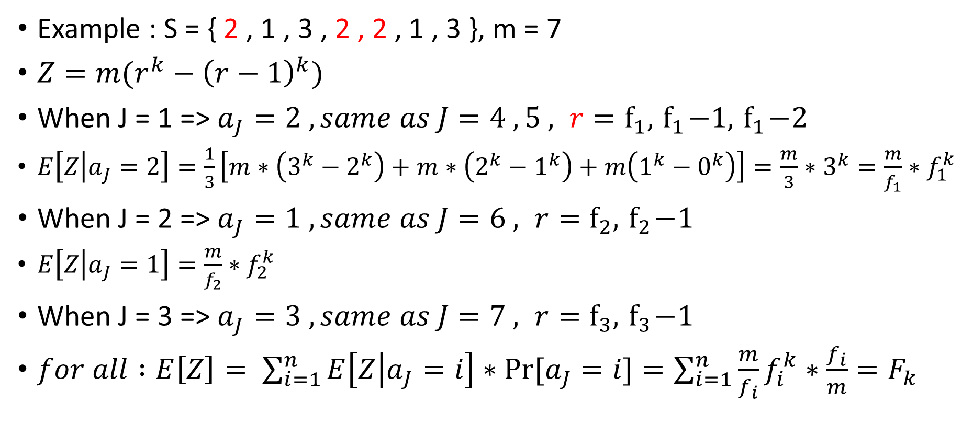
General k ( AMS-K )
Example : S = { 2 , 1 , 3 , 2 , 2 , 1 , 3 }, m = 7
$Z=m(r^{k}−{\left(r−1\right)}^{k})$
When J = 1 => $a_{J}=2 , same as J=4 , 5 , r=f_{1}, { f}_{1}−1, { f}_{1}−2$
$E\left[Z | a_{J}=2\right]=\frac{1}{3}\left[m∗\left(3^{k}−2^{k}\right)+m∗\left(2^{k}−1^{k}\right)+m\left(1^{k}−0^{k}\right)\right]=\frac{m}{3}∗3^{k}=\frac{m}{f_{1}}∗f_{1}^{k}$
When J = 2 => $a_{J}=1 , same as J=6 , r=f_{2}, { f}_{2}−1$
$E\left[Z | a_{J}=1\right]=\frac{m}{f_{2}}∗f_{2}^{k}$
When J = 3 => $a_{J}=3 , same as J=7 , r=f_{3}, { f}_{3}−1$
$for all :E\left[Z\right]= \sum_{i=1}^{n}{E\left[Z | a_{J}=i\right]∗Pr⁡[a_{J}=i]}=\sum_{i=1}^{n}{\frac{m}{f_{i}}f_{i}^{k}∗\frac{f_{i}}{m}}=F_{k}$

