Slide 1
Approximation Algorithms for Scheduling

Slide 2
Graham
We a given a list of the jobs in some arbitrary order. Whenever a machine becomes available, the next job on the list is assigned to begin processing on the machine.

Slide 3
First Approximation Algorithm
Theorem (Graham [1966])
The Graham Algorithm is a 2 – (1/m) factor approximation algorithm

Slide 4
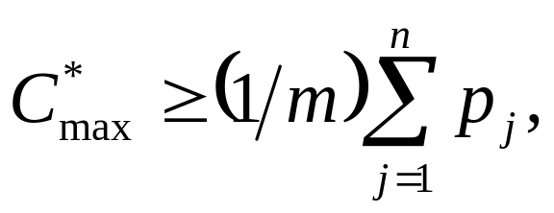
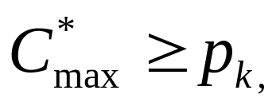
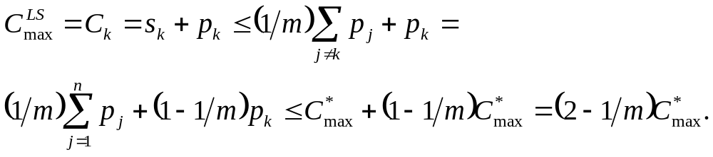
Proof
M₁
M₂
J_{k}
M₃
M₄
t = 0
s_{k}
C_{k}

Slide 5
ModifiedGraham
Order the job list by non-increasing processing times.
Apply Graham Algorithm
ModifiedGraham is a 4/3-factor approximation algorithm

Slide 6
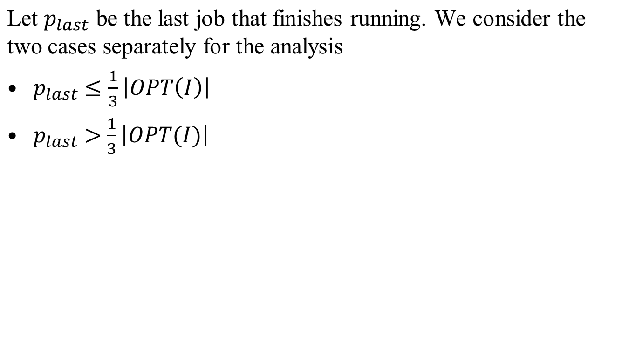
ModifiedGraham

Slide 7
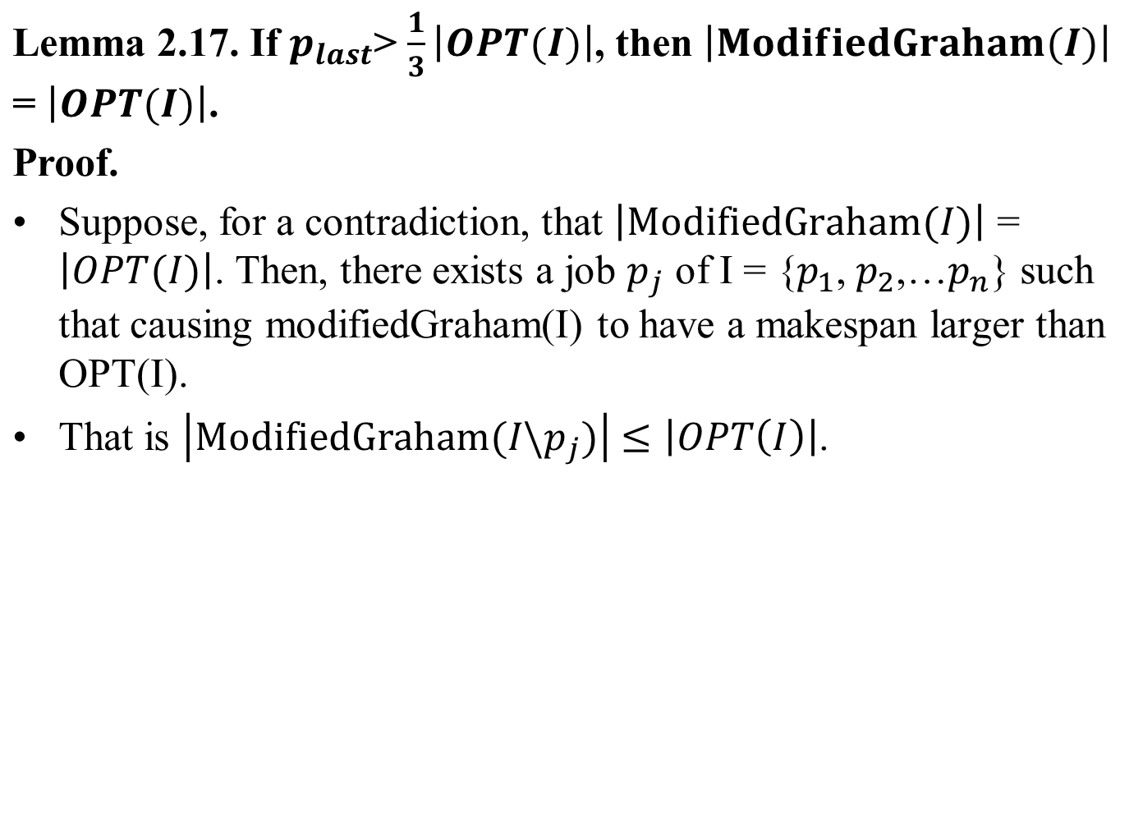

Slide 8





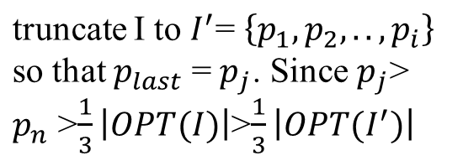



M₁
M₂
M₃
M₄
t = 0
M₁
M₂
M₃
M₄
t = 0

Slide 9




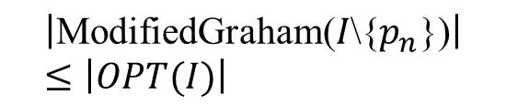
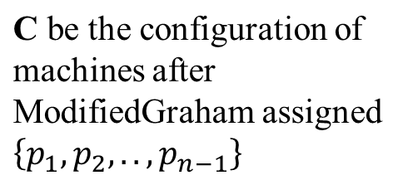
M₁
M₂
M₃
M₄
t = 0
M₁
M₂
M₃
M₄
t = 0

Slide 10
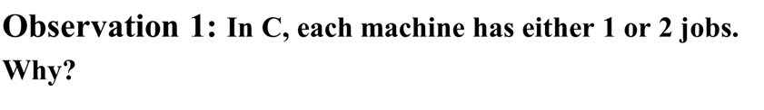
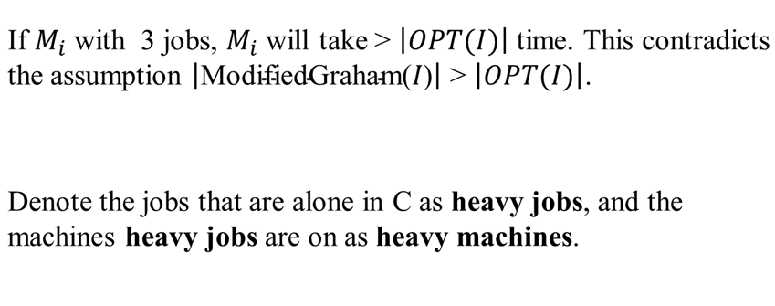

Slide 11
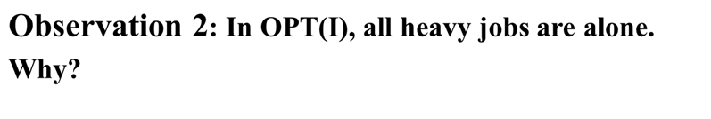
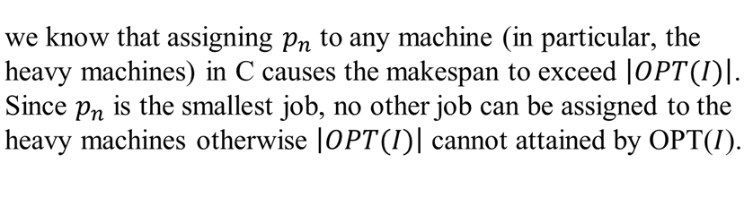

Slide 12

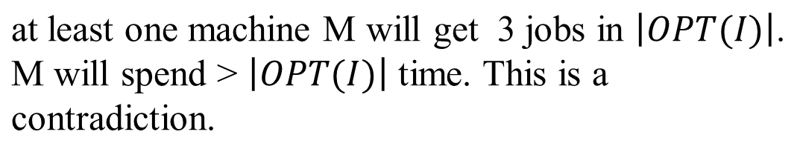
k jobs
k
m-k
2(m-k)+1
t = 0

Slide 13
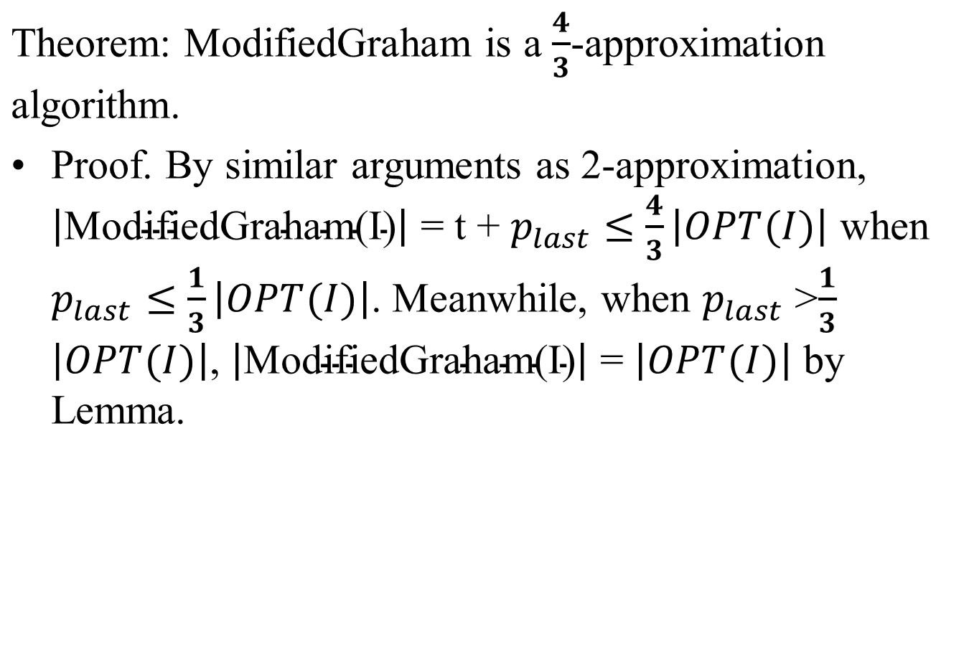

Slide 14
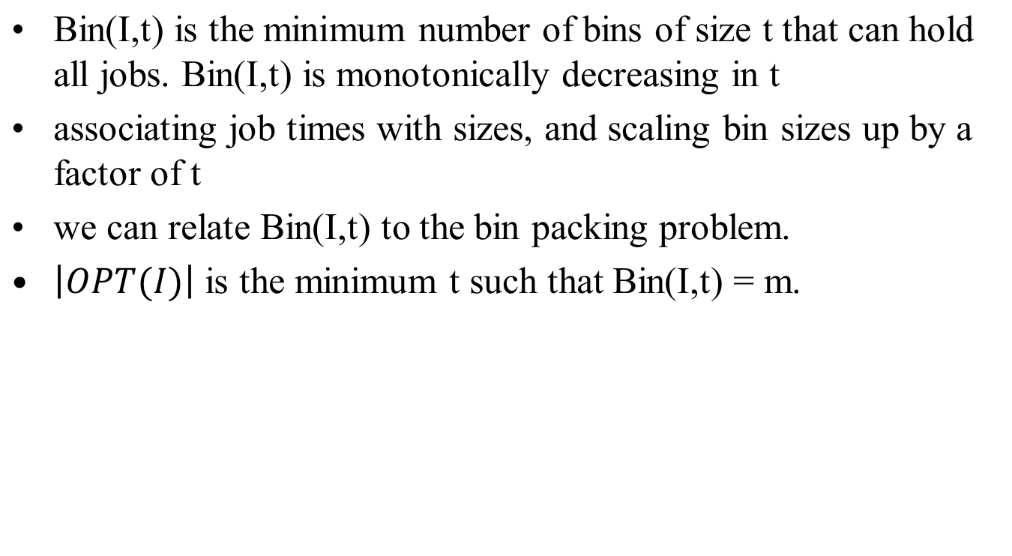
PTAS for minimum makespan scheduling

Slide 15
Bin(I,t)=5
Bin(I,t)=4

Slide 16
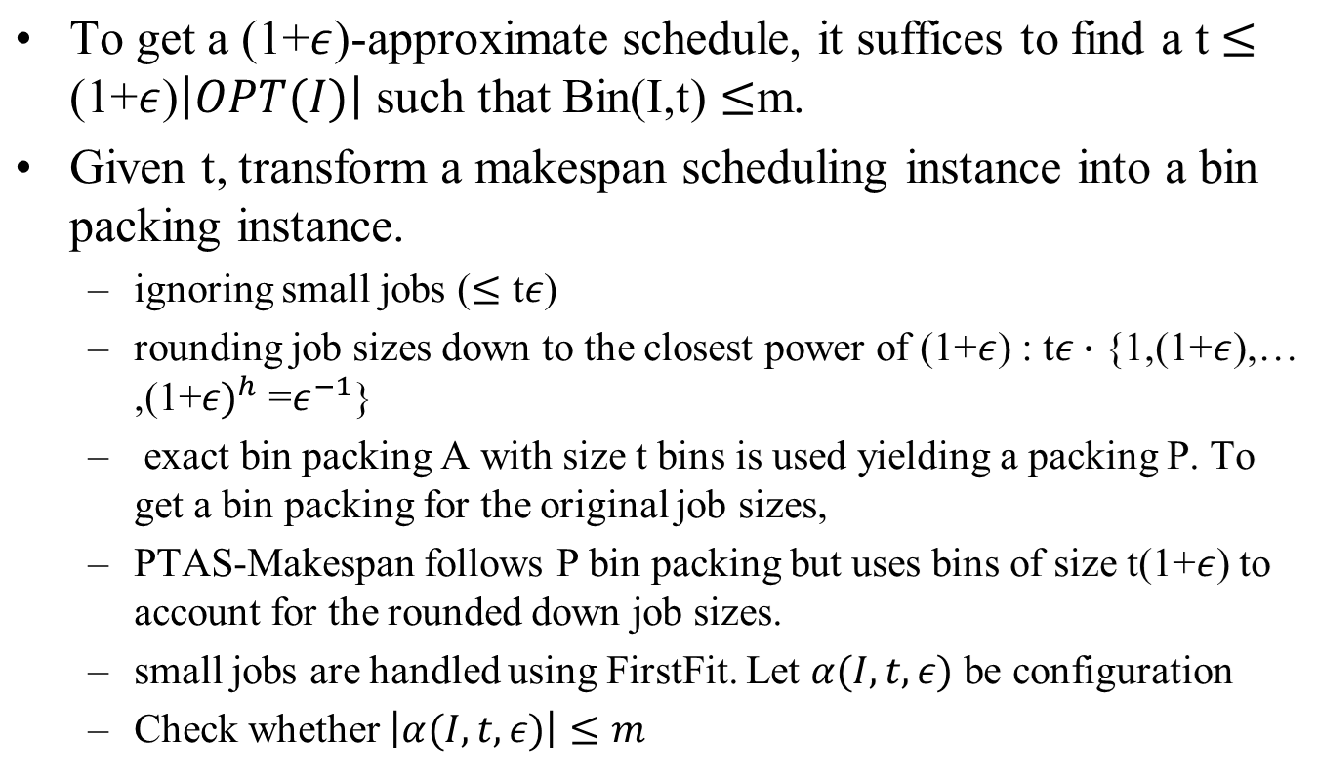
PTAS for minimum makespan scheduling

Slide 17








PTAS for minimum makespan scheduling
0
t
0
t
Rounding job size is bounded

Slide 18
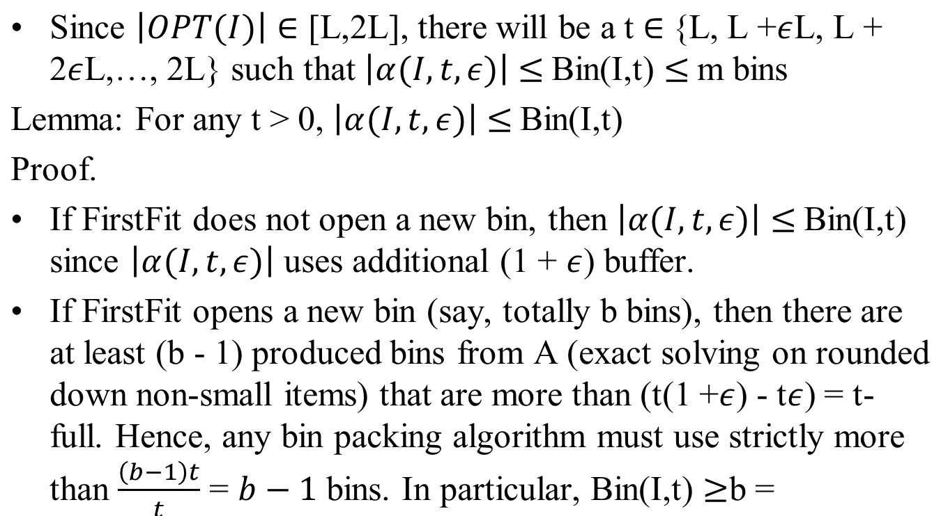


PTAS for minimum makespan scheduling

Slide 19



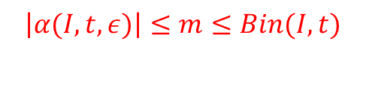
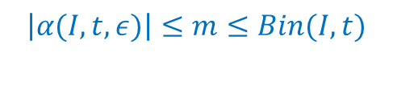

PTAS for minimum makespan scheduling
L
t
2L
………
………

Slide 20
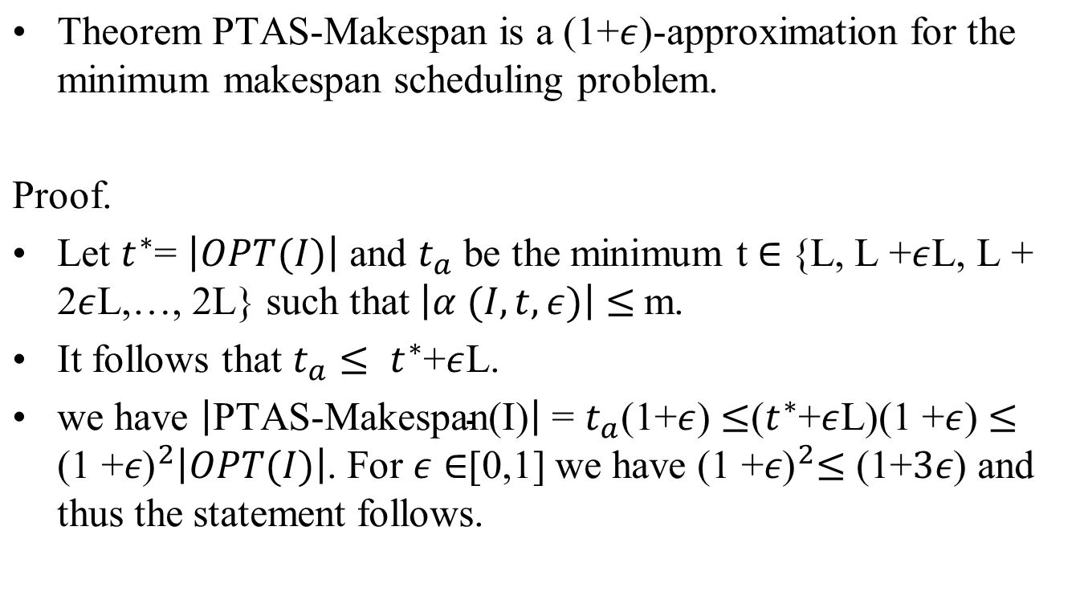
PTAS for minimum makespan scheduling

