Slide 1
FPRAS: DNF Counting and Counting Graph Colorings
Presented by Ting-An Chen
Advisor: De-Nian Yang, Ming-Syan Chen
Feb 28, 2020

Slide 2
Outline
Randomized approximation schemes – FPRAS
Tool – Chernoff bound
DNF counting
Counting graph colorings

Slide 3
FPRAS

Slide 4
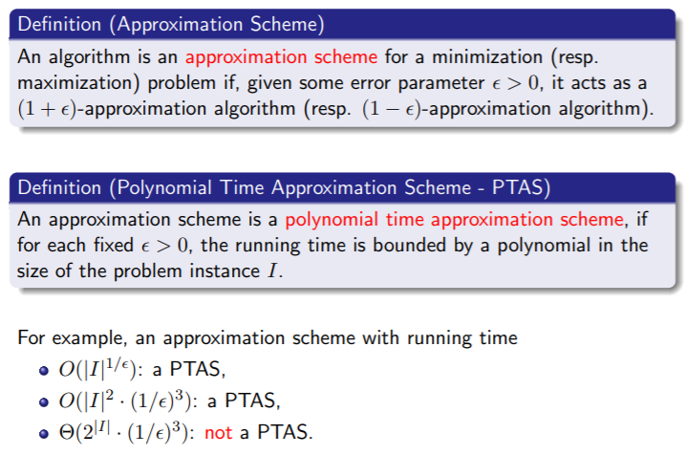
Recap. PTAS and FPTAS

Slide 5
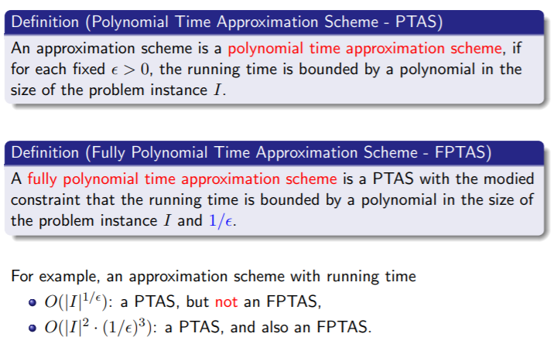
Recap. PTAS and FPTAS

Slide 6
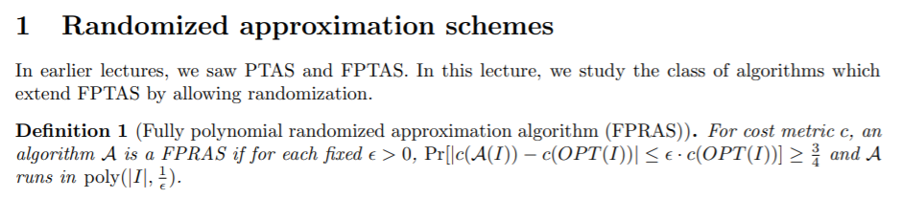
Randomized approximation schemes - FPRAS

Slide 7
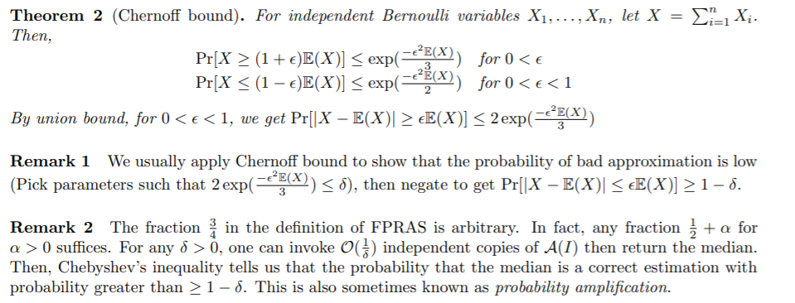

Tool – Chernoff bound

Slide 8
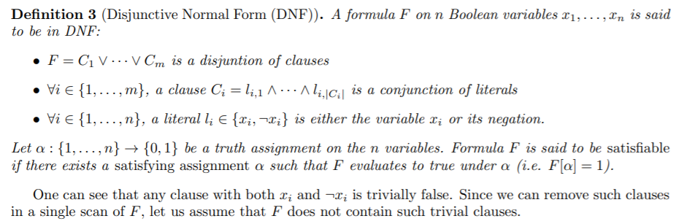
Algorithm 1. DNF counting

Slide 9

Algorithm 1. DNF counting

Slide 10
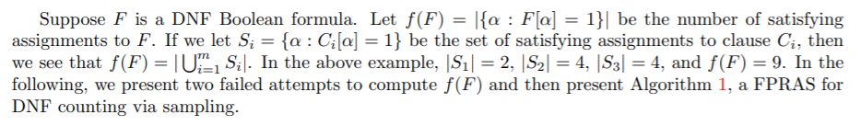
Algorithm 1. DNF counting

Slide 11
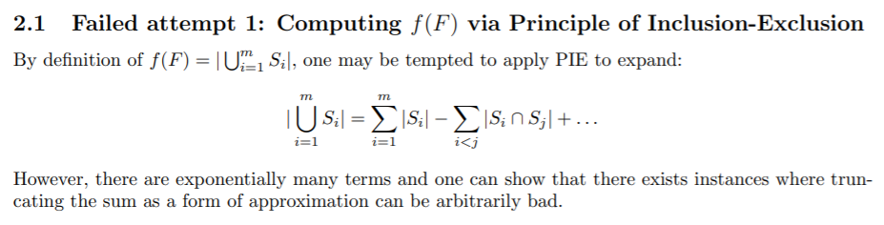
Algorithm 1. DNF counting

Slide 12
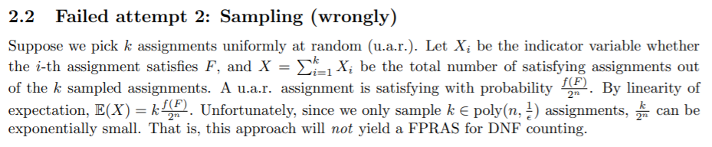
Algorithm 1. DNF counting
-
= ( 1- k/2^n )

Slide 13
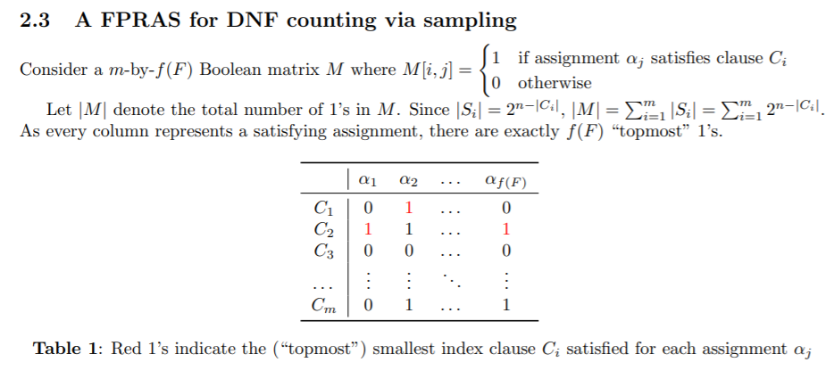
Algorithm 1. DNF counting

Slide 14
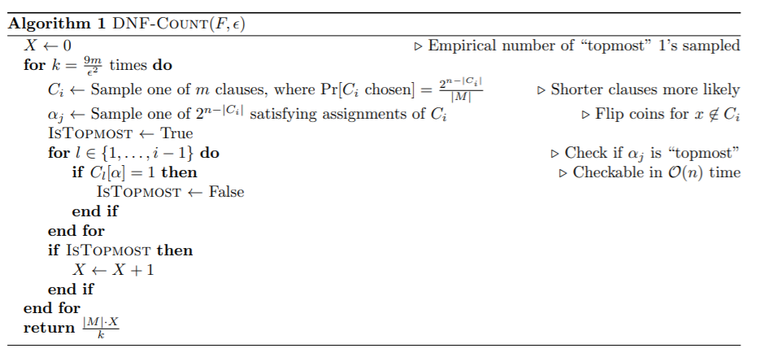
Algorithm 1. DNF counting
WHY?

Slide 15
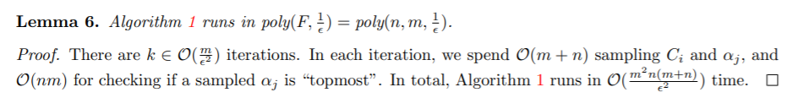
Algorithm 1. DNF counting

Slide 16
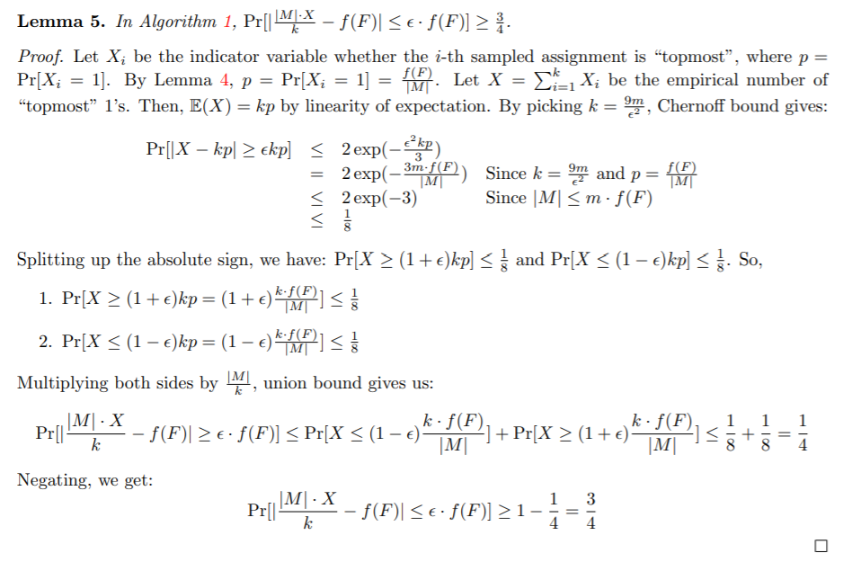
Algorithm 1. DNF counting

Slide 17
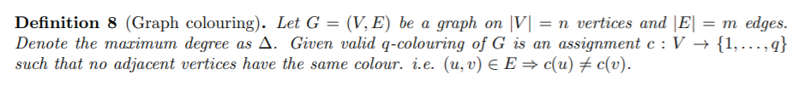
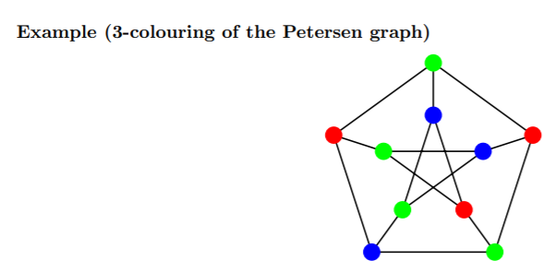
Algorithm 2. Counting Graph Colourings

Slide 18
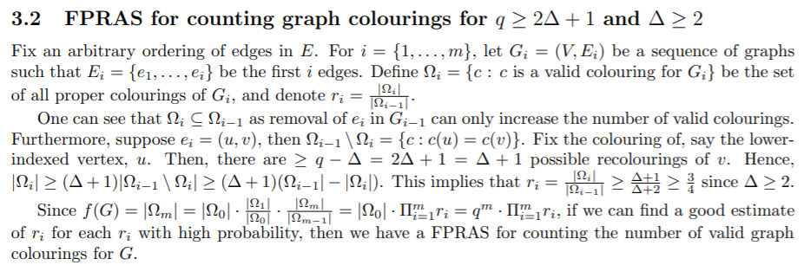
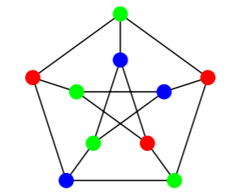
Algorithm 2. Counting Graph Colourings
u
v
Green OR Blue

Slide 19
Algorithm 2. Counting Graph Colourings
u
v
Green OR Blue

Slide 20


Algorithm 2. Counting Graph Colourings
…
u
v
Green OR Blue

Slide 21
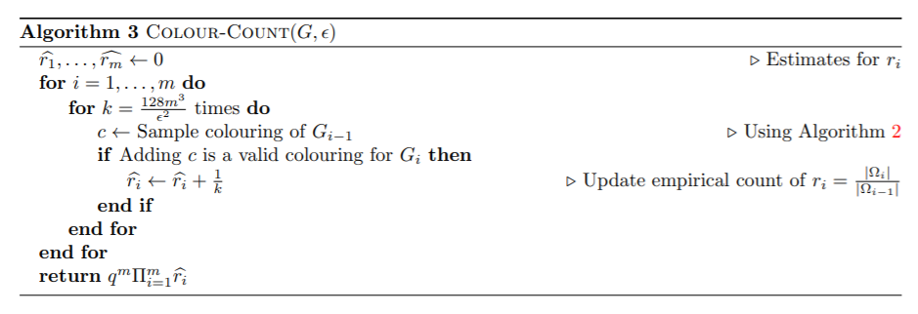
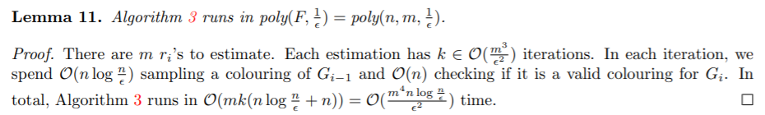
Algorithm 2. Counting Graph Colourings

Slide 22
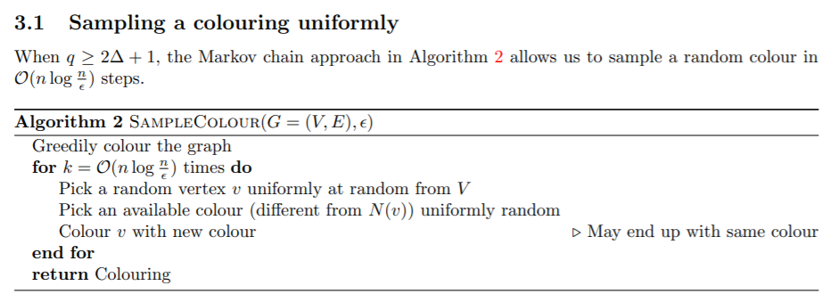
Algorithm 2. Counting Graph Colourings

Slide 23
Algorithm 2. Counting Graph Colourings

Slide 24
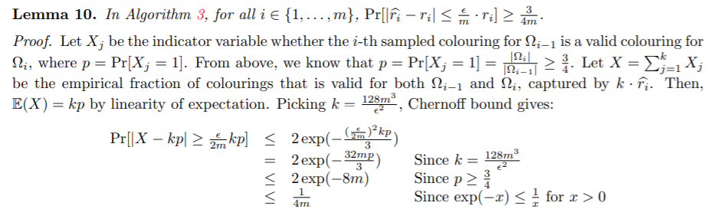
Algorithm 2. Counting Graph Colourings

Slide 25
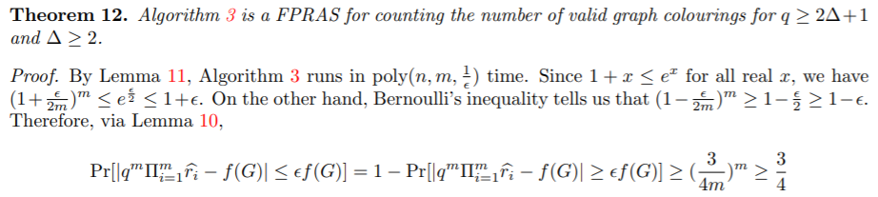
Algorithm 2. Counting Graph Colourings

Slide 26
Reference
[1] Mohsen Ghaffari, Advanced Algorithms
[2] Lecture 04 notes, Advanced Algorithms, ETH Zurich, Fall 2018

