Slide 1
1. Counting problem
2. Recall fully polynomial randomized approximation schemes (FPRAS) for hard counting problem
3. Method for FPRAS

Slide 2
#P, #P-Complete(#PC)
The problem is in #P, the class of problems that can be defined as counting the number of accepting paths of a polynomial-time non-deterministic Turing machine.
NP and #P, who is harder?

Slide 3
# Matching
# DNF
# graph colorings

Slide 4
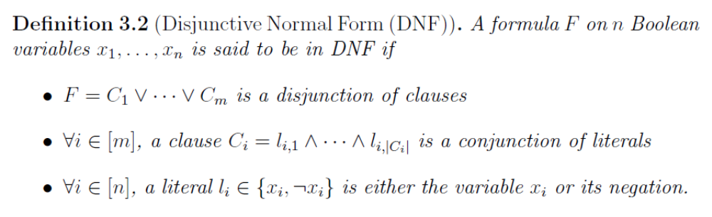
Conjunctive Normal Form (CNF)
Decision problem of DNF is in P while the one of CNF is NP-complete
DNF and CNF can be reducted from each other
DNF can be transformed into CNF by preserving satisfiability (linearly increase the size, introduce new variables) to avoid exponential explosion.
P=NP?

Slide 5

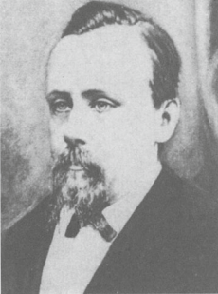
The Four Color Problem: Coloring of planar maps.
In many areas of mathematics, attempts to ﬁnd solutions to challenging unsolved problems have led to the advancement of ideas and techniques. In the case of graph theory, it was a seemingly innocuous map-colouring problem that provided the motivation for many of the developments during its ﬁrst one hundred years.
The Four Color Problem seems to have been first proposed by Möbius in 1840.
Later, the Four Color problem posed by Francis Guthrie, while trying to color the map of counties of England, noticed that only four different colors were needed.

Slide 6
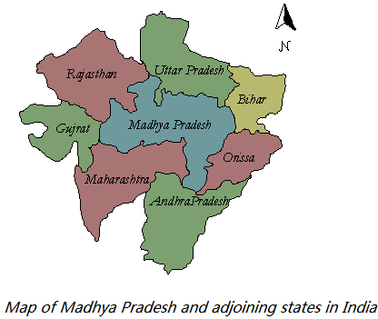
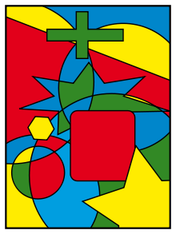
The Four Color Problem: Coloring of planar maps.
Francis Guthrie has discussed this problem with his brother Frederick Guthrie. At the time, Guthrie's brother, Frederick, was a student of Augustus De Morgan (the former advisor of Francis) at University College London. Francis inquired with Frederick regarding it, who then took it to De Morgan (Francis Guthrie graduated later in 1852, and later became a professor of mathematics in South Africa).

Slide 7
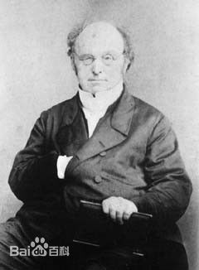
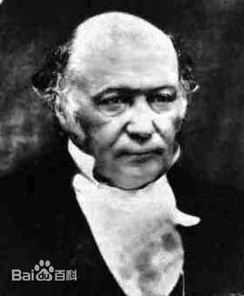
The Four Color Problem: Coloring of planar maps.
Then Augustus De Morgan communicated the following Four-Colour Problem in a letter written to William Rowan Hamilton in 1852.
a letter

Slide 8
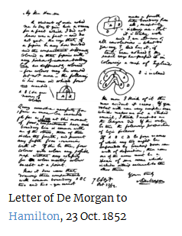
The Four Color Problem: Colroing of planar maps.
A student of mine [Frederick Guthrie, brother of Francis] asked me today to give him a reason for a fact which I did not know was a fact – and do not yet. He says that if a ﬁgure be anyhow divided and the compartments differently coloured so that ﬁgures with any portion of common boundary line are differently coloured – four colours may be wanted, but not more – the following is the case in which four colours are wanted. Query cannot a necessity for ﬁve or more be invented ...

Slide 9
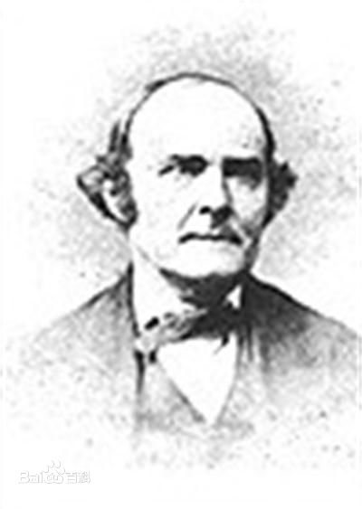
The Four Color Problem: Coloring of planar maps.
"F.G.", perhaps one of the two Guthries, published the question in The Athenaeum in 1854, and De Morgan posed the question again in the same magazine in 1860. Another early published reference by Arthur Cayley (1879) in turn credits the conjecture to De Morgan.
There were several early failed attempts at proving the theorem. De Morgan believed that it followed from a simple fact about four regions, though he didn't believe that fact could be derived from more elementary facts.
Arthur Cayley

Slide 10
The Four Color Problem: “Proof by computer”.
During the 1960s and 1970s German mathematician Heinrich Heesch developed methods of using computers to search for a proof. Notably he was the first to use discharging for proving the theorem, which turned out to be important in the unavoidability portion of the subsequent Appel–Haken proof. He also expanded on the concept of reducibility and, along with Ken Durre, developed a computer test for it. Unfortunately, at this critical juncture, he was unable to procure the necessary supercomputer time to continue his work.
Others took up his methods and his computer-assisted approach. While other teams of mathematicians were racing to complete proofs, Kenneth Appel and Wolfgang Haken at the University of Illinois announced, on June 21, 1976, that they had proved the theorem. They were assisted in some algorithmic work by John A. Koch.
K. Appel and W. Haken, Every planar map is four colorable. Part I. Discharging, Illinois J. Math. 21 (1977), 429-490.
K. Appel, W. Haken and J. Koch, Every planar map is four colorable. Part II. Reducibility, Illinois J. Math. 21 (1977), 491--567.

Slide 11
Face coloring: A k-face coloring of a plane graph is an assignment of k colors to its faces. The coloring is proper if no two adjacent faces are assigned the same color.
Four Color Theorem: Every plane graph without cut edges is 4-face-colorable.

Slide 12
vertex coloring: A proper k-vertex-coloring of a graph, or simply a k-coloring,
is an assignment of [k] to its vertices if no two adjacent vertices are assigned the same color. A graph is k-colorable if it has a k-coloring.
1
4
2
3
Chromatic number:

Slide 13
1. Counting problem
2. Recall fully polynomial randomized approximation schemes (FPRAS) for hard counting problem
3. Method for FPRAS

Slide 14
1. Counting problem
2. Recall fully polynomial randomized approximation schemes (FPRAS) for hard counting problem
3. Method for FPRAS

Slide 15
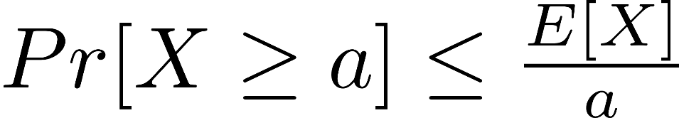
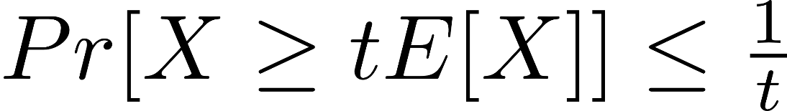
Lemma 5.25: If X is a random variable taking on nonnegative values, then for a > 0,

Slide 16
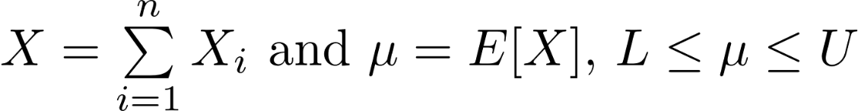

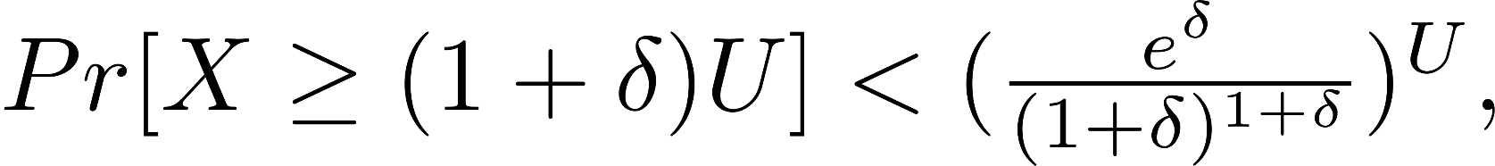
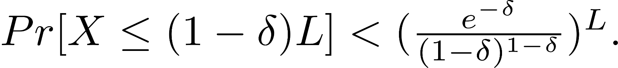
Chernoﬀ bounds
It is very likely that the sum of n independent 0-a_{i} random variables is not far away from the expected value of the sum, where 0 < a_{i} ≤ 1.
Theorem 5.24: Let X₁,X₂, ...,X_{n}, be n independent random variables, not necessarily idenically distributed, such that each X_{i} takes either the value 0 or the value a_{i} for some 0 < a_{i} ≤ 1.Then for
and

Slide 17
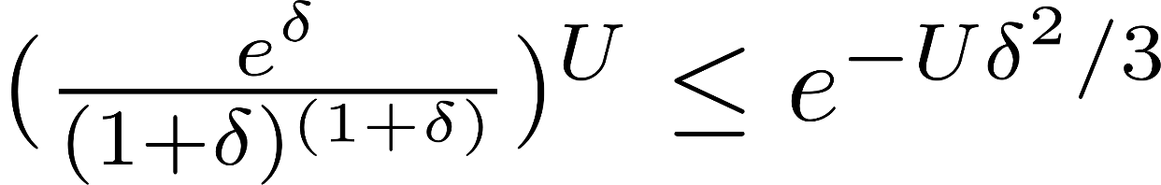
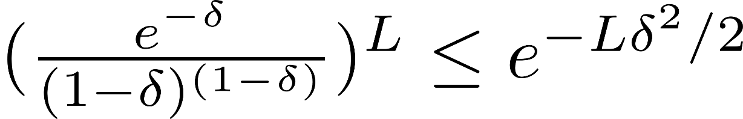
Lemma 5.26: For 0 ≤ δ ≤ 1, we have that
and for 0 ≤ δ < 1, we have that

Slide 18

Lemma 5.26: For 0 ≤ δ ≤ 1, we have that

Slide 19
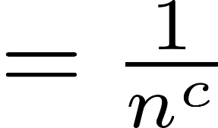
Chernoﬀ bounds: 0-1 random variables
Theorem 5.23: Let X₁,X₂, ...,X_{n}, be n independent 0-1 random variables, not necessarily idenically distributed. Then for

Slide 20
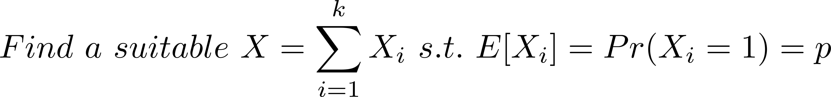
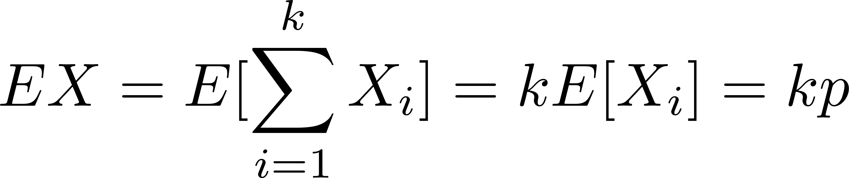
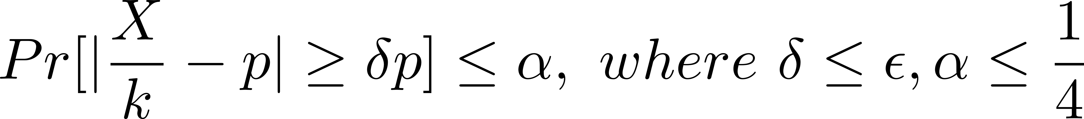
FPRAS by means of Chernoﬀ bounds

Slide 21
Questions
Deterministic approximation schemes for #PC?
Can you count the number of your hair fast?

