Slide 1
Graph Sparsifier

Slide 2
What is sparsification?

Slide 3
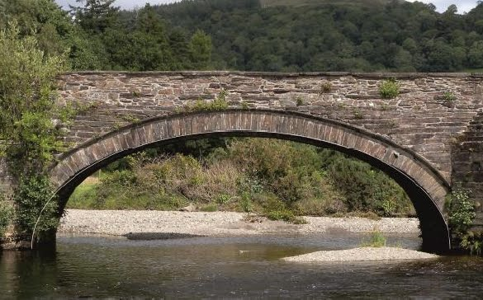
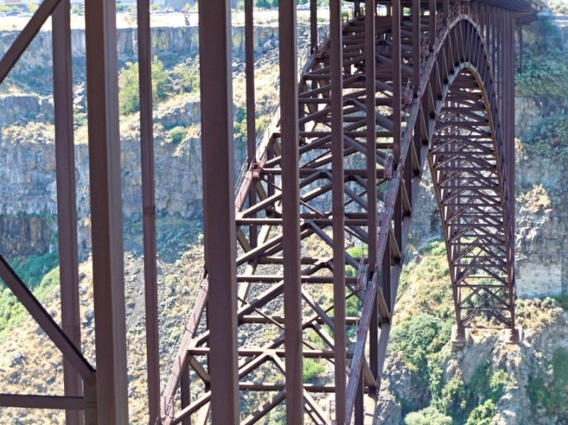
Approximating Dense Objects by Sparse Objects
Bridges
Masonry Arch
Truss Arch

Slide 4
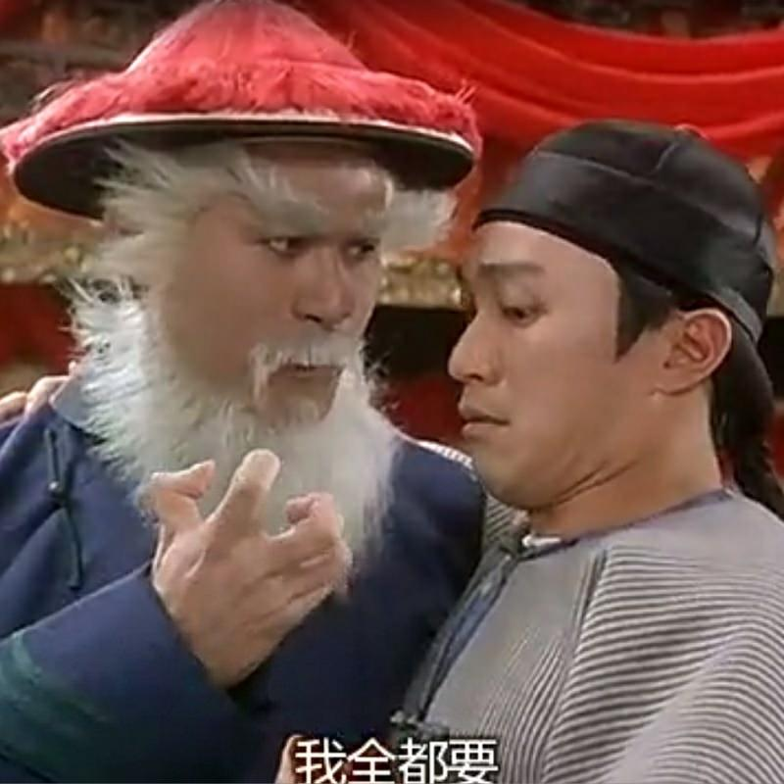
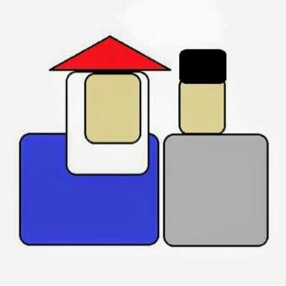
Approximating Dense Objects by Sparse Objects
Images

Slide 5
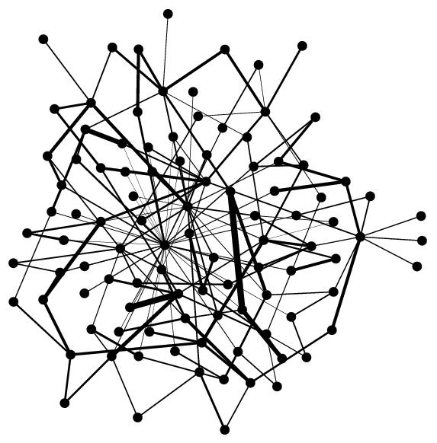
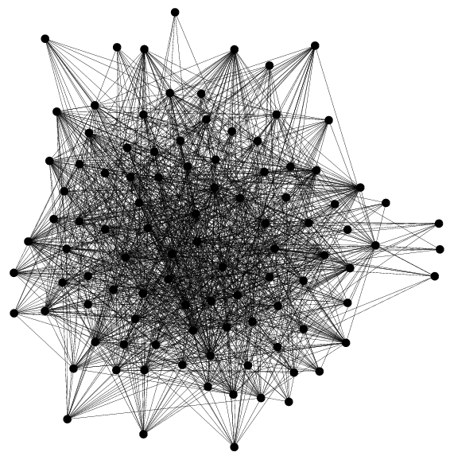
Approximating Dense Objects by Sparse Objects
Graphs
Dense Graph
Sparse Graph

Slide 6
Motivation: Faster Algorithms
Algorithm A for some problem P
Dense Input graph G
Exact/Approx Output
Min s-t cut, Sparsest cut, Max cut, …
(Fast) Sparsification Algorithm
Algorithm A runs faster on sparse input
Sparse graph H
Approximately preserves solution of P
Approximate Output

Slide 7
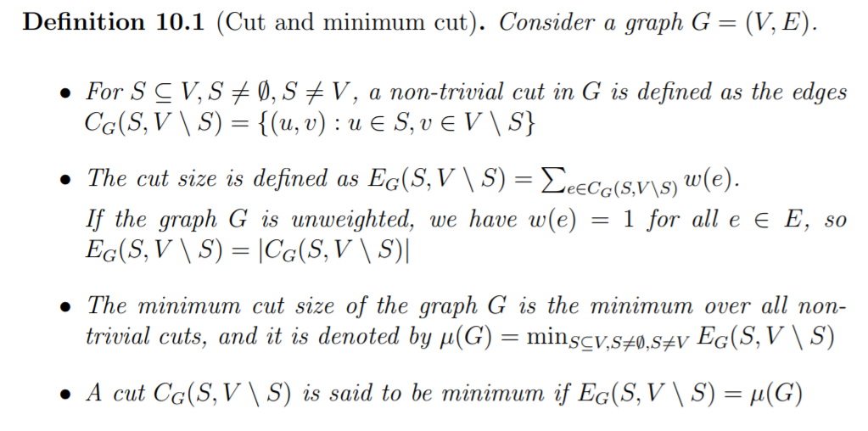
Preserving cuts

Slide 8
Preserving cuts

Slide 9
Preserving cuts

Slide 10
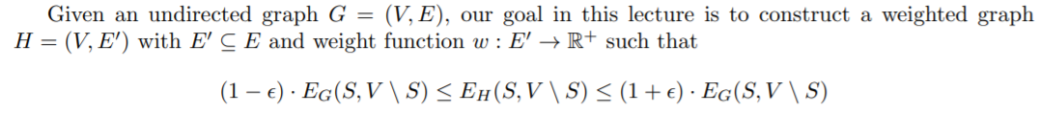
Preserving cuts

Slide 11
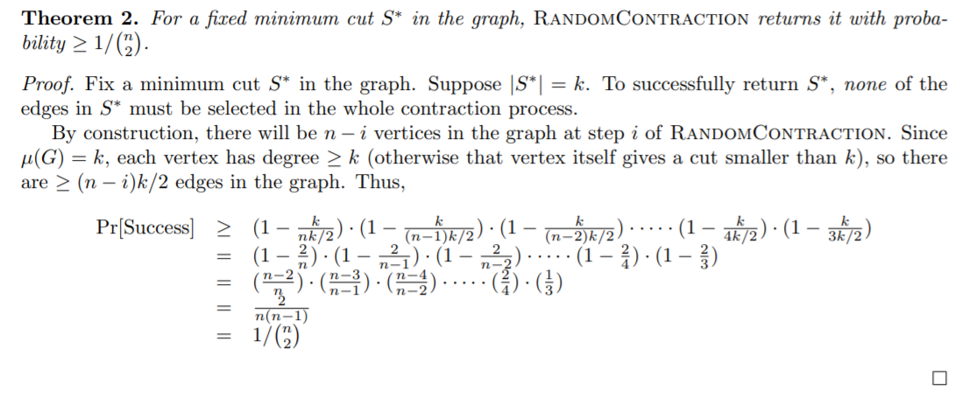
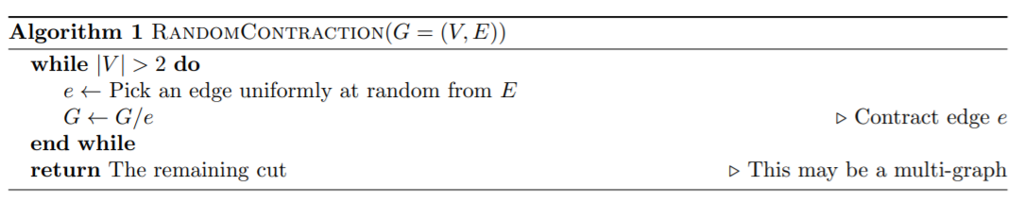
Random contraction
Q:
Notes:
問題: 最多可以有幾個minimum cut
Ans: (n 2)

Slide 12
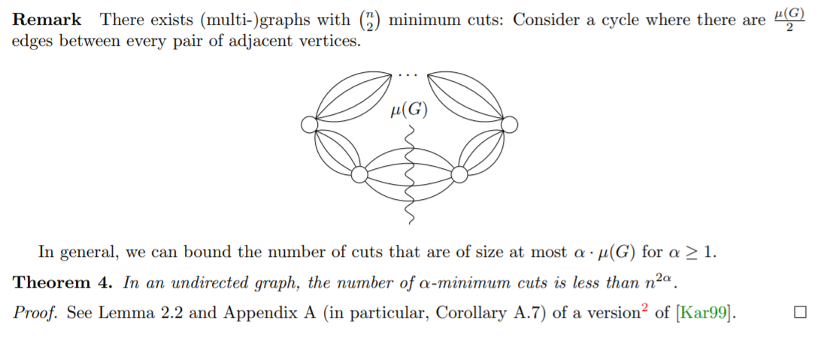
Random contraction

Slide 13
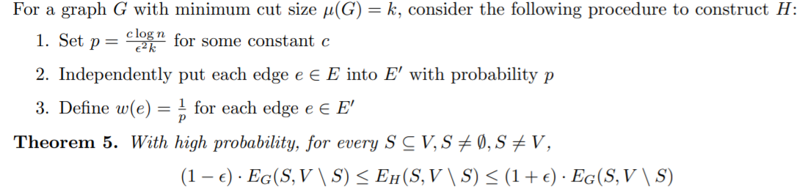
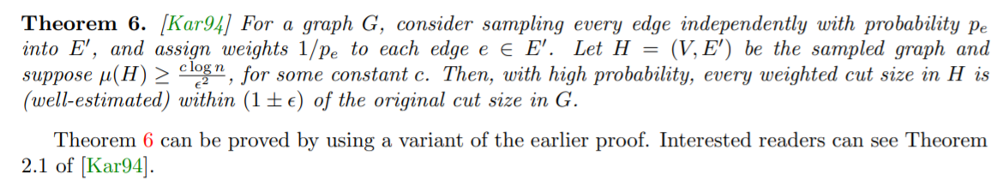
Uniform edge sampling
proof
Q:

Slide 14

Uniform edge sampling
Running the uniform sampling does not work well as$μ\left(G\right)=1$leads to large sampling probability p. $(p=\frac{c\log{n}}{ε^{2 }μ\left(G\right)})$
Notes:
在甚麼情況下 uniform sampling 會表現不好

Slide 15
Nonuniform edge sampling
Sample high/low-connectivity edges with low/high probababilty
Eliminate most of these
Keep this
Notes:
在甚麼情況下 uniform sampling 會表現不好

Slide 16
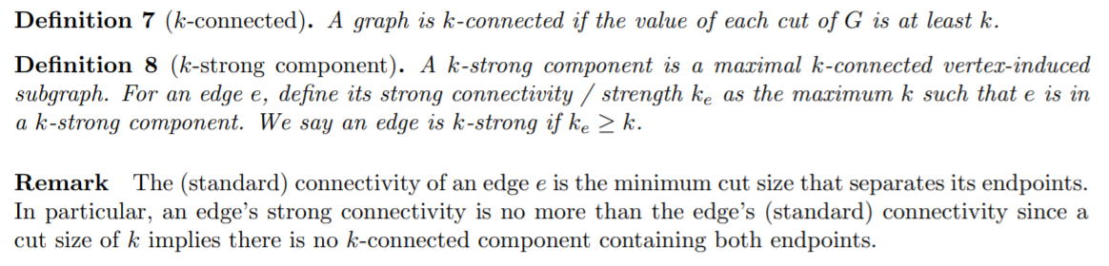
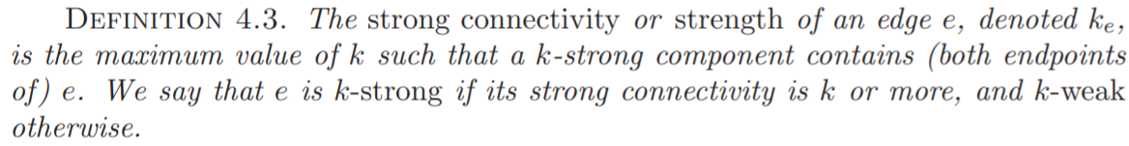
Nonuniform edge sampling
Notes:
在甚麼情況下 uniform sampling 會表現不好

Slide 17
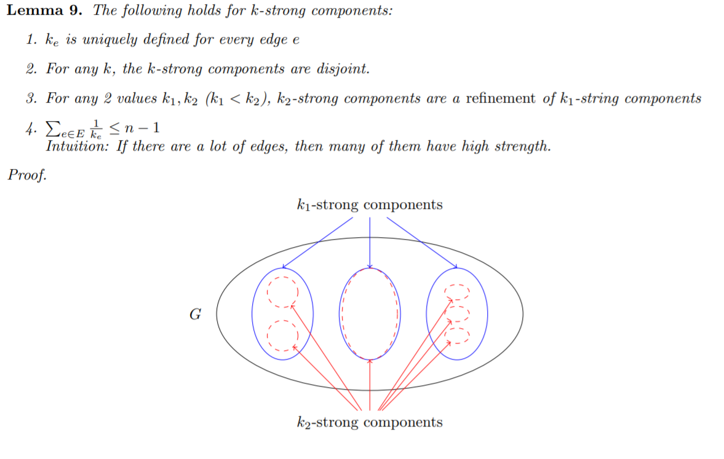
Nonuniform edge sampling
Notes:
在甚麼情況下 uniform sampling 會表現不好

Slide 18
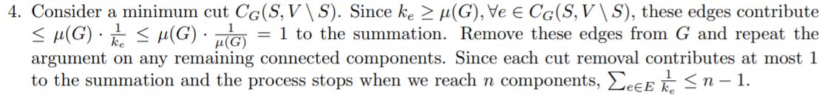
Nonuniform edge sampling
Notes:
在甚麼情況下 uniform sampling 會表現不好

Slide 19
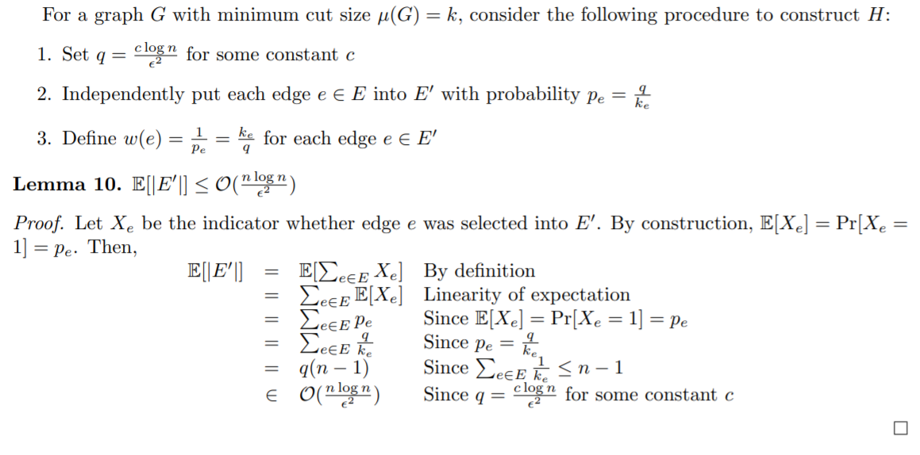
Nonuniform edge sampling
Notes:
在甚麼情況下 uniform sampling 會表現不好

Slide 20
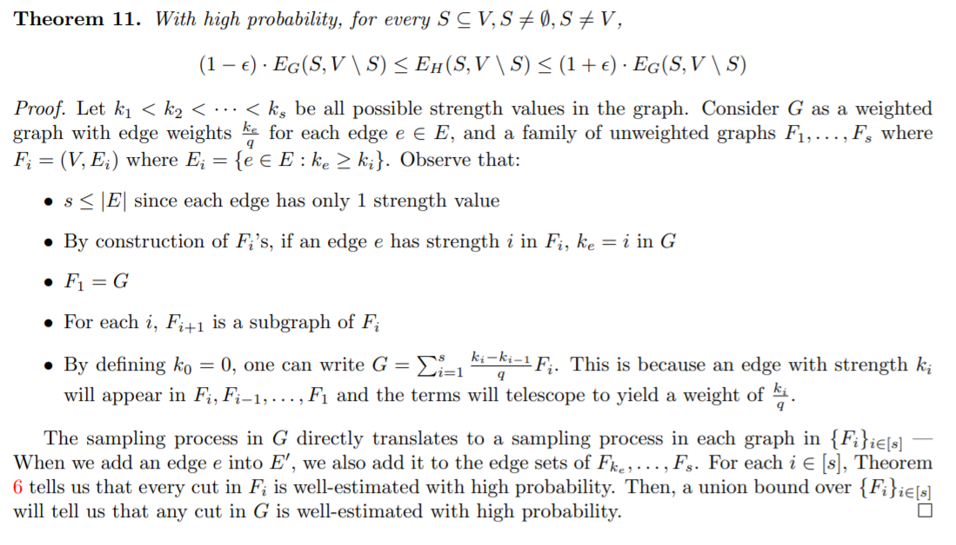
Nonuniform edge sampling
Notes:
在甚麼情況下 uniform sampling 會表現不好

Slide 21
Reference
Graph Sparsifiers: A Survey, Nick Harvey
Lecture Notes11 form 2018
Chapter 10 lecture notes
RANDOMIZED APPROXIMATION SCHEMES FOR CUTS AND FLOWS IN CAPACITATED GRAPHS

