Slide 1
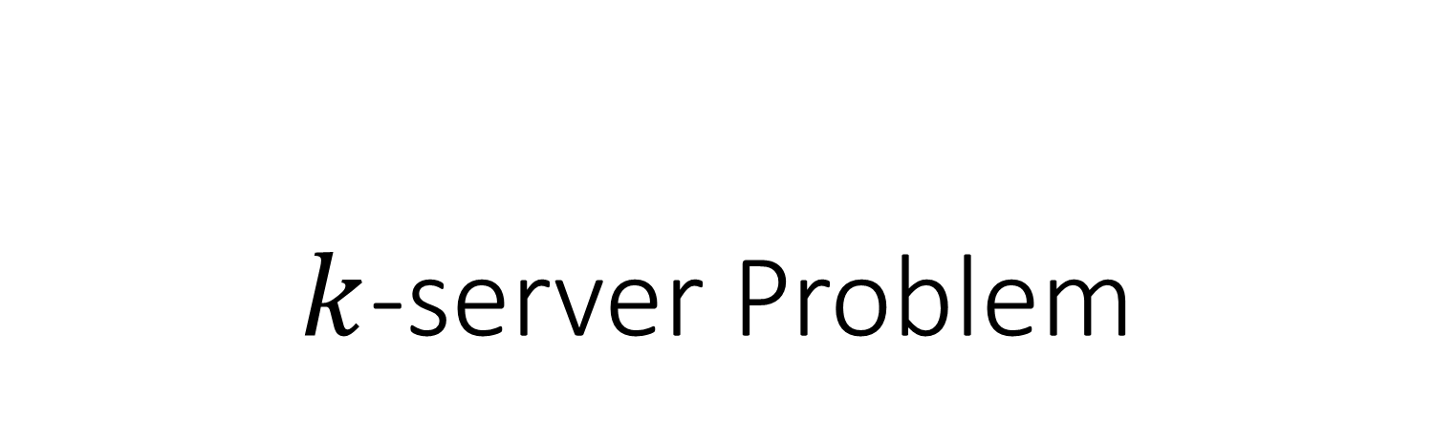
$k$-server Problem

Slide 2
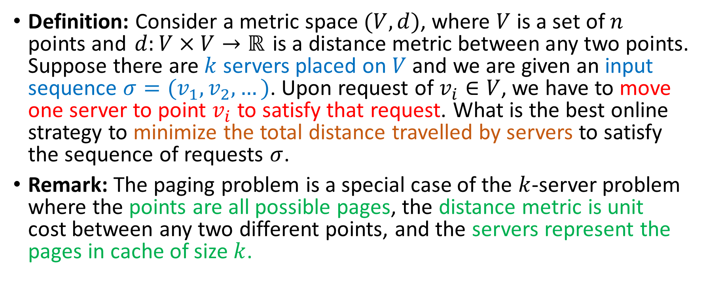
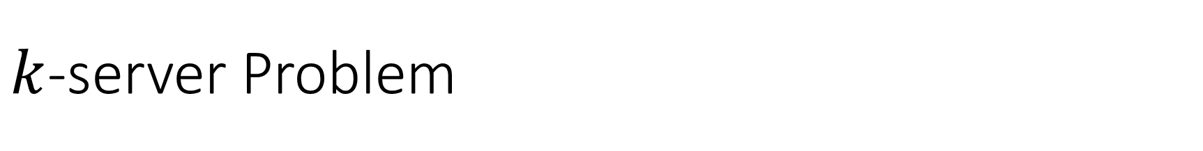
$k$-server Problem
Definition: Consider a metric space $(V,d)$, where $V$ is a set of $n$ points and $d:V×V→ℝ$ is a distance metric between any two points. Suppose there are $k$ servers placed on $V$ and we are given an input sequence $σ=(v_{1},v_{2},…)$. Upon request of $v_{i}∈V$, we have to move one server to point $v_{i}$ to satisfy that request. What is the best online strategy to minimize the total distance travelled by servers to satisfy the sequence of requests $σ$.
Remark: The paging problem is a special case of the $k$-server problem where the points are all possible pages, the distance metric is unit cost between any two different points, and the servers represent the pages in cache of size $k$.

Slide 3
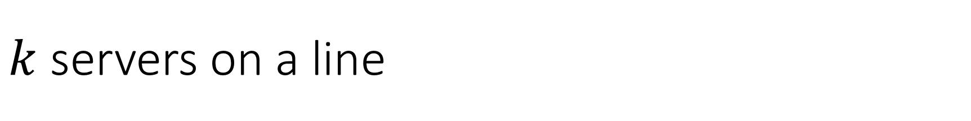
$k$ servers on a line
Intuitive algorithm: pick the closest server to serve any given request.
This algorithm is very bad! (why?)
OPT moves servers to A and B, and has constant cost
s
A
B

Slide 4
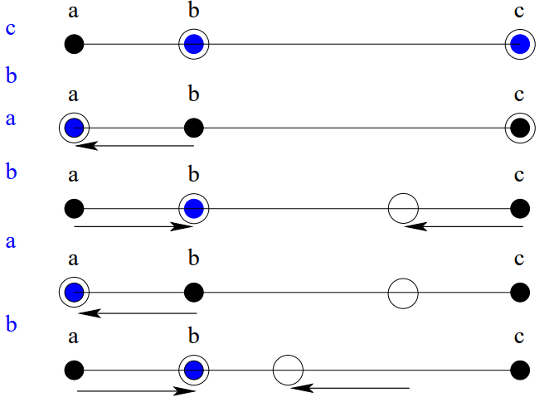

Double Coverage (DC)
If request $r$ is on one side of all servers, move the closest server to cover it.
If request $r$ lies between two servers, move both towards it at constant speed until $r$ is covered.
Source: http://algo2.iti.kit.edu/vanstee/courses/kserver.pdf
Notes:
最弱的對手都至少是log k，所以不會有比這更好的ratio

Slide 5
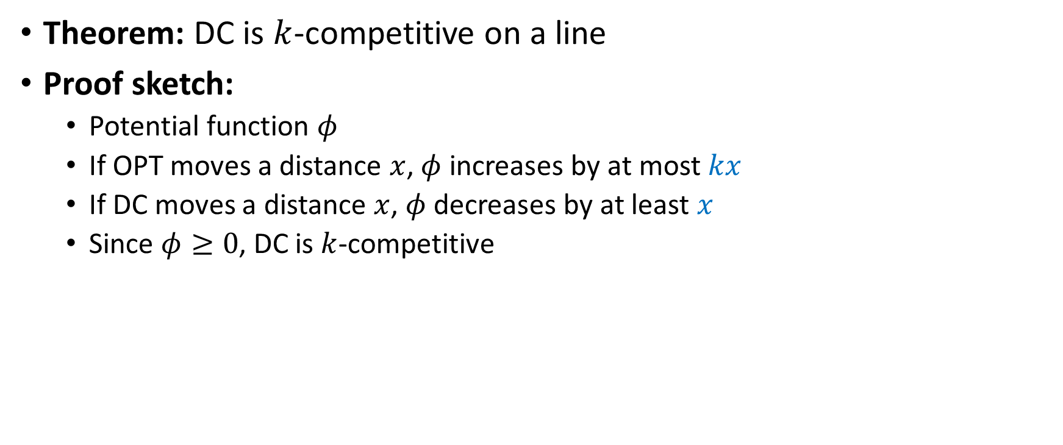
Double Coverage
Theorem: DC is $k$-competitive on a line
Proof sketch:
Potential function $φ$
If OPT moves a distance $x$, $φ$ increases by at most $kx$
If DC moves a distance $x$, $φ$ decreases by at least $x$
Since $φ≥0$, DC is $k$-competitive

