Slide 1
Coal Miner’s Assistant
Aditya Raj 18BIT0412
Shaolin Kataria 18BIT0415

Slide 2
Objectives
As we see in our day to day life, we use a lot of non renewable resources and they are depleting at a very fast rate. So, we’re urged to switch over to alternative resources such as non renewable. But while it is good that we’re thriving for sustainable development, we often forget the hardworking people involved in this. One such example of this is Coal mine workers. As many as 145 died in 2016, while the figure was 103 in 2015. Coal mines have accounted for the highest number of casualties due to accidents in mines. Of the 377, more than half, 210, were killed in coal mines.

Slide 3
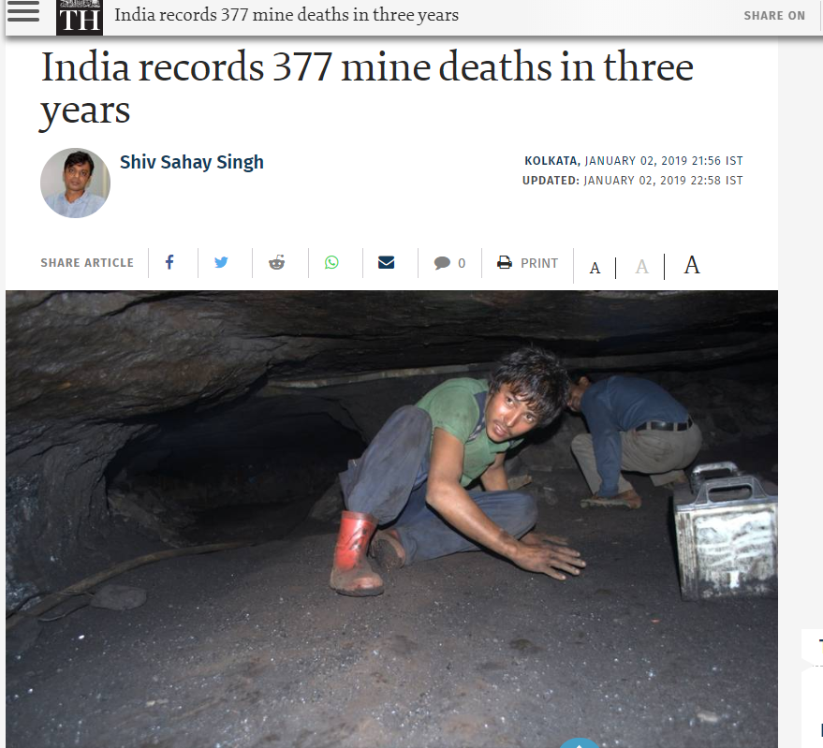

Slide 4

Not only is it necessary to take precaution for the safety of the workers, but it is important that with the thriving technology nowadays, we incorporate that with the automation of the state of the system. We plan to assist the coal miner as well as the monitoring of the coal mine.

Slide 5
Novelty
The following is a classic model of a smart coal mine monitoring system along with smart helmet for the coal miners developed for the mining industry in order to detect hazardous events in the mining environment. We make this possible with the help of Arduino UNO, NodeMCU connected to cloud, and various sensors. As we know, the underground is a very dark site, the workers will be provided with a protective helmet which will act as a friend in darkness for them. Monitoring section contains alerting units, that deliver an automatic email to authorized personal in case of emergencies.

Slide 6
Methodology
The methodology used involves IoT and connected devices. IoT includes modules such as Arduino UNO, Raspberry PI, NODE MCU, along with a whole lot of sensors. Thingspeak has been used as the cloud platform to store the data received from the sensors which we can act on according to our choice and give specific instructions for specific thresholds. Blynk has been used to making a task as simple as touching a button on your phone. This entirely together constitutes our system, along with a lot of care for the coal miners.

Slide 7

Results and Discussions
We were successful in receiving the waterlevel of the coal mine, which helps us detect any possibility flood in the coal mines. This was done taking into consideration the fact that when heavy rainfalls happen, or excess groundwater seeps through, there would be an alert beforehand of the possible flooding of the mine.

Slide 8

MQ2
We have also deployed MQ2 gas sensors which gives us a certain number which we can compare with a user defined threshold to categorise an environment as safe or unsafe to be in. Breathing in such an environment can lead to various lung problems. This is definitely an occupational hazard but if we can still monitor the severity of the drop in air cleanliness levels, we can help generate an awareness about what levels are acceptable.

Slide 9

LCD, PiCamera
We have also deployed an LCD screen which will constantly show us “Coal Mine Assistant” written on it. This can also be used to show certain values from the sensor such as humidity and temperature but for not it has been used like this. We’re also using a PiCamera to keep a regular eye on the system.

Slide 10

Passcode
Up next comes passcode, basically, we’ve divided our entire project into 3 tiers, first one is external coal mine, second one internal coal mine and the last one the helmet of the coal mine worker. Passcode is an essential part of the external coal mine because to gain access to enter the coal mine, you need to enter the correct passcode so a keypad is used to make that sure.

Slide 11

Flame
Going more into working inside the coal mine, there’s one danger that follows us everywhere and one such example is fire. Now, if the place catches fire, flames will lit up, to make the situation addressed to the coal miner and the administration, we use flame sensor to detect flames and then send an alert for a fire situation.

Slide 12

Ultrasonic
As the name suggests, ultrasonic sensor detects distance from it. It basically tells you the distance between itself and its closest object. It sends a wave and the time that it takes to hit the object in sight and come back is used to evaluate how far the object is from the sensor. We can put threshold on minimum amount of distance as security purpose outside the mines or to get an idea through compass representation about which worker is working at which place at what time.

Slide 13

Temperature and Humidity
Always maintaining the amount of temperature and the amount of Humidity gives us the idea of ideal conditions to work in for the workers.

Slide 14

Buzzer
Buzzer is used to send an alert, a noise, to make the supervisor alert of any emergency or alert the worker about any emergency happening. For example, if a flame lits up, or any other such emergency arises, the buzzer will go off.

Slide 15

MQ7, Shock, PIR
We’re using MQ7 sensor to get the CO levels inside, fulfilling a similar purpose as the gas sensor did. Shock sensor is used to detect tremors in the mine and alert the people. PIR aka Motion Detection sensor is used to detect any motion in the mine at suspicious places to alert the people about any danger. In case the rocks start falling, or there is motion because of something else, they will know.

Slide 16
Smart Helmet, Coal Miner’s Best Friend
We’re using various number of sensors in the helmet of the coal miner, starting from the heartbeat sensor which will give a constant note of how well each worker is doing. Secondly, we’re using an avoid sensor which gives light whenever there is no object around it. In case of a mishap such as rocks falling onto the miner, and him struggling to find path to move out of, this could be handy. The light will literally guide him. Apart from this, we’re using a Big Sound sensor, so that whenever a loud thud comes, the reasons for which may be anything, may be something very dangerous, so this will be taken note of too. Another sensor we’ve used is the light blocking sensor, which gives a beep whenever the light is gone, which basically will alert the supervisor in case of a complete blackout. Apart from this, another flame sensor, and a laser display, has been used here.

Slide 17

Conclusion
Conclusion is that if we start, there’s no stopping to innovation. And if it stands for helping a coal miner’s cause, then it is very wholesome. Technically, the project was implemented around somewhat of the desired result. The sensors were deployed and gave reasonable values, the experimentation was successful, a little creativity was added, and the pre requisite knowledge of sensors was put on the plate.

Slide 18

Outcome
We were able to derive values from all sensors, we divided our project into 4 parts, 2 parts include the internal and external monitoring system, the internal monitoring system includes gas sensor, flame sensor, water level sensor, temperature and humidity sensor, pir sensor, buzzer, smoke sensor, ultrasonic sensor and shock sensor, and output has been received from every single sensor on a single monitor screen. The external part includes a keypad, which will only grant access if the key is right, and the other external part is the LCD display which shows us the Coal Mine welcome text at all times. We were also able to make a helmet which uses heartbeat sensor, avoidance sensor, laser, flame sensor, buzzer, big sound and a light blocking sensor, the execution of which has been successfully executed.

Slide 19
The connection of data received from the Temperature, Humidity, heartbeat and distance is being sent to Thingspeak using NODE MCU which can be analysed and visualised according to our choices. Certain components inside the internal monitoring system can be accessed using your mobile phones via the Blynk app.

Slide 20
Future Scope
We want to involve machine learning and analyse the data better and make a data set of the sensor values which will help us design an efficient coal mining system. We can suggest exactly when and how the system is at peak production, and what are the patterns that make that happen. We can also predict the dangers surrounding a coal mine. For the helmet, we can use individual heart rates into consideration for the long time to detect if something abnormal is happening or not. Even though we’ve fulfilled some of our data sending and alerting news to the supervisor via thingspeak, but there’s a lot still that can be done.

Slide 21
Reference
All the Arduino inbuilt examples have been referred to for codes.
Pre-knowledge of breadboard circuits, Arduino UNO, Raspberry PI, sensors, NODE MCU and connections.
Research papers on how a coal mine accident usually happens.
The various ideas on how a smart helmet for a coal mine worker can be formed.

Slide 22
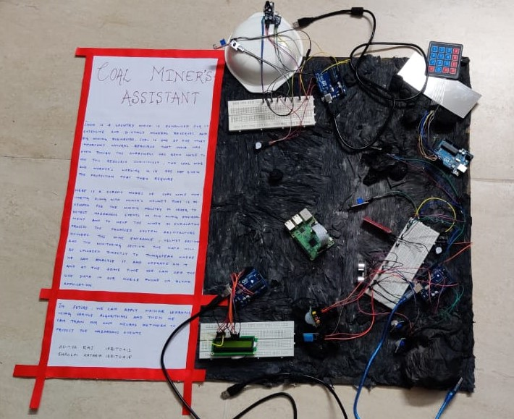

Slide 23

THANK YOU!

