Slide 2
Objectives
Define properties in C#
Explain properties, fields, and methods
Explain indexers
Building Applications Using C# / Session 9

Slide 3
Properties in C#
Access modifiers such as public, private, protected, and internal control accessibility of fields and methods in C#.
  public fields: accessible by other classes
  private fields: accessible only by the class in which they are declared
Properties in C# allow you to set and retrieve values of fields declared with any access modifier in a secured manner.
Building Applications Using C# / Session 9

Slide 4
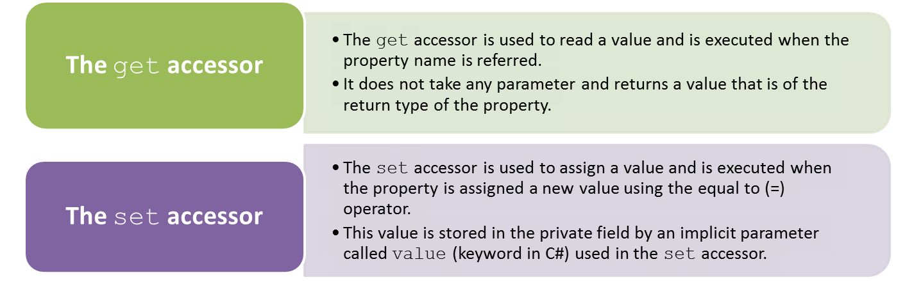
get and set Accessors 1-3
Property accessors allow you to read and assign a value to a field by implementing get and set accessors as follows:
<access_modifier><return_type>PropertyName>
{
  get
  {
  // return value
  }
  set
  {
  // assign value
  }
}
Syntax
Building Applications Using C# / Session 9

Slide 5
get and set Accessors 3-3
In the code:
  The class SalaryDetails creates a private variable _empName and declares a property called EmployeeName.
  The instance of the SalaryDetails class, objSal, invokes the property EmployeeName using the dot (.) operator to initialize the value of employee name. This invokes the set accessor, where the value keyword assigns the value to _empName.
  The code displays the employee name by invoking the property name.
  This invokes the get accessor, which returns the assigned employee name. This invokes the set accessor, where the value keyword assigns the value to _empName.
  Employee Name: Patrick Johnson
Output
Building Applications Using C# / Session 9

Slide 6
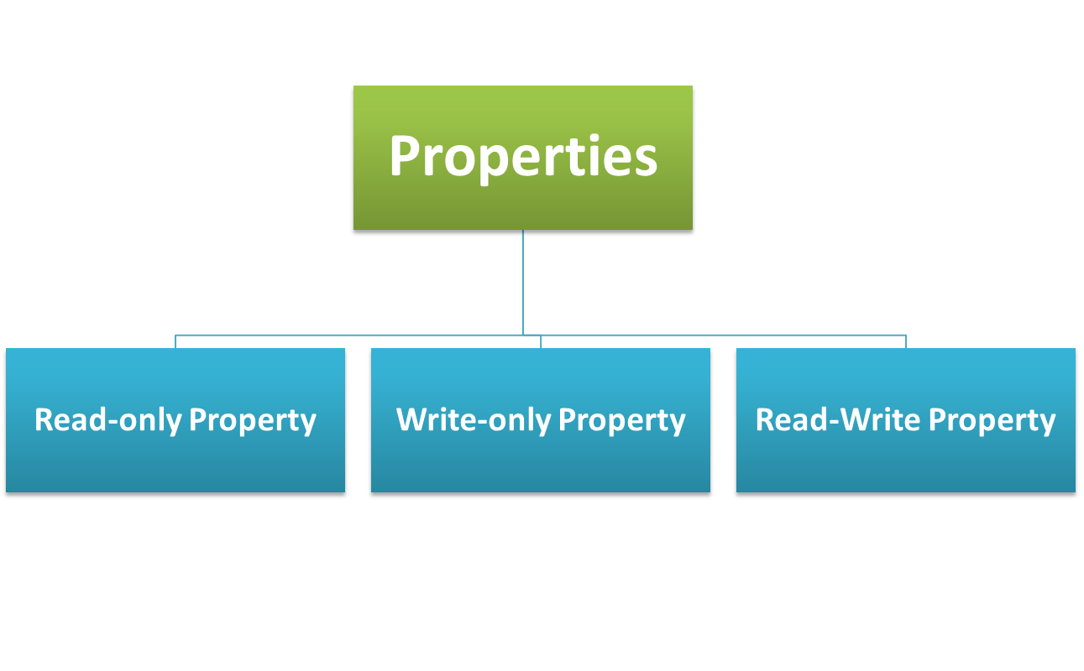
Categories of Properties 1-10
Properties are broadly divided into three categories:
Building Applications Using C# / Session 9

Slide 7
Categories of Properties 2-10
Read-Only Property:
  The read-only property allows you to retrieve the value of a private field. To create a read-only property, you should define the get accessor.
  The following syntax creates a read-only property.
Syntax
<access_modifier><return_type><PropertyName>{
get
{
// return value
}
}
Building Applications Using C# / Session 9

Slide 8
Categories of Properties 3-10
The following code demonstrates how to create a read-only property.
Snippet
using System;
class Books {
string _bookName;
long _bookID;
public Books(string name, int value){
_bookName = name;
_bookID = value;
}
public string BookName {
get{ return _bookName; }
}
public long BookID {
get { return _bookID; }
}
}
class BookStore {
static void Main(string[] args) {
Books objBook = new Books("Learn C# in 21 Days", 10015);
Console.WriteLine("Book Name: " + objBook.BookName);
Console.WriteLine("Book ID: " + objBook.BookID);
}
}
Building Applications Using C# / Session 9

Slide 9
Categories of Properties 4-10
In the code:
  The Books class creates two read-only properties that returns the name and ID of the book.
  The class BookStore defines a Main() method that creates an instance of the class Books by passing the parameter values that refer to the name and ID of the book.
  The output displays the name and ID of the book by invoking the get accessor of the appropriate read-only properties.
  Book Name: Learn C# in 21 Days
  Book ID: 10015
Output
Building Applications Using C# / Session 9

Slide 10
Categories of Properties 5-10
Write-Only Property:
  The write-only property allows you to change the value of a private field.
  To create a write-only property, you should define the set accessor.
  The following syntax creates a write-only property.
Syntax
<access_modifer><return_type><PropertyName>
{
  set
  {
  // assign value
  }
}
Building Applications Using C# / Session 9

Slide 11
Categories of Properties 6-10
The following code demonstrates how to create a write-only property.
using System;
class Department {
string _deptName;
int _deptID;
public string DeptName{
set { _deptName = value; }
}
public intDeptID {
set { _deptID = value; }
}
public void Display() {
Console.WriteLine("Department Name: " + _deptName);
Console.WriteLine("Department ID: " + _deptID);
}
}
class Company {
static void Main(string[] args) {
Department objDepartment = new Department();
objDepartment.DeptID = 201;
objDepartment.DeptName = "Sales";
objDepartment.Display();
}
}
Snippet
Building Applications Using C# / Session 9

Slide 12
Categories of Properties 7-10
In the code:
  The Department class consists of two write-only properties.
  The Main() method of the class Company instantiates the class Department and this instance invokes the set accessor of the appropriate write-only properties to assign the department name and its ID.
  The Display() method of the class Department displays the name and ID of the department.
  Department Name: Sales
  Department ID: 201
Output
Building Applications Using C# / Session 9

Slide 13
Categories of Properties 8-10
Read-Write Property:
  The read-write property allows you to set and retrieve the value of a private field. To create a read-write property, you should define the set and get accessors.
  The following syntax creates a read-write property.
Syntax
<access_modifer><return type><PropertyName>
{
get
  {
  // return value
  }
  set
  {
  // assign value
  }
}
Building Applications Using C# / Session 9

Slide 14
Categories of Properties 9-10
The following code demonstrates how to create a read-write property.
Snippet
using System;
class Product {
string _productName;
int _productID;
float _price;
public Product(string name, intval) {
_productName = name;
_productID = val;
}
public float Price {
get { return _price;}
set { if (value < 0) { _price = 0; }
else { _price = value; }
}
}
public void Display() {
Console.WriteLine("Product Name: " + _productName);
Console.WriteLine("Product ID: " + _productID);
Console.WriteLine("Price: " + _price + "$");
}
}
class Goods {
static void Main(string[] args) {
  Product objProduct = new Product(“Hard Disk”, 101);
  objProduct.Price = 345.25F;
  objProduct.Display();
}
}
Building Applications Using C# / Session 9

Slide 15
Categories of Properties 10-10
In the code:
  The class Product creates a read-write property Price that assigns and retrieves the price of the product based on the if statement.
  The Goods class defines the Main()method that creates an instance of the class Product by passing the values as parameters that are name and ID of the product.
  The Display() method of the class Product is invoked that displays the name, ID, and price of the product.
  Product Name: Hard Disk
  Product ID: 101
  Price: 345.25$
Properties can be further classified as static, abstract, and boolean properties.
Output
Building Applications Using C# / Session 9

Slide 16
Static Properties 3-3
In the code:
  The class University defines two static properties UniversityName and DepartmentName.
  The Main() method of the class Physics invokes the static properties UniversityName and DepartmentName of the class University by using the dot (.) operator.
  This initializes the static fields of the class by invoking the set accessor of the appropriate properties.
  The code displays the name of the university and the department by invoking the get accessor of the appropriate properties.
  University Name: University of Maryland
  Department name: Physics
Output
Building Applications Using C# / Session 9

Slide 17
Auto-Implemented Properties 1-3
C# provides an alternative syntax to declare properties where a programmer can specify a property in a class without explicitly providing the get and set accessors.
Such properties are called auto-implemented properties and results in more concise and easy-to-understand programs.
For an auto-implemented property, the compiler automatically creates:
  a private field to store the property variable.
  the corresponding get and set accessors.
The following syntax creates an auto-implemented property.
The following code uses auto-implemented properties.
Syntax
public string Name { get; set; }
Snippet
_{class Employee}
{
public string Name { get; set; }
_{public int Age { get; set; }}
Building Applications Using C# / Session 9

Slide 18
Object Initializers 1-2
In C#, programmers can use object initializers to initialize an object with values without explicitly calling the constructor.
The declarative form of object initializers makes the initialization of objects more readable in a program.
When object initializers are used in a program, the compiler first accesses the default instance constructor of the class to create the object and then performs the initialization.
Building Applications Using C# / Session 9

Slide 19
Properties, Fields, and Methods 1-2
  A class in a C# program can contain a mix of properties, fields, and methods, each serving a different purpose in the class.
  It is important to understand the differences between them in order to use them effectively in the class.
  Properties are similar to fields as both contain values that can be accessed. However, there are certain differences between them.
  The following table shows the differences between properties and fields.
Properties | Fields
Properties are data members that can assign and retrieve values. | Fields are data members that store values.
Properties cannot be classified as variables and therefore, cannot use the ref and out keywords. | Fields are variables that can use the ref and out keywords.
Properties are defined as a series of executable statements. | Fields can be defined in a single statement.
Properties are defined with two accessors or methods, the get and set accessors. | Fields are not defined with accessors.
Properties can perform custom actions on change of the field’s value. | Fields are not capable of performing any customized actions.
Building Applications Using C# / Session 9

Slide 20
Indexers 2-2
Indexers:
  are data members that allow you to access data within objects in a way that is similar to accessing arrays.
  provide faster access to the data within an object as they help in indexing the data.
  allows you to use the index of an object to access the values within the object.
  are also known as smart arrays in C#.
In arrays, you use the index position of an object to access its value.
The implementation of indexers is similar to properties, except that the declaration of an indexer can contain parameters.
Indexers allow you to index a class, struct, or an interface.
Building Applications Using C# / Session 9

Slide 21
Declaration of Indexers 1-2
An indexer can be defined by specifying the following:
  An access modifier, which decides the scope of the indexer.
  The return type of the indexer, which specifies the type of value an indexer will return.
  The this keyword, which refers to the current instance of the current class.
  The bracket notation ([]), which consists of the data type and the identifier of the index.
  The open and close curly braces, which contain the declaration of the set and get accessors.
  The following syntax creates an indexer.
Where:
  _{access_modifier}: Determines the scope of the indexer, which can be private, public, protected or internal.
  _{return_type}: Determines the type of value an indexer will return.
  _{parameter}: Is the parameter of the indexer.
Syntax
<access_modifier><return_type> this [<parameter>]
{
_{get { // return value }}
_{set { // assign value }}
}
Building Applications Using C# / Session 9

Slide 22
Parameters
Indexers must have at least one parameter.
The parameter denotes the index position, using which the stored value at that position is set or accessed.
Indexers can also have multiple parameters. Such indexers can be accessed like a multi-dimensional array.
When accessing arrays, you need to mention the object name followed by the array name.
The value can be accessed by specifying the index position.
Indexers can be accessed directly by specifying the index number along with the instance of the class.
Building Applications Using C# / Session 9

Slide 23
Difference between Properties and Indexers
Indexers are syntactically similar to properties.
However, there are certain differences between them.
The following table lists the differences between properties and indexers.
Properties | Indexers
Properties are assigned a unique name in their declaration. | Indexers cannot be assigned a name and use the this keyword in their declaration.
Properties are invoked using the specified name. | Indexers are invoked through an index of the created instance.
Properties can be declared as static. | Indexers can never be declared as static.
Properties are always declared without parameters. | Indexers are declared with at least one parameter.
Properties cannot be overloaded. | Indexers can be overloaded.
Overridden properties are accessed using the syntax base.Prop, where Prop is the name of the property. | Overridden indexers are accessed using the syntax base[indExp], where indExp is the list of parameters separated by commas.
Building Applications Using C# / Session 9

