Slide 1
Session: Multiple Document Interface
(MDI) Windows User-Defined Controls

Slide 2
Introduction
Continues study of Graphical User Interface
Explores:
  Multiple-document interface windows (MDIs)
  Examples: PaintShop Pro or Adobe Photoshop

Slide 3
Multiple-Document Interface Windows
Users can edit multiple documents at once
Usually more complex then single-document-interface applications
Application window called parent, others child
Child windows can be arranged in parent window:
  Tiled windows: completely fill parent, no overlap
    Either horizontal or vertical
  Cascaded windows: overlap, same size, display title bar
  ArrangeIcons: arranges icons for minimized windows

Slide 4
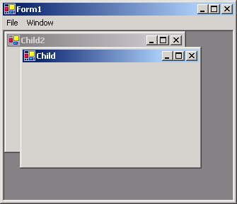
Multiple Document Interface (MDI) Windows
MDI parent
MDI child
MDI child
MDI parent and MDI child.

Slide 5
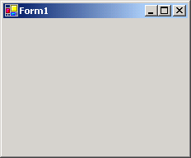
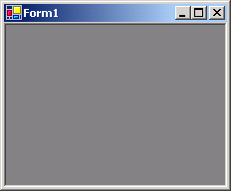
Multiple Document Interface (MDI) Windows
Single Document Interface (SDI)
Multiple Document Interface (MDI)

Slide 6
Create a Child form
  Create a new Form, set its IsMDIContainer property to true
  Create a child form class to be added to form
    Select Project | Add Windows Form … name the file
  To add the child form to parent, in a parent’s event handler
    Set child’s MDIParent property to parent form
    Call method Show
// create new child
ChildForm child = new ChildForm("Child 1",
"\\images\\csharphtp1.jpg");
child.MdiParent = this; // set parent
child.Show(); // display child

Slide 7
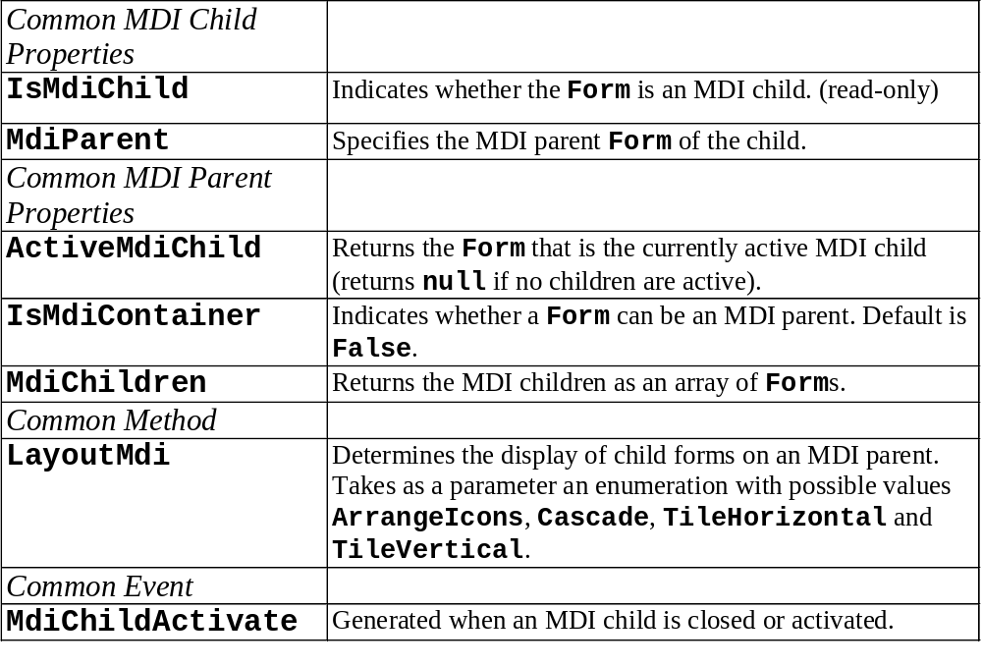
Multiple Document Interface (MDI) Windows

Slide 8
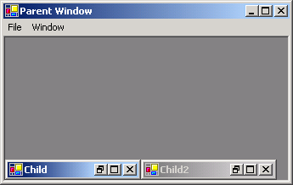
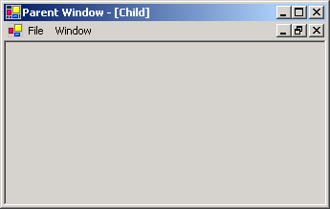
Multiple Document Interface (MDI) Windows
Parent’s icons: minimize, maximize and close
Maximized child’s icons: minimize, restore and close
Minimized child’s icons: restore, maximize and close
Parent’s title bar displays maximized child
Minimized and maximized child windows.

Slide 9
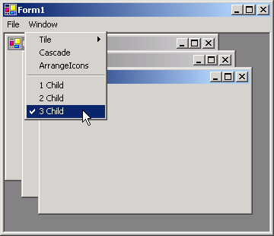
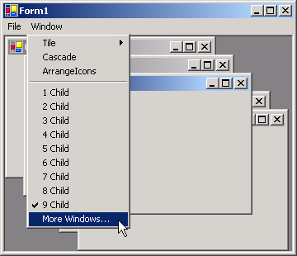
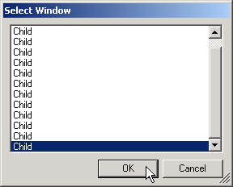
Multiple Document Interface (MDI) Windows
Separator bar and child windows
9 or more child windows enables the More Windows... option
Child windows list
Using MenuItem property MdiList.

Slide 10
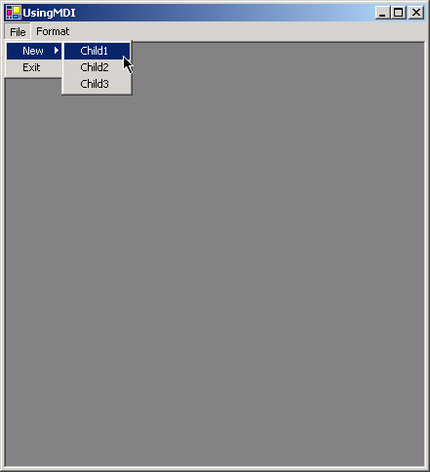
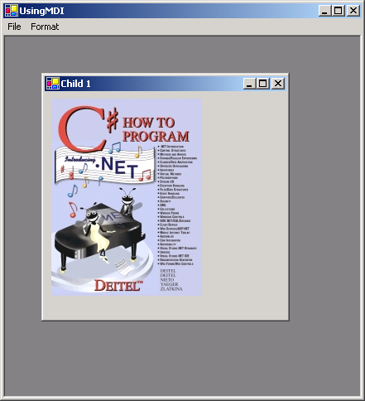
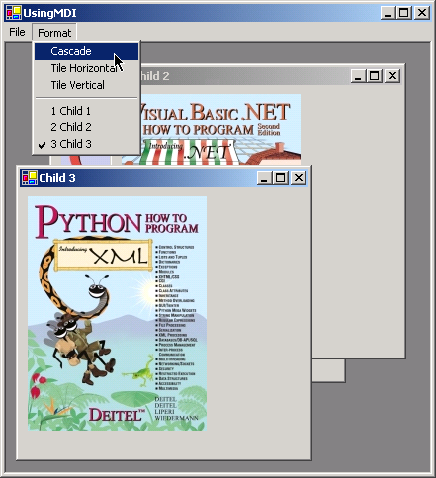
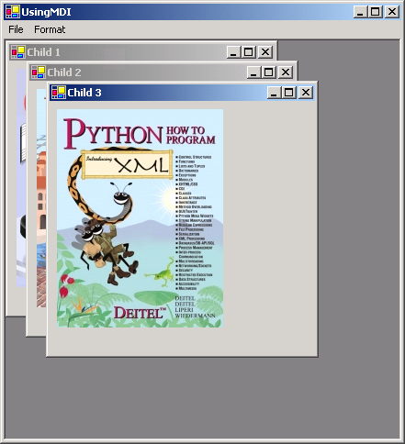
DEMO!

Slide 11
UsingMDI.cs
// UsingMDI.cs
// Demonstrating use of MDI parent and child windows.
private System.Windows.Forms.MainMenu menuStrip1;
private System.Windows.Forms.MenuItem fileToolStripMenuItem;
private System.Windows.Forms.MenuItem newToolStripMenuItem;
private System.Windows.Forms.MenuItem csToolStripMenuItem;
private System.Windows.Forms.MenuItem cppToolStripMenuItem1;
private System.Windows.Forms.MenuItem pythonToolStripMenuItem;
private System.Windows.Forms.MenuItem exitToolStripMenuItem;
private System.Windows.Forms.MenuItem windowToolStripMenuItem;
private System.Windows.Forms.MenuItem cascadeToolStripMenuItem;
private System.Windows.Forms.MenuItem
tileHorizontalToolStripMenuItem;
private System.Windows.Forms.MenuItem
tileVerticalToolStripMenuItem;
File menu
New submenu
Exit submenu
Format menu
Cascade option
Tiling options

Slide 12
// create Child 1 when menu clicked
private void csToolStripMenuItem_Click (
object sender, System.EventArgs e )
{
// create new child
ChildForm child= new ChildForm( “Visual C#",
"\\images\\csharphtp1.jpg" );
child.MdiParent = this; // set parent
child.Show(); // display child
}
// set cascade layout
private void cascadeToolStripMenuItem_Click (
object sender, System.EventArgs e )
{
this.LayoutMdi( MdiLayout.Cascade );
}
Creating one of the child windows
Cascade

Slide 13
// FormChild.cs
// Child window of MDI parent.
public partial class ChildForm : Form
{
public Child( string title, string resourceName )
{
// Required for Windows Form Designer support
InitializeComponent();
Text = title; // set title text
// set image to display in pictureBox
pictureBox.Image = Image.FromFile(
Directory.GetCurrentDirectory() + resourceName );
}
}
Child class
Display title
Display picture

Slide 14
Visual Inheritance
Create Form by inheriting from another Form
  Derived Form inherits functionality of base Form
  Derived Form inherits visual aspects of base Form
  Visual Inheritance enables developers to achieve visual consistency across applications by reusing code.

Slide 15
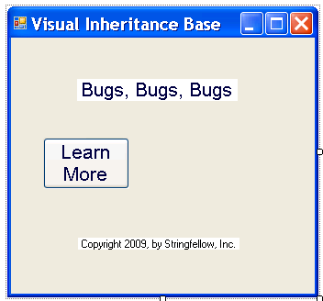
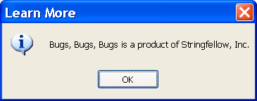
Visual Inheritance
A base form
VisualInheritance.cs
Program Output

Slide 16
Visual Inheritance
Before deriving a form from this base class, must produce a .dll.
  Right click on the project in Solution Explorer, select Properties , then choose Application tab. In OutputType drop-down list, change to ClassLibrary, then build to produce a .dll
To create the derived form, create an empty project.
From Project menu, select Add Reference
Click Browse, select the .dll file, add using statement.
Modify the line that defines the class to indicate that the application’s Form inherits from class VisualInheritanceBaseForm
You’ll see next screen

Slide 17
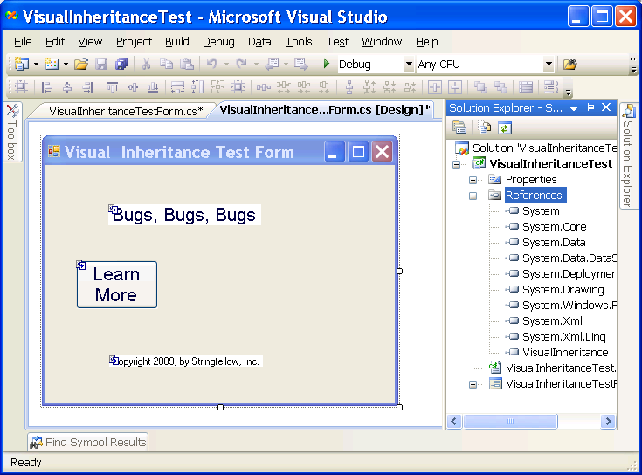
Visual Inheritance

Slide 18
User-Defined Controls
Custom controls that inherit from other classes
  Example: can change appearance of a label
Custom controls appear in the user’s Toolbox and can be added to Forms, Panels or GroupBoxes the way we add other controls

Slide 19
Creating User-Defined Controls
Derive a class from an existing Windows Form Control
  Easiest way
  Add functionality to preexisting control.
  To add to the control’s appearance, override method OnPaint (call base class OnPaint)
Create UserControl composed of existing controls
  Use class UserControl
  Acts as a container for controls added to it
  Cannot override OnPaint for constituent controls: their appearance modified only by adding code to each control’s Paint event.

Slide 20
Creating User-Defined Controls
Inherit from class Control
  Defines a brand-new control
  Override OnPaint, call base class OnPaint and include methods to draw the control.
  Can customize control appearance and functionality

