Slide 1
Session : Introduction to ADO.NET

Slide 2
Objectives
By the end of this session, you will be able to understand:
Introduction to ADO.NET
Connected and Disconnected Architecture
Types of providers
Data Set
Architecture of Data Set
Data controls
Types of Data Binding
Notes:
2

Slide 3
Objectives
Used to learn to create a Microsoft® ADO.NET Connection object
Submit SQL through an ADO.NET Command object
Use the ADO.NET DataReader class
Learn to load objects into a list box
Use DataTable objects and DataSet objects
Modify data using DataSet objects

Slide 4
Introduction to ADO.NET
ADO is a Microsoft technology
ADO stands for ActiveX Data Objects
ADO is a Microsoft Active-X component
ADO is automatically installed with Microsoft IIS
ADO is a programming interface to access data in a database

Slide 5
ADO.NET is a set of classes that expose data access services for .NET Framework programmers. ADO.NET provides a rich set of components for creating distributed, data-sharing applications. It is an integral part of the .NET Framework, providing access to relational, XML, and application data. ADO.NET supports a variety of development needs, including the creation of front-end database clients and middle-tier business objects used by applications, tools, languages, or Internet browsers
ADO.NET provides consistent access to data sources such as SQL Server and XML, and to data sources exposed through OLE DB and ODBC. Data-sharing consumer applications can use ADO.NET to connect to these data sources and retrieve, handle, and update the data that they contain.

Slide 6
The ADO.NET Framework supports two models of Data Access Architecture,
Connection Oriented Data Access Architecture
Disconnected Data Access Architecture

Slide 7
Connection Architecture
In Connection Oriented Data Access Architecture the application makes a connection to the Data Source and then interact with it through SQL requests using the same connection. In these cases the application stays connected to the database system even when it is not using any Database Operations.

Slide 8
Disconnected Architecture
The architecture of ADO.net in which data retrieved from database can be accessed even when connection to database was closed is called as disconnected architecture. Disconnected architecture of ADO.net was built on classes connection, dataadapter, commandbuilder and dataset and dataview.

Slide 9
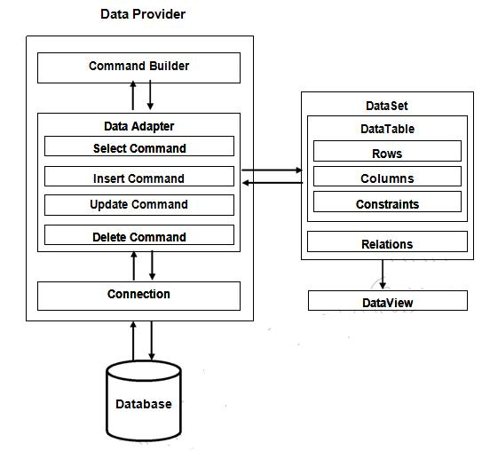
Fig: Disconnected Architecture

Slide 10
Providers
The ADO.NET Data Provider model provides a common managed interface in the .NET Framework for connecting to and interacting with a data store. The ADO.NET Entity Framework builds on top of the ADO.NET Data Provider model to allow for use of the Entity Framework with any data source for which a supported provider is available.
The .NET Framework includes ADO.NET providers for direct access to Microsoft SQL Server and for indirect access to other databases with ODBC and OLE DB drivers.

Slide 11
Data Set
The DataSet object is central to supporting disconnected, distributed data scenarios with ADO.NET. The DataSet is a memory-resident representation of data that provides a consistent relational programming model regardless of the data source. It can be used with multiple and differing data sources, with XML data, or to manage data local to the application. The DataSet represents a complete set of data, including related tables, constraints, and relationships among the tables.

Slide 12
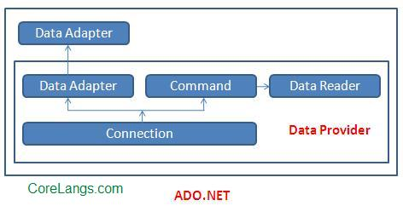
Data Providers and Data Set

Slide 13
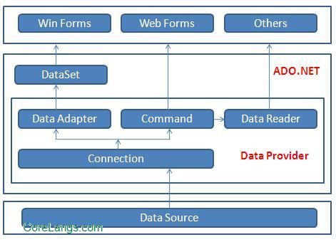
Architecture of Data Set

Slide 14
There are two types of ASP.NET data controls available in Microsoft Expression Web:
Data Source controls, which allow you to set properties for connections to database or XML data sources,
Data controls, which allow you to display data from data sources specified in Data Source controls.

Slide 15
The DataList control is useful for displaying data in any repeating structure, such as a table. The DataList control can display rows in different layouts, such as ordering them in columns or rows.
The DetailsView control gives you the ability to display, edit, insert, or delete a single record at a time from its associated data source.
The DetailsView control displays only a single data record at a time, even if its data source exposes multiple records.
The FormView control gives you the ability to work with a single record from a data source, similar to the DetailsView control.
The GridView control displays the values of a data source in a table where each column represents a field and each row represents a record.

Slide 16
The following controls are list controls which support data binding:
asp:RadioButtonList
asp:CheckBoxList
asp:DropDownList
asp:Listbox

Slide 17
Data Binding
Simple data binding involves the read-only selection lists. These controls can bind to an array list or fields from a database. Selection lists takes two values from the database or the data source; one value is displayed by the list and the other is considered as the value corresponding to the display.

Slide 18
Choosing a data source for the bulleted list control involves:
Selecting the data source control
Selecting a field to display, which is called the data field
Selecting a field for the value

Slide 19
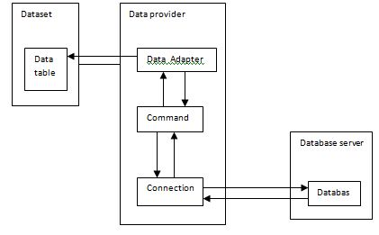
Relation between Data Binding Objects

