Slide 1
Course : Advanced ASP.NET and WCF
Session : Security Management
Notes:
1

Slide 2
Objective
By the end of this session, you will be able to understand:
Introducing the ASP.NET Security Model
Configuring IIS for Implementing Security
Configuring an ASP.NET Application for Security
Configuring Authentication
Configuring Authorization
Configuring Impersonation
Activity: Implementing Forms Authentication
Notes:
Students have learnt the structure of different types of dimensions and the importance of surrogate keys in Module I. In this session, students will learn to load the data into the dimension tables after the data has been transformed in the transformation phase. In addition, students will also learn to update data into these dimension tables.
Students already know about different types of dimension tables. Therefore, you can start the session by recapitulating the concepts. Initiate the class by asking the following questions:
1. What are the different types of dimensions?
2. Define flat dimension.
3. What are conformed dimension?
4. Define large dimension.
5. Define small dimension.
6. What is the importance of surrogate key in a dimension table?
Students will learn the loading and update strategies theoretically in this session. The demonstration to load and update the data in the dimension table will be covered in next session.

Slide 3
Introducing the ASP.NET Security Model
Three Categories of Web Security:
Content freely available to everyone (public).
Serve the general population but require a login (application-level security, protected).
Intranet sites for a controlled population of users — a company’s employees (private).
Security Issues:
Application-level security (users).
Deployment security (programmers).
Web Security Components:
Authentication identifies the originator of requests (who).
Authorization defines who can access which pages (what).

Slide 4
Configuring IIS for Implementing Security
IIS (Internet Information Services) Server
a Web server
runs in process Inetinfo.exe as SYSTEM
accepts connections
responds to HTTP requests
Web applications are deployed in application directories. Remote clients can’t arbitrarily grab files outside application directories.
IIS assigns every request an access token representing a Windows security principal. The access token enables the operating system to perform ACL checks on resources targeted.
IIS supports IP address and domain name restrictions.
IIS supports encrypted HTTP connections using the Secure Sockets Layer (SSL) family of protocols.

Slide 5
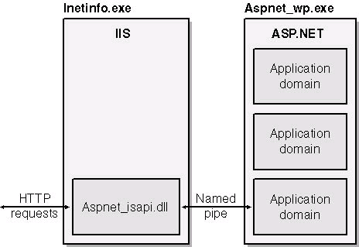
Configuring IIS for Implementing Security
Anonymous access (access by unauthenticated users)
Request from anonymous users are tagged with IUSR_machinename’s access token. IUSR_machine name is an Internet guest account created when IIS is installed, where machine name is usually the Web server’s machine name.

Slide 6
Configuring an ASP.NET Application for Security
Pages can be freely browsed by any: no application-level security
Intranet application: use Windows authentication and ACL authorization.
Internet application with secure page access: use forms authentication and URL authorization.
To secure the application these steps are followed:
Isolate Web Applications
.NET Trust Levels
.NET Authentication
Machine Key Settings
TLS/SSL Communication

Slide 7
Configuring Authentication
ASP.NET supports three types of authentication:
Forms (Page-wide)
Windows (Machine-wide)
Passport (Internet-wide)
None
Web.config
<configuration> <system.web>
<authentication mode="Forms"/>
</system.web> </configuration>
Note
The authentication mode is an application-wide setting that can be set only in the application root and can’t be overridden in subordinate Web.config files.
You can’t use Windows authentication in one part of an application and forms authentication in another.

Slide 8
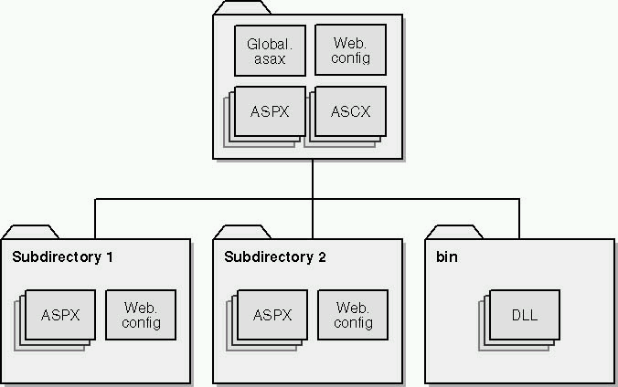
Configuring Authentication Model

Slide 9
Configuring Authorization
Authorization: specifies which users and roles are allowed or denied access; typically not used with Windows authentication since ACLs address the same problem
ASP.NET supports two forms of authorization:
ACL (access control list) authorization, also known as file authorization, based on file system permissions, typically used with Windows authentication.
URL authorization, relies on configuration directives in Web.config files, most often used with forms authentication.

Slide 10
Configuring Impersonation
By default, ASP.NET applications do not impersonate.
The security context of the ASP.NET worker process account (ASPNET by default) is used when your application accesses Windows resources.
The <identity> element is used to enable impersonation.
To impersonate the original caller, use the following configuration: <identity impersonate="true" />
The impersonation uses the access token provided by IIS that represents the authenticated caller.

Slide 11
Configuring Impersonation
If you do enable original caller impersonation, note the following issues:
Application scalability is reduced because database connections cannot be effectively pooled.
Administration effort increases as ACLs on back-end resources need to be configured for individual users.
Delegation requires Kerberos authentication and a suitably configured Windows 2000 / Windows Server 2003 environment.

