Slide 1
Course : Advanced ASP.NET and WCF
Session : Distributed Architecture
Notes:
1

Slide 2
Objective
By the end of this session, you will be able to understand:
Identifying the Distributed Application Architecture
The Distributed Application Architecture
Identifying the Distributed Application Technologies
COM+ Services
.NET Remoting
Web Services
Notes:
Students have learnt the structure of different types of dimensions and the importance of surrogate keys in Module I. In this session, students will learn to load the data into the dimension tables after the data has been transformed in the transformation phase. In addition, students will also learn to update data into these dimension tables.
Students already know about different types of dimension tables. Therefore, you can start the session by recapitulating the concepts. Initiate the class by asking the following questions:
1. What are the different types of dimensions?
2. Define flat dimension.
3. What are conformed dimension?
4. Define large dimension.
5. Define small dimension.
6. What is the importance of surrogate key in a dimension table?
Students will learn the loading and update strategies theoretically in this session. The demonstration to load and update the data in the dimension table will be covered in next session.

Slide 3
Divide Responsibility Accordingly
CSS
HTML
ASP
Code Behind
Business Logic
Themes (New)
MasterPage (New)
Web.config
Database

Slide 5
Page Composition Parts
Server Side:
Client Side:

Slide 6
Breakthrough Technologies
DOM (Demo)
Document Object Model - allows for live interactive web pages
AJAX (Demo)
JavaScript and XML – allows for partial post-back of a page
SQL Server 2005 (Home Page)
Advanced Security and Encryption Features
Intrinsic SOAP Access to Database
Native XML Understanding
Get Visual Studio Express Editions

Slide 7
COM + SERVICES
Object Oriented to the core
Classes and inheritance fully supported
Even across languages!
Seamless integration
Any .NET class can be used as a COM class with zero extra work
COM classes can be imported as .NET classes
.NET classes utilise COM+ services
Transactions, Object pooling, etc…

Slide 8
COM + SERVICES
No registration required
Code is completely self-describing
Simply copy components to application directory
Zero-impact install
Installing one app will not affect another
Side-by-side execution
Multiple component versions can co-exist

Slide 9
.NET Remoting: Channels
Channels transport messages
Built-in channels: TCP, HTTP
Extensible model: Named Pipes as SDK sample
Establish endpoint-to-endpoint communication
Formatters render wire format (Binary, SOAP, ...)
Proxies map calls to messages
Architecture makes no assumptions about endpoint architecture

Slide 10
Web services
“Web services are web apps that return data, not presentation. Since applications are typically about accessing data, web services are poised to become the next evolutionary step in distributed software development...”
Why?
cross-platform application development
legacy system integration
Web server
obj
obj
XML
obj
obj

Slide 11
Web services involve many technologies:
WSDL to learn about web service
to call: proxy objects, SOAP, XML, HTTP and .ASMX pages
web service
client app
WSDL
Web server
obj
obj
method call
method call
obj
.asmx
proxy
SOAP msg (XML)
HTTP request

Slide 12
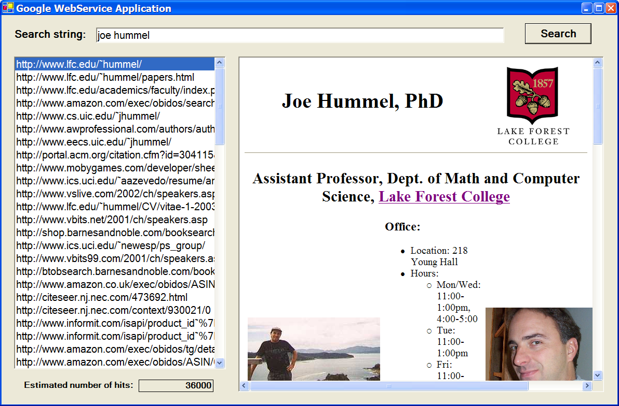
Google offers a web service that performs searches for you
Why?
clients can build custom GUIs
google.com can make money!
// ask google to search for us...
google = new GoogleSearchService();
result = google.doGoogleSearch("4a8/TvZQFHID0WIWnL1CMmMx0sNqhG8H",
txtSearch.Text, 0, 10, false, "", false, "", "", "");
// display resulting URLs...
foreach (ResultElement re in result.resultElements)
lstURLs.Items.Add(re.URL);
Notes:
Cool? You'll build this app in the lab!

Slide 13
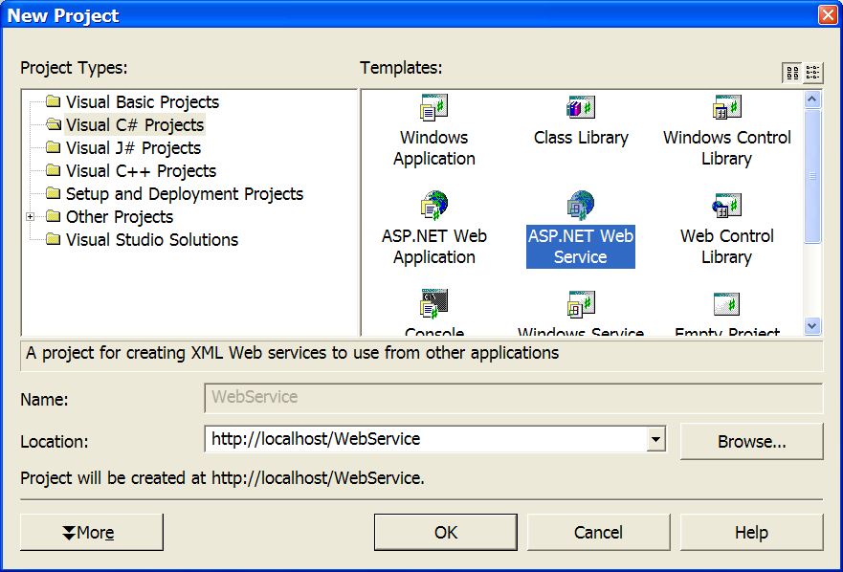
Start by creating a project of type “ASP.NET Web Service”

Slide 14
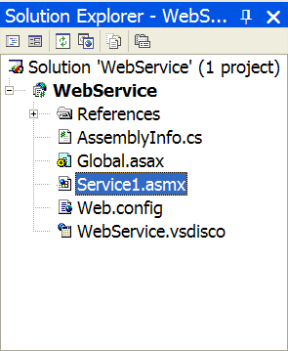
One or more objects that respond to web-based method calls
there is no GUI design to a web service
only raw classes with methods…
public class Service1 : System.Web.Services.WebService
{
.
.
.
}

Slide 15
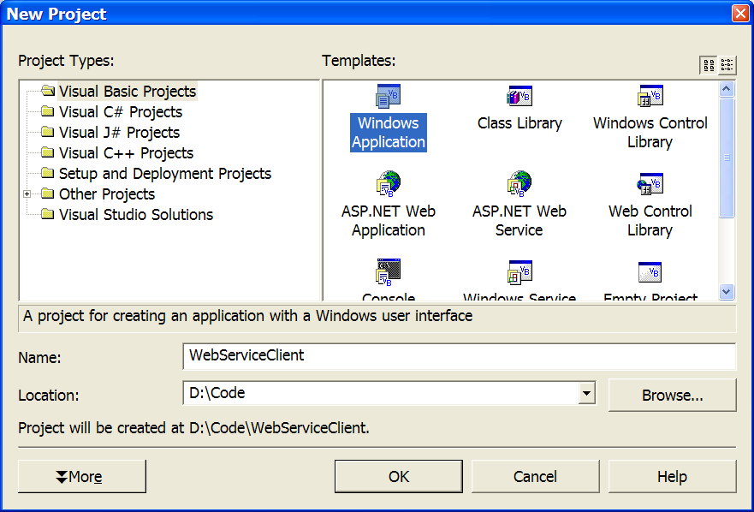
Start by creating a client…
WinForm, WebForm, console-based, anything you want!
for fun, let's use VB…

