Slide 1

Robot Manipulation (Grasping)

Slide 2
Objectives
Object pose and shape estimation → Implicit Shape Model
Simulating Care-O-Bot
Configuration of Care-O-Bot
Robot kinematics + planning for grasping (MoveIT)

Slide 3
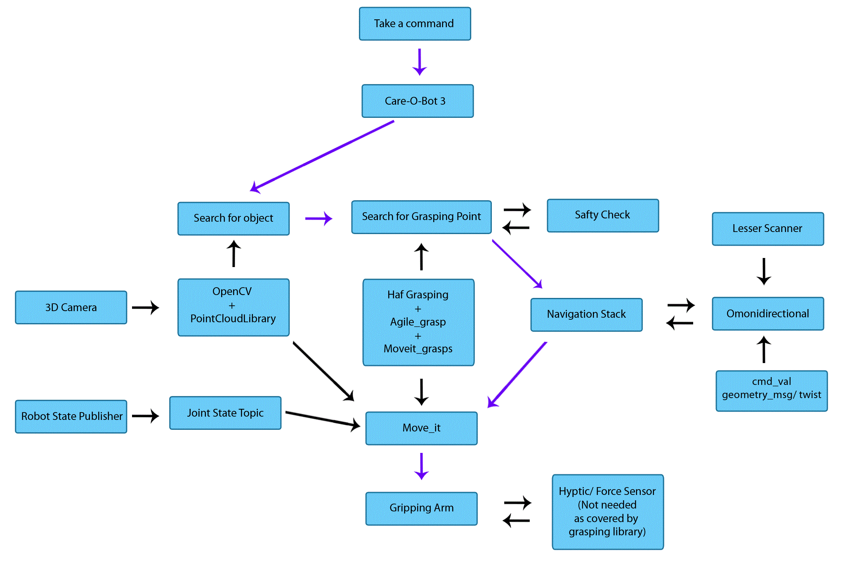
Architecture

