Slide 1

IoT Anomaly Detection System
Detecting Irregularities in Industrial Sensor Data
Using Unsupervised Machine Learning
MSc Project Presentation

Slide 2
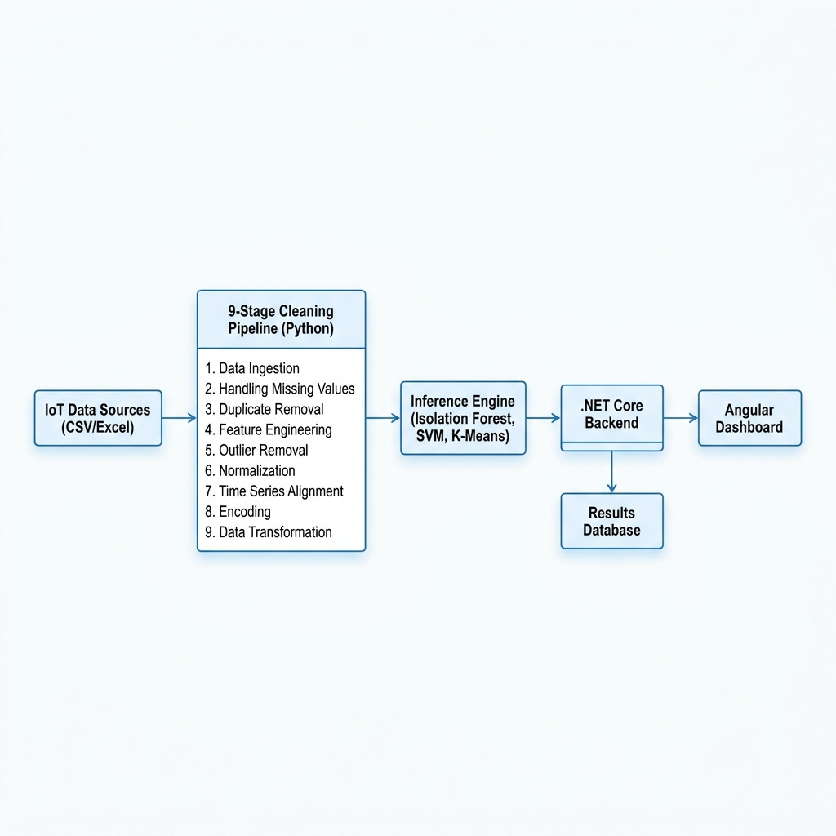
System Architecture & Pipeline
IoT Anomaly Detection System - MSc Thesis

Slide 3
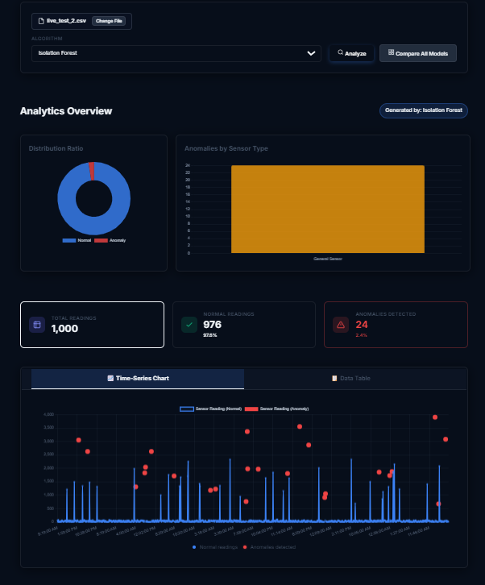
Dashboard Overview
IoT Anomaly Detection System - MSc Thesis

Slide 4
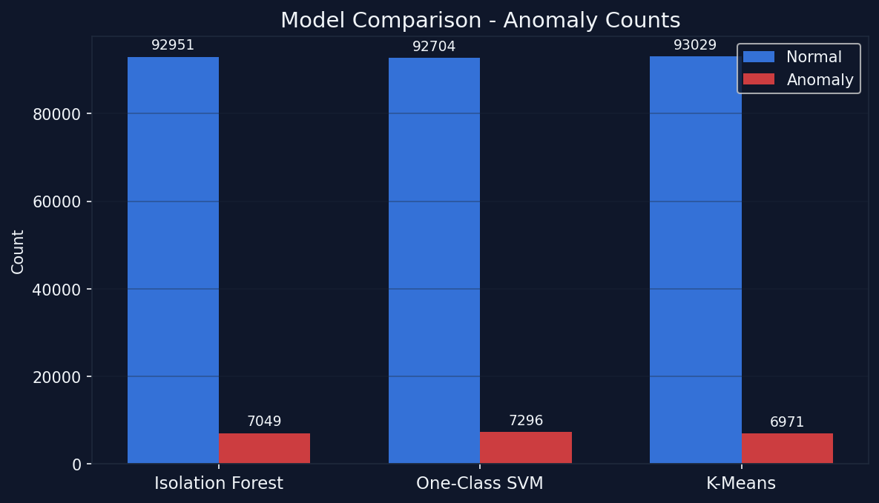
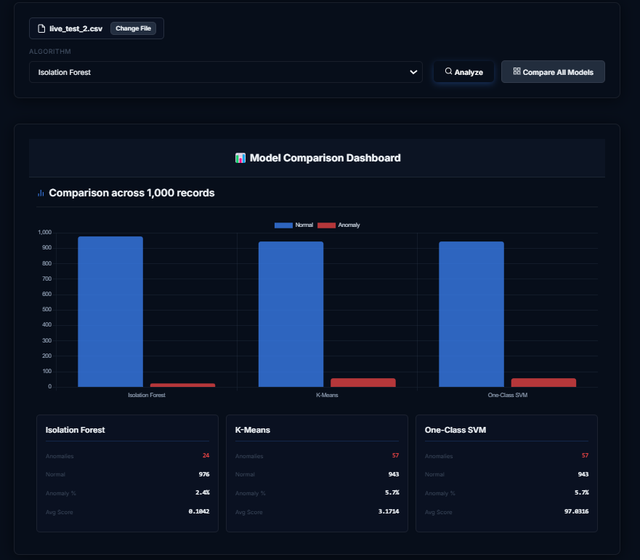
Model Performance Comparison
IoT Anomaly Detection System - MSc Thesis

Slide 5
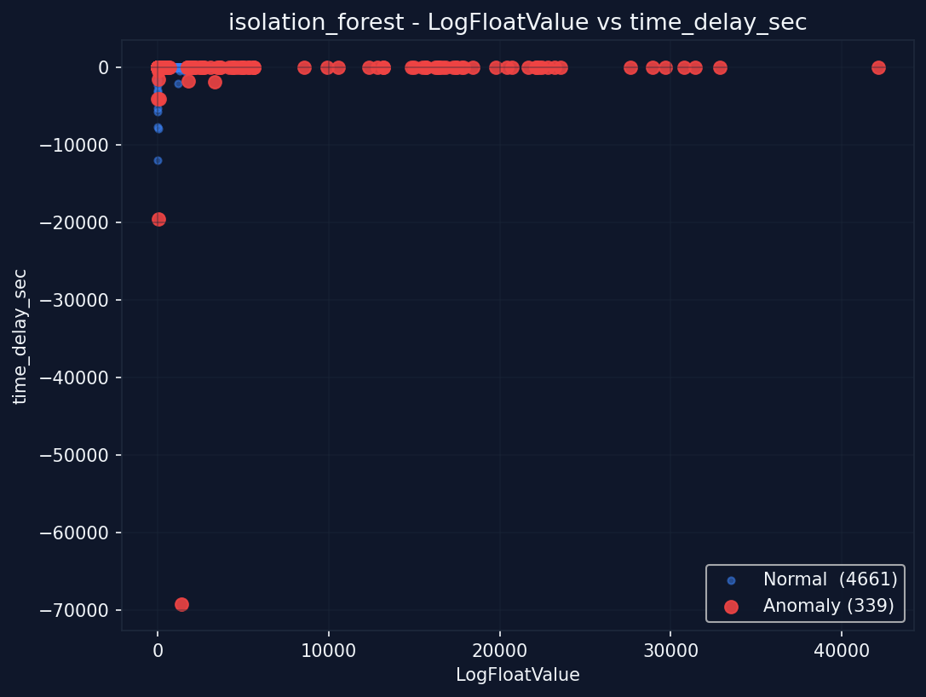
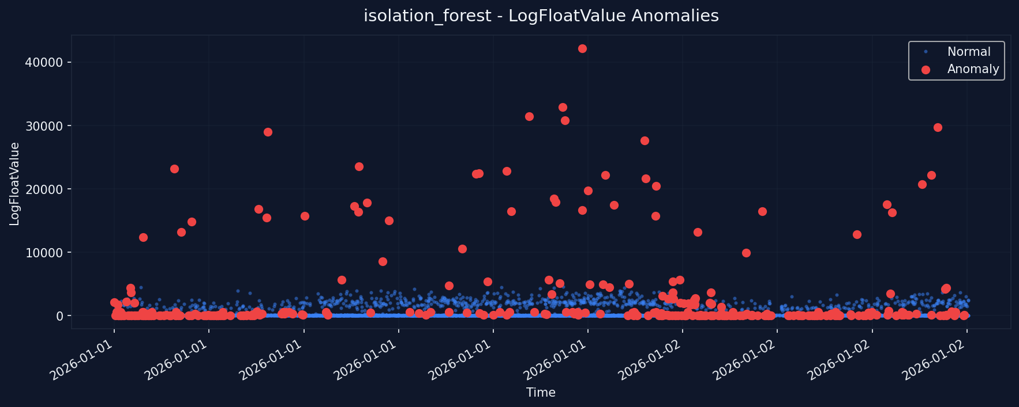
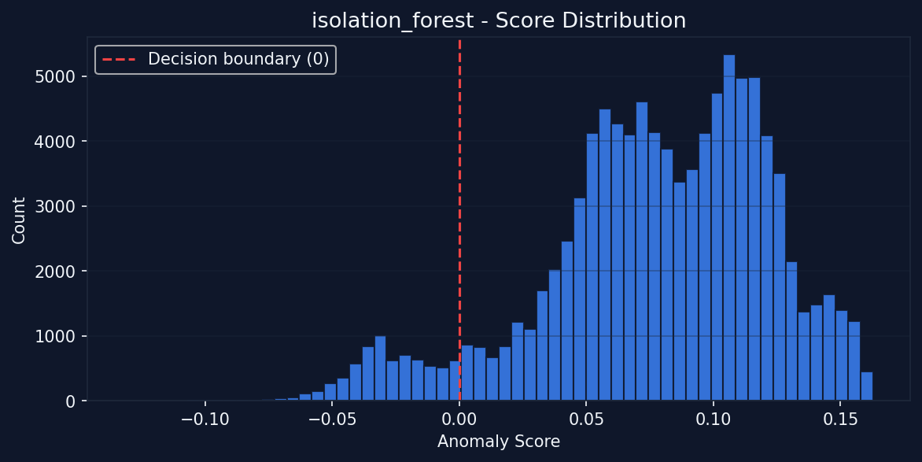
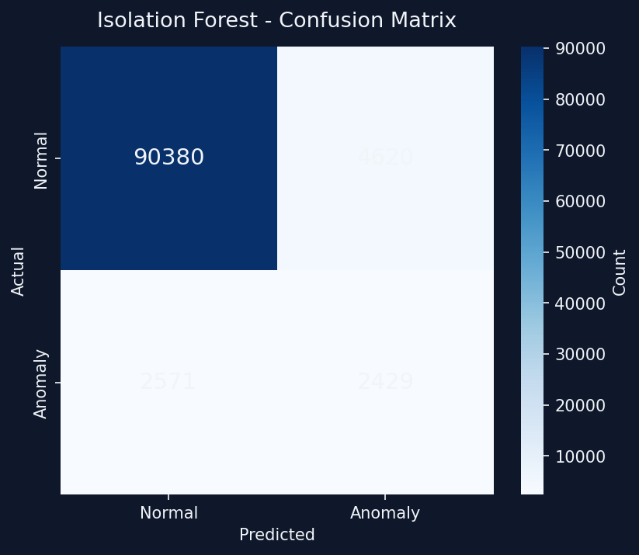
Isolation Forest: In-Depth Results
IoT Anomaly Detection System - MSc Thesis

Slide 6
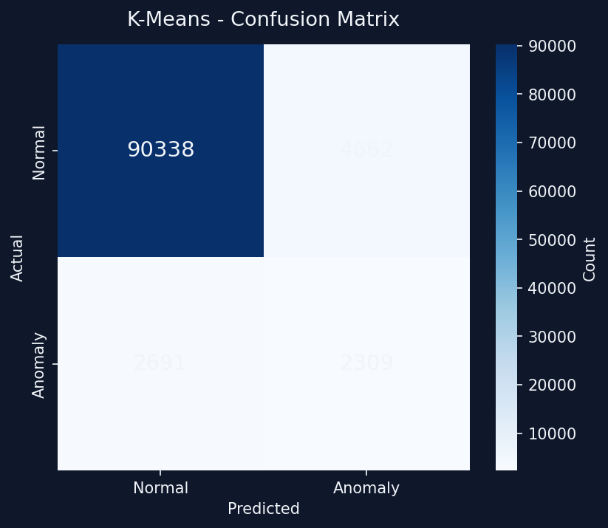
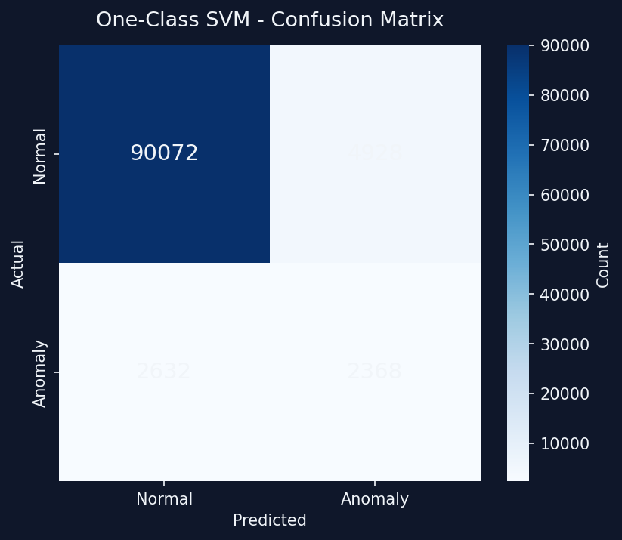
Alternative Models: K-Means & One-Class SVM
IoT Anomaly Detection System - MSc Thesis

Slide 7

Diagnostic Metadata: Network Time Analysis
IoT Anomaly Detection System - MSc Thesis

Slide 8
Conclusion & Future Work
Successfully developed an integrated IoT Anomaly Detection System.
Key Achievements:
9-stage automated cleaning pipeline.
Best Model: Isolation Forest (92.81% accuracy).
Future Work:
Implement hybrid ensemble learning for complex non-linear anomalies.
Edge deployment on IoT gateways to reduce latency.
IoT Anomaly Detection System - MSc Thesis

