Slide 1

IoT Anomaly Detection System
Detecting Irregularities in Industrial Sensor Data
Using Unsupervised Machine Learning
MSc Project Presentation

Slide 2
Introduction & Problem Statement
Challenges in real-world IoT data:
High noise due to network latency and sensor errors.
Traditional threshold-based systems lack context.
Lack of labeled anomaly datasets for supervised learning.

Slide 3
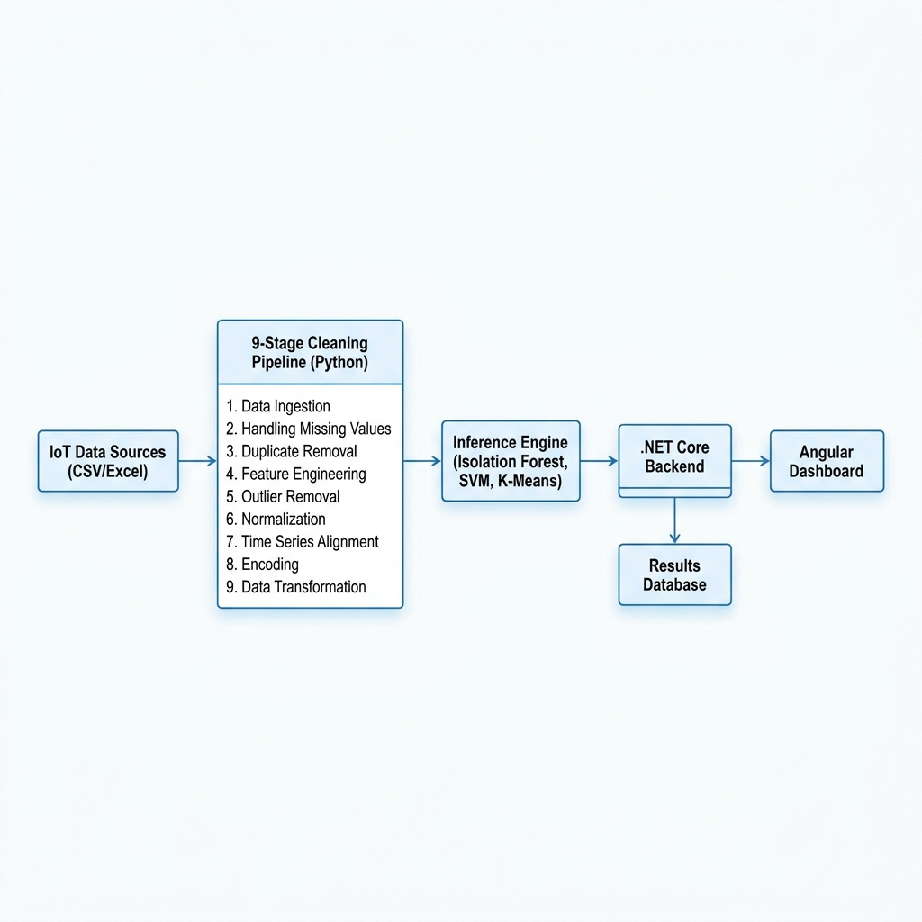
System Architecture & 9-Stage Pipeline

Slide 4
Unsupervised Machine Learning Models
Three algorithms evaluated to adapt without labeled data:
Isolation Forest: Highly efficient for large batches. Best overall.
One-Class SVM: Effective for non-linear, subtle patterns.
K-Means: Distance-based clustering to group normal data.

Slide 5
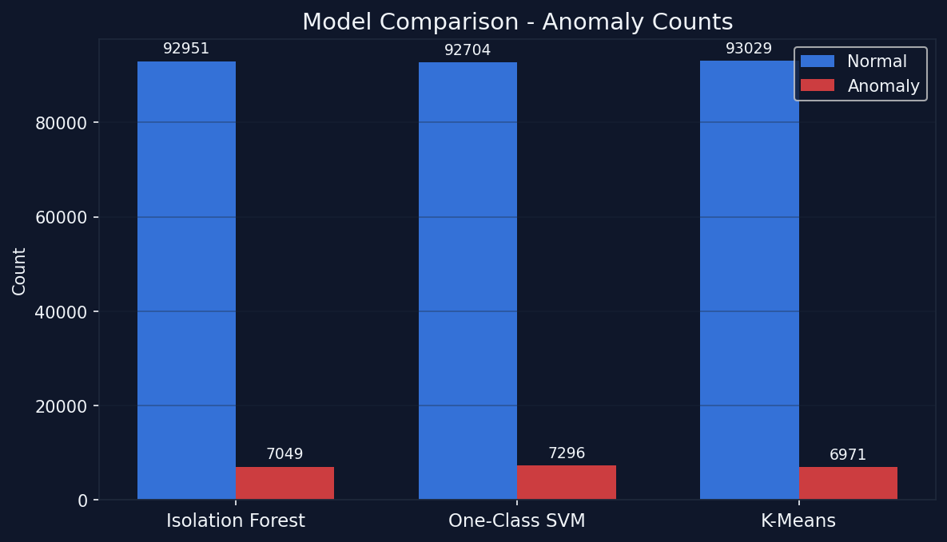
Results: Model Comparison

Slide 6
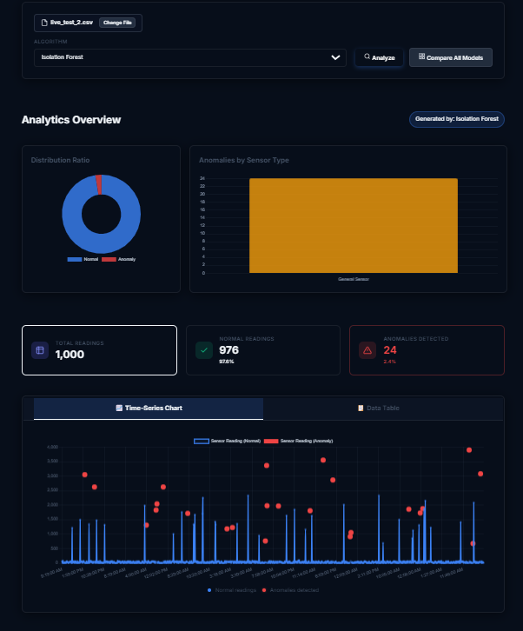
Web-Based Analysis Dashboard

Slide 7
Conclusion
Key Achievements:
Successfully handled real-world noisy data.
Isolation Forest identified as the best model with 92.81% accuracy.
Future Work:
Explore edge deployment on IoT gateways.

