Slide 1

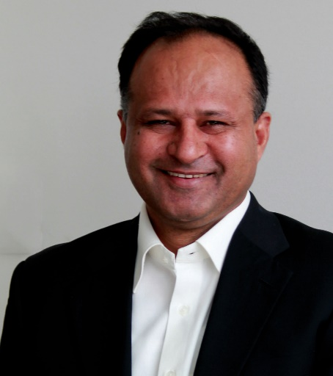


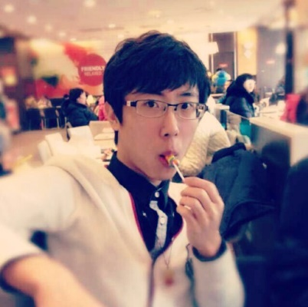

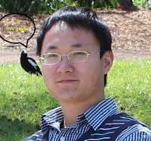
Shopping AI
Supervisors
The University of Adelaide
Group members
Pro. Ali
Qiaoyang Luo
a1728768
Qiming Shao
a1699631
Junwei Li
a1710640
Dr. Lingqiao
Group
1
Notes:
After brainstorms and a long discussion with supervisors, we decided to keep study based on the previous project.
So, let’s Review what we have done in the last semester.

Slide 2

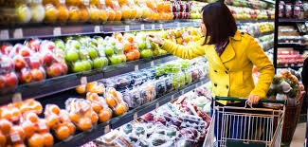


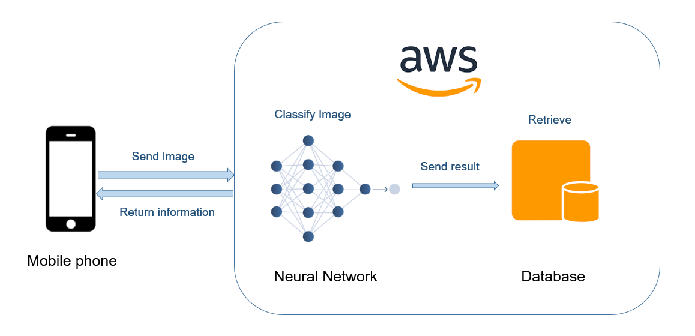
Review
Aim
Android application :
help customers shop fruits at markets
Achievements
Recognize 10 different fruits
with 90% accuracy
Provide fruit’s information and
price comparison services
a1728768 Qiaoyang
2
Notes:
Since in some scenarios, we want to shop fruits with cheapest prices, and we also want to know what’s the difference between similar fruits, two different apples.

Slide 3


Objectives
Research fields
Software Engineering
A simple Android application with limited features
Image classification, Fine grained
Product detection, Image retrieval, Data analysis
A complete software platform with additional functions
a1728768 Qiaoyang
3
Notes:
So what’s the new objectives in this semester?
We want to enable users to scan more products in the market, we want to optimize user experience.
For example, We will provide recommendation service, provide GPS guiding service, Junwei will introduce the detail information later.

Slide 4


Motivations & Scenarios
Motivations
Keep further study and Provide better user experience
Scenarios
Online Shopping
Offline Shopping
Search
+
Recommendation
Product
Information
Photograph
+
Experiencing
a1728768 Qiaoyang
4
Notes:
We want to keep further study on computer vision area, and we also want to reinforce our skills in software engineering.
We want to build a pragmatic application which is useful for customers to shop in daily life.
For example, I live near the rundle mall, today I want to buy some foods to cook for the dinner. Where can I buy chicken with lowest price, coles or woolworths,

Slide 5

Problems
1. How to recognize more products ?
2. How to do recommendations?
3. How to build cross-platform app ?
a1728768 Qiaoyang
5
Notes:
In this semester, we face several chanllenges.

Slide 6
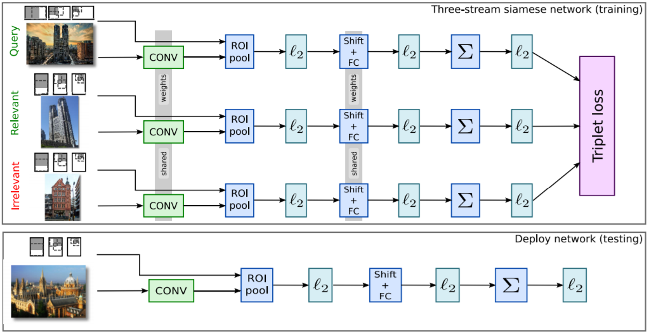
Research – Image Retrieval
How to recognize more products ?
1. Fine-grained
2. Few-shot learning
3. Image Retrieval
a1728768 Qiaoyang
6
Notes:
These are the potential solution for recognizing the large scale datasets.

Slide 7
Research – Data Analysis
How to do recommendations?
02
Product score
04
GPS
01
User information
03
Scan data
a1728768 Qiaoyang
7

Slide 8

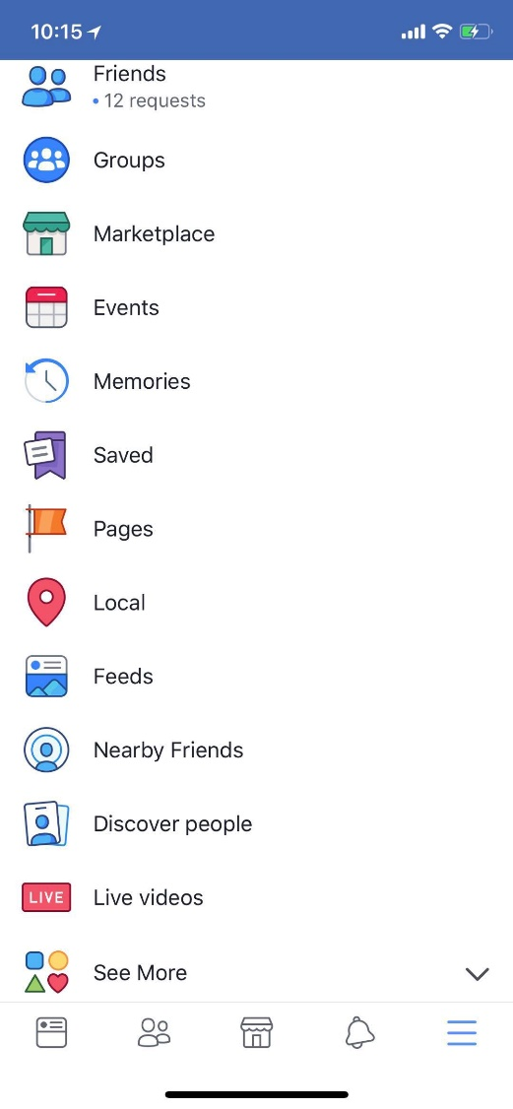



System Characteristics
Cross-platform
not depend on the operating system
nor on the hardware environment
IOS Android
Portability
Embedded Mini programs
Facebook WeChat
a1699631 Qiming
8
Notes:
Generally, our software processing and research areas have been refined and deepened. For system characteristics, the first requirement is cross-platform, which means that it does not depend on the operating system, nor on the hardware environment. At this semester, we mainly focus on IOS and Android platform. The second thing is that our system can be embedded into Facebook and WeChat as mini-programs. In other words, we have the portability of the system.

Slide 9



Cross-platform Approaches
01
03
WebView
ReactNative
Flutter
02
Weak compatibility
Higher learning costs
Advantages: Low development cost；Iterative update easily; Core functions perfect support
a1699631 Qiming
9
Notes:
There are 3 different ways to achieve the cross-platform, which are Responsive view, such as React Native, WebView such as Cordova and Flutter. However, based on our study, react native sometimes would have weak compatibility. It is an unpredictable risk. Besides, Flutter has the higher learning costs, which means we cannot master the new language at the short semester. But, Cordova is a mature and mainstream technology, that lots of companies use it.
the reason why we chose the Cordova is that it has the Low development cost. Secondly, the Iterative update is easy. So we could add more functions in the future easily. In addition, it can perfect support the Core functions, such as GPS and camera based on our project requirements.

Slide 10
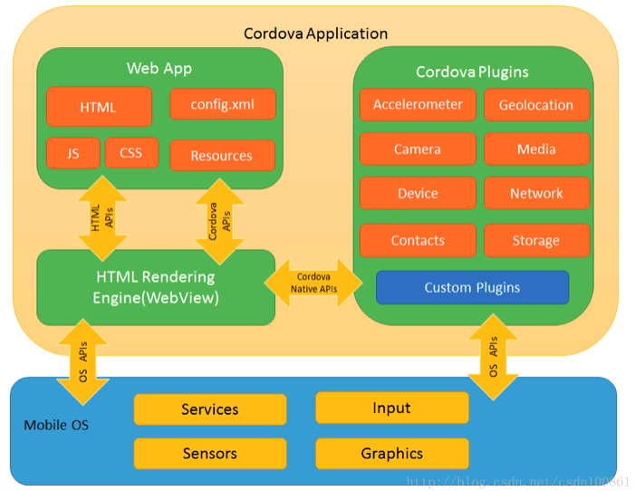


Solution Architecture
Apache Cordova
HTML5
CSS
JavaScript
Encapsulation
  Bridge
a1699631 Qiming
10
Notes:
Apache Cordova is an open source mobile development framework that supports the mobile apps using standard web development technologies (HTML5, CSS3 and JavaScript). The idea of Cordova application is that we will form the app by encapsulation and call the corresponding function of the backend server in the app. The Cordova is seems like a bridge, which connects mobile operating system with all-stack development.

Slide 11



Advantages
AngularJS
NodeJS
Templates are powerful and abundant
Front-end MVVM framework
Server
Single thread :
  low memory usage
  different from Java PHP
  8GB 4000 users <->4w
Non-blocking I/O:
  database
  event dispatching
Ionic
Event-driven :
  asynchronous
  event cycle
Simple
Practical
Beautiful
a1699631 Qiming
11
Notes:
AngularJS + Ionic + Cordova is a sort of tools that could speed up our implementation. The templates of AngularJS are powerful and abundant. It has the front-end MVVM framework which can assist developers to deploy the holistic framework at a short time. The Ionic can be used with AngularJS in order to develop a pretty UI, which is simple and practical. The back-end development we choose the NodeJS to be our server.
There are 3 advantages for using NodeJS. Single thread means that the server has a low memory usage. It is different from java, PHP, etc. If we have an 8 GB memory server, nearly 4000 users can require it at the same time. Because each users will create a new thread, and each thread will cost memories. However, in NodeJS, there is only one thread to dispatch all users requests. So the largest number of users can achieve 40 thousand. Non-blocking I / O can dispatch the callback operation for the database. It is the same thing compared with the event-driven feature. Basically, the whole design depends on the event cycle. Therefore, it can implement asynchronous system.

Slide 12
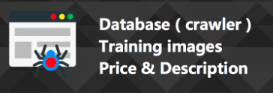
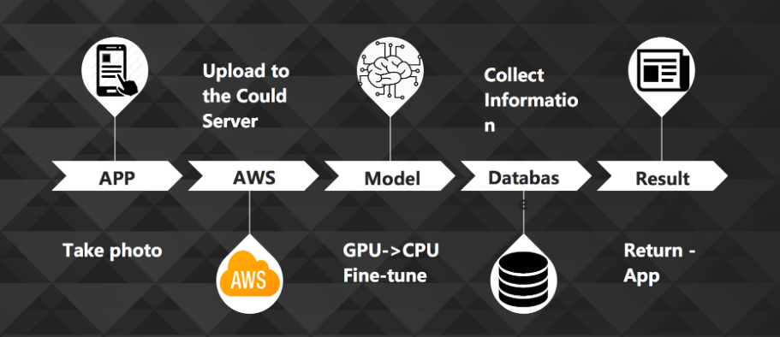
System Architecture
Or
Typing
Security
a1699631 Qiming
12
Notes:
The System Architecture is similar as the last semester we have implemented. We will add a searching button for the online shopping. The taking-photo function aims to offer the convenient experience for offline shopping. The information of our products such as price and images will be download and saved automatically by crawler. Junwei will explain detailed requirements, design and functions.

Slide 13

Final delivery - Users
User ID
Register to login
Password
Information
a1710640 Junwei
13
Notes:
Here Id like to introduce our expect final deliverys of our project.
First, we provide users login system. The users need to register to login in our app and be able to use it, The certain user ID, password, and other personal information are required to register. In this case, we consider the multipul users case, and from the users aspect, We can create a specifc file for each users, and based on the user habit, we can do the furthur data analysis to realise the app can make the recommendations based on your using history.

Slide 14
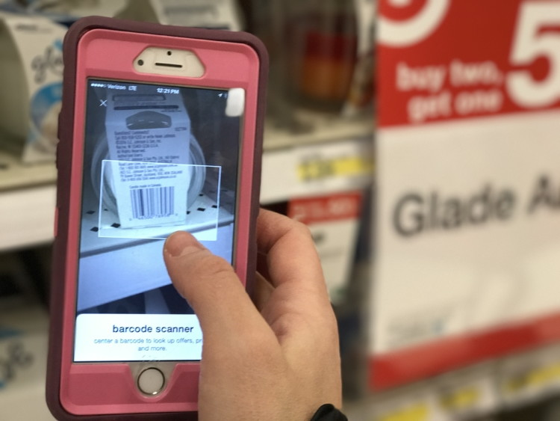
Final delivery - Scan
Scan Products
Better experience
a1710640 Junwei
14
Notes:
For the usage mode, we would change the photo shooting mode to Scan mode. The reason we use scan rather than photos is that, with real-time scan, app could help users to focus on the exact product. and obviously, scan mode provide a faster response, better experience.

Slide 15

Final delivery – Products information
Products info
Rating
Price comparing
For Merchants…
a1710640 Junwei
15
Notes:
THe food scanner app are aim to provide users products info, which we already realised in last semester, However, in this smester, we aim to provide more products for users to scan, beside this, we offer users a rating system. You can rate the products according to your preference. system would gather these rating information and make a final rating for one specifec product. Also, the users could see the prices of the same product provide by other markets.

Slide 16

Final delivery – Data analysis
Know customers better
recommendations
Customers ←→ Merchants
a1710640 Junwei
16
Notes:
For the merchants, With these info, they could know what kind of products that customers prefer, which products customers are intending to perchase in different market or with the same price tag and so on. They could use these data to make further data analysis or other marketing decision.
WIth the database, and user profile, we could provide an algorithm to provide users recommentdations, for example, Every times you use the app, You have a great intention to scan the OREO, and when the Oreo on sale, we could recommend you such information.

Slide 17



Final delivery - GPS
Specific Merchant
Accurate information
GPS – Detection combination
a1710640 Junwei
17
Notes:
We combine the GPS and the food scanner together, In google map, It could locate you to each merchant in Central Market. Food scanner asks users to allow GPS permissions to locate where are you when you scan the food. Once the app know which market you are, or which specific store you at, the range of the products could be limited, and much more accurate information of the scan result could be garenteed.

Slide 18
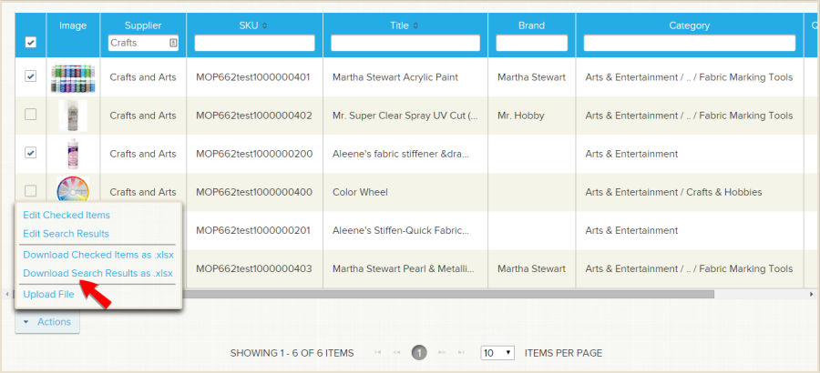
Final delivery – Interface for Merchants
a1710640 Junwei
18
Notes:
Here's an example of the interface for merchants. THe sellers could upload the required information of the products to the systems, and could have the marketing feedback from our database.

Slide 19
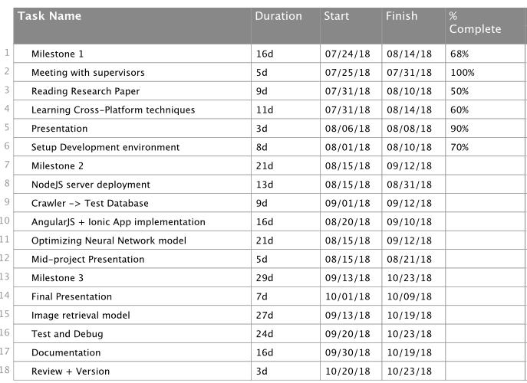
Milestones
Milestone 1
Set up environment, read paper, learn tutorials
Milestone 2
Cross-platform app development, model training
Milestone 3
Test, complete app functions, further research study
Group
19

Slide 20
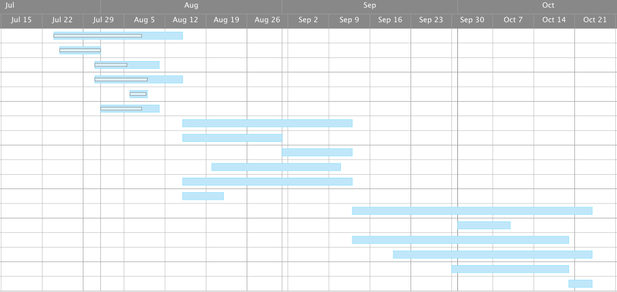
Gantt Chart
Group
20

Slide 21
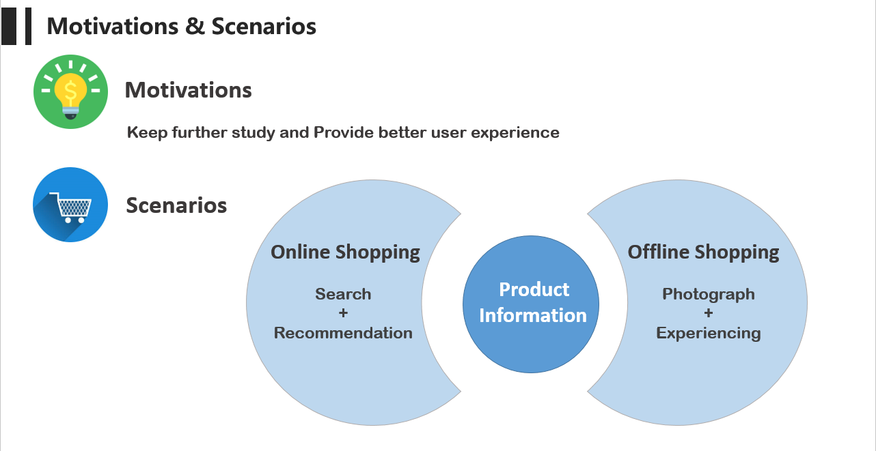
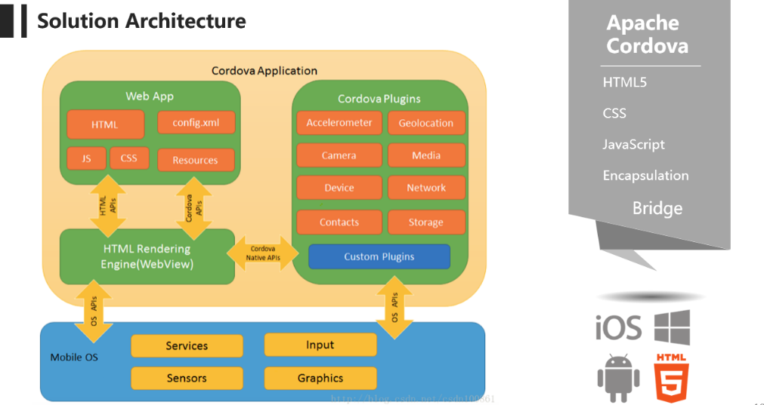
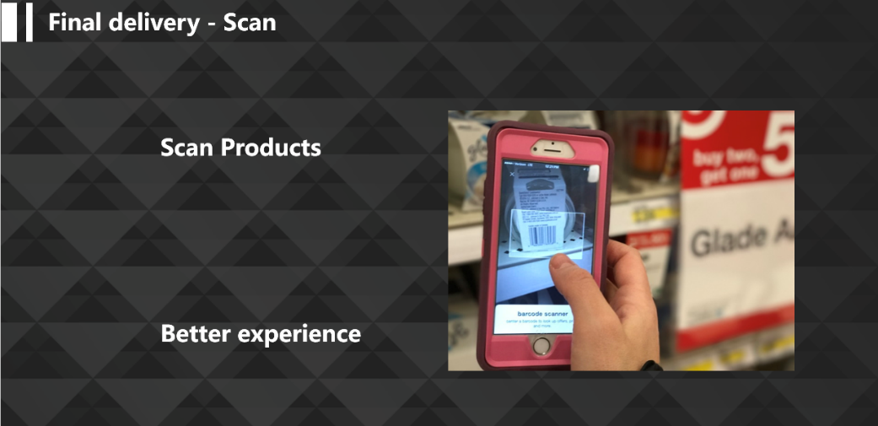
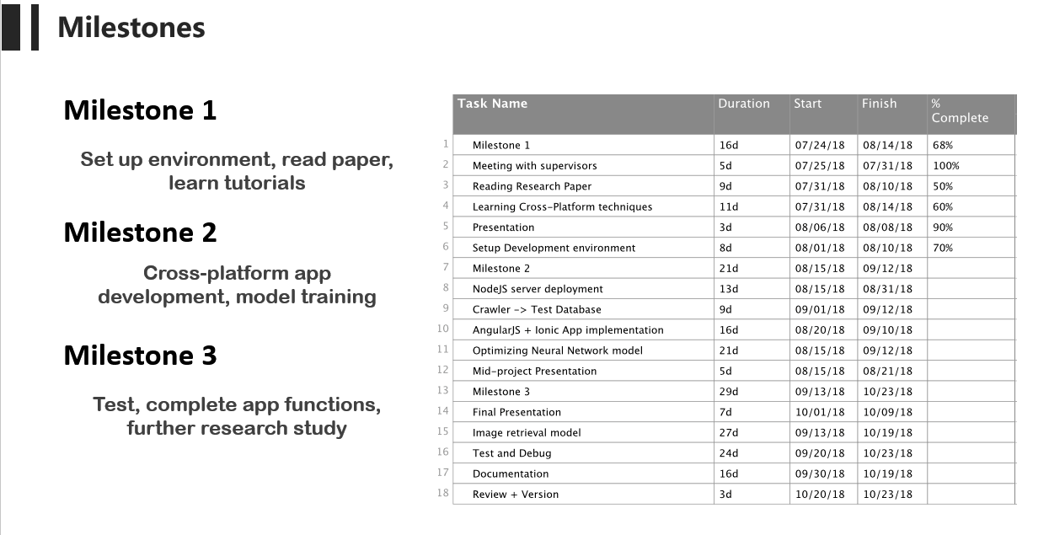
Conclusion
Fuji Apple
Group
21

