Slide 1
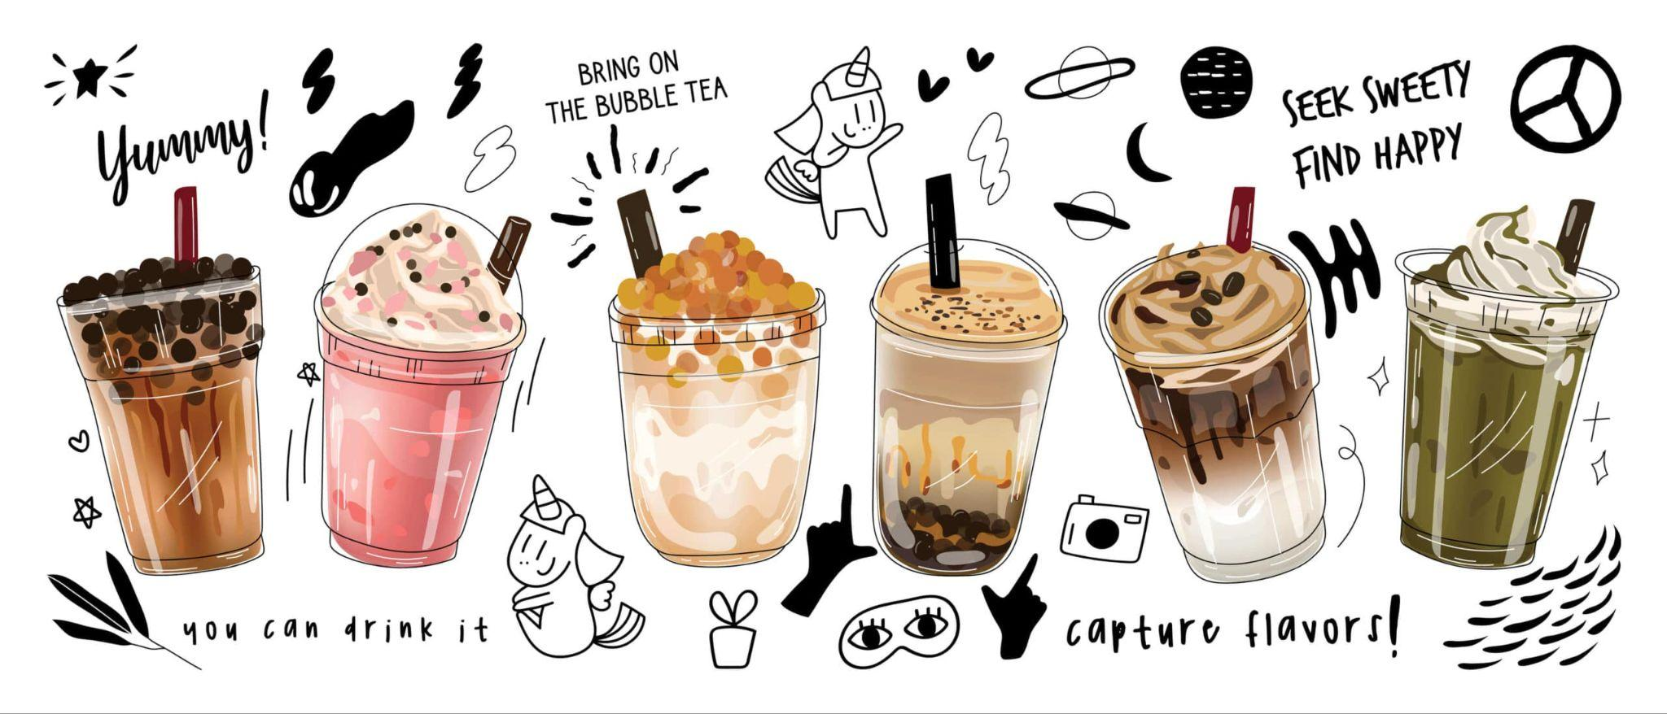
InfiniTea-App
Team Members:
Kyle Cush
Shaoru Wu-Zhu
Deming Huang
Anthony Sy

Slide 2
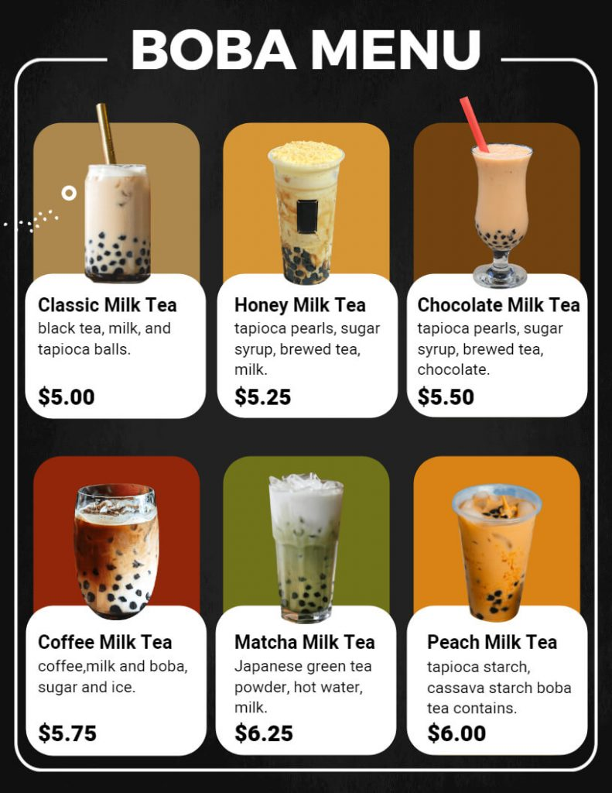
Intro
What is InfiniTea-App???
InfiniTea-App makes getting bubble tea quick and easy! 🧋 We chose this app as our project because we love bubble tea, but waiting in long lines and not being able to customize drinks exactly how we want can be a hassle. With InfiniTea-App, you can choose your tea flavors, adjust sweetness and ice levels, add different toppings, order ahead, and pick up your drink without the wait. We just want to make enjoying bubble tea simple and fun! 🍹

Slide 3
Features:
# 1: Explore a Variety of Flavors
# 2: Custom Drink Sizes
# 3: Sweetness & Ice Control
# 4: Topping Selection & Dynamic Pricing
# 5: Order Review & Checkout

Slide 4
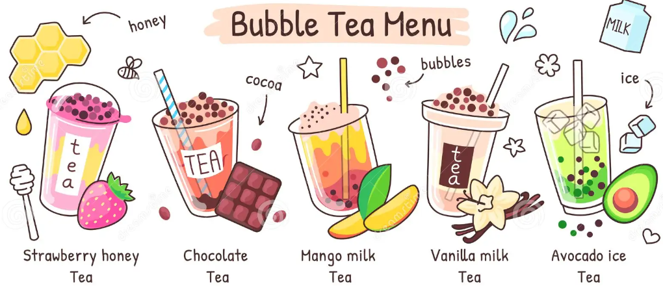
# 1: The app displays a list of different tea flavors, users can see drink descriptions and decide what to order - specialty bubble tea or build your own drink.

Slide 5
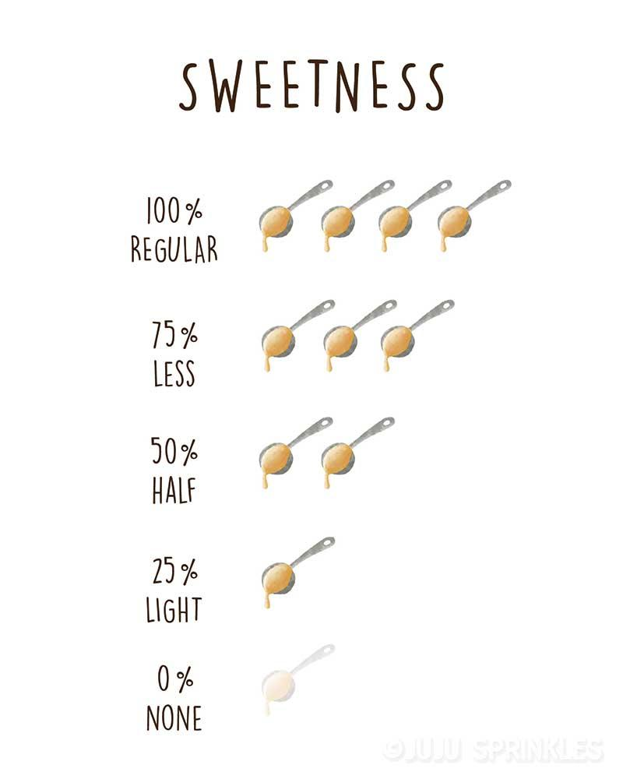
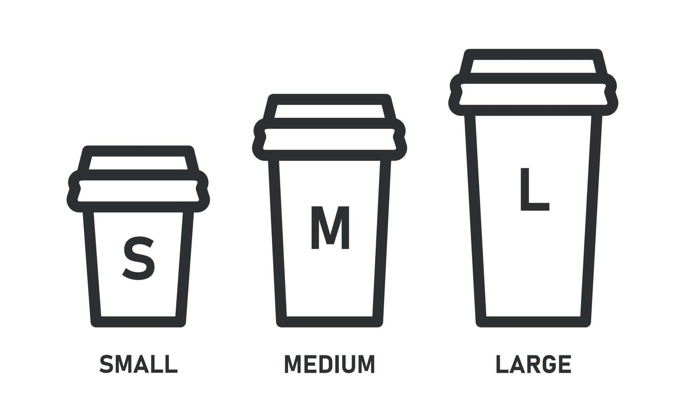
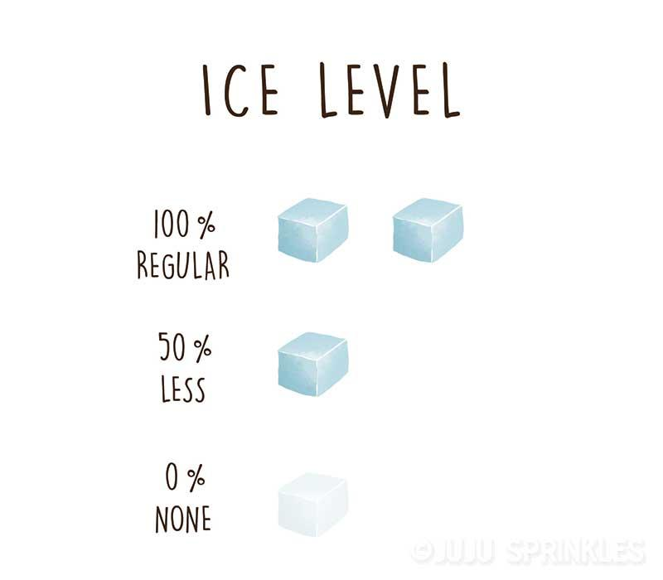
# 3: When a tea size is selected, user can adjust the sweetness and ice level to create the perfect drink for their taste.
# 2: When a tea type is selected, the users can select a size: small, medium, or large to match their preference.

Slide 6
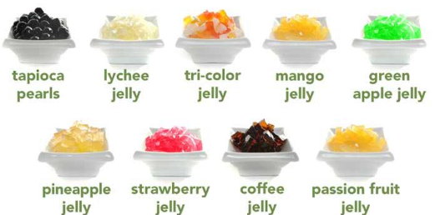
# 4: The app allows the user to build their own drink with different toppings like boba, jelly, or pudding, and the prices adjust automatically based on the drink size and any additional toppings they choose.
# 5: The app allows the user to check the detail of the current order, and edit the order before placing the order.

Slide 7
Thank You
InfiniTea-App
getting your perfect bubble tea quick and easy!

