Slide 1
ECE/CS 757: Advanced Computer Architecture II
Instructor:Mikko H Lipasti
Spring 2009
University of Wisconsin-Madison
Lecture notes based on slides created by John Shen, Mark Hill, David Wood, Guri Sohi, and Jim Smith, Natalie Enright Jerger, and probably others

Slide 2
Cache Coherence
Coherence States
Snoopy bus-based Invalidate Protocols
Invalidate protocol optimizations
Update Protocols (Dragon/Firefly)
Directory protocols
Implementation issues

Slide 3
Readings
Readings:
  Firefly
  Archibald
  Sweazey/Smith
  Laudon/Lenoski: Origin 2000
  Opteron
  Gigaplane
  Power5
  Intel 870

Slide 4
Cache Coherence Problem
Load A
P0
P1
Load A
Store A<= 1
Load A
A
0
1
A
0
Memory
© 2005 Mikko Lipasti

Slide 5
Cache Coherence Problem
Load A
P0
P1
Load A
Store A<= 1
Load A
A
0
A
0
1
A
1
Memory
© 2005 Mikko Lipasti

Slide 6
Possible Causes of Incoherence
Sharing of writeable data
  Cause most commonly considered
Process migration
  Can occur even if independent jobs are executing
I/O
  Often fixed via O/S cache flushes
02/07
ECE/CS 757; copyright J. E. Smith, 2007

Slide 7
Cache Coherence
Informally, with coherent caches: accesses to a memory location appear to occur simultaneously in all copies of the memory location
  “copies” ⇒ caches
Cache coherence suggests an absolute time scale -- this is not necessary
  What is required is the "appearance" of coherence... not absolute coherence
  E.g. temporary incoherence between memory and a write-back cache may be OK.
02/07
ECE/CS 757; copyright J. E. Smith, 2007
Notes:
7

Slide 8
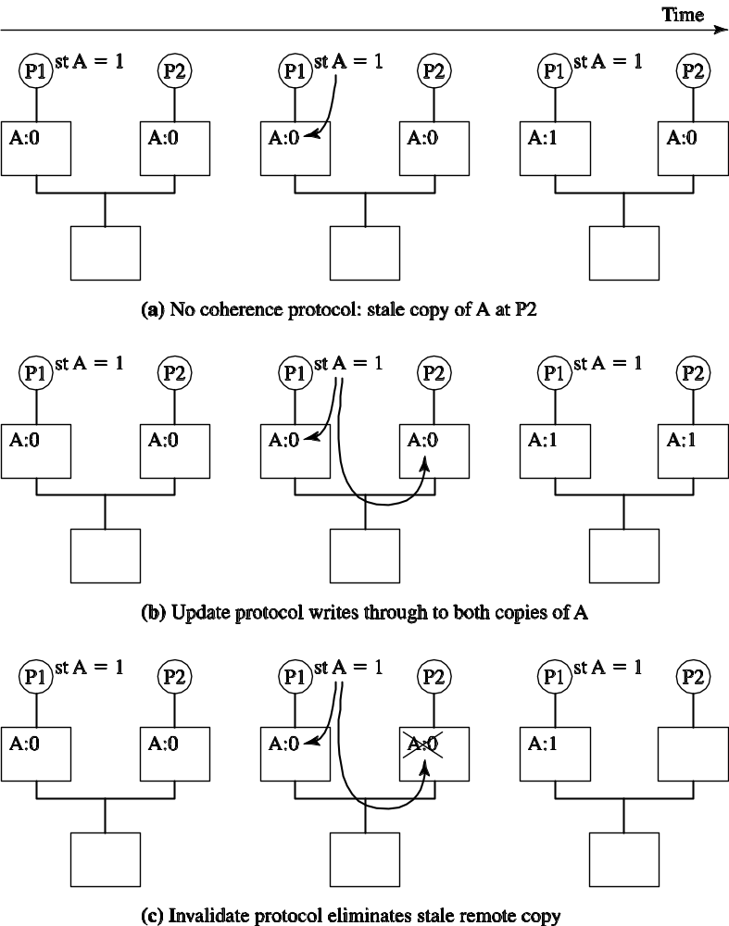
Update vs. Invalidation Protocols
Coherent Shared Memory
  All processors see the effects of others’ writes
How/when writes are propagated
  Determine by coherence protocol
© 2005 Mikko Lipasti
Notes:
USPTO -- Advanced Modern Processor Design
© 2005 Mikko Lipasti

Slide 9
Global Coherence States
A memory line can be present (valid) in any of the caches and/or memory
Represent global state with an N+1 element vector
  First N components => cache states (valid/invalid)
  N+1st component => memory state (valid/invalid)
Example:
Line A: <1,1,0,1>
Line B: <1,0,0,0>
Line C: <0,0,0,1>
Memory
line A: V
line B: I
line C: V
Cache 0
Cache 1
Cache 2
line A
line A
line B
02/07
ECE/CS 757; copyright J. E. Smith, 2007
Notes:
7

Slide 10
Local Coherence States
Individual caches can maintain a summary of the state of memory lines, from a “local” perspective
  Reduces storage for maintaining state
  May have only partial information
Invalid (I): <0,X,X,X....X> -- local cache does not have a valid copy; (cache miss)
  Don’t confuse invalid state with empty frame
Shared (S): <1,X,X,X,…,1> -- local cache has a valid copy, main memory has a valid copy, other caches ??
Modified(M): <1,0,0,..0,…0> -- local cache has only valid copy.
Exclusive(E): <1,0,0,..0,…1> -- local cache has a valid copy, no other caches do, main memory has a valid copy.
Owned(O): <1,X,X,X,….X> -- local cache has a valid copy, all other caches and memory may have a valid copy.
  Only one cache can be in O state
  <1,X,1,X,… 0> is included in O, but not included in any of the others.
02/07
ECE/CS 757; copyright J. E. Smith, 2007
Notes:
7

Slide 11
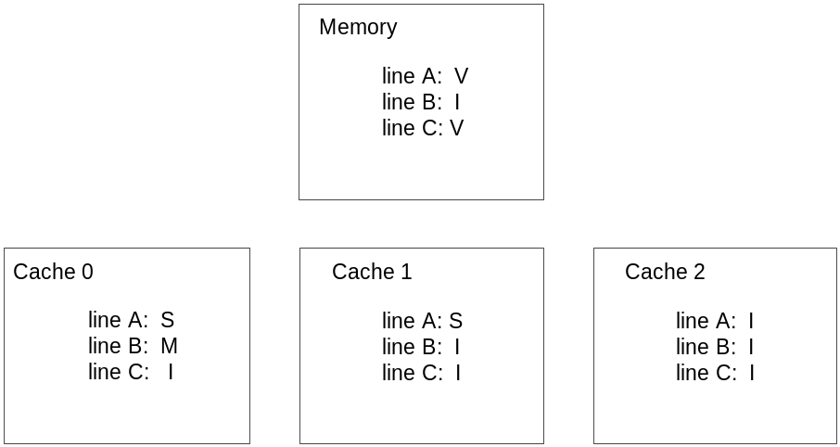
Example
Memory
line A: V
line B: I
line C: V
Cache 0
Cache 1
Cache 2
line A
line A
line B
02/07
ECE/CS 757; copyright J. E. Smith, 2007
Notes:
7

Slide 12
Snoopy Cache Coherence
All requests broadcast on bus
All processors and memory snoop and respond
Cache blocks writeable at one processor or read-only at several
  Single-writer protocol
Snoops that hit dirty lines?
  Flush modified data out of cache
  Either write back to memory, then satisfy remote miss from memory, or
  Provide dirty data directly to requestor
  Big problem in MP systems
    Dirty/coherence/sharing misses
© 2005 Mikko Lipasti

Slide 13
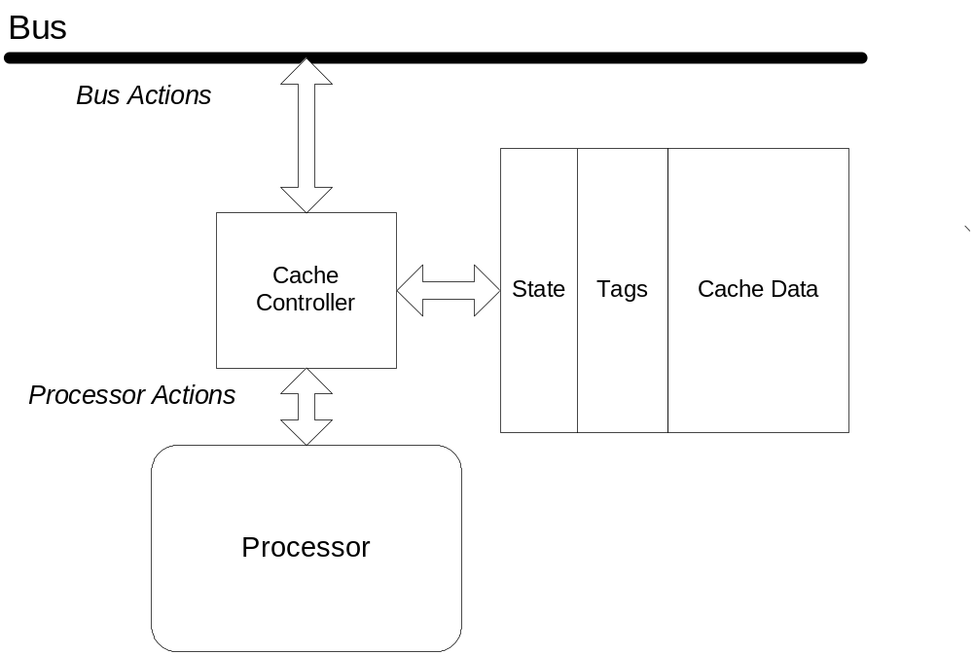
Bus-Based Protocols
Protocol consists of states and actions (state transitions)
Actions can be invoked from processor or bus
02/07
ECE/CS 757; copyright J. E. Smith, 2007

Slide 14
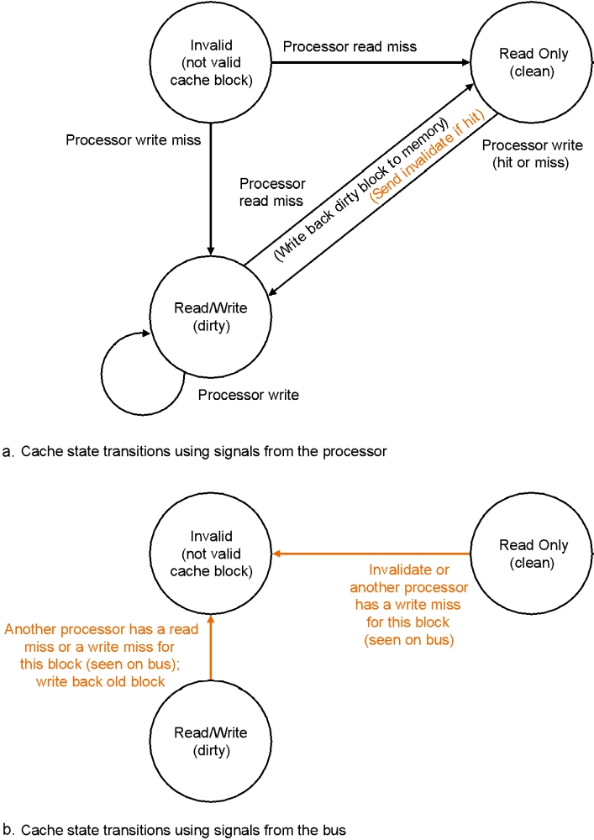
Minimal Coherence Protocol FSM
[Source: Patterson/Hennessy, Comp. Org. & Design]
© 2005 Mikko Lipasti

Slide 15
MSI Protocol
 | Action and Next State
Current State | Processor Read | Processor Write | Eviction |  | Cache Read | Cache Read&M | Cache Upgrade
I | Cache Read Acquire Copy → S | Cache Read&M Acquire Copy → M |  |  | No Action → I | No Action → I | No Action → I
S | No Action → S | Cache Upgrade → M | No Action → I |  | No Action → S | Invalidate Frame → I | Invalidate Frame → I
M | No Action → M | No Action → M | Cache Write back → I |  | Memory inhibit; Supply data; → S | Invalidate Frame; Memory inhibit; Supply data; → I
02/07
ECE/CS 757; copyright J. E. Smith, 2007
Notes:
7

Slide 16
MSI Example
Thread Event | Bus Action | Data From | Global State | Local States: C0 C1 C2
0. Initially: |  |  | <0,0,0,1> | I | I | I
1. T0 read→ | CR | Memory | <1,0,0,1> | S | I | I
2. T0 write→ | CU |  | <1,0,0,0> | M | I | I
3. T2 read→ | CR | C0 | <1,0,1,1> | S | I | S
4. T1 write→ | CRM | Memory | <0,1,0,0> | I | M | I
If line is in no cache
  Read, modify, Write requires 2 bus transactions
  Optimization: add Exclusive state
02/07
ECE/CS 757; copyright J. E. Smith, 2007

Slide 17
Invalidate Protocol Optimizations
Observation: data can be read shared
  Add S (shared) state to protocol: MSI
State transitions:
  Local read: I->S, fetch shared
  Local write: I->M, fetch modified; S->M, invalidate other copies
  Remote read: M->S, supply data
  Remote write: M->I, supply data; S->I, invalidate local copy
Observation: data can be write-private (e.g. stack frame)
  Avoid invalidate messages in that case
  Add E (exclusive) state to protocol: MESI
State transitions:
  Local read: I->E if only copy, I->S if other copies exist
  Local write: E->M silently, S->M, invalidate other copies
© 2005 Mikko Lipasti

Slide 18
MESI Protocol
Variation used in Pentium Pro/2/3
  (cache to cache transfer)
4-State Protocol
  Modified: <1,0,0…0>
  Exclusive: <1,0,0,…,1>
  Shared: <1,X,X,…,1>
  Invalid: <0,X,X,…X>
Bus/Processor Actions
  Same as MSI
Adds shared signal to indicate if other caches have a copy
02/07
ECE/CS 757; copyright J. E. Smith, 2007

Slide 19
MESI Protocol
 | Action and Next State
Current State | Processor Read | Processor Write | Eviction |  | Cache Read | Cache Read&M | Cache Upgrade
I | Cache Read If no sharers: → E If sharers: → S | Cache Read&M → M |  |  | No Action → I | No Action → I | No Action → I
S | No Action → S | Cache Upgrade → M | No Action → I |  | Respond Shared: → S | No Action → I | No Action → I
E | No Action → E | No Action → M | No Action → I |  | Respond Shared; → S | No Action → I
M | No Action → M | No Action → M | Cache Write-back → I |  | Respond dirty; Write back data; → S | Respond dirty; Write back data; → I
02/07
ECE/CS 757; copyright J. E. Smith, 2007

Slide 20
MESI Example
Optimization – cache-to-cache transfer for shared data (but only one sharer can respond)
If modified in some cache and another reads then writeback to memory (w/ snarf)
  Optimization: add Owned state (and perform cache-to-cache transfer)
Thread Event | Bus Action | Data From | Global State | Local States: C0 C1 C2
0. Initially: |  |  | <0,0,0,1> | I | I | I
1. T0 read→ | CR | Memory | <1,0,0,1> | E | I | I
2. T0 write→ | none |  | <1,0,0,0> | M | I | I
02/07
ECE/CS 757; copyright J. E. Smith, 2007

Slide 21
MOESI Optimization
Observation: shared ownership complicates/delays sourcing data
  Owner is responsible for sourcing data to any requestor
  Add O (owner) state to protocol: MOSI/MOESI
  Last requestor becomes the owner
  Ownership can be on per-node basis in hierarchically structured system
  Avoid writeback (to memory) of dirty data
  Also called shared-dirty state, since memory is stale
© 2005 Mikko Lipasti

Slide 22
MOESI Protocol
Used in AMD Opteron
5-State Protocol
  Modified: <1,0,0…0>
  Exclusive: <1,0,0,…,1>
  Shared: <1,X,X,…,X>
  Invalid: <0,X,X,…X>
  Owned: <1,X,X,X,X> ; only one owner
Owner can supply data, so memory does not have to
  Avoids lengthy memory access
02/07
ECE/CS 757; copyright J. E. Smith, 2007

Slide 23
MOESI Protocol
 | Action and Next State
Current State | Processor Read | Processor Write | Eviction |  | Cache Read | Cache Read&M | Cache Upgrade
I | Cache Read If no sharers: → E If sharers: → S | Cache Read&M → M |  |  | No Action → I | No Action → I | No Action → I
S | No Action → S | Cache Upgrade → M | No Action → I |  | Respond shared; → S | No Action → I | No Action → I
E | No Action → E | No Action → M | No Action → I |  | Respond shared; Supply data; → S | Respond shared; Supply data; → I
O | No Action → O | Cache Upgrade → M | Cache Write-back → I |  | Respond shared; Supply data; → O | Respond shared; Supply data; → I
M | No Action → M | No Action → M | Cache Write-back → I |  | Respond shared; Supply data; → O | Respond shared; Supply data; → I
02/07
ECE/CS 757; copyright J. E. Smith, 2007

Slide 24
MOESI Example
Thread Event | Bus Action | Data From | Global State | local states C0 C1 C2
0. Initially: |  |  | <0,0,0,1> | I | I | I
1. T0 read→ | CR | Memory | <1,0,0,1> | E | I | I
2. T0 write→ | none |  | <1,0,0,0> | M | I | I
3. T2 read→ | CR | C0 | <1,0,1,0> | O | I | S
4. T1 write→ | CRM | C0 | <0,1,0,0> | I | M | I
02/07
ECE/CS 757; copyright J. E. Smith, 2007

Slide 25
Update Protocols
Basic idea:
  All writes (updates) are made visible to all caches:
    (address,value) tuples sent “everywhere”
    Similar to write-through protocol for uniprocessor caches
  Obviously not scalable beyond a few processors
  No one actually builds machines this way
Simple optimization
  Send updates to memory/directory
  Directory propagates updates to all known copies: less bandwidth
Further optimizations: combine & delay
  Write-combining of adjacent updates (if consistency model allows)
  Send write-combined data
  Delay sending write-combined data until requested
Logical end result
  Writes are combined into larger units, updates are delayed until needed
  Effectively the same as invalidate protocol
© 2005 Mikko Lipasti

Slide 26
Update Protocol: Dragon
Dragon (developed at Xerox PARC)
5-State Protocol
  Invalid:<0,X,X,…X>
    Some say no invalid state – due to confusion regarding empty frame versus invalid line state
  Exclusive: <1,0,0,…,1>
  Shared-Clean (Sc): <1,X,X,…X> memory may not be up-to-date
  Shared-Modified (Sm): <1,X,X,X…0> memory not up-to-date; only one copy in Sm
  Modified: <1,0,0,…0>
Includes Cache Update action
Includes Cache Writeback action
Bus includes Shared flag
  Appears to also require memory inhibit signal
  Distinguish shared case where cache (not memory) supplies data
02/07
ECE/CS 757; copyright J. E. Smith, 2007

Slide 27
Dragon State Diagram
 | Action and Next State
Current State | Processor Read | Processor Write | Eviction |  | Cache Read | Cache Update
I | Cache Read If no sharers: → E If sharers: → Sc | Cache Read If no sharers: → M If sharers: Cache Update → Sm |  |  | → I | → I
Sc | No Action → Sc | Cache Update If no sharers: →M If sharers: → Sm | No Action → I |  | Respond Shared; → Sc | Respond shared; Update copy; → Sc
E | No Action → E | No Action → M | No Action → I |  | Respond shared; Supply data → Sc
Sm | No Action → Sm | Cache Update If no sharers: →M If sharers: → Sm | Cache Write-back → I |  | Respond shared; Supply data; → Sm | Respond shared; Update copy; → Sc
M | No Action → M | No Action → M | Cache Write-back → I |  | Respond shared; Supply data; → Sm
02/07
ECE/CS 757; copyright J. E. Smith, 2007

Slide 28
Example
Thread Event | Bus Action | Data From | Global State | local states C0 C1 C2
0. Initially: |  |  | <0,0,0,1> | I | I | I
1. T0 read→ | CR | Memory | <1,0,0,1> | E | I | I
2. T0 write→ | none |  | <1,0,0,0> | M | I | I
3. T2 read→ | CR | C0 | <1,0,1,0> | Sm | I | Sc
4. T1 write→ | CR,CU | C0 | <1,1,1,0> | Sc | Sm | Sc
5. T0 read→ | none (hit) | C0 | <1,1,1,0> | Sc | Sm | Sc
Appears to require atomic bus cycles CR,CU on write to invalid line
02/07
ECE/CS 757; copyright J. E. Smith, 2007

Slide 29
Update Protocol: Firefly
Develped at DEC by ex-Xerox people
5-State Protocol
  Similar to Dragon – different state naming based on shared/exclusive and clean/dirty
  Invalid:<0,X,X,…X>
  EC: <1,0,0,…,1>
  SC: <1,X,X,…X> memory may not be up-to-date
  EM: <1,0,0,…0>
  SM: <1,X,X,X…0> memory not up-to-date; only one copy in Sm
Performs write-through updates (different from Dragon)
02/07
ECE/CS 757; copyright J. E. Smith, 2007

Slide 30
Firefly State Diagram
 | Action and Next State
Current State | Processor Read | Processor Write | Eviction |  | Cache Read | Cache Read&M
I | Cache Read If no sharers: → Ec If sharers: → Sc | Cache Read If no sharers: → Em If sharers: Cache Update → Sm |  |  | No Action → I | No Action → I
Sc | No Action → Sc | Cache Read&M If no sharers: →Ec If sharers: → Sc | No Action → I |  | Respond Shared; → Sc | Respond Shared → Sc
Ec | No Action → Ec | No Action → Em | No Action → I |  | Respond shared; → Sc | Respond Shared → Sc
Sm | No Action → Sm | Cache Read&M If no sharers: →Ec If sharers: → Sc | Cache Write-back → I |  | Respond shared; Supply data; → Sm | Respond shared; Supply data; → Sc
Em | No Action → Em | No Action → Em | Cache Write-back → I |  | Respond shared; Supply data; → Sm | Respond shared; Supply data; → Sc
02/07
ECE/CS 757; copyright J. E. Smith, 2007

Slide 31
Update vs Invalidate
[Weber & Gupta, ASPLOS3]
  Consider sharing patterns
No Sharing
  Independent threads
  Coherence due to thread migration
  Update protocol performs many wasteful updates
Read-Only
  No significant coherence issues; most protocols work well
Migratory Objects
  Manipulated by one processor at a time
  Often protected by a lock
  Usually a write causes only a single invalidation
  E state useful for Read-modify-Write patterns
  Update protocol could proliferate copies
02/07
ECE/CS 757; copyright J. E. Smith, 2007

Slide 32
Update vs Invalidate, contd.
Synchronization Objects
  Locks
  Update could reduce spin traffic invalidations
  Test&Test&Set w/ invalidate protocol would work well
Many Readers, One Writer
  Update protocol may work well, but writes are relatively rare
Many Writers/Readers
  Invalidate probably works better
  Update will proliferate copies
What is used today?
  Invalidate is dominant
  CMP may change this assessment
    more on-chip bandwidth
02/07
ECE/CS 757; copyright J. E. Smith, 2007

Slide 33
Nasty Realities
State diagram is for (ideal) protocol assuming instantaneous and actions
In reality controller implements more complex diagrams
  A protocol state transition may be started by controller when bus activity changes local state
  Example: an upgrade pending (for bus) when an invalidate for same line arrives
02/07
ECE/CS 757; copyright J. E. Smith, 2007

Slide 34
Partial Implementation State Table
 | Action and Next State
Current State | Processor Read | Processor Write | Bus Grant | Bus Response |  | Cache Read | Cache Read&M | Cache Upgrade
I | Request Bus → IR | Request Bus → IW |  |  |  | No Action → I | No Action → I | No Action → I
S | No Action → S | Request Bus → SW |  |  |  | Respond Shared: → S | No Action → I | No Action → I
E | No Action → E | No Action → M |  |  |  | Respond Shared; → S | No Action → I
M | No Action → M | No Action → M |  |  |  | Respond dirty; Write back data; → S | Respond dirty; Write back data; → I
IR |  |  | Cache Read → IRR
IW |  |  | Cache Read&M → IWR
IRR |  |  |  | If no sharers: → E If sharers: → S Load line
IWR |  |  |  | → M Load line
SW |  |  | Cache Upgrade → M |  |  | Respond Shared: → SW | No Action → IW | No Action → IW
02/07
ECE/CS 757; copyright J. E. Smith, 2007

Slide 35
Further Optimizations
Observation: Shared blocks should only be fetched from memory once
  If I find a shared block on chip, forward the block
  Problem: multiple shared blocks possible, who forwards?
    Everyone? Power/bandwidth wasted
  Single forwarder, but who?
    Last one to receive block: F state
    I->F for requestor, F->S for forwarder
  What if F block is evicted?
    Favor F blocks in replacement?
    Don’t allow silent eviction (force some other node to be F)
    Fall back on memory copy if can’t find F copy
Very old idea (IBM machines have done this for a long time), but recent Intel patent issued anyway [Hum/Goodman]
© 2005 Mikko Lipasti

Slide 36
Further Optimizations
Observation: migratory data often “flies by”
  Add T (transition) state to protocol
  Tag is still valid, data isn’t
  Data can be snarfed as it flies by
  Only works with certain kinds of interconnect networks
  Replacement policy issues
Many other optimizations are possible
  Literature extends 25 years back
  Many unpublished (but implemented) techniques as well
© 2005 Mikko Lipasti

Slide 37
Implementing Cache Coherence
Snooping implementation
  Origins in shared-memory-bus systems
  All CPUs could observe all other CPUs requests on the bus; hence “snooping”
    Bus Read, Bus Write, Bus Upgrade
  React appropriately to snooped commands
    Invalidate shared copies
    Provide up-to-date copies of dirty lines
      Flush (writeback) to memory, or
      Direct intervention (modified intervention or dirty miss)
Snooping suffers from:
  Scalability: shared busses not practical
  Ordering of requests without a shared bus
  Lots of recent and on-going work on scaling snoop-based systems
© 2005 Mikko Lipasti
Notes:
USPTO -- Advanced Modern Processor Design
© 2005 Mikko Lipasti

Slide 38
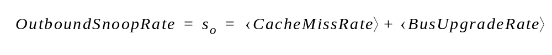
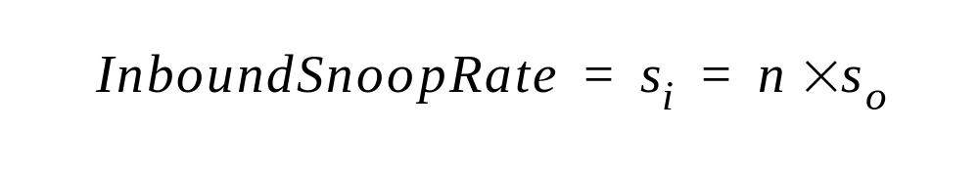
Snooping Cache Coherence
Basic idea: broadcast snoop to all caches to find owner
Not scalable?
  Address traffic roughly proportional to square of number of processors
  Current implementations scale to 64/128-way (Sun/IBM) with multiple address-interleaved broadcast networks
Inbound snoop bandwidth: big problem
© 2005 Mikko Lipasti

Slide 39
Snoop Bandwidth
Snoop filtering of various kinds is possible
Filter snoops at sink: Jetty filter [Moshovos et al., HPCA 2001]
  Check small “filter cache” that summarizes contents of local cache
  Avoid power-hungry lookups in each tag array
Filter snoops at source: Multicast snooping [Bilir et al., ISCA 1999]
  Predict likely sharing set, snoop only predicted sharers
  Double-check at directory to make sure
Filter snoops at source: Region coherence
  Concurrent work: [Cantin/Smith/Lipasti, ISCA 2005; Moshovos, ISCA 2005]
  Check larger region of memory on every snoop; remember when no sharers
  Snoop only on first reference to region, or when region is shared
  Eliminate 60%+ of all snoops
© 2005 Mikko Lipasti

Slide 40
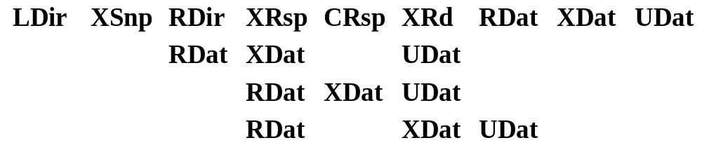
Snoop Latency
Snoop latency:
  Must reach all nodes, return and combine responses
  Probably the bigger scalability issue in the future
  Topology matters: ring, mesh, torus, hypercube
  No obvious solutions
Parallelism: fundamental advantage of snooping
  Broadcast exposes parallelism, enables speculative latency reduction
© 2005 Mikko Lipasti

Slide 41
Scaleable Cache Coherence
Eschew physical bus but still snoop
  Point-to-point tree structure (indirect) or ring
  Root of tree or ring provide ordering point
  Use some scalable network for data (ordering less important)
Or, use level of indirection through directory
  Directory at memory remembers:
    Which processor is “single writer”
    Which processors are “shared readers”
  Level of indirection has a price
    Dirty misses require 3 hops instead of two
      Snoop: Requestor->Owner
      Directory: Requestor->Directory->Owner
© 2005 Mikko Lipasti

Slide 42
Implementing Cache Coherence
Directory implementation
  Extra bits stored in memory (directory) record state of line
  Memory controller maintains coherence based on the current state
  Other CPUs’ commands are not snooped, instead:
    Directory forwards relevant commands
  Powerful filtering effect: only observe commands that you need to observe
  Meanwhile, bandwidth at directory scales by adding memory controllers as you increase size of the system
    Leads to very scalable designs (100s to 1000s of CPUs)
Directory shortcomings
  Indirection through directory has latency penalty
  If shared line is dirty in other CPU’s cache, directory must forward request, adding latency
  This can severely impact performance of applications with heavy sharing (e.g. relational databases)
© 2005 Mikko Lipasti
Notes:
USPTO -- Advanced Modern Processor Design
© 2005 Mikko Lipasti

Slide 43
Directory Protocol Implementation
Basic idea: Centralized directory keeps track of data location(s)
Scalable
  Address traffic roughly proportional to number of processors
  Directory & traffic can be distributed with memory banks (interleaved)
  Directory cost (SRAM) or latency (DRAM) can be prohibitive
Presence bits track sharers
  Full map (N processors, N bits): cost/scalability
  Limited map (limits number of sharers)
  Coarse map (identifies board/node/cluster; must use broadcast)
Vectors track sharers
  Point to shared copies
  Fixed number, linked lists (SCI), caches chained together
  Latency vs. cost vs. scalability
© 2005 Mikko Lipasti
Notes:
USPTO -- Advanced Modern Processor Design
© 2005 Mikko Lipasti

Slide 44
Directory Protocol Latency
Access to non-shared data
  Overlap directory read with data read
  Best possible latency given NUMA arrangement
Access to shared data
  Dirty miss, modified intervention
  Shared intervention?
    If DRAM directory, no gain
    If directory cache, possible gain (use F state)
  No inherent parallelism
  Indirection adds latency
  Minimum 3 hops, often 4 hops
© 2005 Mikko Lipasti
Notes:
USPTO -- Advanced Modern Processor Design
© 2005 Mikko Lipasti

Slide 45
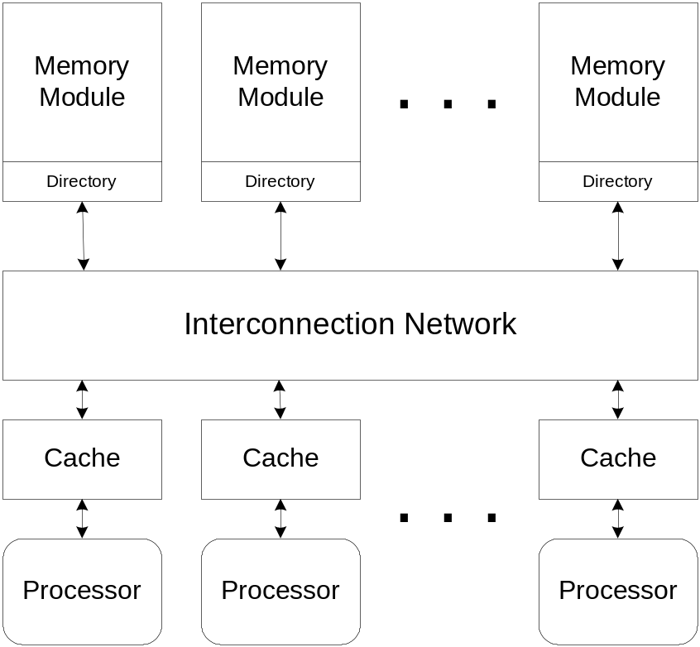
Directory-based Cache Coherence
An alternative for large, scalable MPs
Can be based on any of the protocols discussed thus far
  We will use MSI
Memory Controller becomes an active participant
Sharing info held in memory directory
  Directory may be distributed
Use point-to-point messages
Network is not totally ordered
02/07
ECE/CS 757; copyright J. E. Smith, 2007

Slide 46
Example: Simple Directory Protocol
Local cache controller states
  M, S, I as before
Local directory states
  Shared: <1,X,X,…1>; one or more proc. has copy; memory is up-to-date
  Modified: <0,1,0,….,0> one processor has copy; memory does not have a valid copy
  Uncached: <0,0,…0,1> none of the processors has a valid copy
Directory also keeps track of sharers
  Can keep global state vector in full
  e.g. via a bit vector
02/07
ECE/CS 757; copyright J. E. Smith, 2007

Slide 47
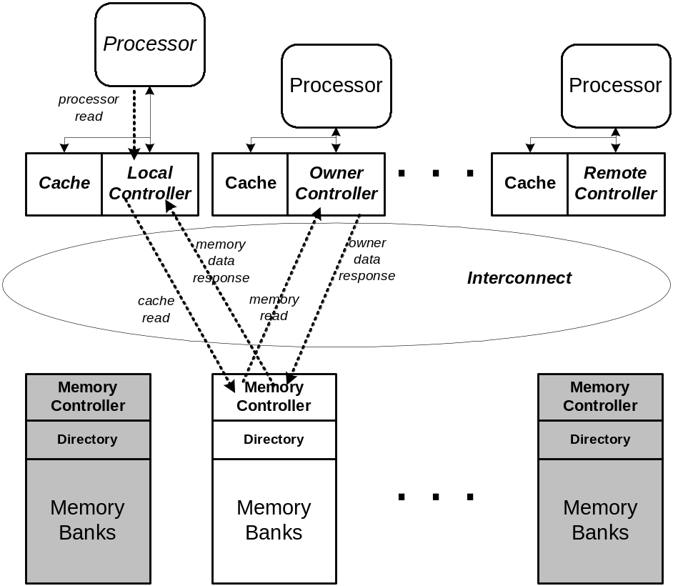
Example
Local cache suffers load miss
Line in remote cache in M state
  It is the owner
Four messages send over network
  Cache read from local controller to home memory controller
  Memory read to remote cache controller
  Owner data back to memory controller; change state to S
  Memory data back to local cache; change state to S
02/07
ECE/CS 757; copyright J. E. Smith, 2007

Slide 48
Cache Controller State Diagram
Intermediate States for clarity
 | Cache Controller Actions and Next States
 | from Processor Side |  |  |  | from Memory Side
Current State | Processor Read | Processor Write | Eviction |  | Memory Read | Memory Read&M | Memory Invalidate | Memory Upgrade | Memory Data
I | Cache Read → I' | Cache Read&M → I'' |  |  |  |  | No Action → I
S | No Action → S | Cache Upgrade → S' | No Action* → I |  |  |  | Invalidate Frame; Cache ACK; → I
M | No Action → M | No Action → M | Cache Write-back → I |  | Owner Data; → S | Owner Data; → I | Invalidate Frame; Cache ACK; → I
I' |  |  |  |  |  |  |  |  | Fill Cache → S
I'' |  |  |  |  |  |  |  |  | Fill Cache → M
S' |  |  |  |  |  |  |  | No Action → M
02/07
ECE/CS 757; copyright J. E. Smith, 2007

Slide 49
Memory Controller State Diagram
 | Memory Controller Actions and Next States
 | command from Local Cache Controller |  |  |  | response from Remote Cache Controller
Current Directory State | Cache Read | Cache Read&M | Cache Upgrade |  | Data Write-back | Cache ACK | Owner Data
U | Memory Data; Add Requestor to Sharers; → S | Memory Data; Add Requestor to Sharers; → M
S | Memory Data; Add Requestor to Sharers; → S | Memory Invalidate All Sharers; → M' | Memory Upgrade All Sharers; → M'' |  | No Action → I
M | Memory Read from Owner; → S' | Memory Read&M; to Owner → M' |  |  | Make Sharers Empty; → U
S' |  |  |  |  |  |  | Memory Data to Requestor; Write memory; Add Requestor to Sharers; → S
M' |  |  |  |  |  | When all ACKS Memory Data; → M | Memory Data to Requestor; → M
M'' |  |  |  |  |  | When all ACKS then → M
02/07
ECE/CS 757; copyright J. E. Smith, 2007

Slide 50
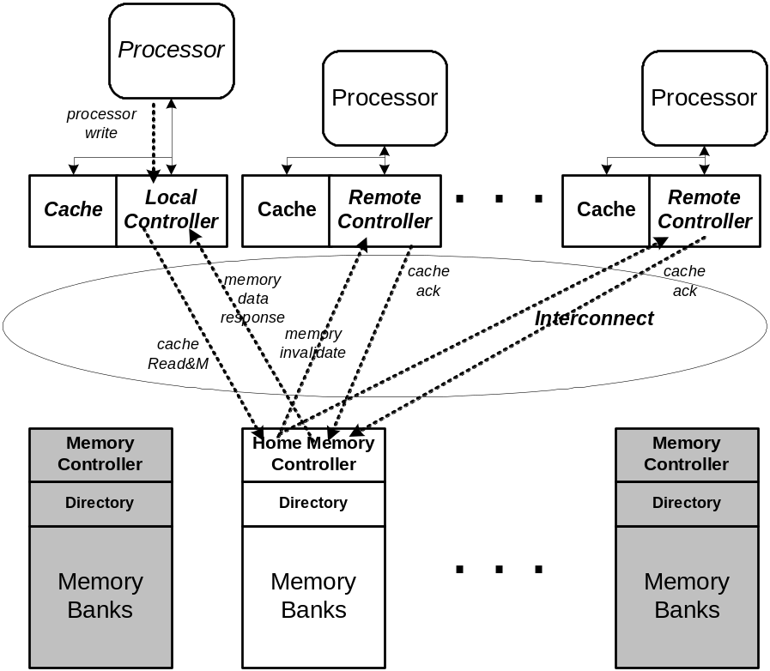
Another Example
Local write (miss) to shared line
Requires invalidations and acks
02/07
ECE/CS 757; copyright J. E. Smith, 2007

Slide 51
Example Sequence
Similar to earlier sequences
Thread Event | Controller Actions | Data From | global state | local states: C0 C1 C2
0. Initially: |  |  | <0,0,0,1> | I | I | I
1. T0 read→ | CR,MD | Memory | <1,0,0,1> | S | I | I
2. T0 write→ | CU, MU*,MD |  | <1,0,0,0> | M | I | I
3. T2 read→ | CR,MR,MD | C0 | <1,0,1,1> | S | I | S
4. T1 write→ | CRM,MI,CA,MD | Memory | <0,1,0,0> | I | M | I
02/07
ECE/CS 757; copyright J. E. Smith, 2007

Slide 52
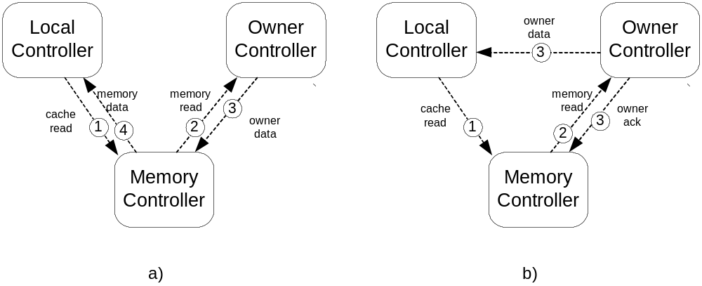
Variation: Three Hop Protocol
Have owner send data directly to local controller
Owner Acks to Memory Controller in parallel
02/07
ECE/CS 757; copyright J. E. Smith, 2007

Slide 53
Directory Protocol Optimizations
Remove dead blocks from cache:
  Eliminate 3- or 4-hop latency
  Dynamic Self-Invalidation [Lebeck/Wood, ISCA 1995]
  Last touch prediction [Lai/Falsafi, ISCA 2000]
  Dead block prediction [Lai/Fide/Falsafi, ISCA 2001]
Predict sharers
  Prediction in coherence protocols [Mukherjee/Hill, ISCA 1998]
  Instruction-based prediction [Kaxiras/Goodman, ISCA 1999]
  Sharing prediction [Lai/Falsafi, ISCA 1999]
Hybrid snooping/directory protocols
  Improve latency by snooping, conserve bandwidth with directory
  Multicast snooping [Bilir et al., ISCA 1999; Martin et al., ISCA 2003]
  Bandwidth-adaptive hybrid [Martin et al., HPCA 2002]
  Token Coherence [Martin et al., ISCA 2003]
  VCT Multicasting [Enright Jerger thesis 2008]
© 2005 Mikko Lipasti
Notes:
USPTO -- Advanced Modern Processor Design
© 2005 Mikko Lipasti

Slide 54
Protocol Races
Atomic bus
  Only stable states in protocol (e.g. M, S, I)
  All state transitions are atomic (I->M)
  No conflicting requests can interfere since bus is held till transaction completes
    Distinguish coherence transaction from data transfer
    Data transfer can still occur much later; easier to handle this case
Atomic buses don’t scale
  At minimum, separate bus request/response
Large systems have broadly variable delays
  Req/resp separated by dozens of cycles
  Conflicting requests can and do get issued
  Messages may get reordered in the interconnect
How do we resolve them?

Slide 55
Resolving Protocol Races
Req/resp decoupling introduces transient states
  E.g. I->S is now I->ItoX->ItoS_nodata->S
Conflicting requests to blocks in transient states
  NAK – ugly; livelock, starvation potential
  Keep adding more transient states …
Directory protocol makes this a bit easier
  Can order at directory, which has full state info
  Even so, messages may get reordered

Slide 56
Common Protocol Races
Read strings: P0 read, P1 read, P2 read
  Easy, since read is nondestructive
  Can rely on F state to reduce DRAM accesses
  Forward reads to previous requestor (F)
Write strings: P0 write, P1 write, P2 write
  Forward P1 write req to P0 (M)
  P0 completes write then forwards M block to P1
  Build string of writes (write string forwarding)
Read after write (similar to prev. WAW)
Writeback race: P0 evicts dirty block, P1 reads
  Dirty block is in the network (no copy at P0 or at dir)
  NAK P1, or force P0 to keep copy till dir ACKs WB
Many others crop up, esp. with optimizations

Slide 57
Summary
Coherence States
Snoopy bus-based Invalidate Protocols
Invalidate protocol optimizations
Update Protocols (Dragon/Firefly)
Directory protocols
Implementation issues

