Slide 1
Mad Cow Disease Statistics in United Kingdom and its Early Diagnosis
STAT 585X
Shaowei Ding
Ag & Biosystems Engineering

Slide 2
Overview
Background & Motivation & Data Collecting
Analysis
- History
- Current Condition
Shiny Application
Mcow Package
Discussion and Conclusion

Slide 3
Background
Bovine Spongiform Encephalopathy(BSE): also known as "Mad Cow“ disease
BSE can be transmitted by eating food containing nervous system tissue from an infected animal, and prions begin to slowly transform normal protein into the abnormal prion shape, which eventually leads to fatal damages to the nervous system.
Infectious Agent: Prion
Long Incubation Period & Limited Diagnosing Technique
Raman Spectroscopy: Non-invasive and Non-destructive

Slide 4
Motivation
Mad Cow disease was first found in mid 1980’s from 16 cattle, and that number dramatically increased to over 190,000 cases worldwide, with the majority of them in Europe. (Lee et al., 2013)
Worst case happened in United Kingdom.
My research is about mad cow disease diagnosis.
Build a shiny application that can simplify Raman Spectra analysis

Slide 5
Data Collecting
Data is obtained from Animal Health and Veterinary Agency.
BSE cases in every year from 1987 to 2014
Locations are available
Categorized into active and passive surveillance
Age and birthdate of all suspected animals are recorded.

Slide 6
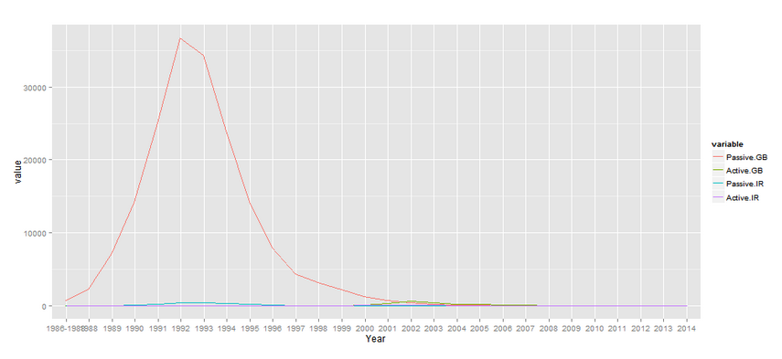
Trend of passive and active surveillance in united kingdom
On August 1st, 1996, extra control measures on animal feed containing mammalian meat and bone meal are considered to have been fully implemented.
Passive Surveillance data from Great Britain has the highest amplitude

Slide 7
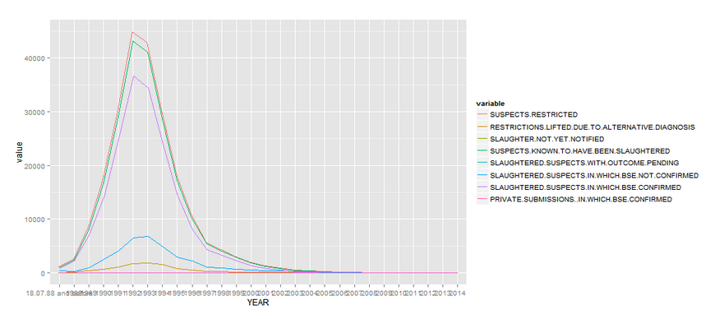
Trend of passive surveillance in Great Britain
Suspected
Confirmed and Slaughtered

Slide 8
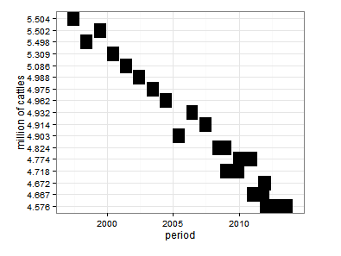
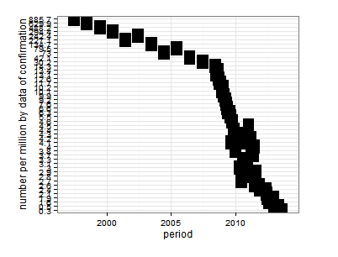
Cattle population over 24 months of ages and number of confirmed cases per million

Slide 9
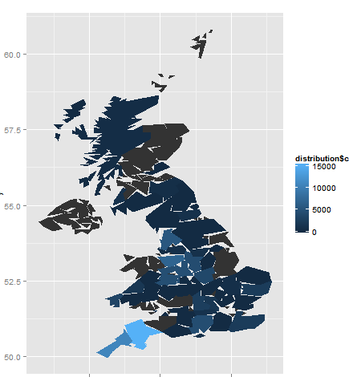
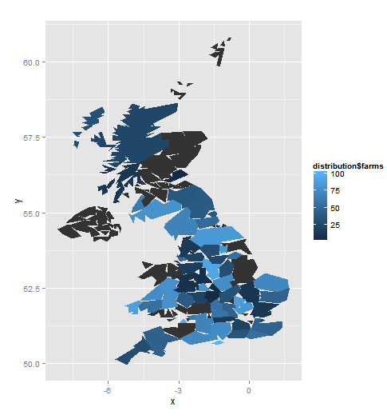
Distribution of confirmed cases

Slide 10
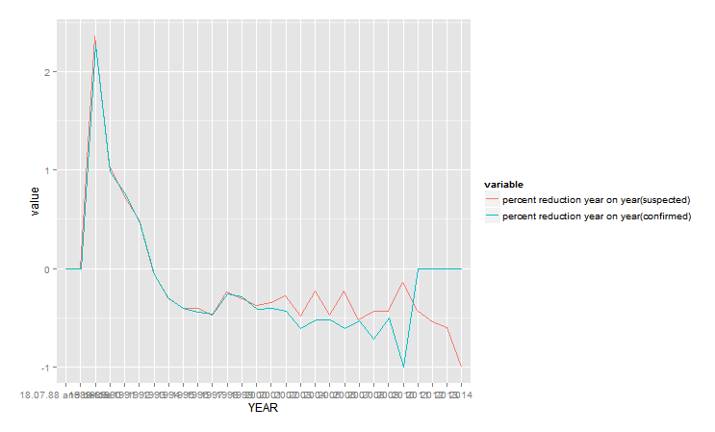
Percent Reduction Year on Year

Slide 11
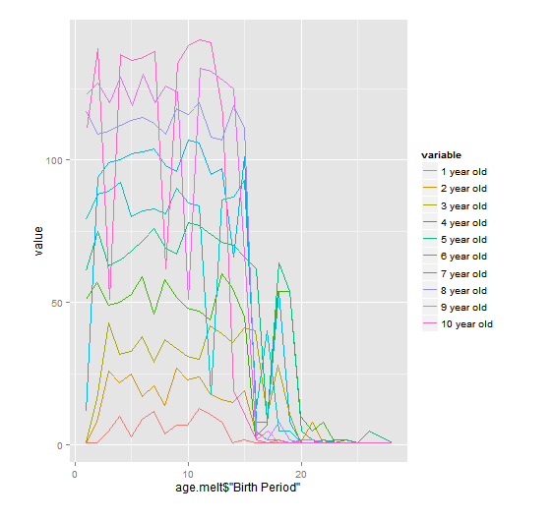
the trend of different age in Great Britain (confirmed case)
10 years old
9 years old
1996
2008

Slide 12
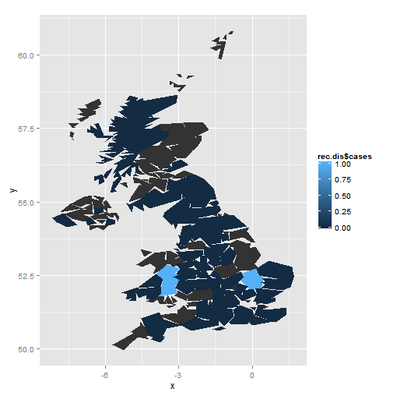
In recent two years, the distribution of BSE cases in Great Britain

Slide 13
Shiny Application
Even though BSE is no longer active in the UK, there are still cases that have appeared in recent years. Since prion disease is hard to diagnose and it easily spreads through food contamination, attention is still required to monitor the development of BSE.
http://shaowei.shinyapps.io/raman_Shiny
Mcow packag
Percentage reduction
Polygon reading
Change of date format
Change unit to percentage

Slide 14
Question?

