Slide 1

My Course Guide ——Search
William Baumeister
Peter Carey
Jeremy Koritzinsky
Shaowen Liu
Notes:
Hello everyone. This is team 32. The goal of our project was to improve the efficiency of the search function of My Course Guide and add a few other features.

Slide 2
Breakdowns:
Displays courses without relating them to DARS, no “degree requirements” section (Main problem)
No “search by time” function
Not a very user-friendly layout
Improvements:
Add an optional button to select courses that fit DARS degree requirements
Create the search by time button
Reformat the search choices panel
Notes:
During our Contextual Inquiries, we found a few breakdowns. First, there was no easy way to incorporate DARS reports. There was also no way to search for courses by time, even though the student center has this function. And the overall layout of the page was not very user-friendly. We decided to improve this page by adding a checkbox for searching courses with degree requirements, adding a function to allow users search courses by time, and reformatting the search choices panel.

Slide 3
Usability Test Tasks
Find a computer science course
Find a course that fulfills the degree requirements on DARS
Find a course that takes place from 1:20 p.m to 2:10p.m
Notes:
For our usability tests, we asked users to find a computer science course, using the new layout. Then find a course that fulfills a specific degree requirement. Finally, they had to find a course to fill a specific time slot, in this case 1:20 to 2:10.

Slide 4
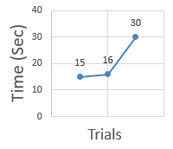
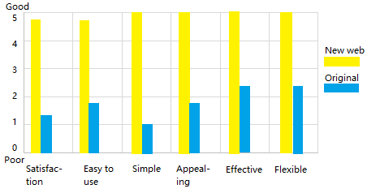
Usability Test Results
The new developed prototype is more efficient than the original one
Notes:
Between our 3 trials, we found that our page was more efficient, easier to use, more appealing, more effective, and more flexible, all of which resulted in much higher user satisfaction rating. This leads us to conclude that our changes were welcome and effectively dealt with the breakdowns we noted earlier. Thank you for watching this presentation.

