Slide 1

YouTube Cultural Probe
TEAM 18:
Laura Laidlaw
Evan Taddonio
Shaowen Liu
Sam Patterson
Notes:
Hello everyone. This is team 18. We decided to conduct a contextual inquiry around the mobile app version of YouTube. We wanted to study YouTube because it is an app that is widely used by college students and we knew from our own personal experiences that there were flaws with the app.

Slide 2
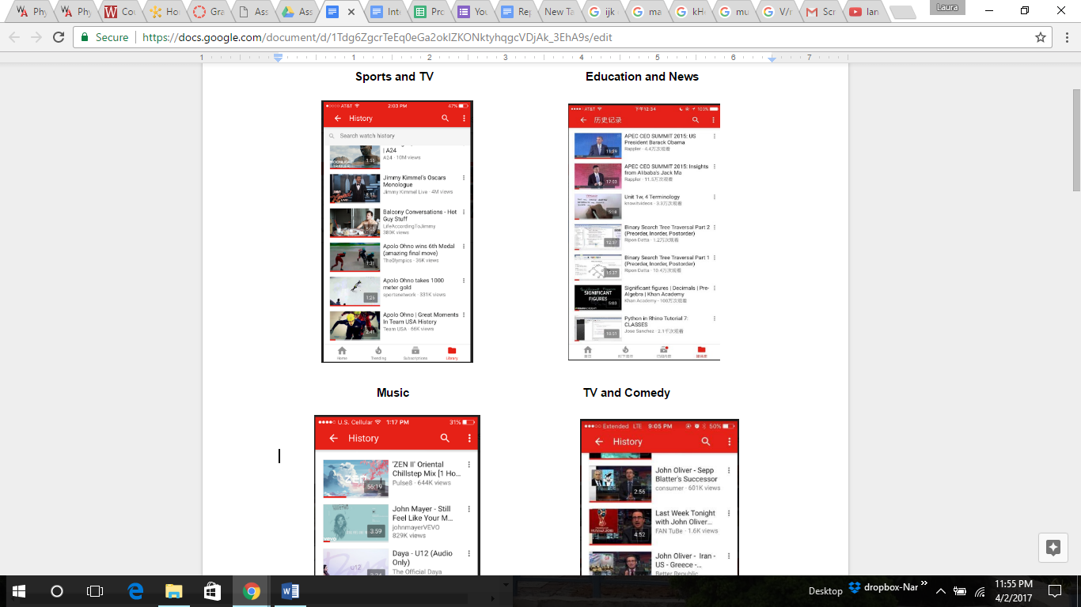
Summary of Study
Population:
College Students, age mainly range from 18 to 25.
Motivation for Choosing YouTube:
It is an extremely popular app
People are likely to use the app every day
Data Analysis:
Users don’t like being told what to watch.
Users want to be able to listen to videos or switch from the app without it stopping.
Users want a different way to discover new content.
None of our participants had YouTube Red
Notes:
We found that most of the youtube user are College Students, whose age are mainly ranging from 18 to 25. Based on the data from our participants, we found that the users want a different way to discover new content, but they don’t like being told what to watch. Also Users want to be able to listen to videos or switch from the app without it stopping and None of our participants had YouTube Red

Slide 3
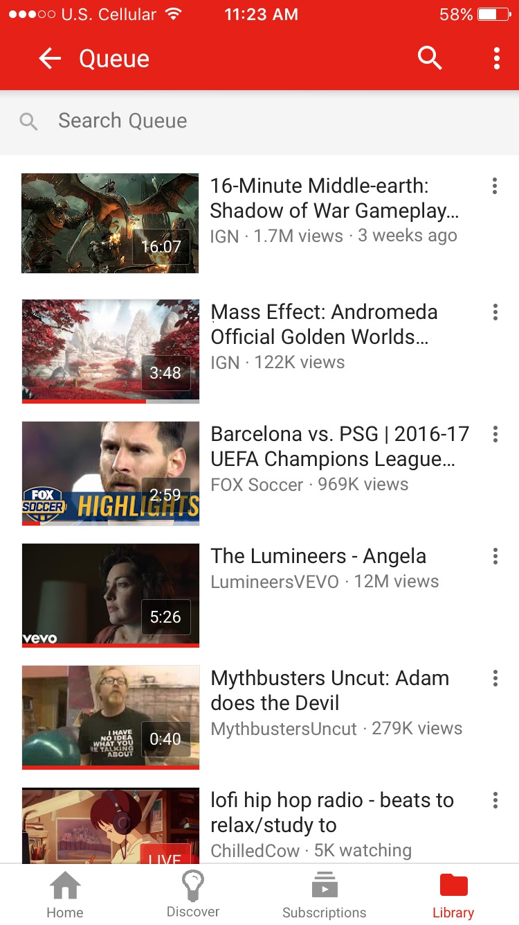
Findings
Breakdowns:
Videos cannot be queued by users.
Recommended videos may not fit users’ need.
Improvements:
Add a queue functionality to enable the users queue videos based on their interest.
Chang the content and layout in Discover page to enable users to look at popular videos and we changed the time parameters of videos.
Link to our prototype:
https://projects.invisionapp.com/share/4XB7FWL5G#/screens
Notes:
Some breaks downs we found are as follows:
First, Videos cannot be queued by users.. Second, Recommended videos may not fit users’ need. Although there are breakdowns, there are opportunities to improve it. We added a queue functionality to enable the users queue videos based on their interest. Moreover, We Chang the content and layout in Discover page to enable users to look at popular videos and we changed the time parameters of videos.

Slide 4
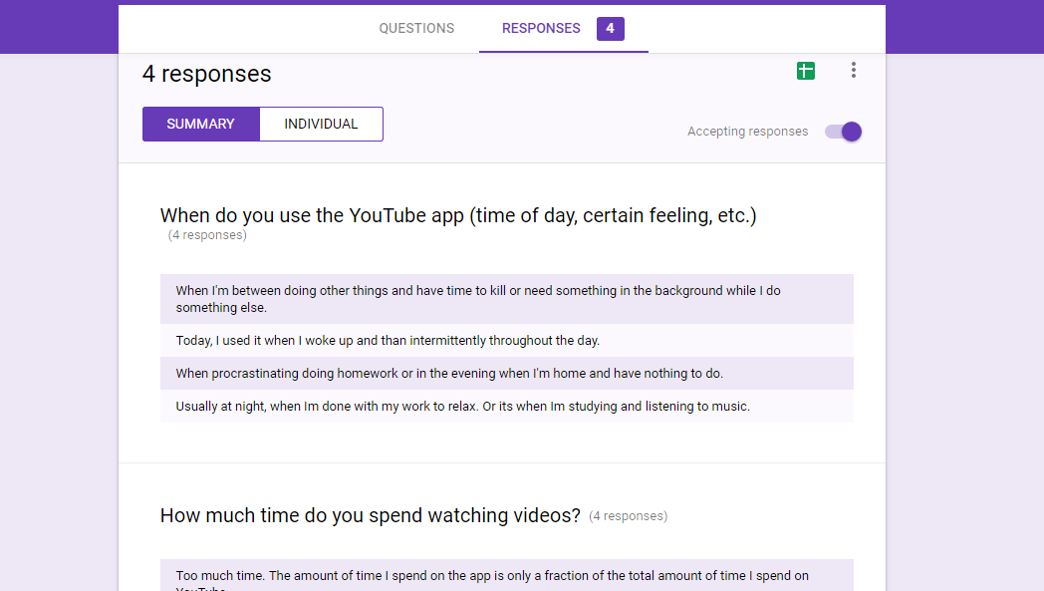
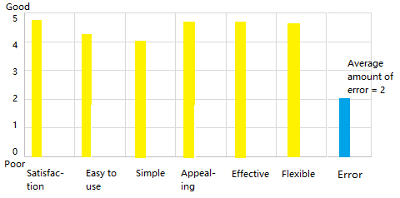
Usability Test Tasks
Find an video and add it to a queue
Back to home page and find the queue
Result
The time and users’ attitude towards our newly developed YouTube App are shown in the following chart. In brief, users are positive about the queue functionality.
Notes:
Finally, we make a usability test. Before the test, we introduced our prototype to the users. Then recorded their time and error when they were using it. After the test, we let them fill out a questionnaire. From the bar chart, we found that users are positive about the queue functionality.

