Slide 1
Recurrent Neural Networks
Shao Michael

Slide 2
Recap
MLPs
CNNs
They all take in a fixed input and output a fixed output.
What if we want the input to change in size.

Slide 3
Tasks
Or what if we want to detect emotion from a sentence like:
“Yay that was fun!”
first we need to know how to input this sentence.

Slide 4
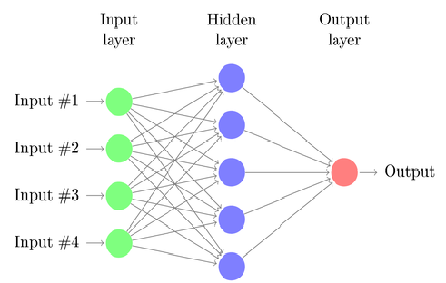
Tasks
Or what if we want to detect emotion from a sentence like:
“Yay that was fun!”
first we need to know how to input this sentence:
We can assign each word a number (details coming soon!), and use 4 inputs for the sentence!
Yay
That
Was
Fun

Slide 5
Tasks
But sentences can vary in length.
What do we do if we get: “I must declare that this particular experience proved to be an absolutely delightful and thoroughly entertaining endeavor that filled me with pure joy!”
Yay
That
Was
Fun
???

Slide 6
RNNs
This is what RNNs can do: deal with dynamic inputs and outputs

Slide 7
Inventing the RNN
Suppose you want to get rich by buying stock:
For each day, you want to predict to buy or sell.
We are going to oversimplify all the stock things in this example.

Slide 8
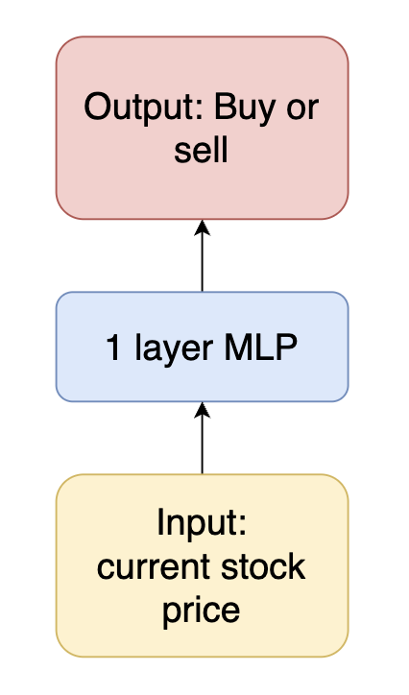
Inventing the RNN
Using what we have, we start with this network:

Slide 9
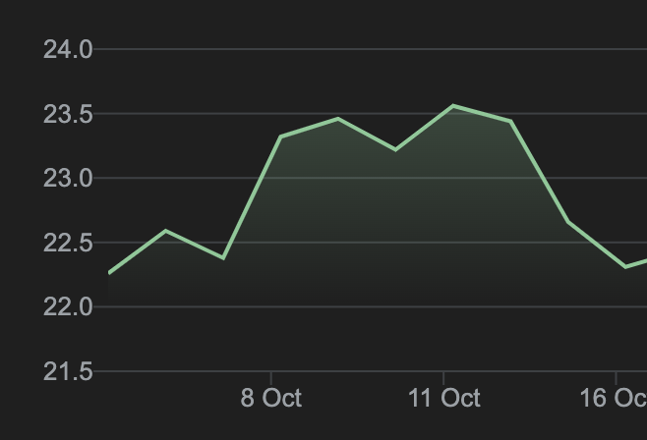
Inventing the RNN
But of course it does a bad job! Consider these two cases:
The model gives the same prediction for the two spots, even though one is clearly growing and one’s falling!

Slide 10
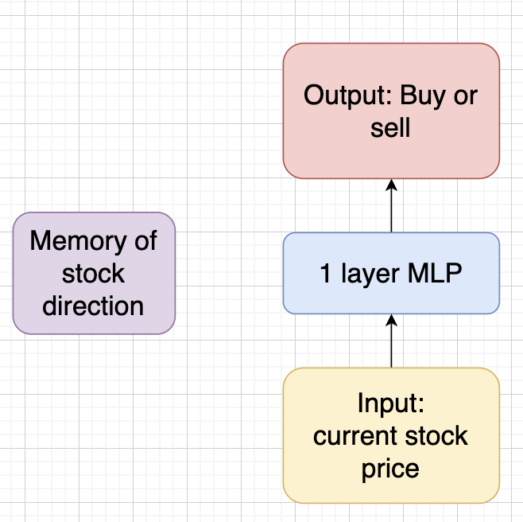
Inventing the RNN
What we need is some kind of “memory”, so the model can remember previous stock statuses.

Slide 11
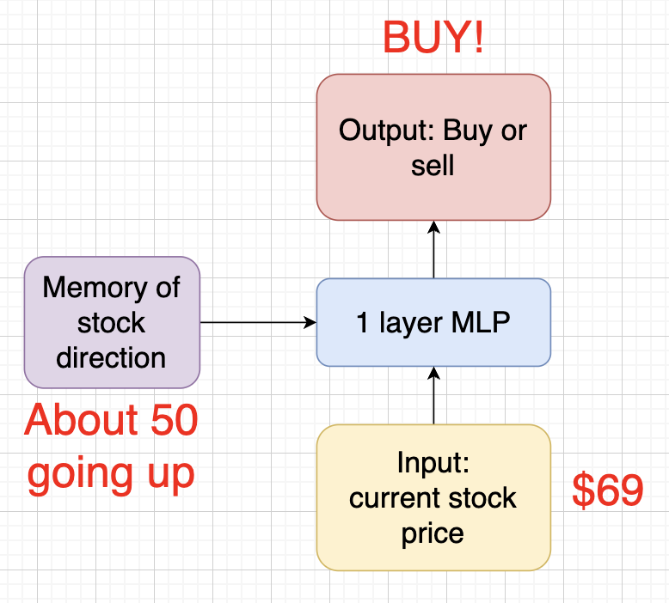
Inventing the RNN
For each prediction, we also take in the memory apart from the current stock price.

Slide 12
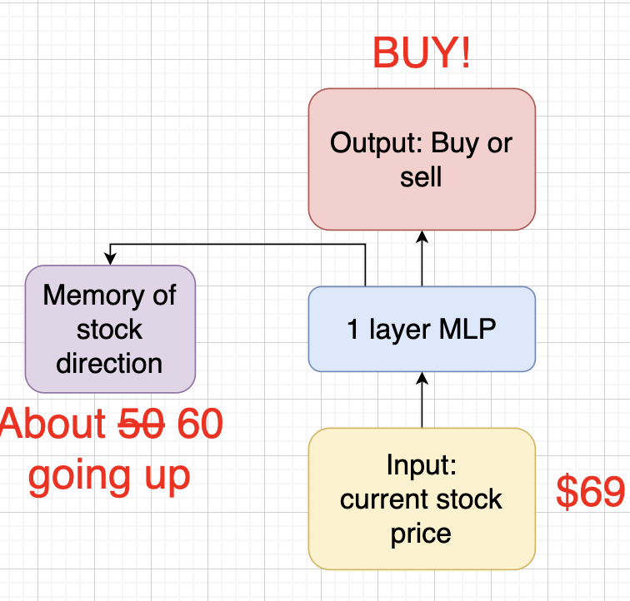
Inventing the RNN
After each prediction, we then take the intermediate calculations and update the memory:

Slide 13
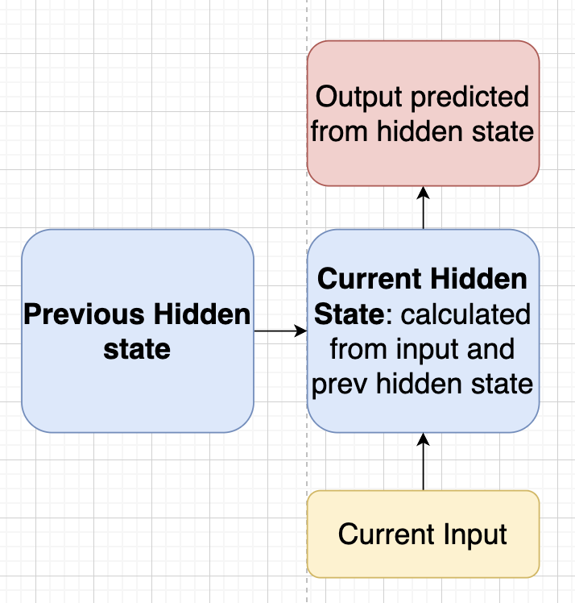
Inventing the RNN
In the RNN, the memory part is known as the Hidden State

Slide 14
Inventing the RNN: Game of telephone
We will play a game to help us understand how RNNs work.
Get into groups of 6, your task is to guess the animal described by a sentence from a drawing you all drew together.
Each person would get their assigned word, and when its your turn, use the drawing your previous teammate drew and add in whatever you can to best add in the meaning of your word to the drawing. Be creative and do not write down words!
The last person in your group will guess the animal based on your drawings.
Notes:
Sentence:

Slide 15
Inventing the RNN: Game of telephone
In the game, the drawings you drew are the “Hidden states” of the human-rnn we made.
Note that unlike in the game where each word is processed by a different person, in RNNs each processing part for each element is the same network. So the RNN basically plays this game for each word inputted over and over again with itself (it has no friends to play with :( ).
Notes:
Sentence:

Slide 16
Inventing the RNN: example with math
To demonstrate this how RNNs work with a concrete example, lets consider the stock example again.
We will see how an RNN can effectively predict when to buy or sell stocks.
Notes:
Sentence:

Slide 17
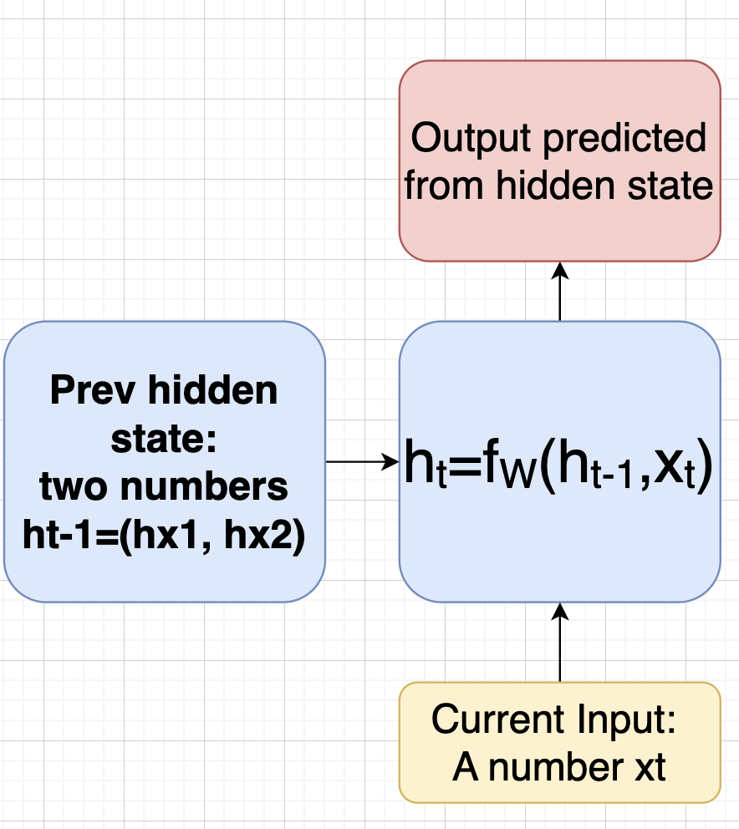
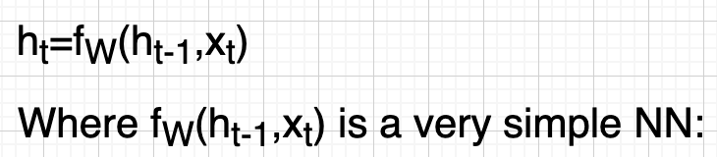
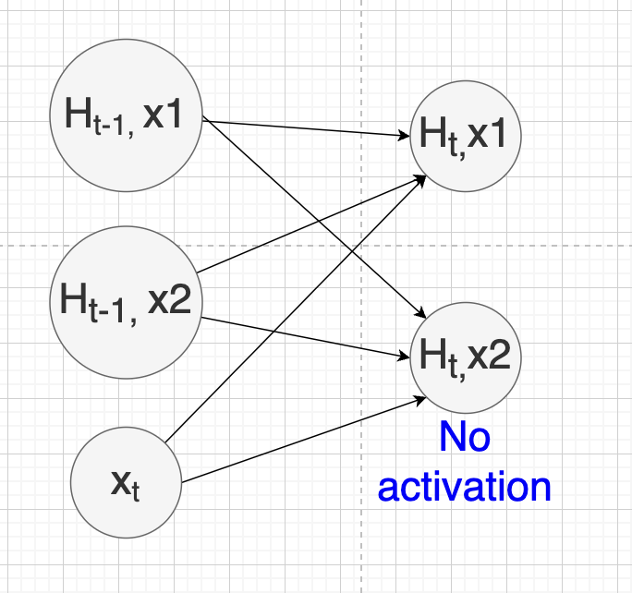
Inventing the RNN: example with math

Slide 18
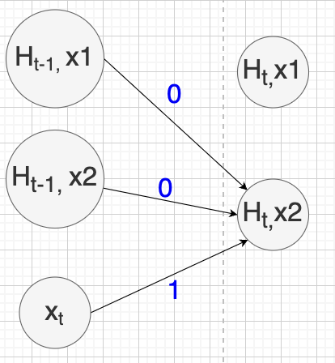
Inventing the RNN: example with math

Slide 19
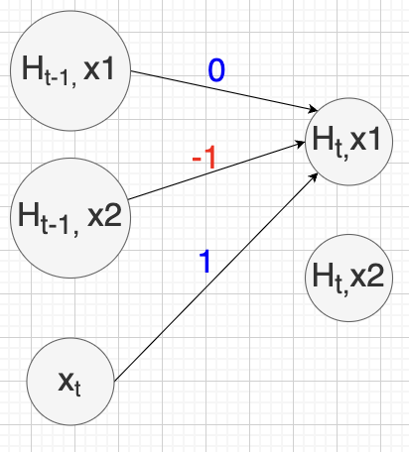
Inventing the RNN: example with math

Slide 20
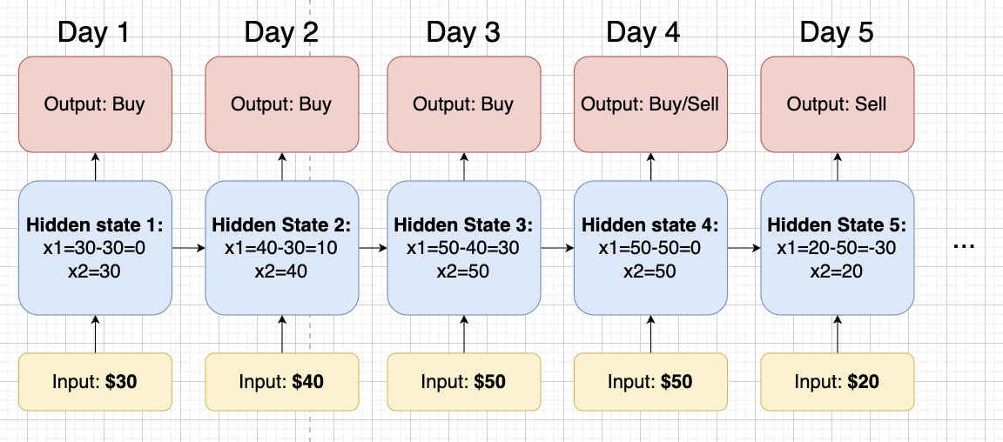
Inventing the RNN: example with math

Slide 21
Inventing the RNN: example with math
Now we go back to the hidden states. Can you try to see what hx1, hx2 are?
hx1: difference between previous day and today
hx2: current day price
In practice, the hidden states can be anything and any size (how many numbers), and they are trained to represent different things (often way more complex than the example given).

Slide 22
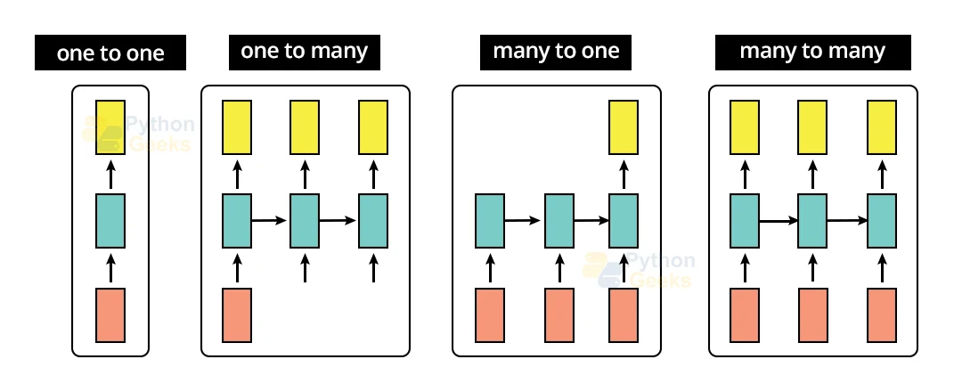
Different types of RNNs
source: Python Geeks

Slide 23
Different types of RNNs: One to One
Just your normal MLP or CNN
source: Python Geeks

Slide 24
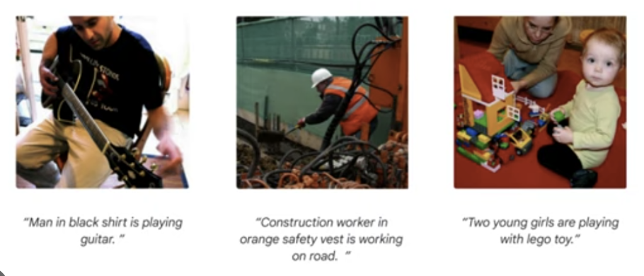
Different types of RNNs: One to Many
Takes in a fixed input, outputs a sequence of things
Used for things like image captioning

Slide 25

Different types of RNNs: Many to One
Takes in a sequence of inputs, outputs one thing
Application: Emotion detection from text, spam/scam detection

Slide 26
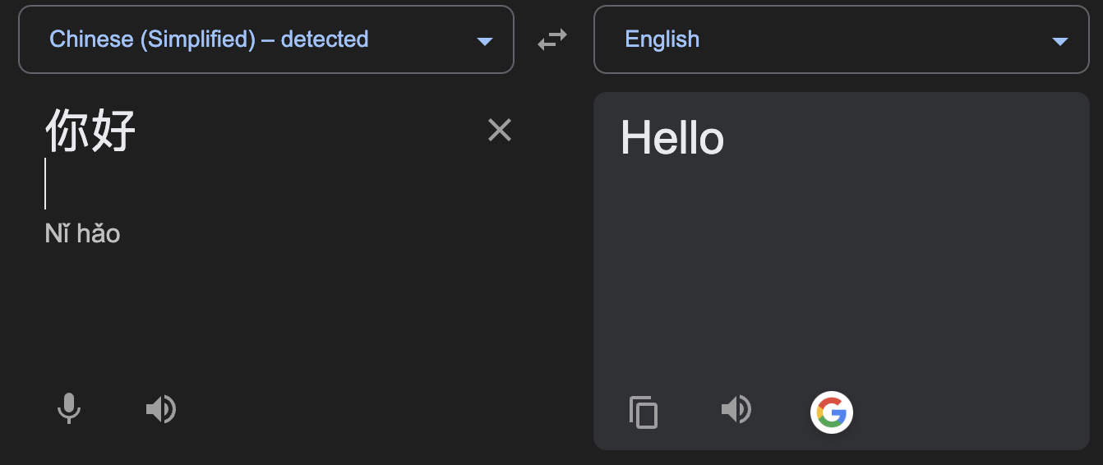
Different types of RNNs: Many to Many
Inputs a sequence of many elements, outputs a sequence
Example application: translation (though we do not use RNNs nowdays because transformers are way better)

Slide 27
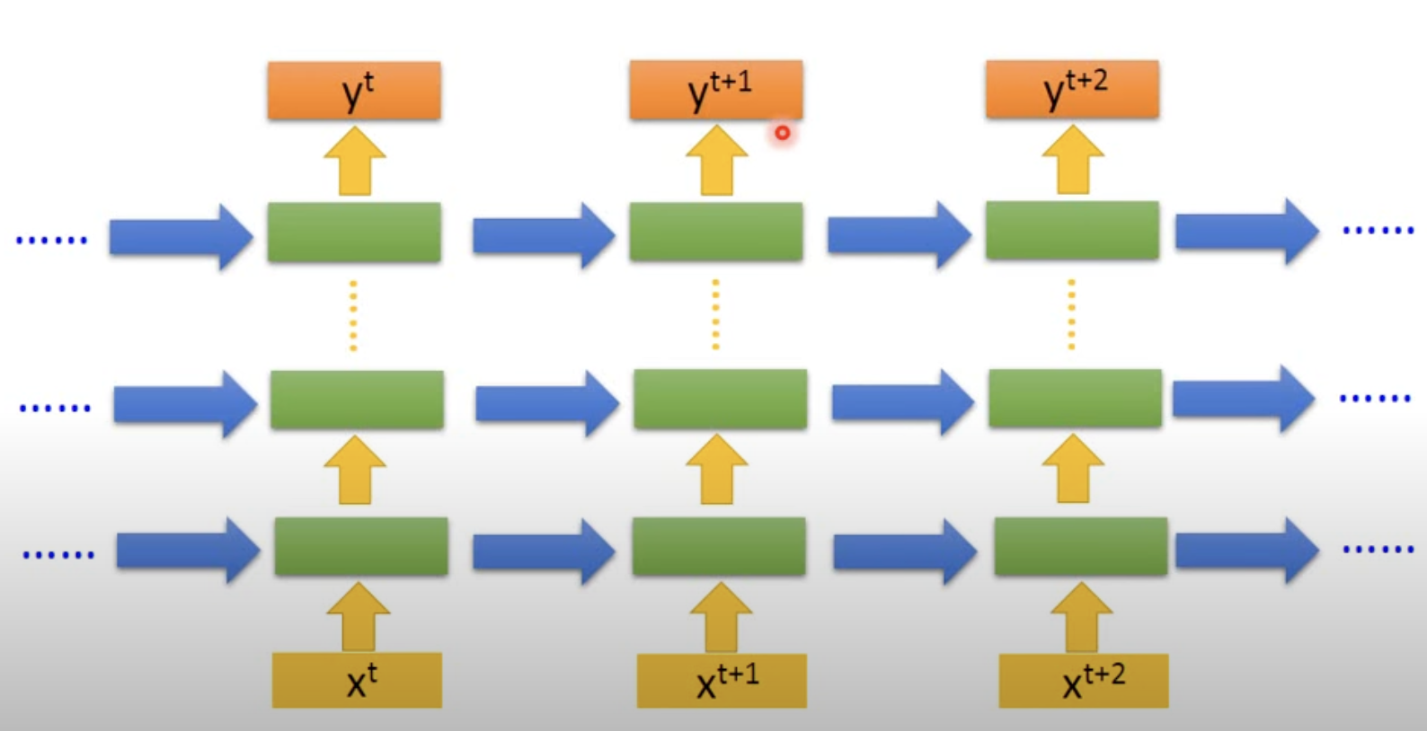
Deeeeeep Networks!
We can also have multiple layers of hidden states, just like how we can add hidden layers in MLPs:
source: https://www.youtube.com/watch?v=xCGidAeyS4M

