Slide 1
Machine Learning Basics
Shao Michael

Slide 2
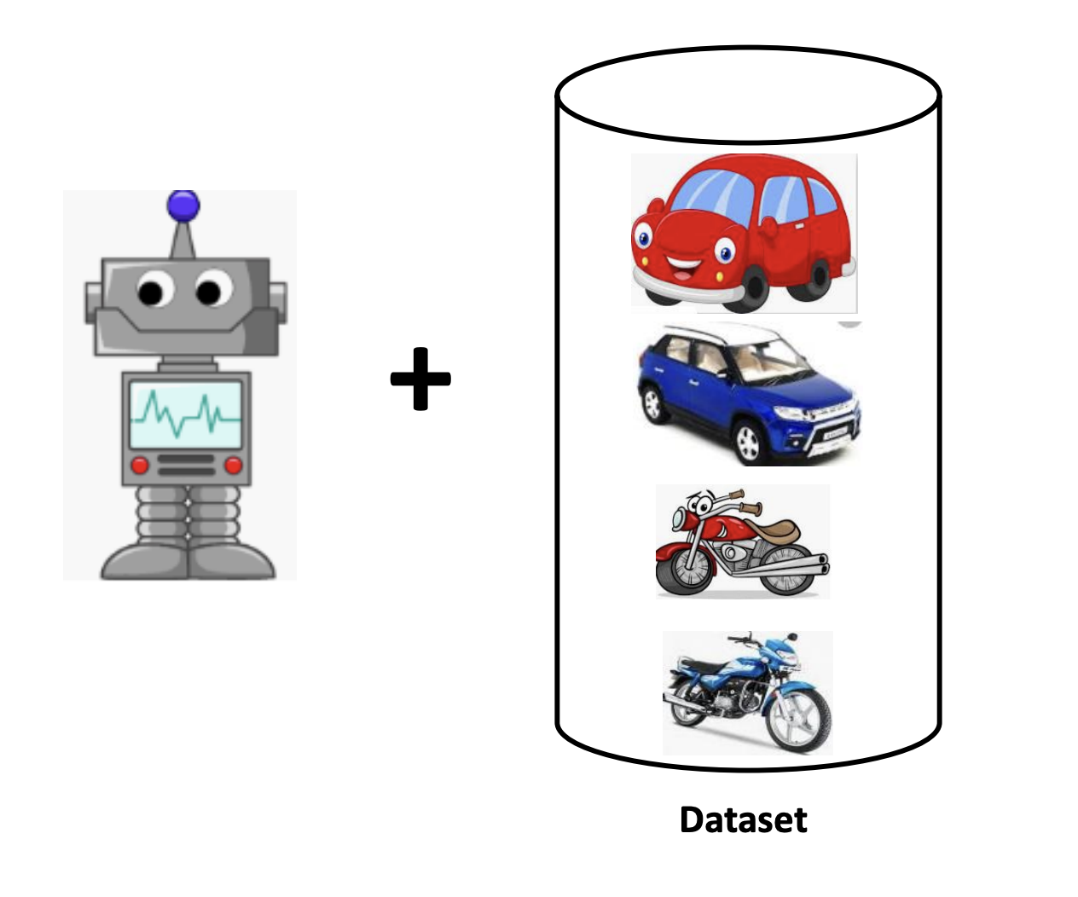
What is Machine Learning
Learning to be like humans from data

Slide 3
What Can Machine Learning Do
Basically anything you can think of!
Face recognition
Chatbots
Video generation

Slide 4
Types of ML Tasks
Supervised Learning
Regression
Classification
Unsupervised Learning
Clustering

Slide 5
Supervised Learning
Labeled Dataset:
Describes a target distribution
We want output distribution to resemble target distribution

Slide 6

Regression: Examples

Slide 7
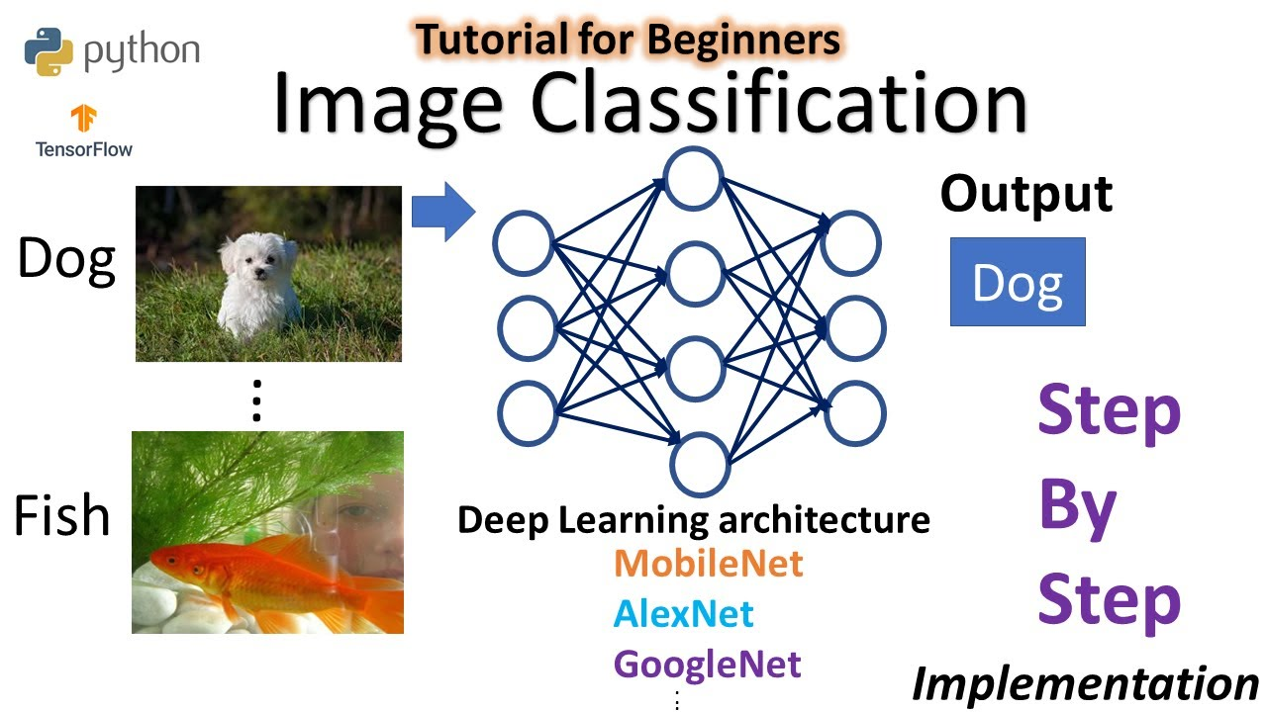
Classification: Examples

Slide 8
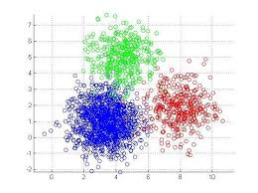
Unsupervised Learning
Unsupervised learning is when the model learn from data without labels.
Example: Clustering

