Slide 1
Neural Network Basics
Shao Michael

Slide 2
What is a Neural Network
A bunch of neurons grouped in a way to do complex tasks.

Slide 3
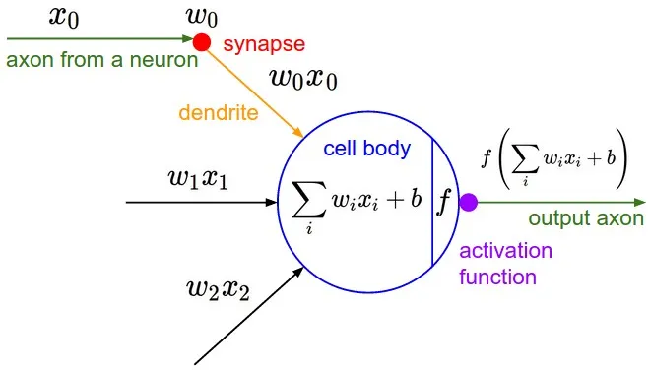
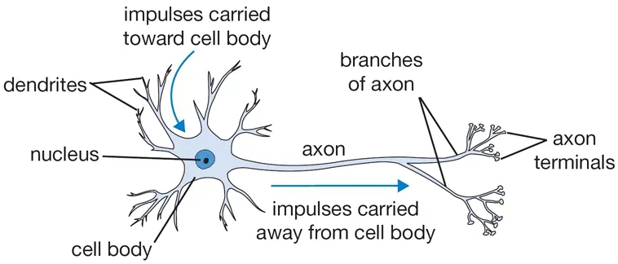
So What is a Neuron Then?
Biological Neuron
Machine Learning Neuron

Slide 4
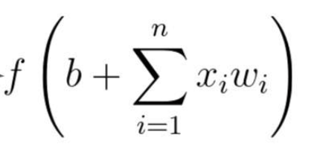
How does a Neuron work?

Slide 5
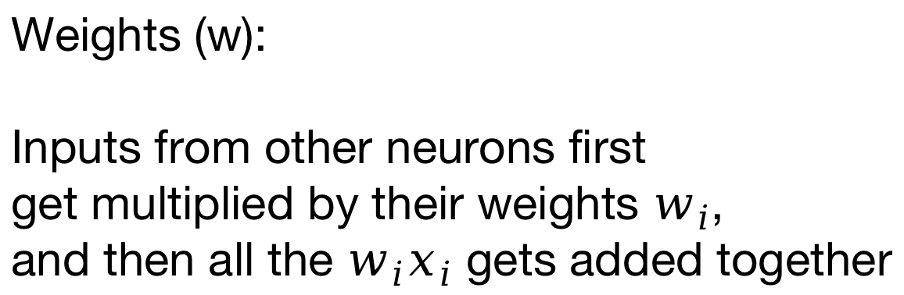
How does a Neuron work?
Weights (w):
Inputs from other neurons first
get multiplied by their weights $w_{i}$,
and then all the $w_{i}x_{i}$ gets added together

Slide 6
How does a Neuron work?
Bias (b):
We then add a value b to the sum.
This value is called the bias.

Slide 7
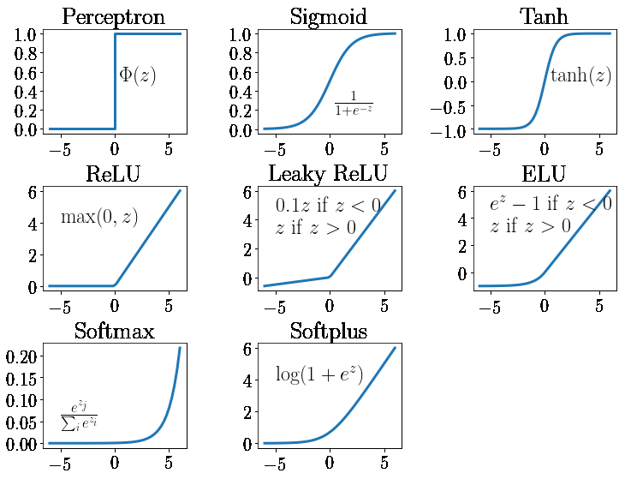
How does a Neuron work?
Activation function(f):
Then this value is passed
into an activation function

Slide 8
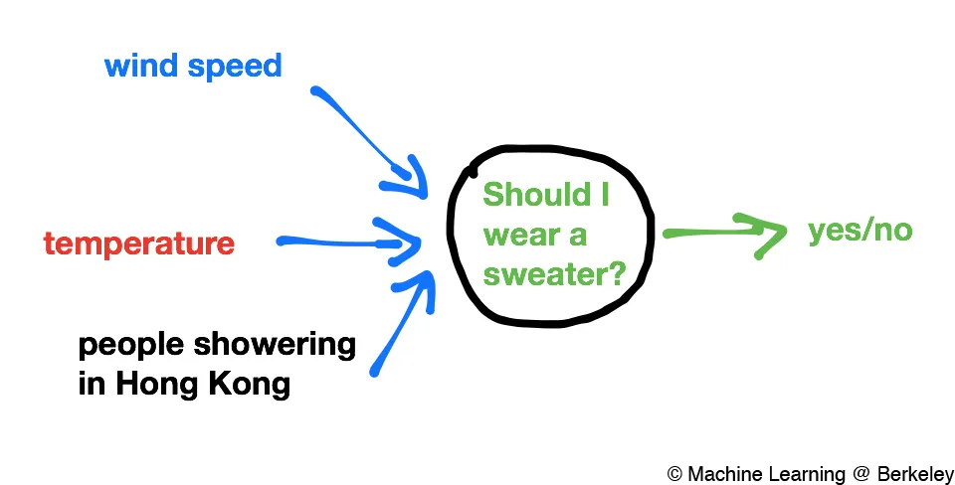
How does a Neuron work? An example
Lets understand how a neuron work with an example.
Suppose this neuron’s job is to tell us whether we should wear
a sweater.

Slide 9
How does a Neuron work? An example
Weights: In this example, the neuron assigns different weights
to different features to capture the important stuff.
(Biases can also be negative)
Wind speed is kinda important
so a moderate weight is assigned
The temp is really important,
so a high weight is assigned
This is not important at all
so a weight of 0 is assigned

Slide 10
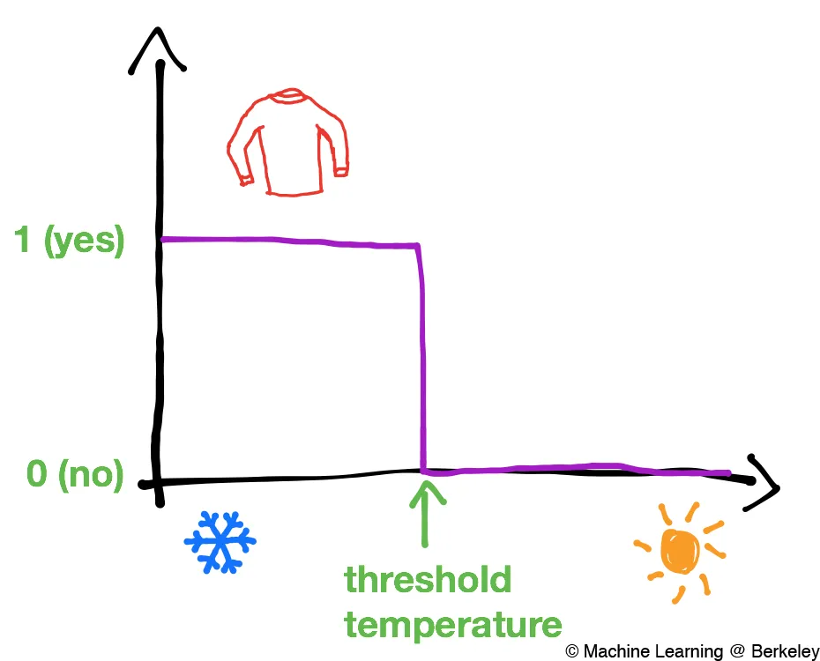
How does a Neuron work? An example
Activation function: In this case, the activation function is the
thing that processes a value into a yes/no answer. A simple
example may look something like this:

Slide 11
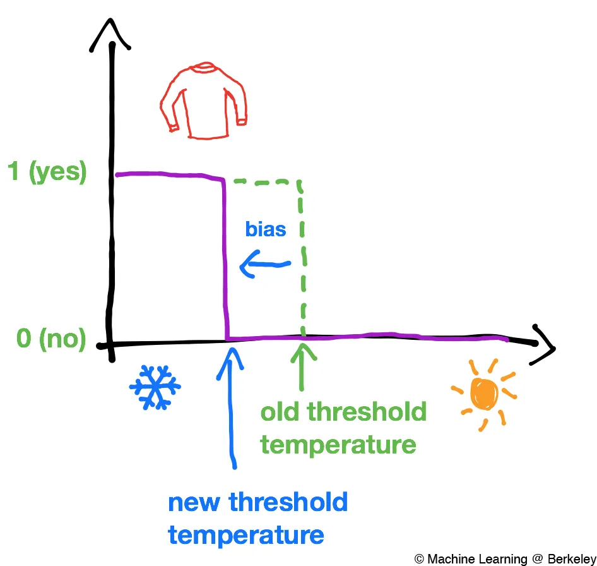
How does a Neuron work? An example
Bias: But sometimes the threshold temperature isnt just one value.
for instance, it might be different for Canada, which has a colder
climate. The bias’s job is to shift the
activation function to fit specific needs.

Slide 12
How does a Neuron work? Interactive demo
That was an oversimplified and unrigorous example. To get an
intuition of how they exactly work, use our interactive demo
notebooks!

Slide 13
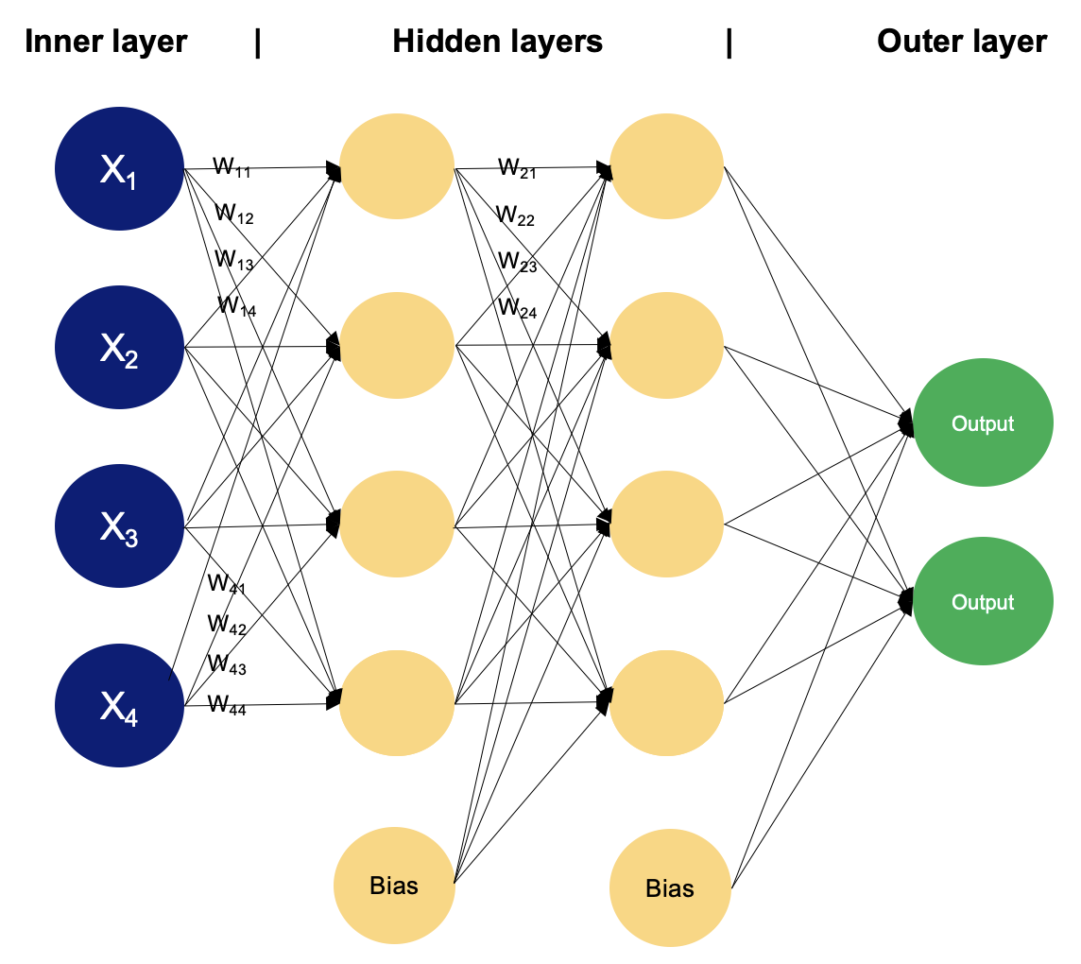
Multiple Neurons Work together: MLPs
To model more complex things,
we put more neurons together in
hidden layers, and connect each
neuron to all of the ones in the previous
layers. This multilayer neural network
is called the MultiLayer Perceptron (MLP)

Slide 14
So many weights and biases! How do we get them?
We can try to calculate how many parameters (total amount of weights and biases)
there are in a MLP with 2 inputs and a hidden layer of 3, and a output of 2:
12 weights in total, and this number is going to only increase as we try more
complex models. How do we set these parameters?
To be continued...

Slide 15
References
https://mlberkeley.substack.com/p/part-1

